Slide 1

Flutter Installation
Abdul Wasey Basir
P19-0113

Slide 2
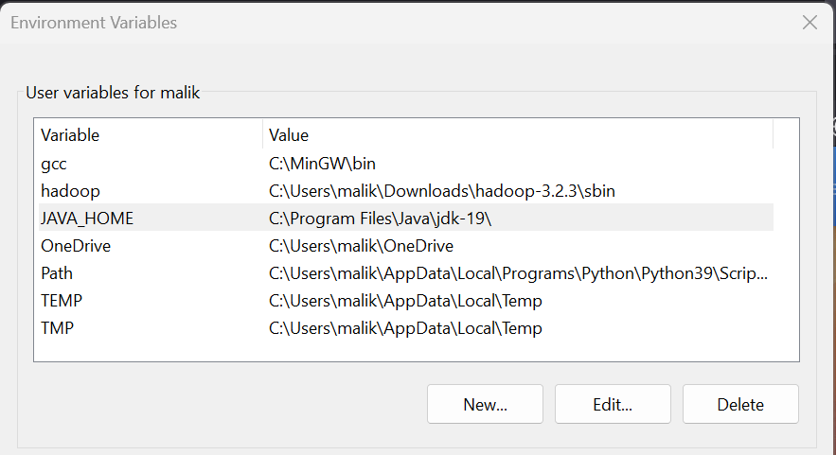
Installing Flutter on Windows
Download the Flutter SDK Zip file.
Extract the zip file and place the flutter folder inside to your desired location.
Add Flutter to your Path Variables like so:
Go to This PC → Properties → Advanced System Settings → Environment Variables → New

Slide 3
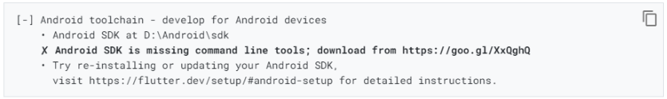
Now open command prompt with admin privileges and type in flutter doctor .
If you see something like this then congratulations Flutter has been installed now we need to install Android Studio.

Slide 4
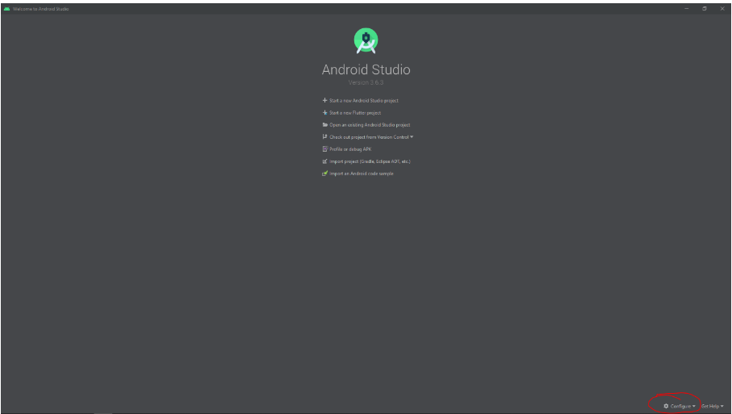
Downloading Android Studio
Download Android Studio from https://developer.android.com/studio
Start Android Studio and follow through the Setup Wizard.
On the bottom right, click on the Configure tab and then click on the Plugin option.

Slide 5

Type in Flutter and install that plugin. It will ask you to also install the Dart package, click yes to install that too.
Restart Android Studio and Create a new Flutter Project.
Give it a Name and as for the Flutter SDK path, point it to the src folder you created.
Click Finish
You have created your first flutter project. We are almost done and just need to set up an Emulator for you to test.

Slide 6
Setting up Emulator
Open up Android Studio and open the flutter project you made on the first page.
Go to File → Settings → System Settings → Android SDK → SDK Tools.
Check the box that says Android Emulator Hypervisor Driver for AMD Processors (for AMD) or Intel x86 Emulator Accelerator (Haxm Installer) (for Intel).

Slide 7
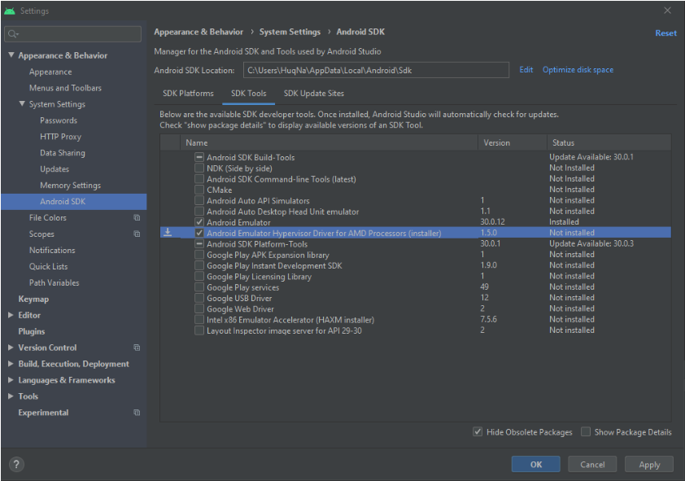

Slide 8
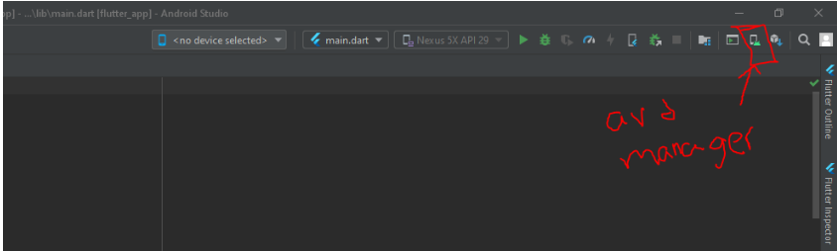
Click on AVD Manager .
AVD Manager
Click on Create New Virtual Device.
Click on Recommended and then Download/Select the same one but the difference is that it will say HAXM instead of x86_64. If it does not show up on Recommended then click on More Images and locate it there.

Slide 9
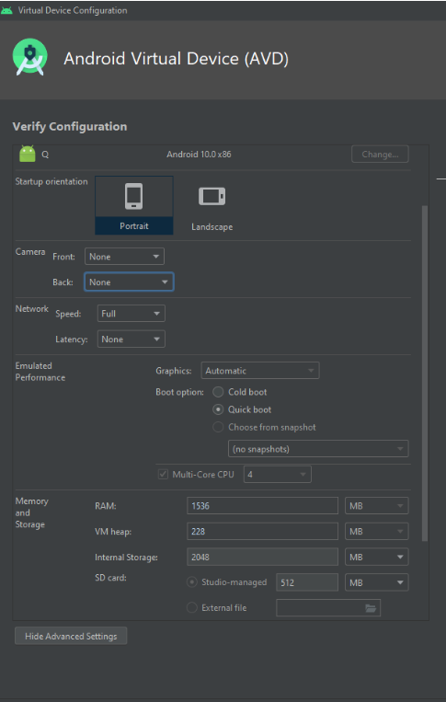

Click Next and then change the settings to match the image.
Click Finish and then click the Play Button next to the newly created emulator.
It will take a bit to load up the emulator but once you see the phone and it is running, congratulations! You have a running Emulator.

Slide 10
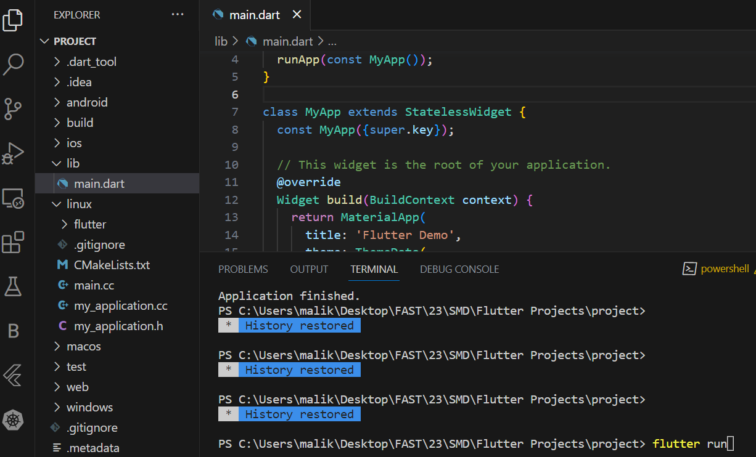
Running Flutter on VS Code
Open the folder where your project is using VS Code.
Go to Project → lib → main.dart
Click on Terminal.
Run the command flutter run.

Slide 11
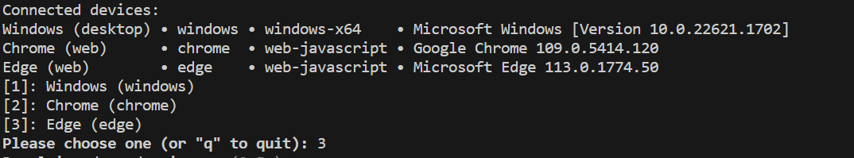
Choose your desired option to run your project on web i.e. in my case I chose 3 .

Slide 12
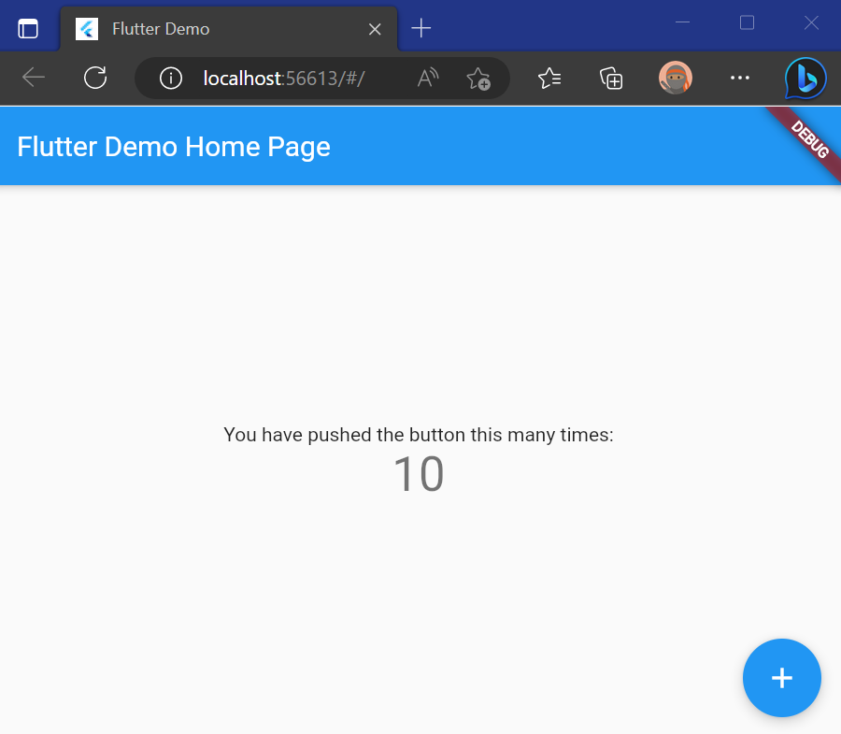
As you can see your Project runs on the Edge Browser.
It is a simple project that counts the number of time the + button is pressed.

Slide 13
Thank You !

