Slide 1
Notifications

Slide 2
Notification
A notification is a message you can display to the user outside of your application's normal UI.
When you tell the system to issue a notification, it first appears as an icon in the notification area.
To see the details of the notification, the user opens the notification drawer.
Both the notification area and the notification drawer are system-controlled areas that the user can view at any time.

Slide 3
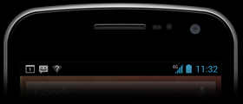
Notification Area

Slide 4
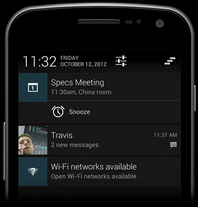
Notification Drawer

Slide 5
Notification Display Elements
Notifications in the notification drawer can appear in one of two visual styles, depending on the version and the state of the drawer:
Normal view
The standard view of the notifications in the notification drawer.
Big view
A large view that's visible when the notification is expanded.
Big view is part of the expanded notification feature available as of Android 4.1.

Slide 6
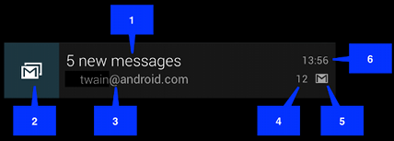
Normal View
The callouts in the illustration refer to the following:
Content title
Large icon
Content text
Content info (Replaced by SubText in 24 and onwards)
Small icon
Time that the notification was issued. You can set an explicit value with setWhen(); if you don't it defaults to the time that the system received the notification.

Slide 7
Big View
The only difference is number 7, the details area. Each big view style sets this area in a different way.
The available styles are:
Big picture style
The details area contains a bitmap up to 256 dp tall in its detail section.
Big text style
Displays a large text block in the details section.
Inbox style
Displays lines of text in the details section.
All of the big view styles also have the following content options that aren't available in normal view:
Big content title
Allows you to override the normal view's content title with a title that appears only in the expanded view.
Summary text
Allows you to add a line of text below the details area.

Slide 8
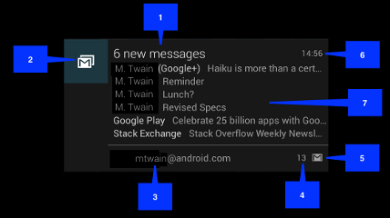
Big View Style

Slide 9
Steps
You specify the UI information and actions for a notification in a NotificationCompat.Builder object.
To create the notification itself, you call NotificationCompat.Builder.build(), which returns a Notification object containing your specifications.
To issue the notification, you pass the Notification object to the system by calling NotificationManager.notify()

Slide 10
Example
NotificationCompat.Builder n=new NotificationCompat.Builder(this);
n.setSmallIcon(R.drawable.email);
n.setContentTitle("New Notification");
n.setContentText("Hello how are you");
n.setContentInfo("Hi");
Notification notific=n.build();
NotificationManager nm=(NotificationManager)getSystemService(Context.NOTIFICATION_SERVICE);
nm.notify(2,notific);

Slide 11
Requirements of Notification
A Notification object must contain the following:
A small icon, set by setSmallIcon()
A title, set by setContentTitle()
Detail text, set by setContentText()

Slide 12
Open an activity from notification
Intent i=new Intent(this,SecondActivity.class);
PendingIntent pendingIntent = PendingIntent.getActivity(this, 0, i,
PendingIntent.FLAG_UPDATE_CURRENT);
Notification notific=n.build();
notific.contentIntent = pendingIntent;

Slide 13
New notifications
From API level 26 and above
NotificationCompat.Builder builder = new NotificationCompat.Builder(this, CHANNEL_ID)
.setSmallIcon(R.drawable.notification_icon)
.setContentTitle(textTitle)
.setContentText(textContent)
.setPriority(NotificationCompat.PRIORITY_DEFAULT);

