Slide 1

CrowdFunding CrowdEngagement
For AUTHORS, ACTORS, & FILMMAKERS

Slide 2
Problem
Book authors are being undervalued by current online selling practices
Most places that sell authors’ products only offer the books
Marketing is time consuming

Slide 3
Solution
Web platform that helps actors, authors, and filmmakers:
Reward orgs they belong to for helping with marketing
Sell before they post on sites offering less
Sell other items

Slide 4
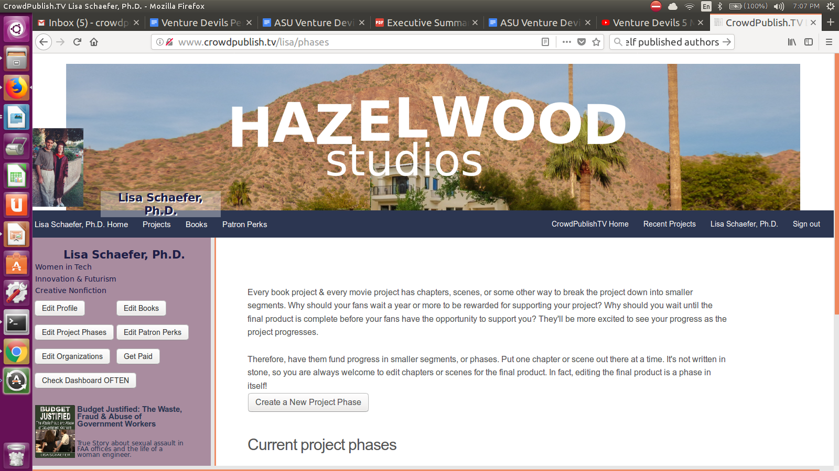
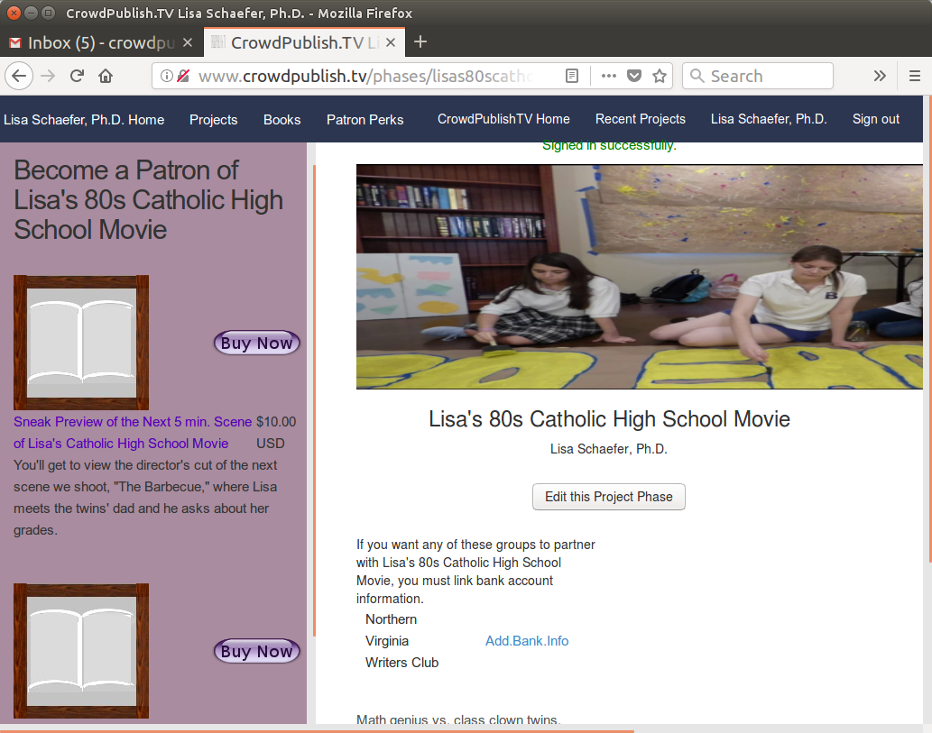
Product (for artists)
Author Posts a project phase
Get existing fans to sign up & purchase
Get organizations to tell their members

Slide 5

Product (for fans)
Fan goes to author or org page
Selects perk to purchase
Author sends perk asap

Slide 6
How much will all this cost me?
We take 5% commission from artist sales on the site.

Slide 7
What you can look forward to
Future features for:
Authors:
Get featured in sidebars, home page
Maintaining fan email notifications
Event rsvps
Premium membership
Fans:
Premium content
Featured reviews
Membership discounts.

Slide 8
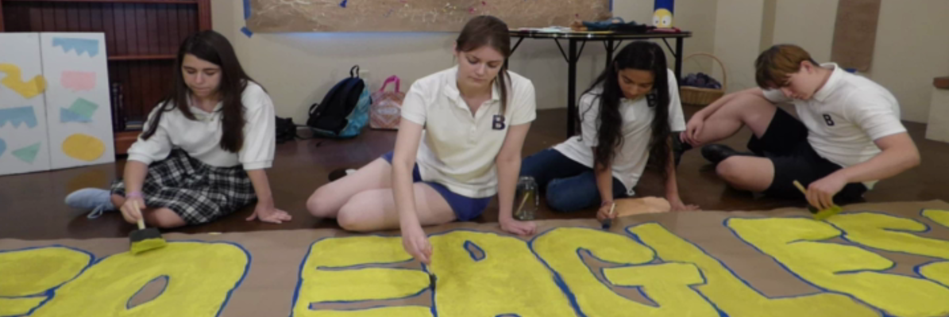
How We’re making Grow
Work one on one with artists
Lisa’s 80s Catholic High School Movie
1200
existing users

Slide 9
Why is better
Artists’ organizations can do the marketing
Artists earn revenue for creative ways of engaging – Your fans pay YOU to advertise for your work
Rather than offering one book only every year or two, authors offer something once a month
Instead of fans waiting months before getting rewards/perks authors offer something immediately available

Slide 10
How you can help Grow
Sign up
Create Campaign
Tell all your friends & fans
Make $

Slide 11
Market Validation
Some books do well on kickstarter, indiegogo
Self published books on Amazon
Artists receive monthly donations from fans on Patreon
1200 authors already signed up

Slide 12
Market Size
Kickstarter 2015
Literary journals: $200,000
Poetry: $300,000
Anthologies: $500,000
Art books: $4m
Self published books on Amazon
727000 Self-Published in 2015 in US

Slide 13






Competition

