Slide 1

CrowdFunding CrowdEngagement
For INDIE ACTORS

Slide 2
Problem
Actors are being undervalued by current online selling practices
Actors are missing out on opportunities to sell themselves
Marketing is time consuming

Slide 3
Solution
Web platform that helps actors:
Reward orgs they belong to for helping with marketing
Engage with fans
Sell other items

Slide 4
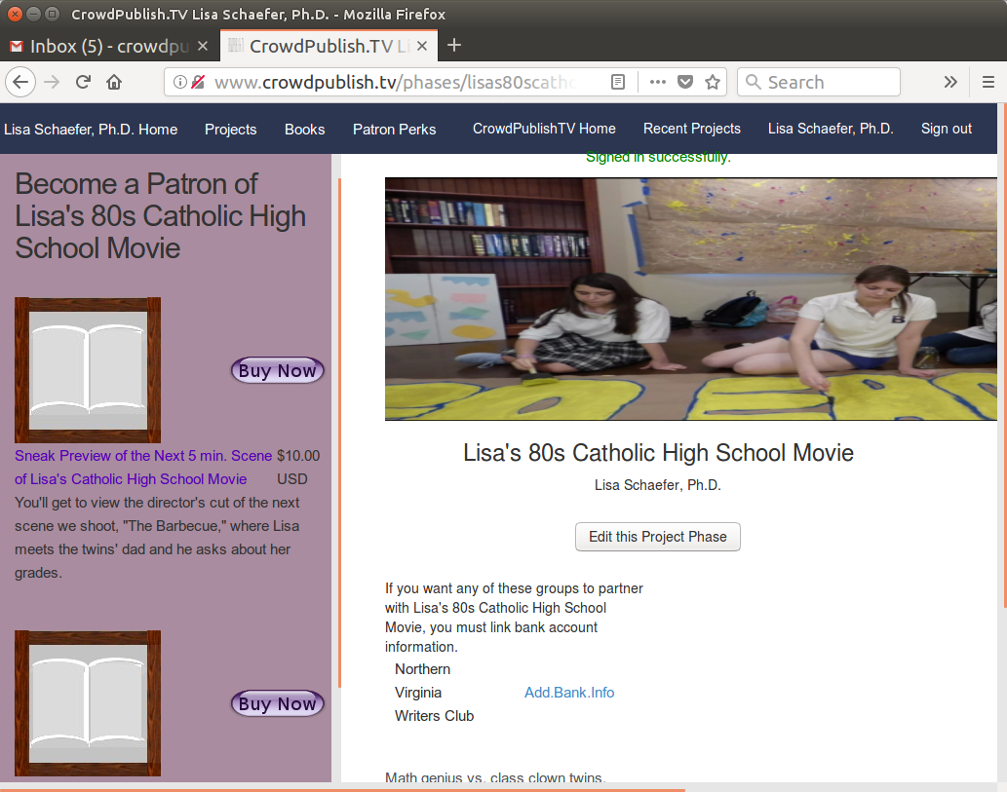
Product (for actors)
Author Posts a project phase
Get existing fans to sign up & purchase
Get organizations to tell their members

Slide 5

Product (for fans)
Fan goes to actor or org page
Selects perk to purchase
Author sends perk asap

Slide 6
How much will all this cost actors?
We take 5% commission from actors’ sales on the site.

Slide 7
What actors and fans can look forward to
Future features for:
Actors:
Get featured in sidebars, home page
Maintaining fan email notifications
Event rsvps
Premium membership
Fans:
Premium content
Featured reviews
Membership discounts.

Slide 8
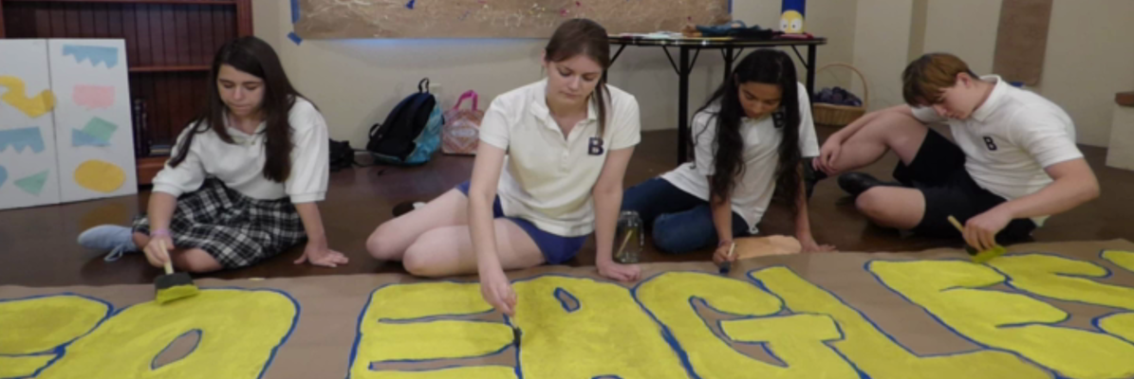
How We’re making Grow
Work one on one with actors
Lisa’s 80s Catholic High School Movie
1200
existing users

Slide 9
Why is better
Artists’ organizations can do the marketing
Artists earn revenue for creative ways of engaging – Your fans pay YOU to tell their friends your work
Instead of fans waiting months before getting rewards/perks authors offer something immediately available
Not dependent on a project

Slide 10
How you can help Grow
Sign up
Create Campaign
Tell all your friends & fans
Make $

Slide 11
Market Validation
Artists receive monthly donations from fans on Patreon
1200 authors already signed up

Slide 12
Market Size
Kickstarter 2015
Literary journals: $200,000

Slide 13




Competition

