Slide 1
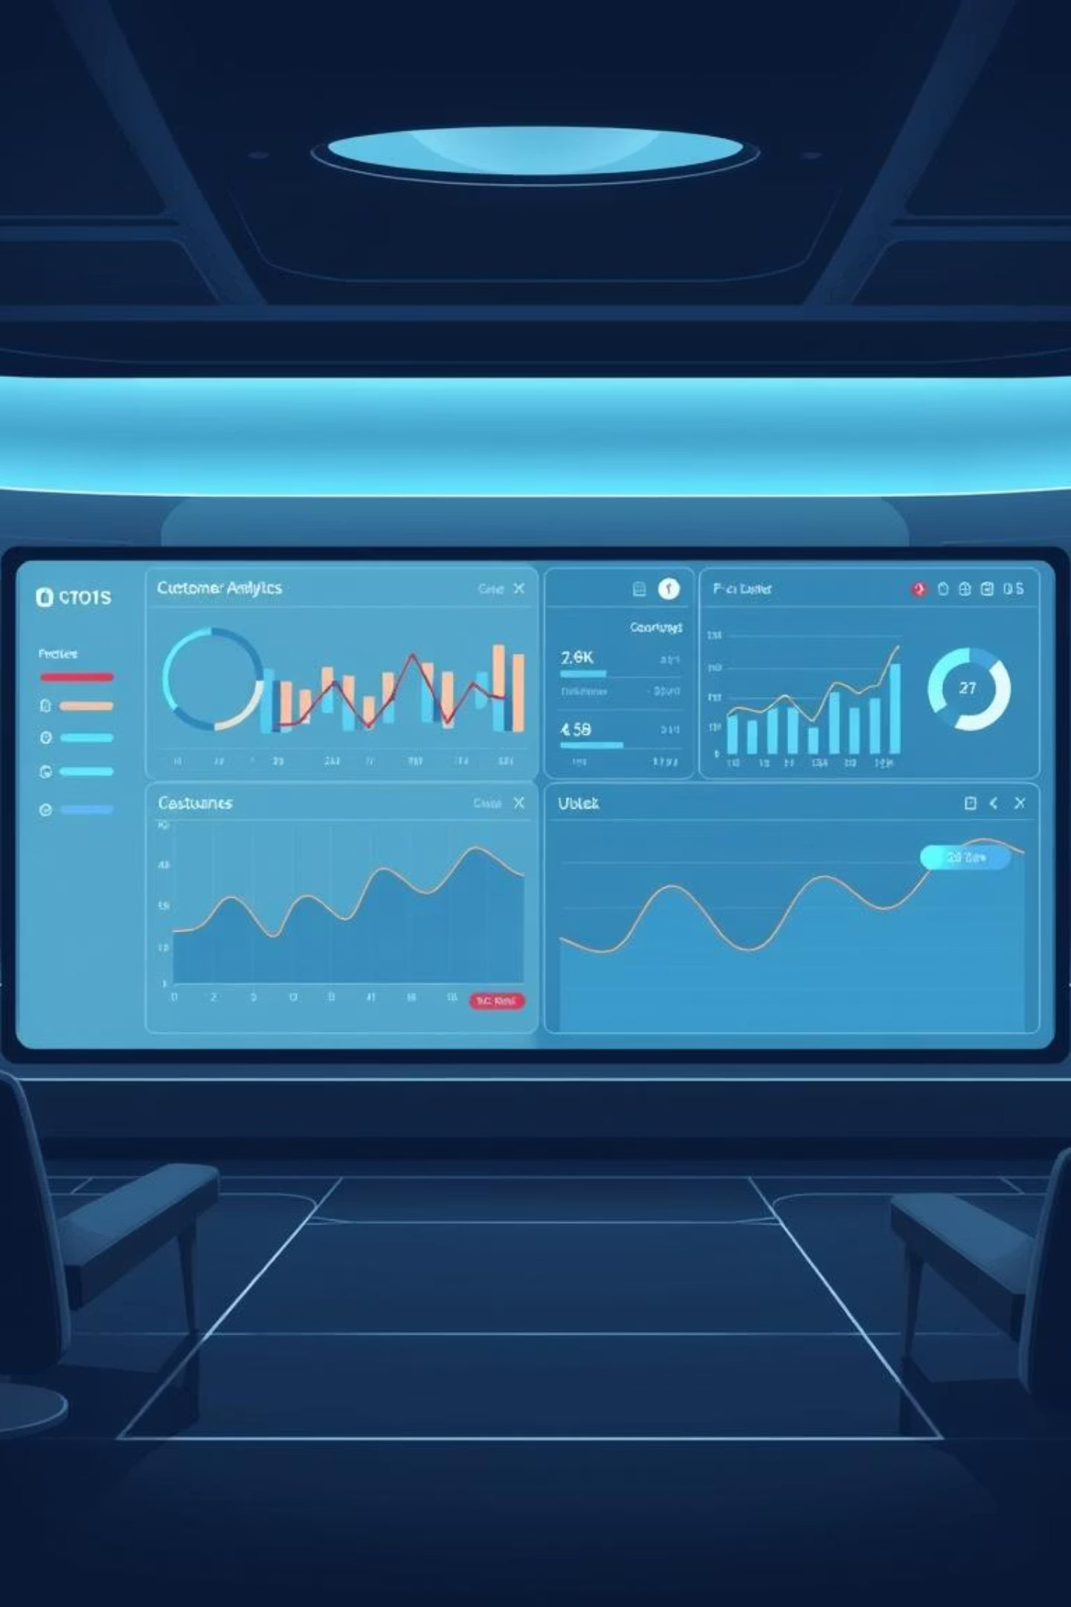
Unlocking Customer Value: A Data-Driven Approach
Sprocket Central Pty Ltd aims to identify its most valuable customers for targeted marketing initiatives. This presentation outlines our analytical approach to pinpoint the top 1000 customers.

Slide 2

Phase 1: Data Exploration & Quality Assurance
Data Acquisition
1
We utilized four key datasets: Transactions, Customer Demographic, Customer Address, and a New Customer List to form a comprehensive customer view.
Data Consistency Checks
2
Rigorous checks were performed for consistency, completeness, and validity across all datasets to ensure data reliability.
Key Quality Issues
3
Missing values in demographics and transactions
Inconsistent gender entries (M, F, Male, Female)
Invalid date formats and irrelevant default columns
Data Cleaning & Standardization
4
Corrections included standardizing data types (dates, numbers) and resolving inconsistencies, primarily using Microsoft Excel.

Slide 3
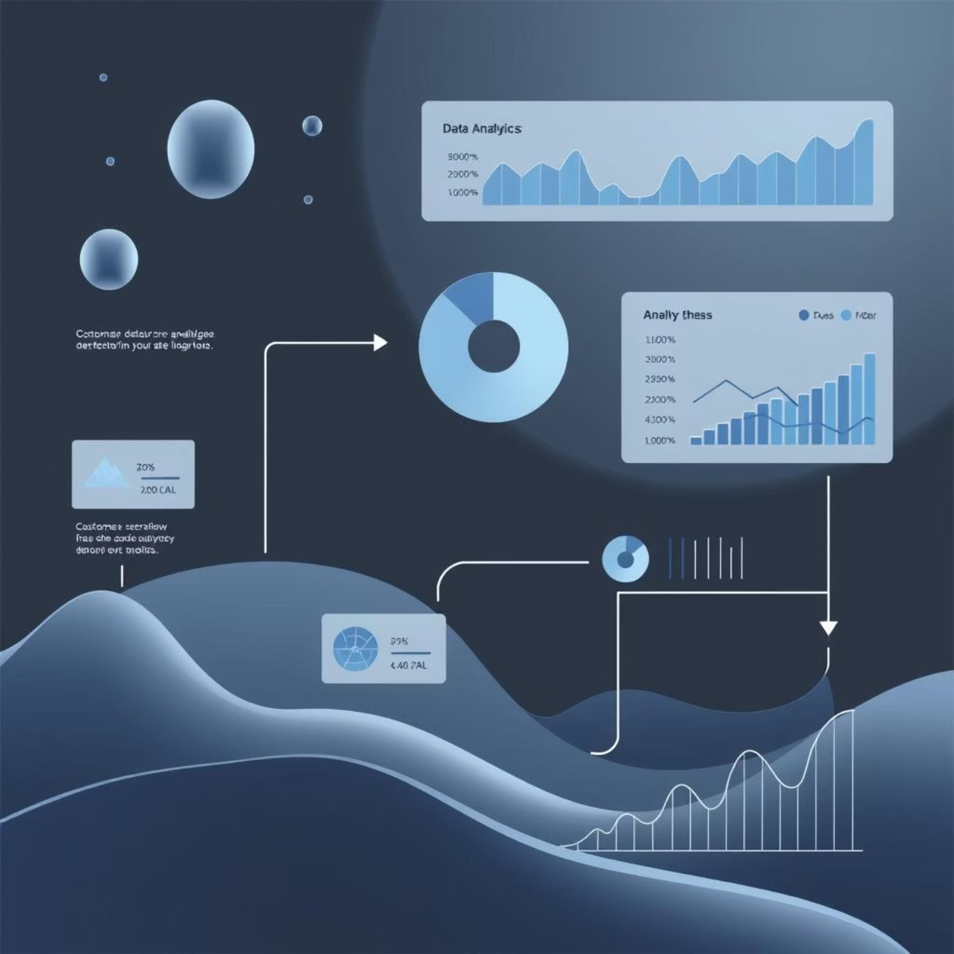
Phase 2: Model Development - RFM Analysis
Feature Engineering
From the Transactions dataset, we engineered two critical features:
Recency: Days since the last transaction, calculated from a comparison date.
Profit: Derived as the difference between list_price and standard_cost.
Customer Aggregation
A Pivot Table was used to aggregate customer-level data, including:
Frequency: Count of product IDs per customer.
Monetary Value: Sum of profit per customer.

Slide 4

RFM Scoring: Quantifying Customer Value
1
2
Individual RFM Scores
Combined RFM Score
Recency (R), Frequency (F), and Monetary (M) scores were calculated using quantiles, ranging from 1 (lowest) to 4 (highest).
A weighted formula combined these scores: RFM Score = (100 × R score) + (10 × F score) + M score.
This model allows us to assign a precise numerical value to each customer based on their transactional behavior.

Slide 5

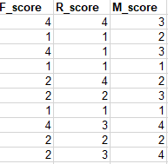
Combined RFM Score
Individual RFM Scores

Slide 6
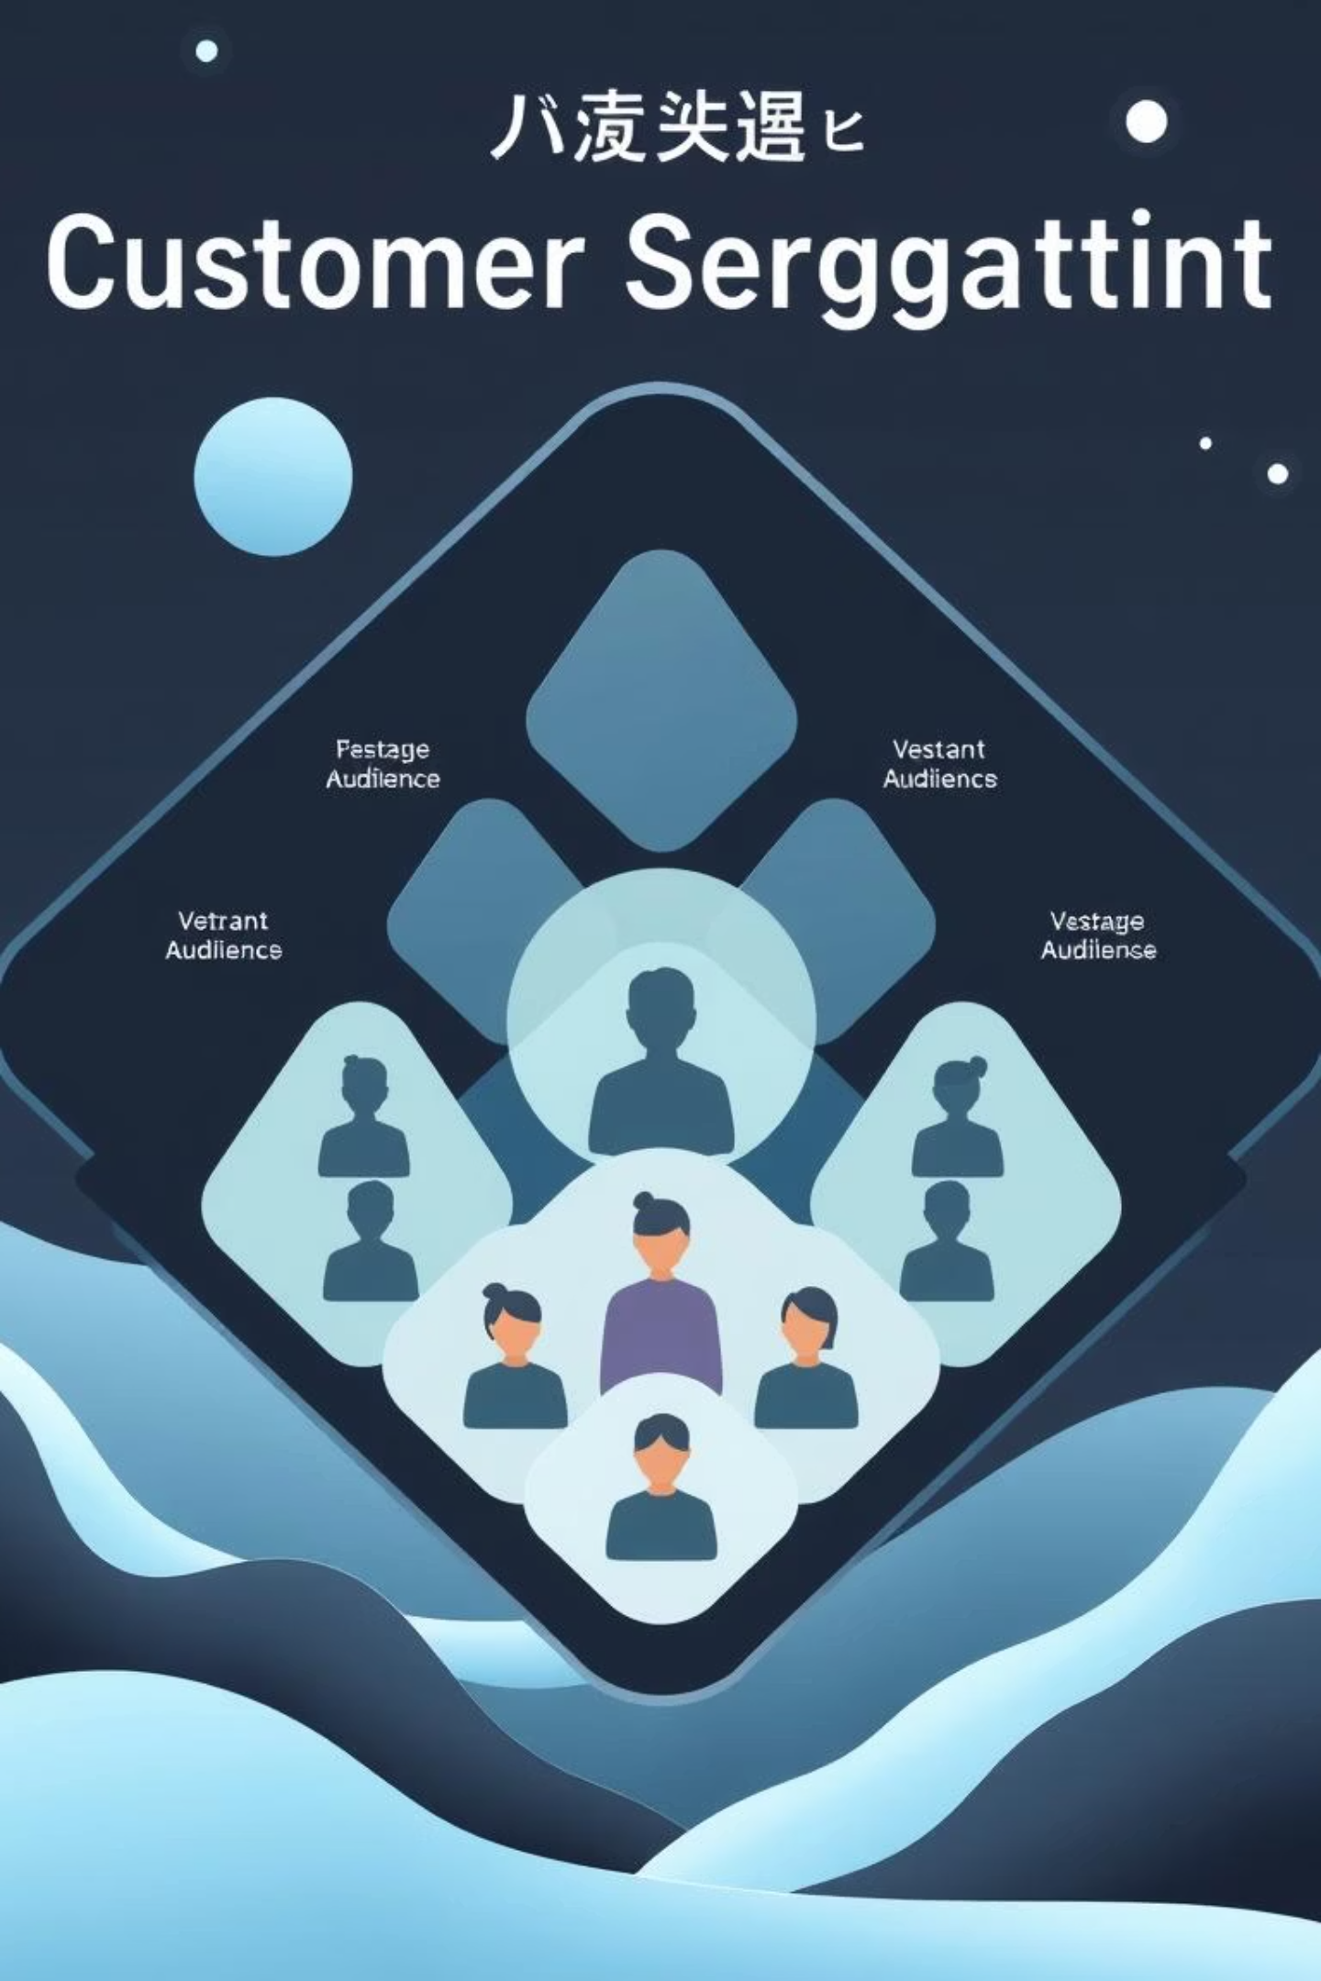
Phase 3: Interpretation & Customer Segmentation
Bronze
Lower RFM scores, occasional purchasers.
Silver
Mid-range RFM, more regular engagement.
Gold
High RFM scores, frequent and valuable customers.
Platinum
Highest RFM scores, our most valuable customers.
Customers were segmented into Bronze, Silver, Gold, and Platinum based on their RFM score quantiles. The Platinum segment represents our highest-value customers.

Slide 7
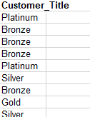
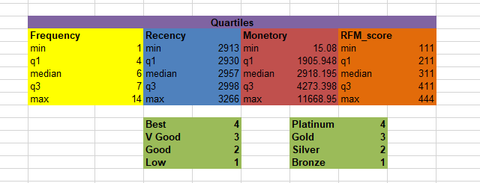
Customer Title
Quantiles and scoring

Slide 8

Conclusion: Identifying Our Top 1000
Targeted Selection
Through Excel visualizations and ranking, the top 1000 customers were precisely identified from the Platinum segment.
Business Impact
This data-driven approach enables Sprocket Central Pty Ltd to focus marketing efforts on high-value customers, maximizing ROI.
Scalability & Efficiency
The methodology is easily scalable and implementable using standard tools like Excel, offering a robust framework for future analyses.
By leveraging structured data cleaning, RFM analysis, and effective visualization, we have successfully pinpointed the most valuable customers for targeted marketing initiatives.

