Slide 1

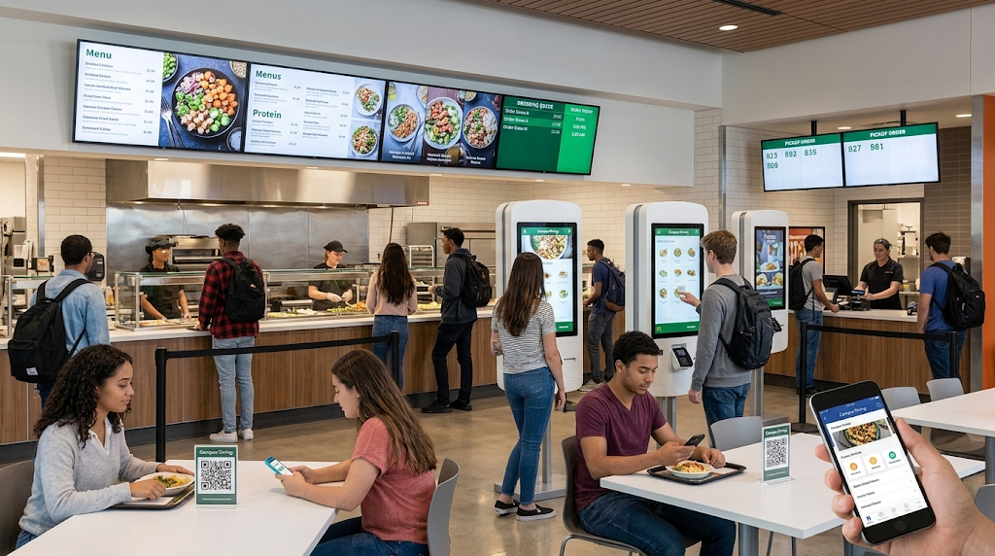

G H Raisoni College of Engineering & Management Pune
Student Cafeteria and Food Ordering Management System
Advanced SQL Implementation using MySQL
Name:- Rahim Auti
Roll Number :- P42 |
Department :- CSE – (Data Science)
Academic Year :- 2026/27
Guided By:- Chinmay Mukim Sir ( DBMS)

Slide 2






Project Introduction
This system manages the complete flow of cafeteria food ordering — from student registration to order placement, payment, and delivery. MySQL handles all relational data, and advanced SQL features support reporting, automation, and performance tuning.
Student
Cafeteria
Food Item
Order
Payment
Delivery

Slide 3
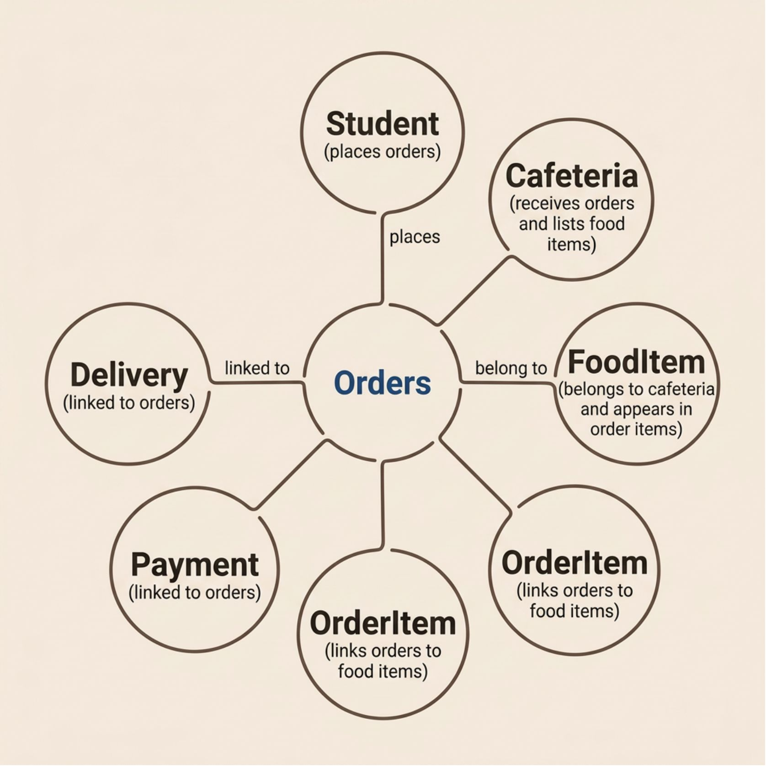
Database Design
The system uses 7 relational tables connected through primary and foreign keys. Referential integrity ensures data consistency across all entities.
Primary Keys — uniquely identify each record
Foreign Keys — enforce relationships between tables
Referential Integrity — prevents orphaned records

Slide 4
Table Structure
Table | Attributes
Student | StudentID, Name, Email, Phone, Department, Year
Cafeteria | CafeteriaID, CafeteriaName, Location, Phone, Status
FoodItem | FoodID, CafeteriaID, FoodName, Category, Price
Orders | OrderID, StudentID, CafeteriaID, TotalAmount, OrderStatus
OrderItem | OrderItemID, OrderID, FoodID, Quantity, Price
Payment | PaymentID, OrderID, Amount, PaymentMethod, PaymentStatus
Delivery | DeliveryID, OrderID, DeliveryAddress, DeliveryStatus

Slide 5
Advanced SQL Queries
INNER / LEFT / OUTER JOIN
SELF JOIN
-- INNER JOIN: Student orders with cafeteria info
SELECT s.Name, c.CafeteriaName, o.TotalAmount
FROM Student s
JOIN Orders o ON s.StudentID = o.StudentID
JOIN Cafeteria c ON o.CafeteriaID = c.CafeteriaID;
-- Correlated subquery with EXISTS
SELECT Name FROM Student s
WHERE EXISTS (
SELECT 1 FROM Orders o
WHERE o.StudentID = s.StudentID
);
Compare records within the same table — e.g., find students from the same department.
Combine student, order, cafeteria, and food data; retrieve unmatched rows when related records are missing.
Correlated Subquery & EXISTS
Aggregate Functions + GROUP BY / HAVING
Row-level comparisons and existence checks across related tables.
COUNT, SUM, AVG, MIN, MAX for grouped business reports.

Slide 6

Stored Procedure, Trigger and Audit
DB Operation
User Action
Trigger Fires
Audit Record
The diagram above shows the automation sequence — from a user-initiated action through trigger execution to audit logging.
Stored Procedure
Trigger & Audit Table
A parameterized procedure handles order creation in a controlled manner, accepting order details and executing all required database operations.
Triggers fire automatically on INSERT, UPDATE, or DELETE events. Changes are logged in an audit table for tracking and compliance.

Slide 7
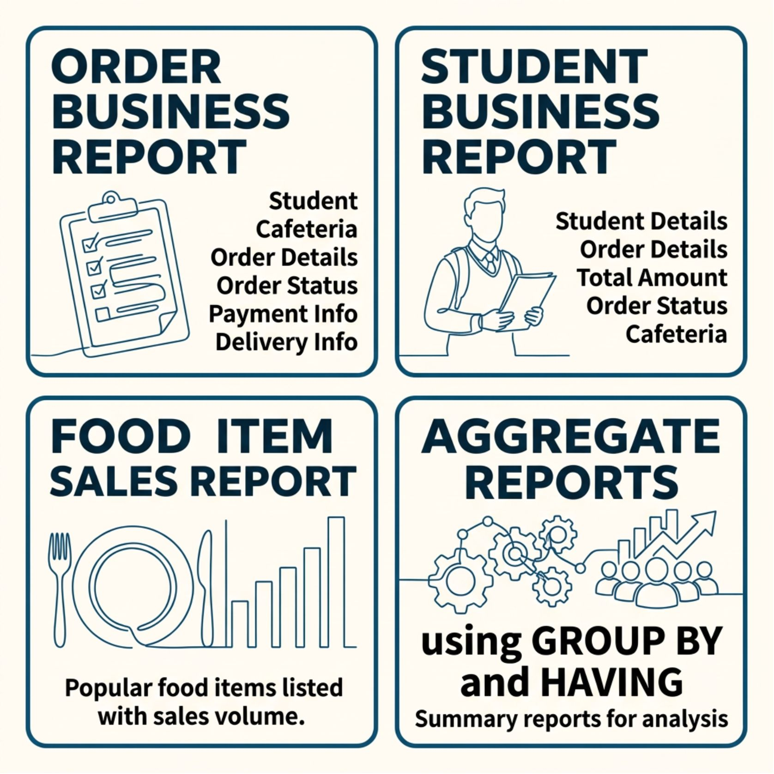
Views and Business Reporting
Order Business Report
Combines student, cafeteria, order, payment, and delivery data into
a single queryable view for complete order tracking
.
Student Business Report
Summarizes each student's orders, total spending, order status,
and associated cafeteria information.
Additional Reports
Food item sales summaries and aggregate reports using
GROUP BY and HAVING for category-wise analysis.

Slide 8

Performance Tuning & Indexing
Before Indexing
Create Composite Index
Compare Performance
Run query and observe slowness
Measure execution time difference
Index frequent join and filter columns
After Indexing
EXPLAIN
Analyze the query execution plan
Re-run query and inspect plan
Each step in the workflow above shows how query performance is analyzed and improved through indexing.
EXPLAIN & EXPLAIN ANALYZE
COMPOSITE INDEXES
Used to inspect the query execution plan and measure actual runtime behavior
before and after optimization.
Created on frequently joined and filtered column combinations. Index metadata is verified
using MySQL system commands.

Slide 9
System Workflow and Output
01
02
03
Student exists in database
Selects cafeteria and food items
Order is created
04
05
06
Order items stored
Payment recorded
Delivery information recorded
07
Reports generated via SQL queries
Key Capabilities
Sample Report Output
Relational data management across 7 tables
Order, payment, and delivery tracking
SQL-based business reporting and analysis
Query results show student orders with cafeteria details, payment status, and delivery information — all retrieved through JOIN-based views.

Slide 10


Conclusion
Relational Design
Seven well-structured tables with primary keys, foreign keys, and referential integrity.
Advanced SQL
Joins, subqueries, aggregates, GROUP BY, and HAVING for complex data retrieval.
Automation
Stored procedures and triggers handle order processing and audit logging.
Reporting & Performance
Virtual views simplify reporting; EXPLAIN and composite indexes optimize queries.
This project provides practical, hands-on experience with MySQL and advanced SQL in a real-world database scenario.

Slide 11

Thank You

