Slide 1
AI-Based Language Translator

Slide 2
Abstract
The AI-Based Language Translator facilitates the translation of multilingual text, speech, images (via OCR), audio, and files within a unified platform.
It provides functionalities such as grammar correction, pronunciation assistance, speech input and output capabilities, as well as multi-language batch translation, thereby enhancing accessibility for a wider audience.
Additionally, the system incorporates a translation history feature, which allows users to effectively monitor and reutilize previous translations.

Slide 3
Objectives
The main objective of this project to develop an AI-powered language translation system that can translate text, speech, image (OCR), audio and file translation in multiple languages.
To help users correct grammar and spelling mistakes in their input.
To enable multi-language batch for translating input text into several languages simultaneously.
To show pronunciation guides for better understanding of English words.
To provide speech to text and translated text to speech audio features.

Slide 4
Literature Review
Paper Title | Author and Year of Publication | Methodology Proposed | Disadvantages or Limitations
AI-Based Multilingual Translator with speech and text capabilities | Ritika sharma, Ayush Sharma (2024) | Implementing features that support both speech-to-text and text-to-speech functionalities, allowing users to input and receive translations via spoken or written language. | The application may require substantial computational resources, potentially impacting performance on devices with limited processing capabilities.
Language Translation Using Artificial Intelligence | Rupayan Dirghangi, Koushik Pal - (2022) | This model employs artificial neural networks to process and translate entire sentences. | The model may struggle with accurately translating rare or domain-specific terms that were underrepresented in the training data.

Slide 5
Literature Review
Paper Title | Author and Year of Publication | Methodology Proposed | Disadvantages or Limitations
AI for Real-Time Language Translation(2024) | Gauri Kulkarni, Suraj Ahale | The study specifically focused on how AI-driven translation tools perform in facilitating cross-language communication in various sectors, including international trade, education, healthcare, and social interactions | AI systems may struggle with accurately interpreting context, leading to potential misunderstandings in translation.

Slide 6
Existing Systems
Most platforms focus on single-functionality (e.g., only text translation or speech translation), without integrating multiple features into one unified system.
Common systems lack grammar correction or spelling improvement before translating the input, leading to inaccurate translations.
They do not support image translation with OCR, text file translation with correction, or multi-language batch translation from a single input.
Existing systems do not provide phonetic transcription or speech pronunciation guidance for learners.

Slide 7
Proposed Systems
It uses Natural Language Processing (NLP) and deep learning libraries like googletrans, gTTS, SpeechRecognition, and Tesseract OCR to detect, translate, and pronounce content in multiple languages.
The system provides grammar and spelling correction using a combination of pyspellchecker, TextBlob python libraries.
A pronunciation feature is included using the eng_to_ipa library, which gives phonetic text and plays audio for correct pronunciation.
It allows users to translate one text into many languages at the same time with multi-language batch translation.

Slide 8
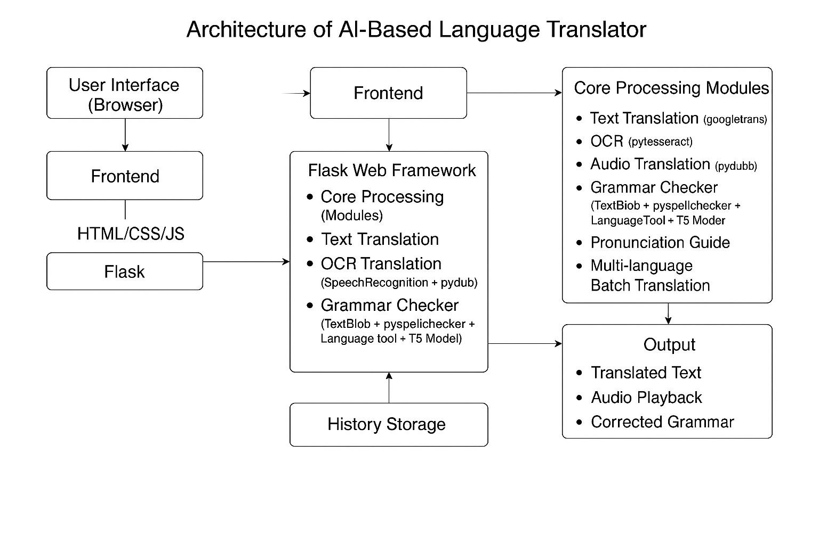
Architecture design

Slide 9
Tools Used
Flask – Web framework to build and run the application.
HTML/CSS/JavaScript – For designing the front-end interface and adding interactivity.
Tesseract OCR – To extract text from uploaded images.
FFmpeg – For audio format conversion (e.g., MP3 to WAV)
googletrans – Used for translating text between languages.
gTTS (Google Text-to-Speech) – Converts translated text into spoken audio.
SpeechRecognition – Converts audio input to text (speech-to-text)

Slide 10
Tools Used
Pydub – Handles audio file conversion and manipulation.
Pillow (PIL) – Used to process image files for OCR.
pytesseract – Interfaces with Tesseract OCR for image-to-text conversion.
TextBlob – Provides basic grammar and spelling correction.
pyspellchecker – Identifies and corrects spelling mistakes in the input.
language_tool_python – Checks and corrects grammar errors.
eng_to_ipa – Converts English words to phonetic transcriptions (IPA) for pronunciation guidance.

Slide 11
Modules
Text Translation
Image Translation (OCR)
Audio Translation (Speech to Text)
Grammar and Spelling Correction
Multi-language Batch Translation
Language Detection

Slide 12
Modules Description
Text Translation – Converts text into another language.
Image Translation (OCR) – Extracts and translates text from uploaded images.
Audio Translation – Extracts text from the audio file then translates it into another language.
Grammar and Spelling Correction – Fixes grammar and spelling mistakes
Multi-language Batch Translation – Translates one input into several languages at the same time.
Language Detection – Detects the language of any given input text automatically.

Slide 13
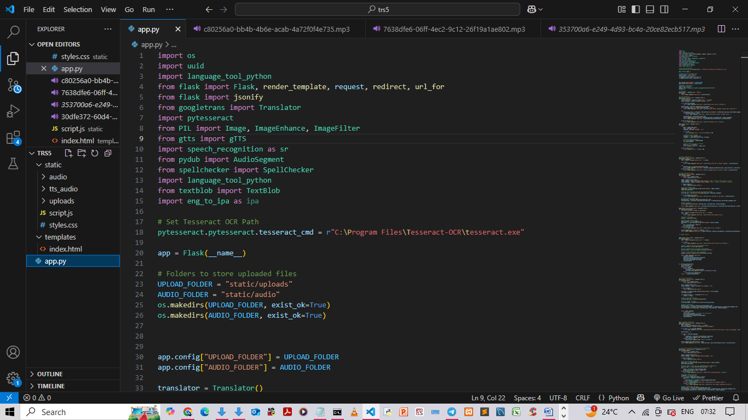
IMPLEMENTATION

Slide 14
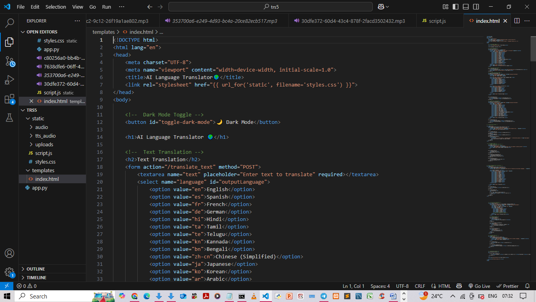
IMPLEMENTATION

Slide 15
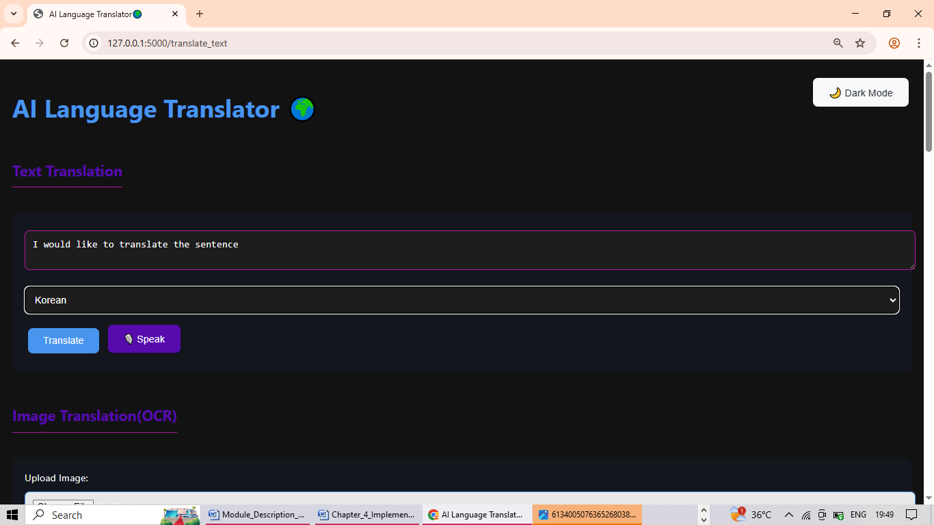
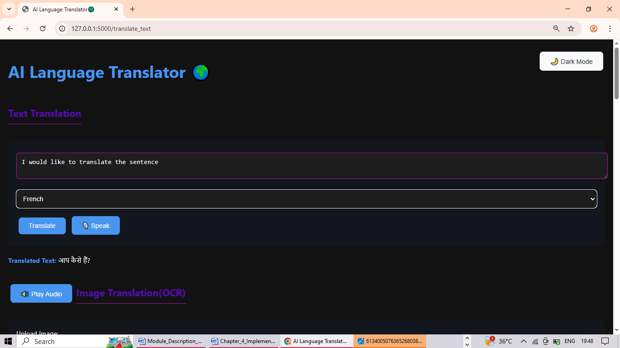
SAMPLE INPUT AND OUTPUT (TEXT)

Slide 16

Sample Input and Output (TEXT)

Slide 17
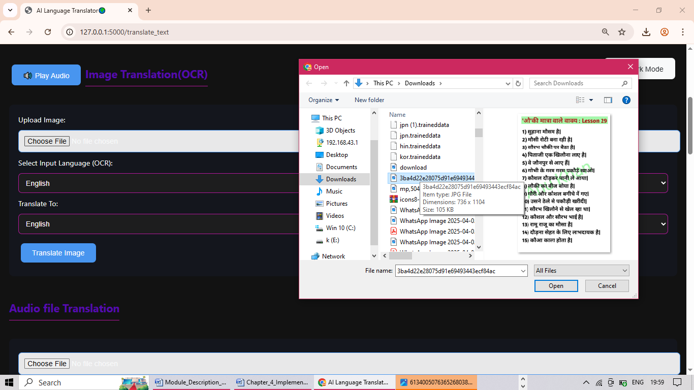
Sample Input and Output (IMAGE)

Slide 18
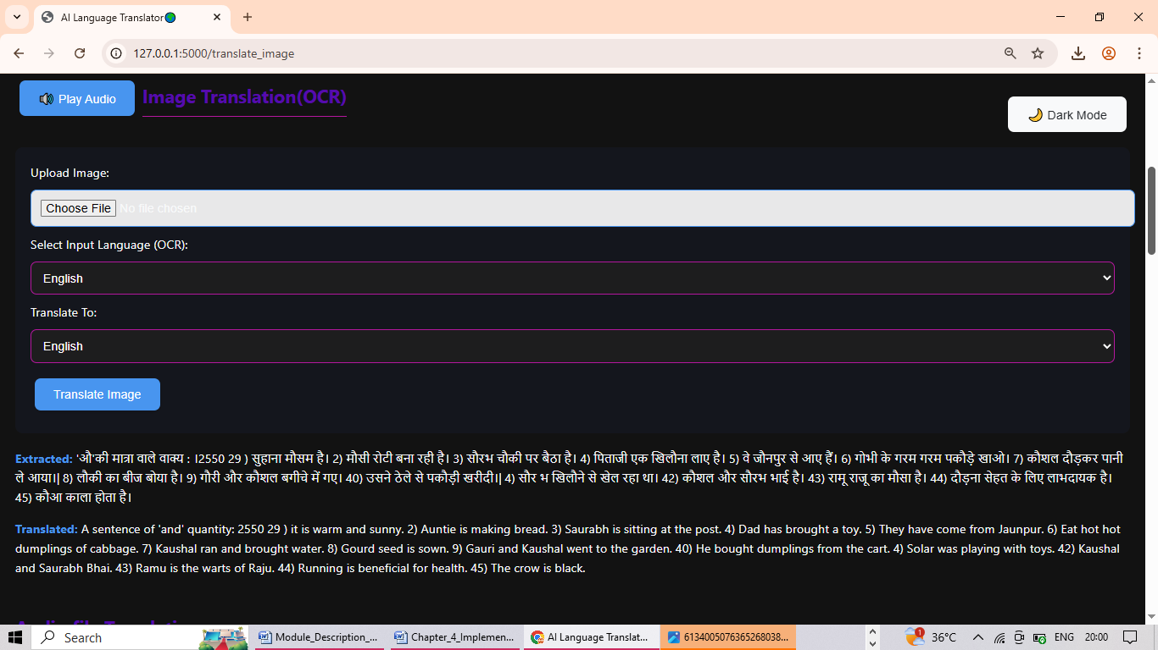
Sample Input and Output (IMAGE)

Slide 19
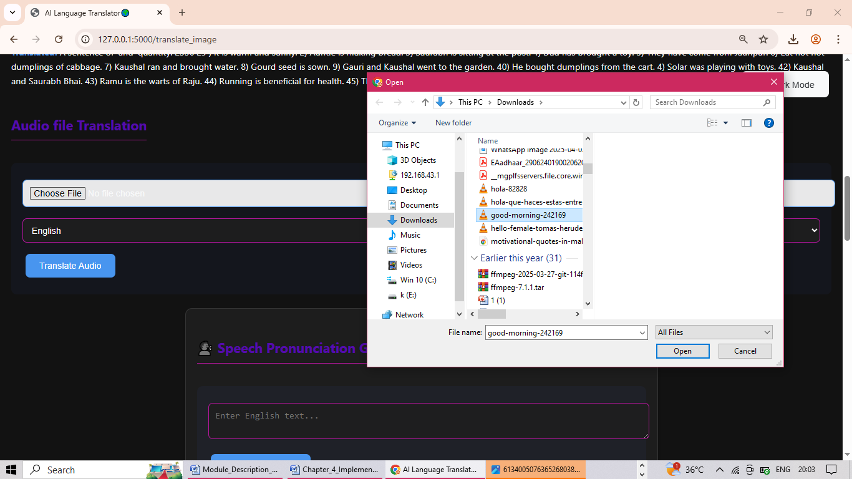
Sample Input and Output (AUDIO)

Slide 20
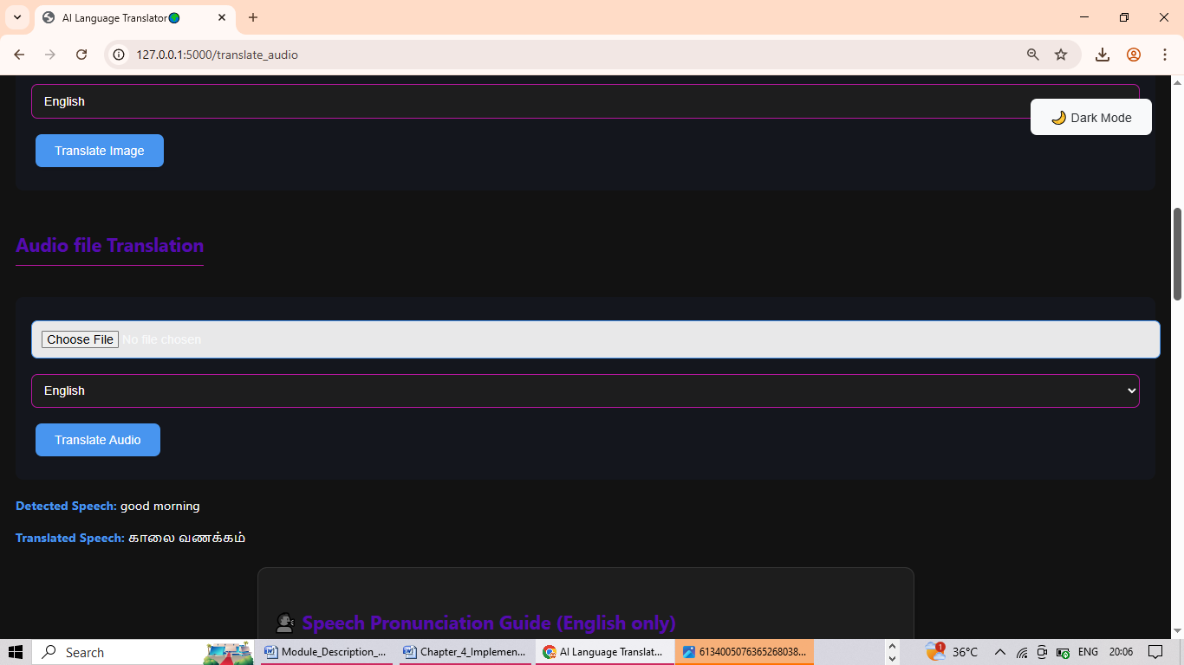
Sample Input and Output (AUDIO)

Slide 21
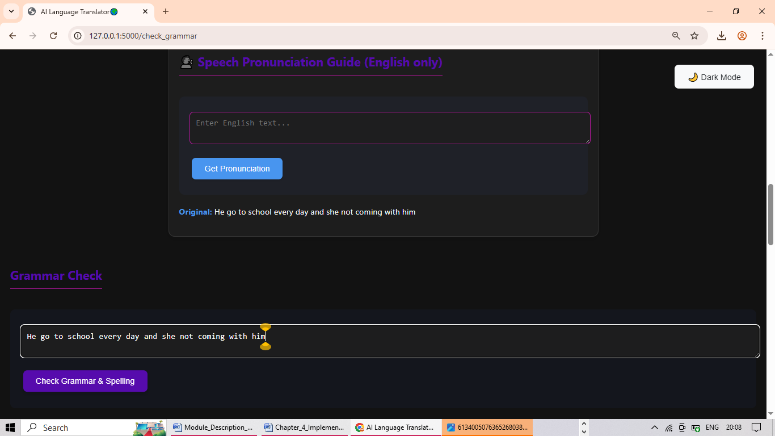
Sample Input and Output (GRAMMAR)

Slide 22
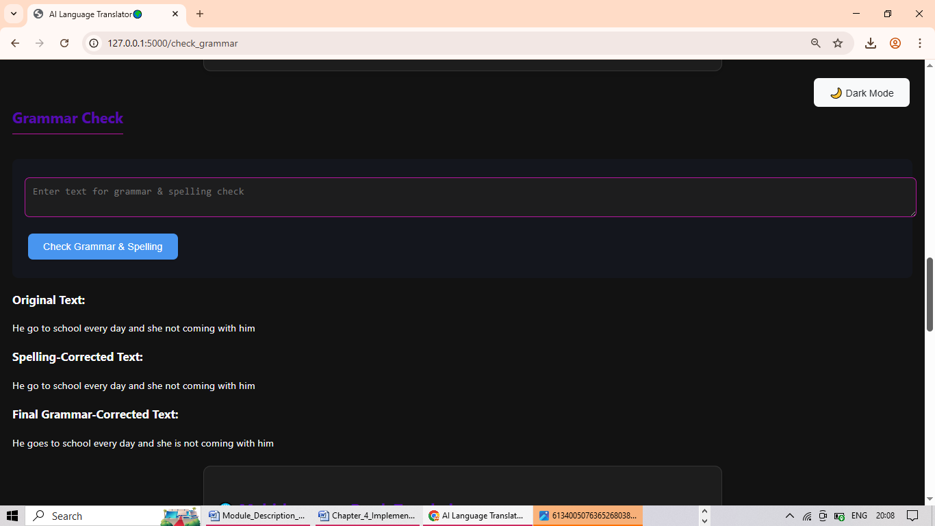
Sample Input and Output

Slide 23
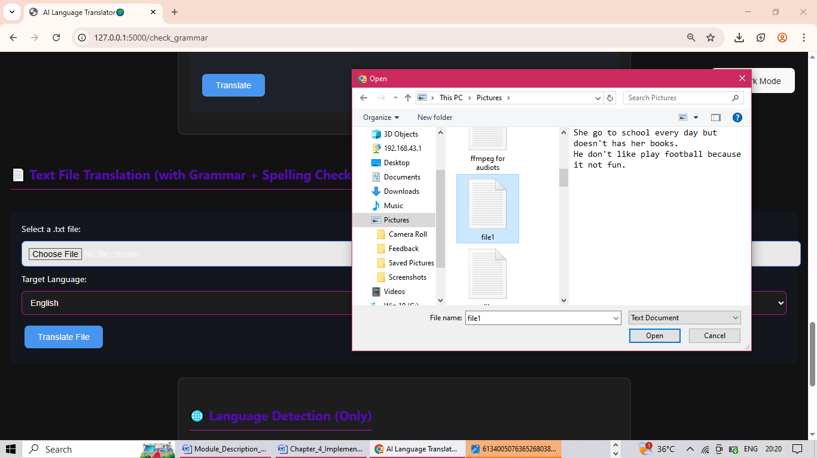
Sample Input and Output (FILE)

Slide 24
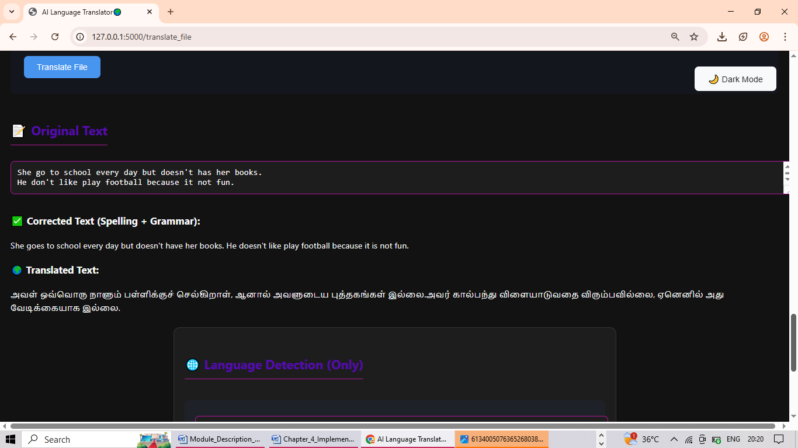
Sample Input and Output

Slide 25
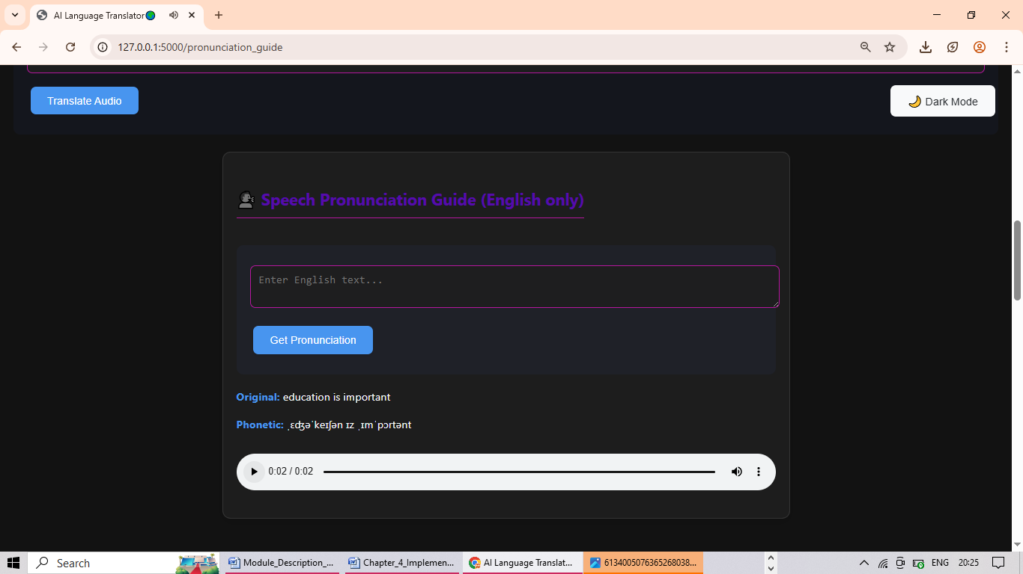
Sample Input and Output (PRONUNCIATION)

Slide 26
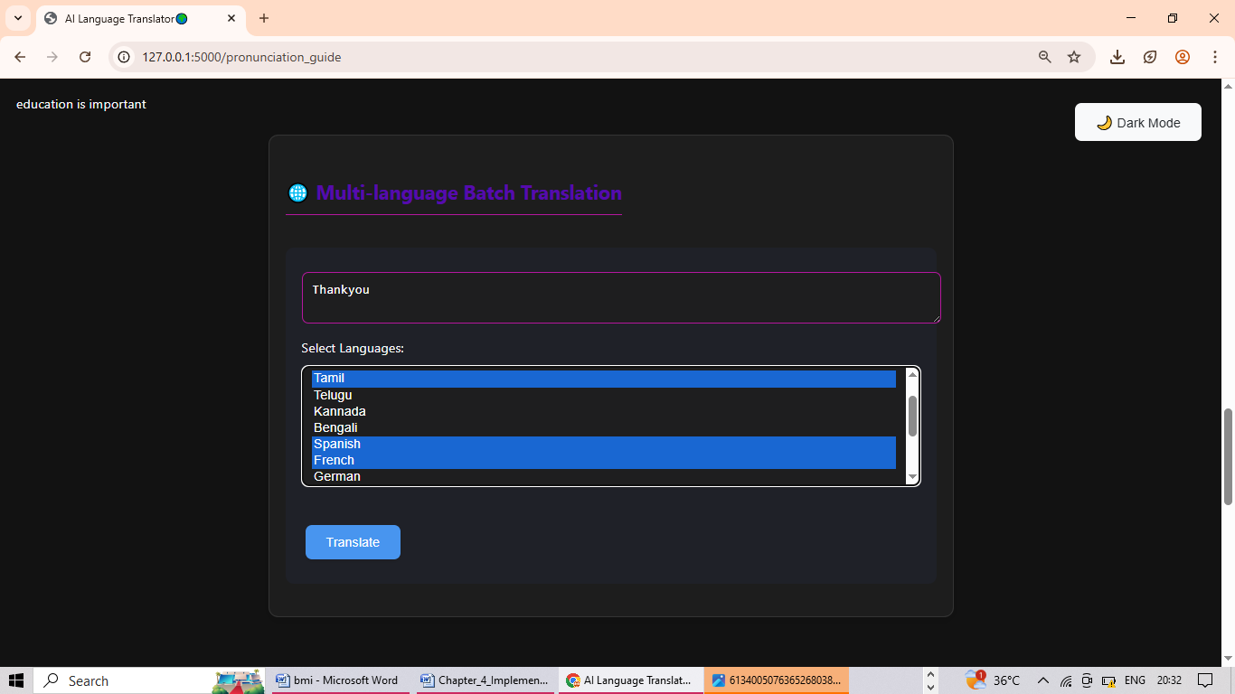
Sample Input and Output (BATCH TRANSLATION)

Slide 27
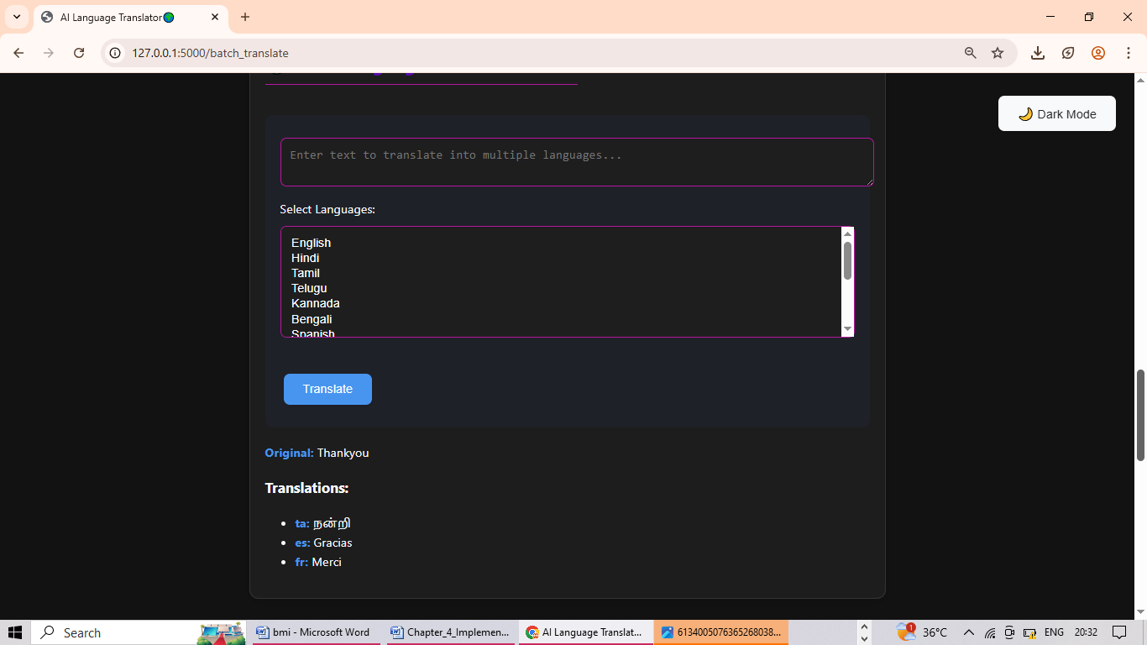
Sample Input and Output

Slide 28
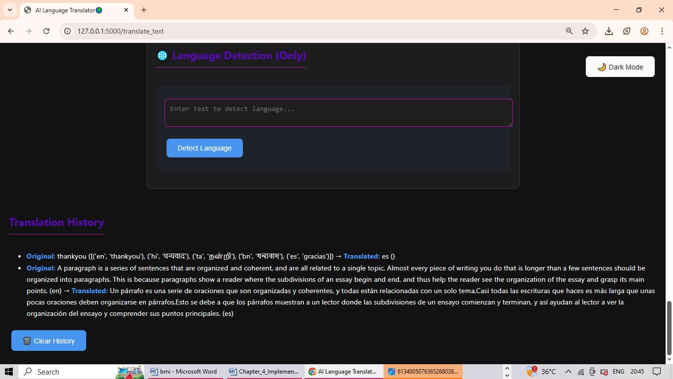
Sample Input and Output

Slide 29
FUTURE ENAHNCEMENT
Real-time voice translation for multilingual conversations
Offline translation support using lightweight AI models
Context-aware and domain-specific translation improvements
Mobile application development for broader accessibility
Enhanced grammar feedback with detailed suggestions

Slide 30
CONCLUSION
The AI-based Language Translator developed in this project successfully integrates multiple advanced language processing features into a single, user-friendly web application. It enables users to translate text, audio, images, and text files into multiple languages, while also offering grammar and spelling correction, pronunciation guides, language detection, and multi-language batch translation. The application not only supports real-time communication but also enhances language learning and accessibility for users across different regions. With a responsive interface and features like dark mode, download support, and translation history, the system provides a robust and practical tool for global communication. Future enhancements can further extend the capabilities of this translator, making it even more intelligent, context-aware, and versatile.

Slide 31
Plan of action
Details | Completion status
Problem identification | Completed
Modules design | Completed
Modules implementation(coding) | First week of April 25
Testing | Second week of April 25
Documentation draft | Last week of April 25
Conference /journal publication | First week of may 25
Final project report | second week of may 25

Slide 32
References
Rupayan Dirghangi, Koushik Pal - Language Translation Using Artificial Intelligence (2022)
Ritika sharma, Ayush Sharma - AI-Based Multilingual Translator with speech and text capabilities(2024)
Gauri Kulkarni, Suraj Ahale - AI for Real-Time Language Translation(2024)
Yasir Abdelgadir mohamed, Akbar Khanan - Impact of Artificial intelligence on Language Translation(2024)

Slide 33
Thank you

