Slide 1

Customer Support Ticket Classifier
AI-Powered Ticket Triage · Task 29 Final Capstone
PKCERT AI & Software Development Internship
Abdul Rehman | github.com/Abdul1652005/TASK-29 | August 2026

Slide 2

Problem Statement
Support tickets are usually sorted manually — this takes time and delays customer response.
Target User
Core Task
Value
Support teams that receive many customer tickets every day and need to route them to the right department.
Read a ticket description and automatically predict its category — no manual sorting needed.
Faster routing, less manual reading, fewer tickets sent to the wrong team.
Task 29 · PKCERT Internship
2

Slide 3


Project Scope
In Scope
Out of Scope
Single-ticket text classification
8 predefined categories
Web interface: Classify, History, About tabs
REST API (FastAPI) for predictions
Session history + CSV export
User accounts / login system
Automatic routing into real helpdesk software
Multi-language support (English only)
Analytics dashboards beyond session history
Task 29 · PKCERT Internship
3

Slide 4





Technology Stack
Model Training
Jupyter Notebook
Step-by-step, easy to document and rerun
Model
TF-IDF + Linear SVM
Lightweight — fast, no GPU needed
Backend
FastAPI
Fast to build, auto-docs, input validation
Frontend
Streamlit
Quick, clean UI without separate HTML/CSS/JS
Hosting
Railway + Streamlit Cloud
Free tier, no credit card, GitHub auto-deploy
Task 29 · PKCERT Internship
4

Slide 5
Dataset & Preparation
A public, labeled support ticket dataset — 47,837 tickets across 8 categories.
47,837
8
70/15/15
Total Tickets
Categories
Train/Val/Test Split
Cleaning Steps
Removed rows with missing ticket text or category label
Lowercased and trimmed all text
Removed empty entries after cleaning
Task 29 · PKCERT Internship
5

Slide 6
Model: Baseline vs Improved
Text converted to features using TF-IDF. Two models trained and compared on identical data.
Final Model
Linear SVM (LinearSVC)
85.5% F1 — a small but consistent improvement over the Logistic Regression baseline across every metric.
Error Analysis
Most errors occur between categories with overlapping vocabulary (e.g. Hardware vs Access). Categories with fewer examples show slightly higher error.
Task 29 · PKCERT Internship
6

Slide 7
System Architecture
Jupyter Notebook
FastAPI Backend
Streamlit Frontend
Data cleaning, training, evaluation, save model
Loads model, exposes POST /predict
UI, calls API, displays result
API Contract: POST /predict → { text } ⟶ { category, confidence, distribution }
Input validation rejects empty or missing text with a clear error, before it reaches the model.
Task 29 · PKCERT Internship
7

Slide 8
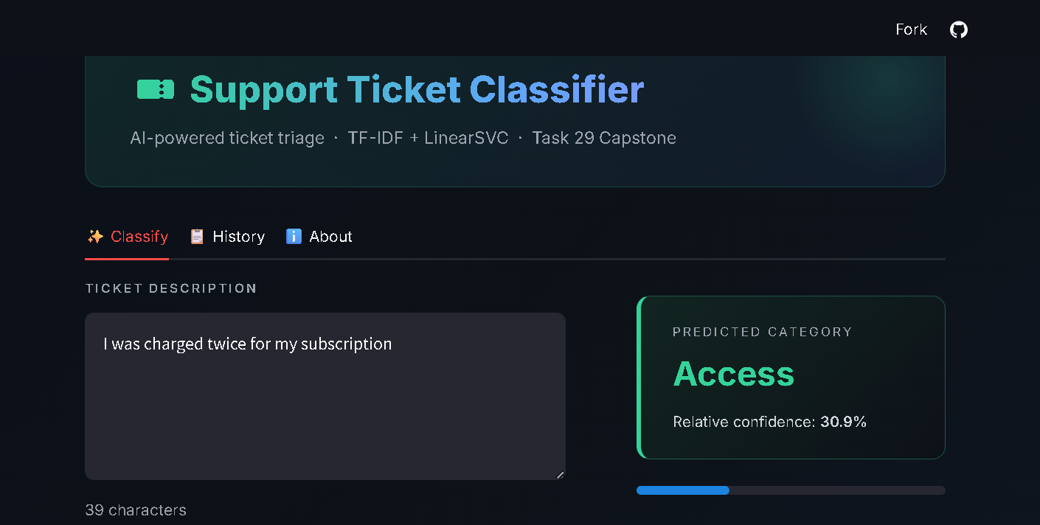
Live Demo — Classify Tab
Task 29 · PKCERT Internship
8

Slide 9
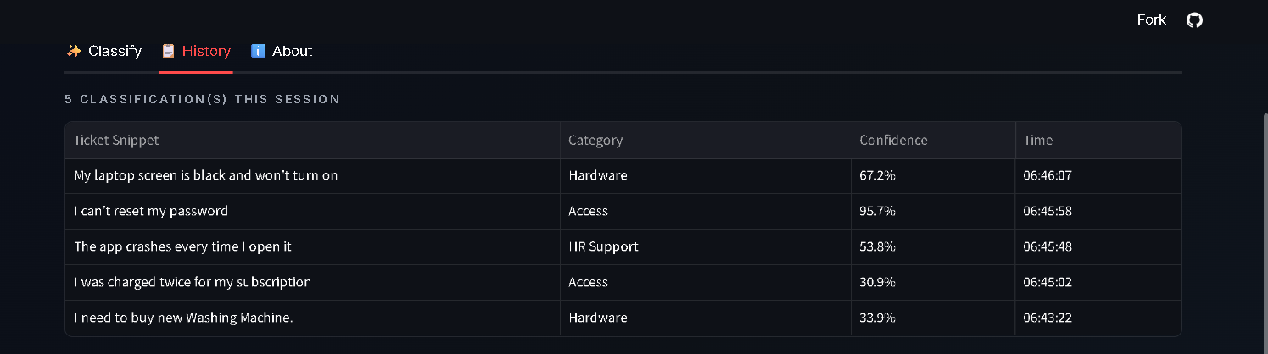
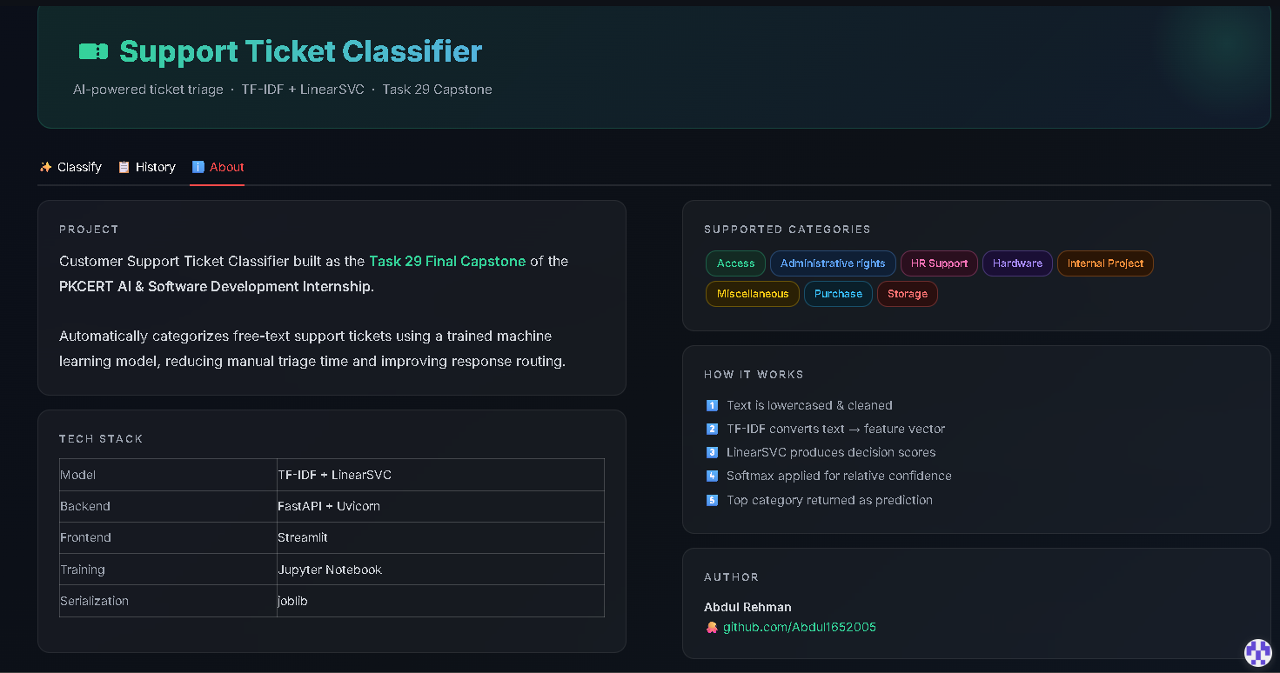
Live Demo — History & About
History Tab
About Tab
Category distribution and 5-entry session log with CSV export.
Task 29 · PKCERT Internship
9

Slide 10
Testing
Test Case | Input | Result
Valid ticket text | "My laptop is not turning on" | Passed — 'Hardware'
Empty text | "" | Passed — 422 error
Missing field | {} (no text) | Passed — 422 error
API health check | GET / | Passed — {"status":"ok"}
Live frontend → API call | Any valid ticket | Passed — verified live
Deployment: Railway (backend) + Streamlit Community Cloud (frontend) — both free-tier, no credit card, auto-deploy from GitHub.
Task 29 · PKCERT Internship
10

Slide 11

Challenges Faced
Hardware Limits
Free Hosting Constraints
Chose lightweight TF-IDF + classical ML over a heavier Transformer to run on a standard laptop.
Railway's memory limits and a Streamlit Cloud Python version issue both had to be resolved.
Dataset Selection
Frontend–Backend Integration
An initial dataset gave near-random results; replaced with a better-labeled dataset.
Connected Streamlit to the live FastAPI service with safe fallback handling.
Task 29 · PKCERT Internship
11

Slide 12

Conclusion & Lessons Learned
A complete, working, end-to-end ML application — from raw data to a live, publicly accessible tool.
Choose the right model for the available hardware
Test each layer — model, API, UI — independently before connecting them
Free-tier cloud platforms can fully support real deployment when configured correctly
Thank you — github.com/Abdul1652005/TASK-29

