Slide 1

SMART WASTE CLASSIFICATION SYSTEM
A Convolutional Neural Network (CNN) Approach for Automated Waste Sorting
CB
Cardboard • Glass • Paper
Viva Presentation
Deep Learning — Final Year Project

Slide 2






OVERVIEW
Project Roadmap
01
02
03
Dataset
Preprocessing
Data Split
Real TrashNet images collected & cleaned
Resize, normalize, augment to 2,000/class
70% train / 15% val / 15% test
04
05
06
CNN Model
Training
Deployment
4 convolution blocks + dense layers
13 epochs, resumable strategy
Flask web app for live predictions
Smart Waste Classification System — CNN Viva
2

Slide 3

MOTIVATION
Why This Project?
The Problem
Why CNN, Not a Plain ANN?
Manual waste sorting is slow, inconsistent, and labor-intensive.
Contaminated recycling streams reduce material recovery rates.
Automated visual classification can sort waste faster and more consistently at the source.
A 96×96 RGB image flattened for an ANN needs 27,648 input neurons — too many parameters, high overfitting risk.
Flattening destroys spatial relationships between neighboring pixels.
CNNs use small filters that scan the image, detecting patterns (edges, textures) regardless of position.
96.56%
3
6,000
Final Test Accuracy
Waste Categories
Training Images Used
Smart Waste Classification System — CNN Viva
3

Slide 4
PHASE 01 — DATASET
The Dataset: TrashNet
Real-world waste photographs, sourced from the public TrashNet dataset (garythung/trashnet).
1,488
Total real images (after removing 10 duplicates)
0
Corrupted images found
512×384
Original image resolution (uniform)
Smart Waste Classification System — CNN Viva
4

Slide 5
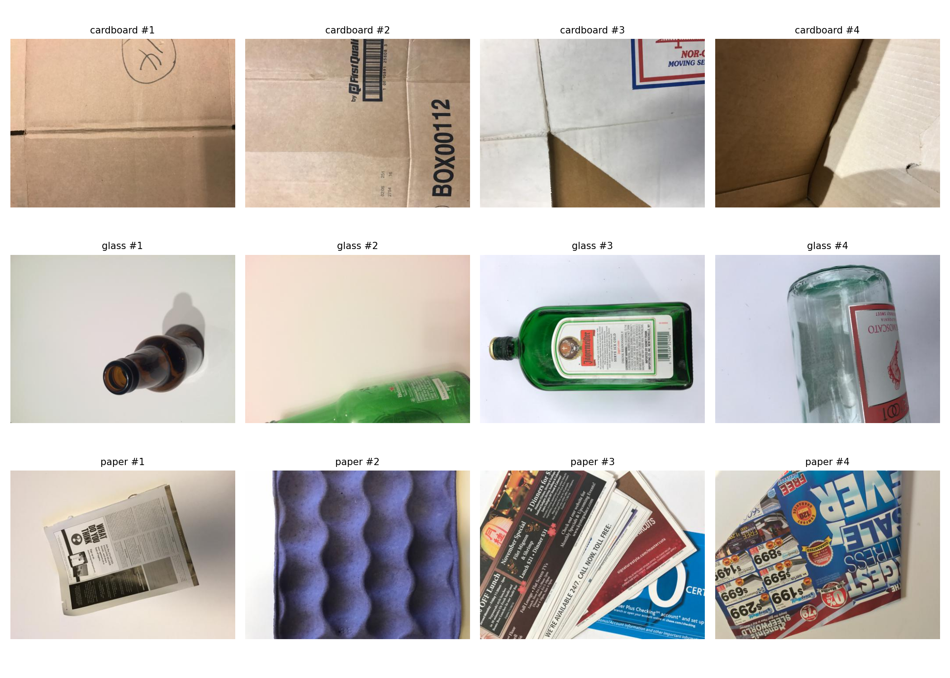

PHASE 02 — EXPLORATORY DATA ANALYSIS
What Does the Data Look Like?
EDA Findings
Cardboard images are visibly darker on average than glass or paper (brightness histogram).
Glass images trend brightest — reflective surfaces & studio lighting.
All images share a consistent 512×384 resolution — no resizing anomalies.
Classes are reasonably balanced (27% / 34% / 39%), no severe imbalance.
Smart Waste Classification System — CNN Viva
5

Slide 6
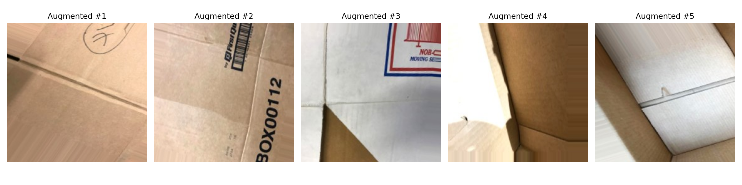
PHASE 03 — PREPROCESSING
Preprocessing & Data Augmentation
DATASET EXPANSION
1,488
real images collected
Augmented cardboard samples — same source image, different rotation/zoom/shift each time
↓ augmentation
6,000
Steps Applied
Resize every image to 96×96 pixels
Normalize pixel values from 0–255 to 0–1
Augment: rotation, width/height shift, zoom, horizontal flip, brightness, shear
total training-ready images
2,000 images per class — exactly balanced
Smart Waste Classification System — CNN Viva
6

Slide 7
PHASE 04 — DATA SPLIT
Train / Validation / Test Split
Applied uniformly across all three classes — 1,400 / 300 / 300 each.
4,200
Training images
900
Validation images
900
Test images (held out)
Smart Waste Classification System — CNN Viva
7

Slide 8
MODEL DESIGN
CNN Architecture
Input
96 × 96 × 3 (RGB image)
MODEL STATS
Conv Block 1
↓
32 filters, 3×3 → BatchNorm → ReLU → MaxPool
2,496,331
Conv Block 2
↓
64 filters, 3×3 → BatchNorm → ReLU → MaxPool
Total parameters
Conv Block 3
↓
128 filters, 3×3 → BatchNorm → ReLU → MaxPool
831,875
Conv Block 4
↓
Trainable parameters
128 filters, 3×3 → BatchNorm → ReLU → MaxPool
Flatten
↓
Adam
6 × 6 × 128 → 4,608 features
Optimizer (lr = 0.0001)
Dense + Dropout
↓
128 neurons, ReLU, 40% dropout
Categorical
Output
↓
3 neurons, Softmax → class probabilities
Crossentropy loss
Smart Waste Classification System — CNN Viva
8

Slide 9
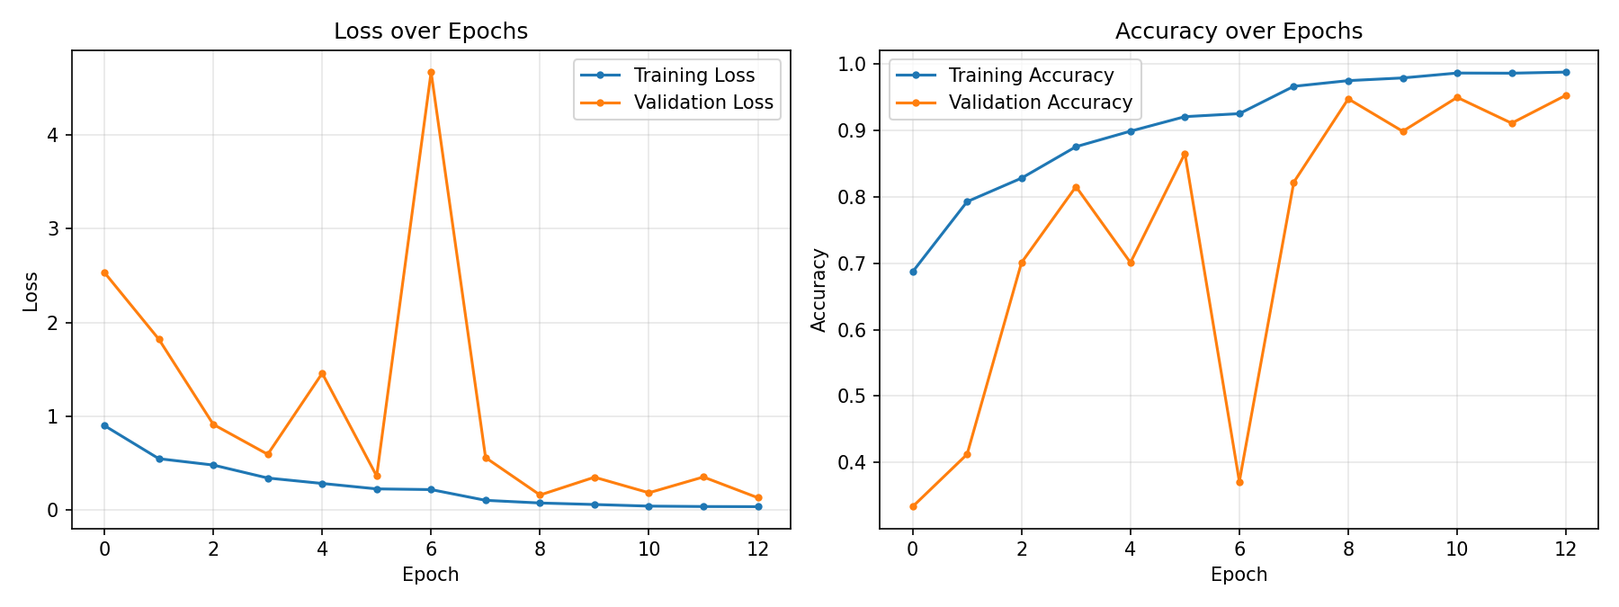
TRAINING
Training the Model
13
Epochs trained
32
Batch size
95.33%
Best validation accuracy
A real training challenge
At epoch 6, validation accuracy suddenly dropped from 86% to 37% and validation loss spiked — a sign the learning rate was too high. Reducing it to 0.0001 immediately stabilized training, which then improved steadily to 95.3% validation accuracy by epoch 13.
Resumable
Training strategy (checkpoint-based)
Smart Waste Classification System — CNN Viva
9

Slide 10
RESULTS
Final Test Set Performance
TEST ACCURACY
96.56%
on 900 held-out test images
0.1055
TEST LOSS
31 / 900
MISCLASSIFIED (3.4%)
Smart Waste Classification System — CNN Viva
10

Slide 11
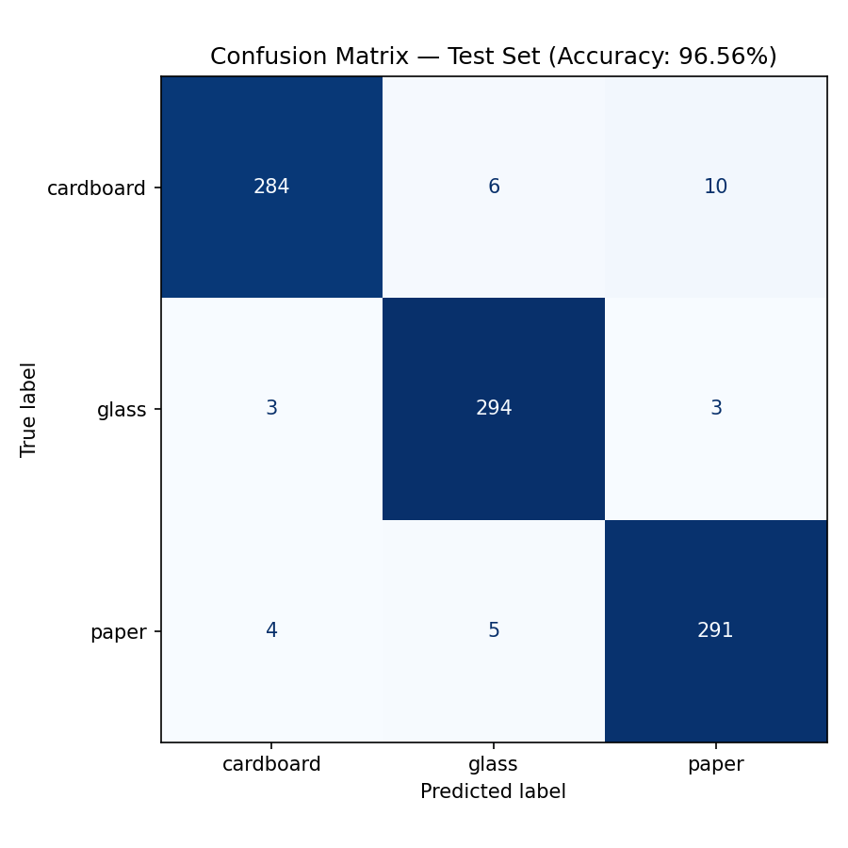

EVALUATION
Confusion Matrix & Error Analysis
Reading the Matrix
Diagonal cells = correct predictions (284, 294, 291 out of 300 each).
Most confusion is between cardboard and paper (10 cardboard images predicted as paper) — both are similar-textured, light-colored materials.
Glass is the most reliably identified class (294/300 correct) — likely due to its distinct reflective texture.
Overall: 869 correct / 900 total test images → 96.56% accuracy
Smart Waste Classification System — CNN Viva
11

Slide 12
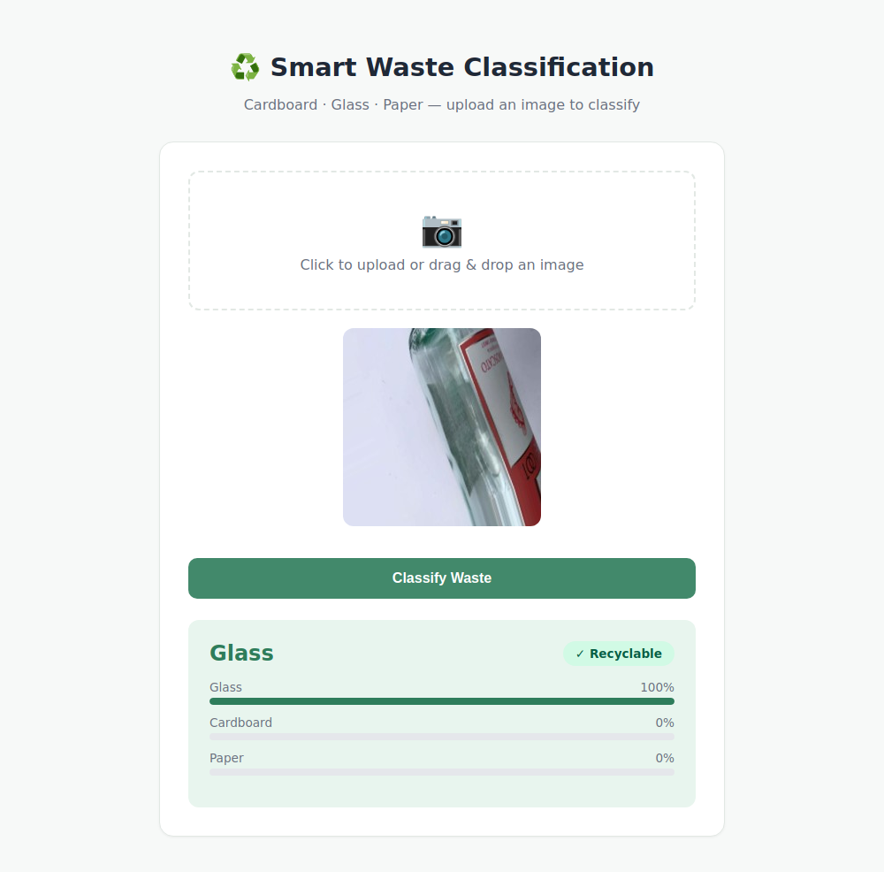

DEPLOYMENT
From Model to Web Application
The trained model is served through a Flask web app, so anyone can upload a photo and get an instant prediction.
Key Features
Drag-and-drop or click-to-upload image interface
Real-time classification (Cardboard / Glass / Paper)
Confidence percentage for every class shown as progress bars
Recyclable / Non-recyclable badge for quick decision-making
Lightweight Flask backend calling the trained Keras model directly
Smart Waste Classification System — CNN Viva
12

Slide 13
CONCLUSION
Summary & Future Work
What Was Achieved
Future Improvements
Built a real, working CNN pipeline end-to-end — data prep, EDA, augmentation, training, evaluation, deployment.
Trained on 6,000 real + augmented images across 3 waste categories.
Achieved 96.56% test accuracy with balanced precision/recall across all classes.
Deployed as a usable Flask web application.
Add the remaining TrashNet classes: metal, plastic, trash.
Use transfer learning (MobileNetV2 / ResNet50) for higher accuracy.
Train at full 224×224 resolution on GPU hardware.
Deploy publicly on cloud hosting (Render / Railway) with a mobile-friendly UI.
Thank You — Questions?

