Slide 1


Slide 2


Slide 3
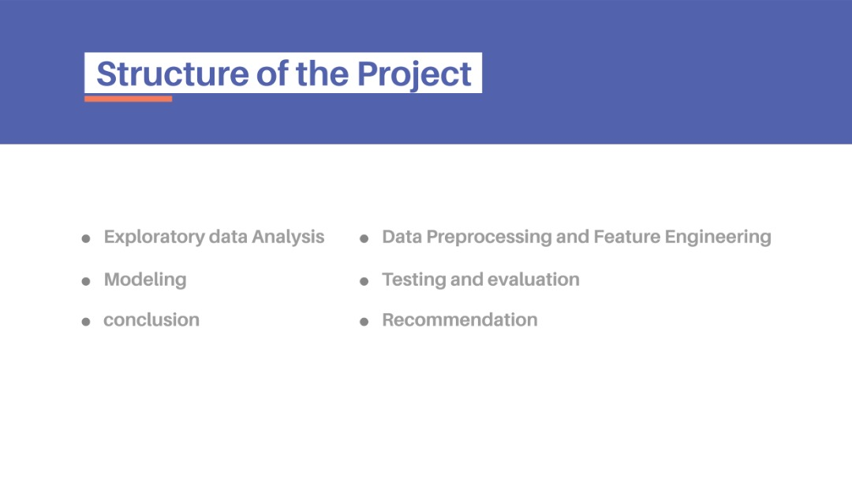
Exploratory Data Analysis
Data processing and feature engineering
Selection of Model
Modeling and Evaluation

Slide 4

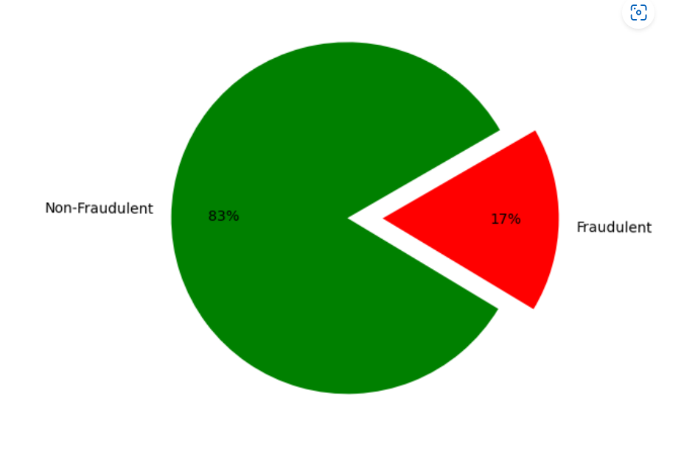

Slide 5

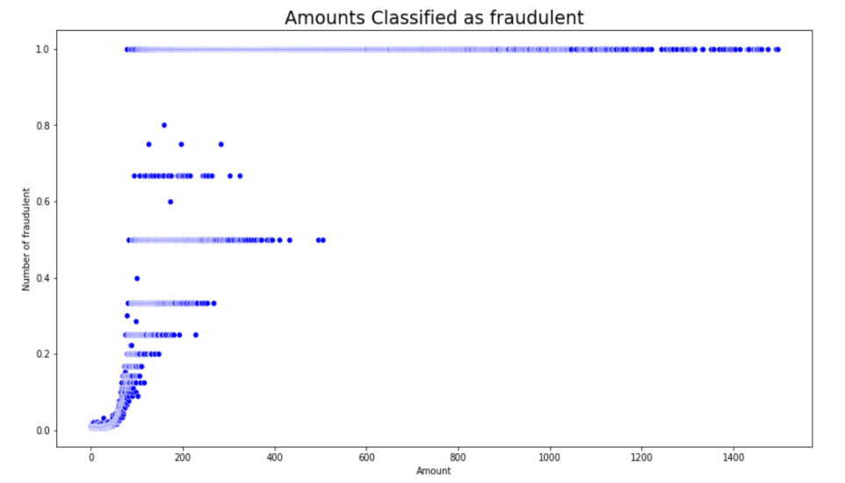

Slide 6

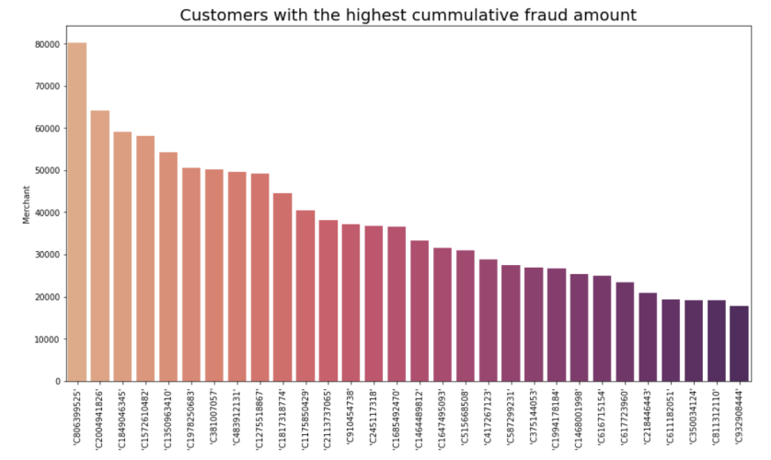

Slide 7

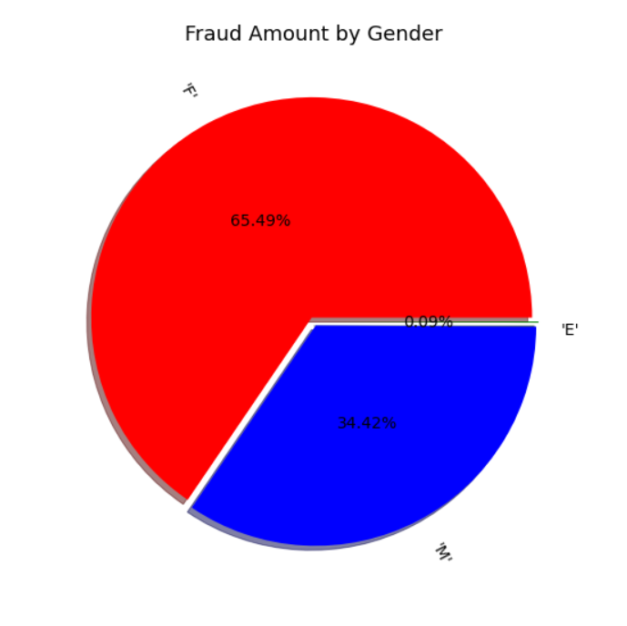

Slide 8

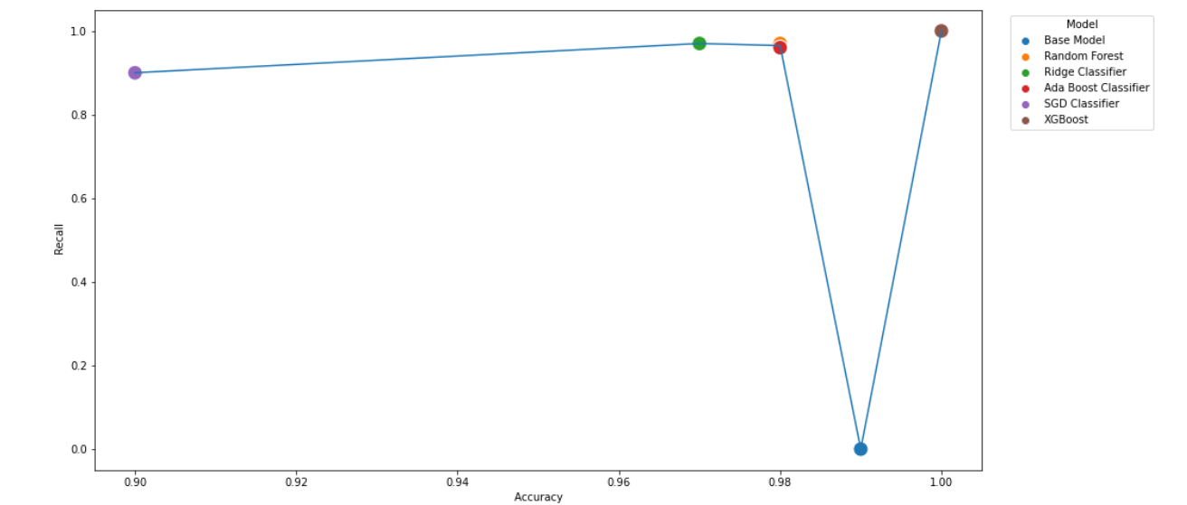

Slide 9



Slide 10


Slide 12


