Slide 1

Bank Fraud Detection

Slide 2
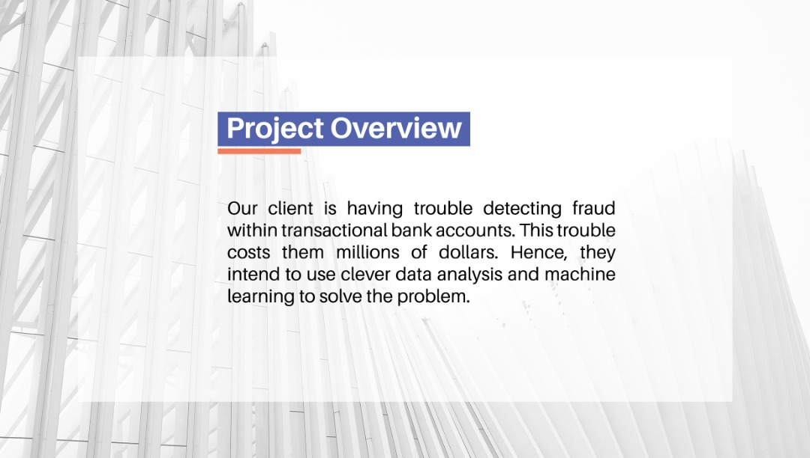


Slide 3
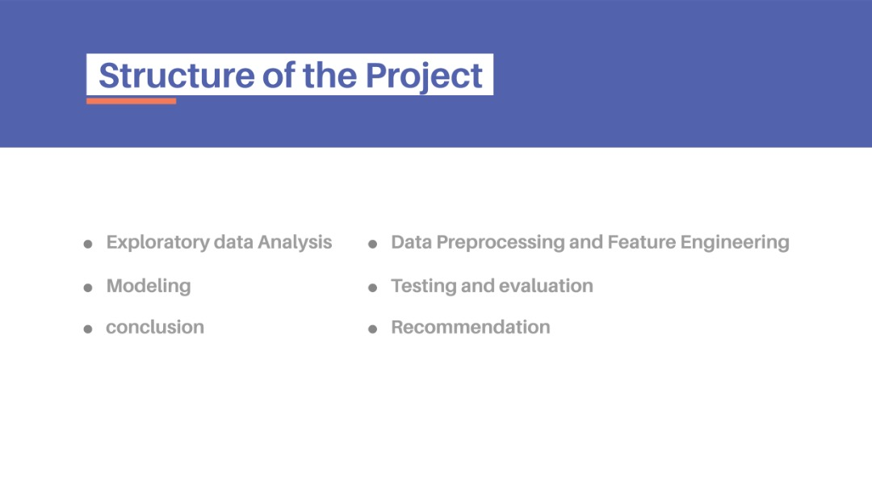
Exploratory Data Analysis
Data processing and feature engineering
Modeling and Evaluation
Selection of Model

Slide 4
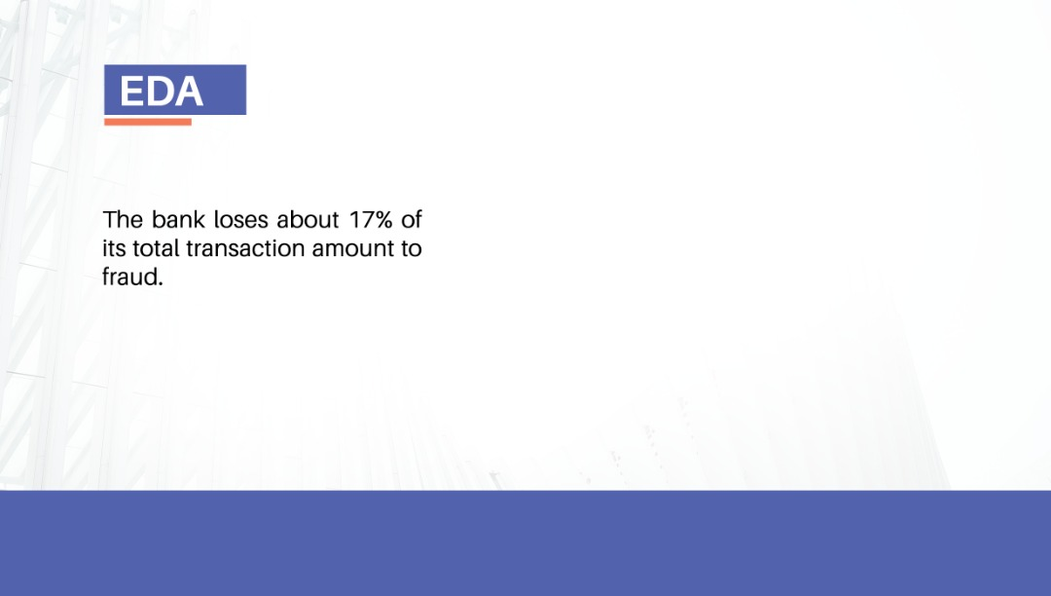
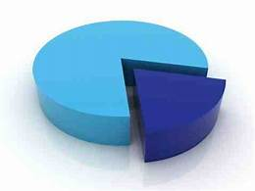
83% NON-FRAUDULENT
17% FRAUDULENT

Slide 5


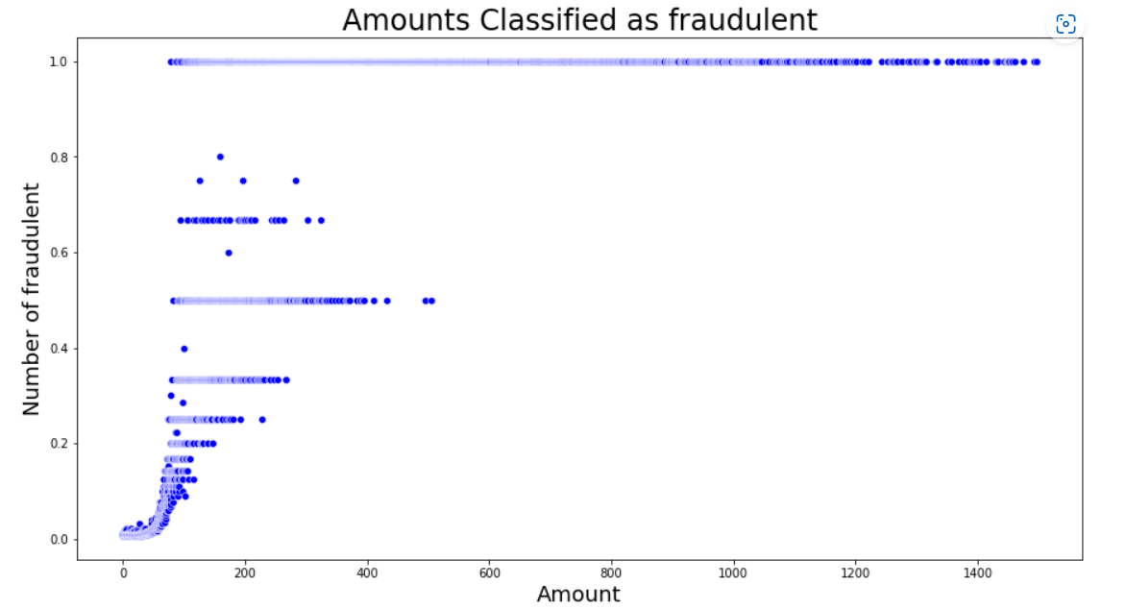
All transaction above 600 dollars are certainly fraudulent

Slide 6
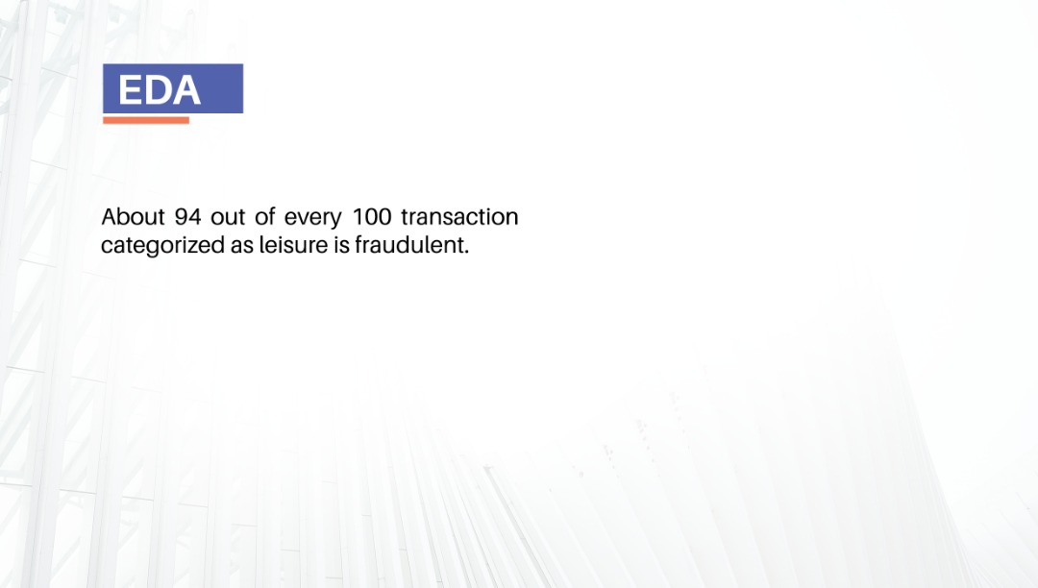
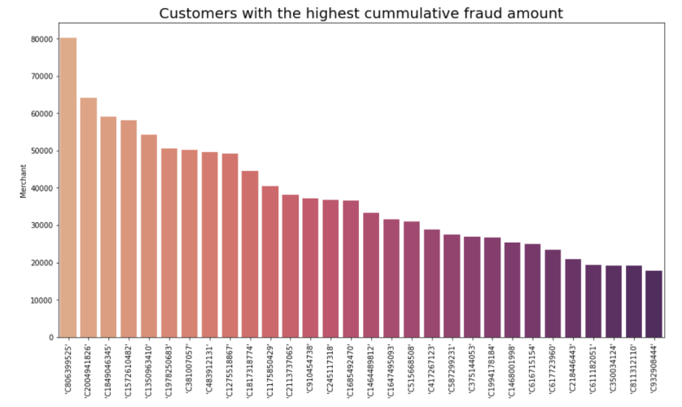
About 94 out of every 100 transaction categorized as leisure is fraudulent

Slide 7
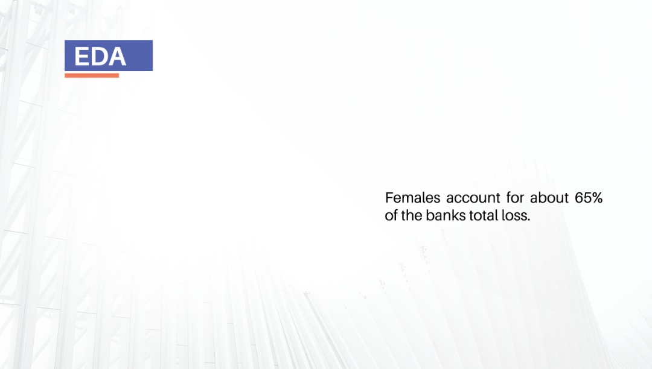
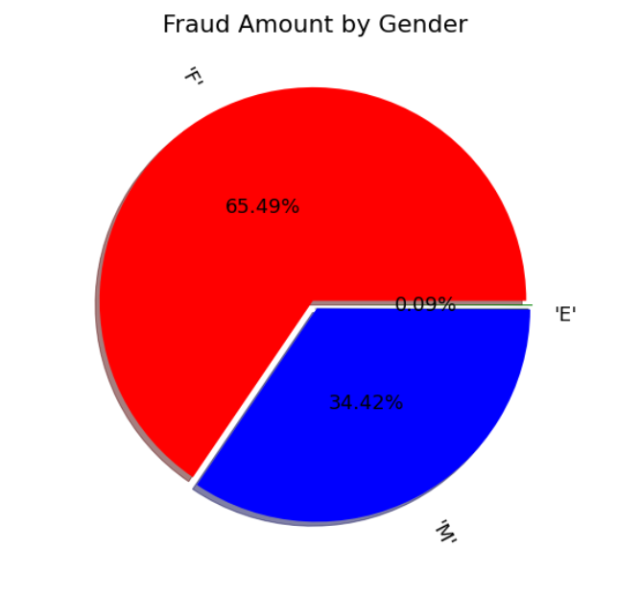

Slide 8

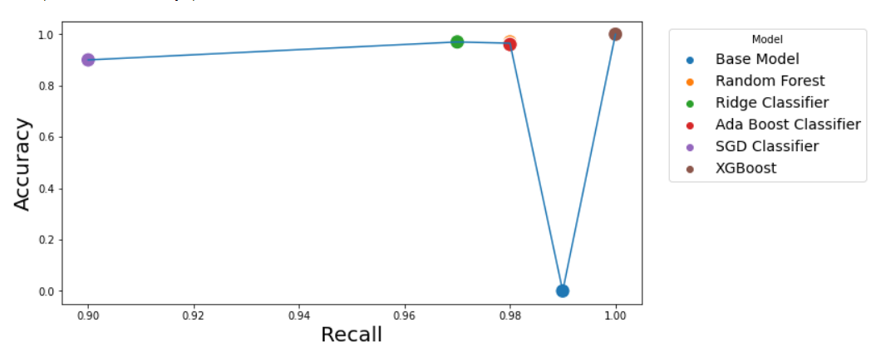
Model Performance

Slide 9
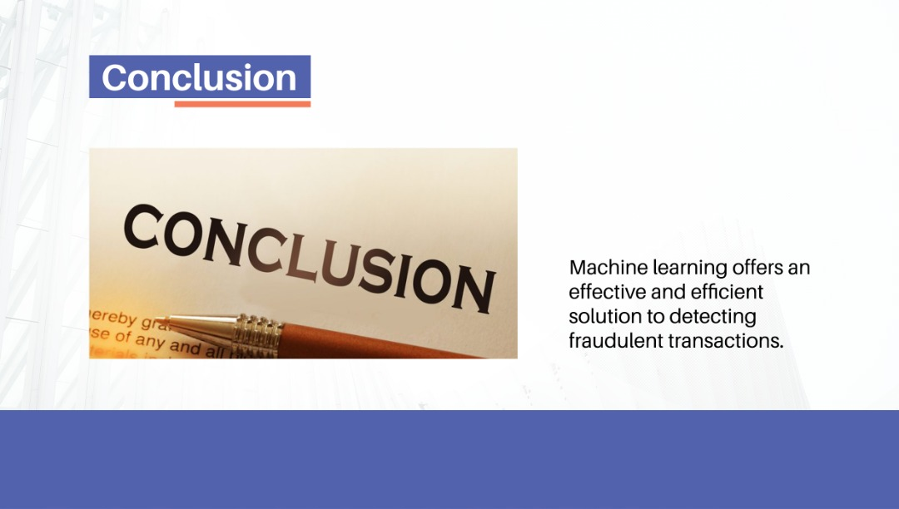


Slide 10
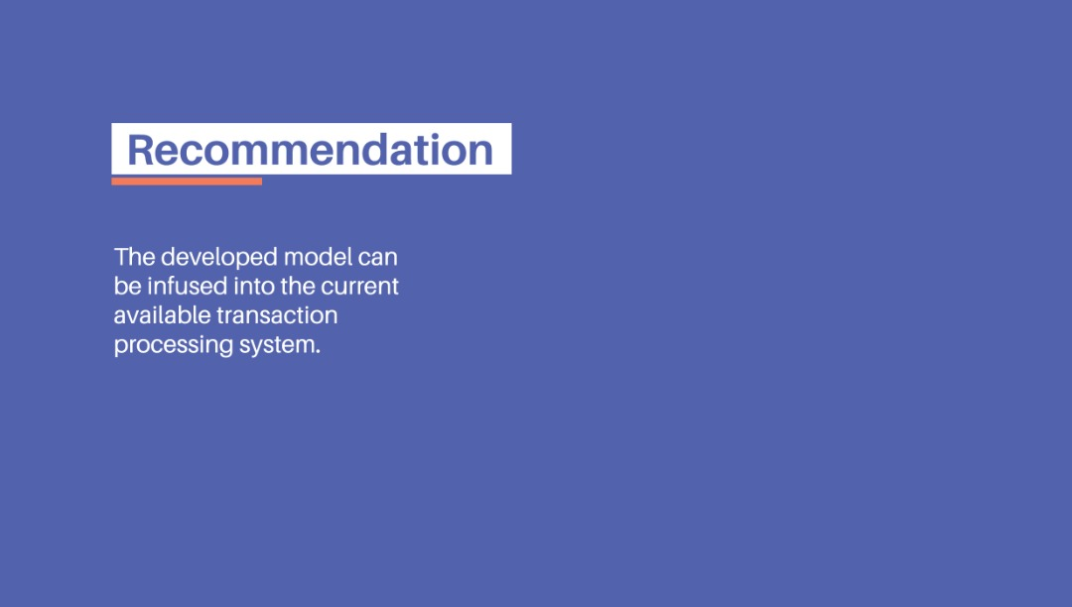


Slide 11

thank
you

