Slide 1
Multithreaded Programming Using Pthreads and OpenMP
Parallel Computing Laboratory Project

Slide 2
Aim and Objectives
- Develop multithreaded programs using Pthreads and OpenMP.
- Demonstrate thread creation, work distribution.
- Handle race conditions with mutex & critical sections.
- Compare sequential vs parallel performance.

Slide 3
Environment
- OS: Windows, WSL Ubuntu
- Compiler: GCC
- Libraries: POSIX Pthreads, OpenMP
- Editor: Nano

Slide 4
Pthreads Overview
POSIX Threads (Pthreads) provides explicit thread management, allowing granular control over thread lifecycle, synchronization (mutexes), and joining.

Slide 5
Thread Creation and Work Distribution
- Created threads using pthread_create().
- thread_sum.c distributed an array among 4 threads.
- Work was cleanly divided, demonstrating data parallelism (partial sums).

Slide 6
Race Condition & Mutex (Pthreads)
- race.c demonstrated simultaneous access causing lost increments (Expected: 400000, Actual: 135420).
- mutex.c fixed this using pthread_mutex_lock(), safely achieving 400000.

Slide 7
OpenMP Overview
OpenMP provides compiler-directed parallelism. Using #pragma directives simplifies parallel regions, work sharing (for-loops), and synchronization without manually managing thread objects.

Slide 8
OpenMP Synchronization
- omp_race.c showed OpenMP race conditions (101499 instead of 400000).
- omp_critical.c used #pragma omp critical to resolve it.
- omp_barrier.c ensured all threads met before advancing stages.

Slide 9
Performance Experiment Setup
- Workload: N = 1,000,000,000 iterations.
- Sequential baseline time: 1.817299s.
- Executed across 1, 2, 4, 6, and 16 threads in both Pthreads and OpenMP.

Slide 10
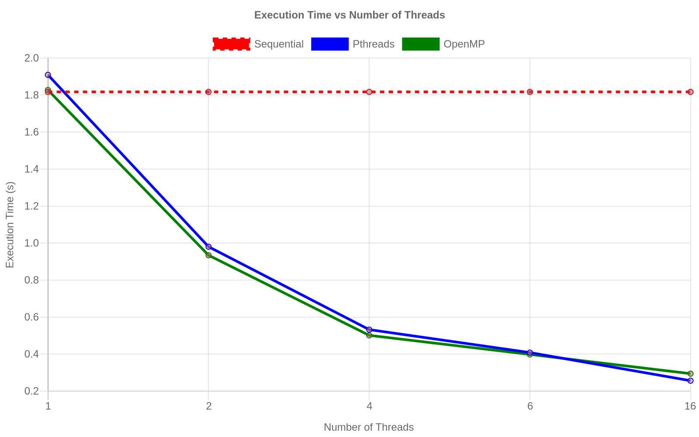
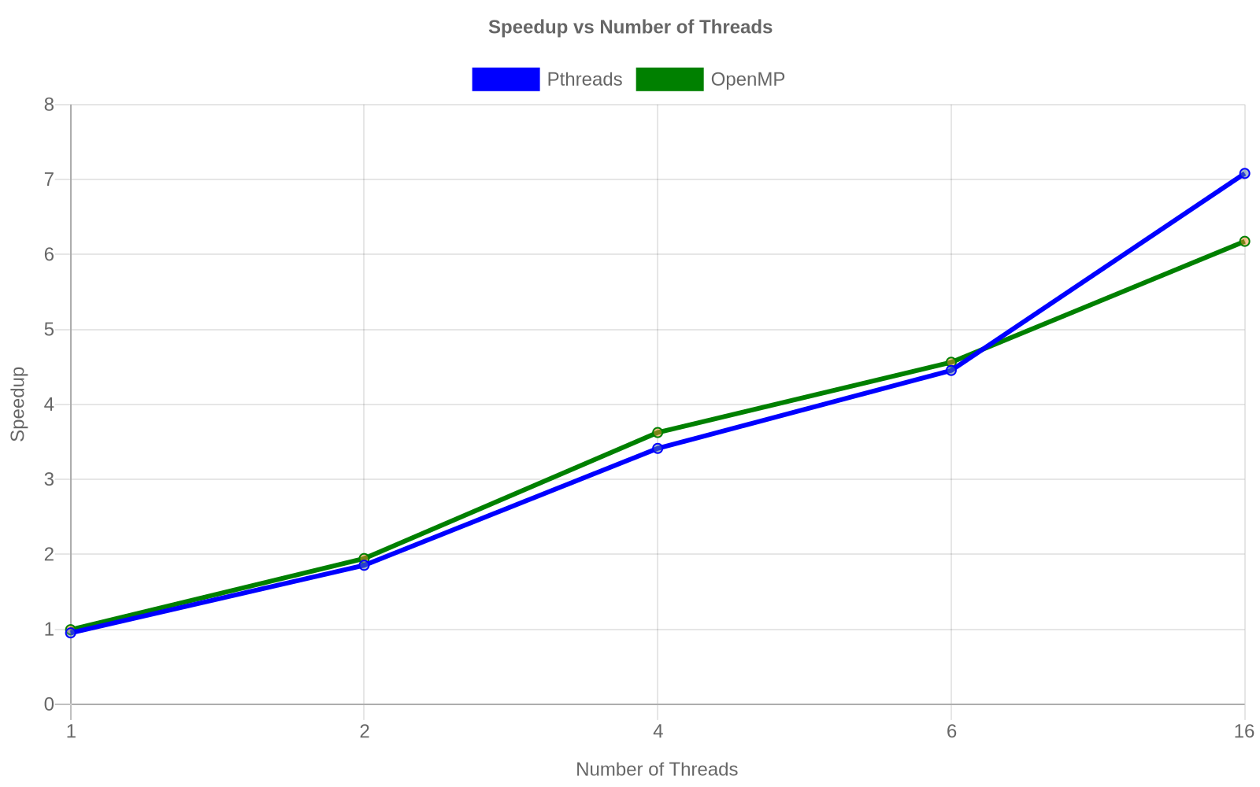
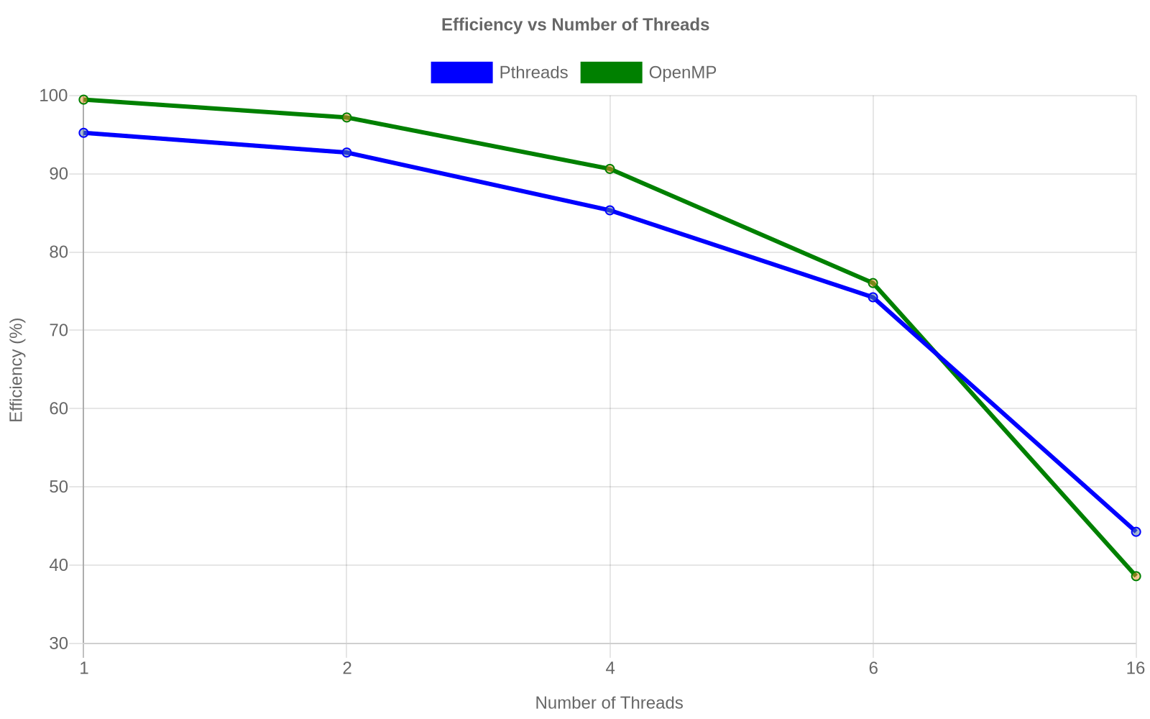
Performance Results
Pthreads (16 threads): 0.256s (Speedup 7.081)
OpenMP (16 threads): 0.294s (Speedup 6.175)
Both successfully dropped execution time significantly compared to 1.81s baseline.

Slide 11
Observations
- Speedup scales well but isn't perfectly linear.
- Efficiency decreases as thread count hits 16 (44% for Pthreads, 38% for OpenMP).
- Overhead and scheduling limits perfect scaling.

Slide 12
Conclusion
Multithreading vastly improves performance on large datasets. However, shared data access requires strict synchronization to prevent race conditions, which introduces overhead limiting maximum efficiency.

