Slide 1

Water Delivery System:

Slide 2
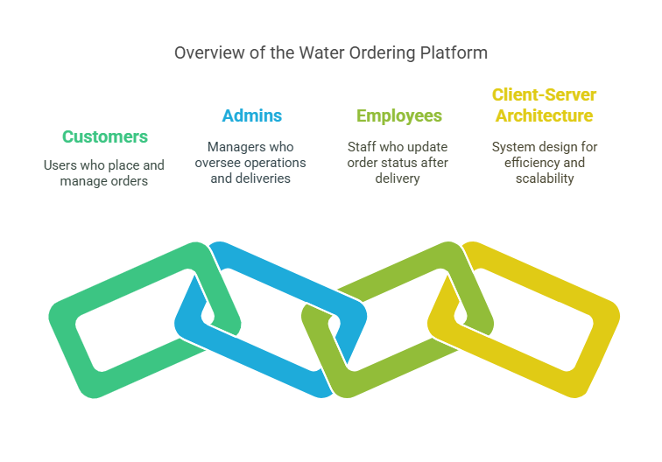
Project Introduction:

Slide 3
Advantages:
Separate dashboards for all users.
Both frontend and Backend are protected by middleware routes, for only role-based access generation.
Easy Account Management for Customers.
Real-time Order Tracking and Status Updates.
100% responsive design with better UX.
Secured credentials + JWT tokens so that no multiple requirement of credentials for a session of 1 hour.

Slide 4
Disadvantages:
Requires manually startup of server and client side.
No desktop application, only web application variant.
Not responsive for mobile and tablet displays.
Gets stuck sometimes due to browser cache mess-up.
Only one profile should be accessed via one browser, otherwise the user id stored in local browser cache gets replaced.

Slide 5
Non-Functional Requirements (NFR):
Performance: System must handle up to 100 concurrent users without noticeable delays.
Security: User data (account info, order history) is protected via authentication and data encryption.

Slide 6
Design:
Frontend: Responsive web interface for customers, admins, and delivery staff.
Backend: REST API server handling business logic and database communication.
Database: Secure storage of user accounts, orders, and delivery information.
Actors: Customer, Admin, Employees, Database.

Slide 7
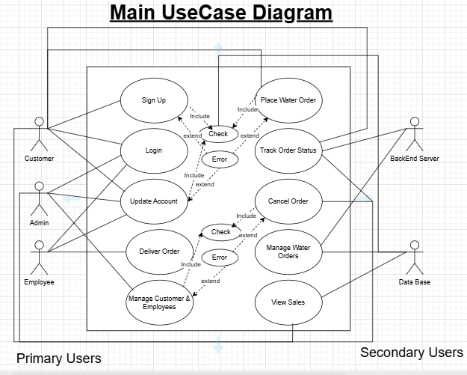

Slide 8
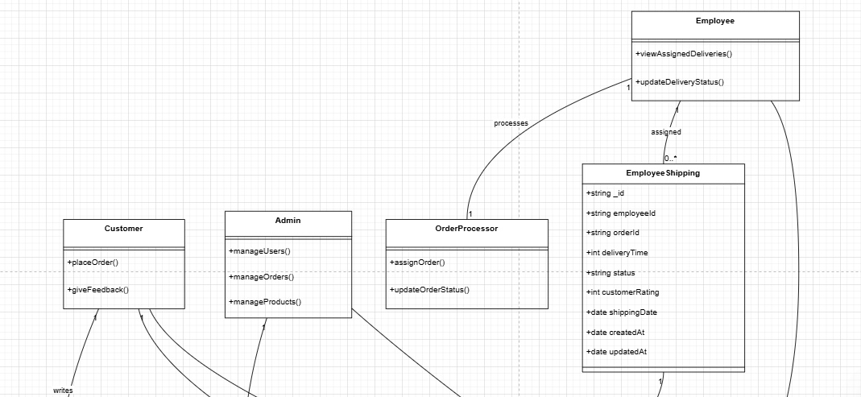
A Piece of Class Diagram:

Slide 9
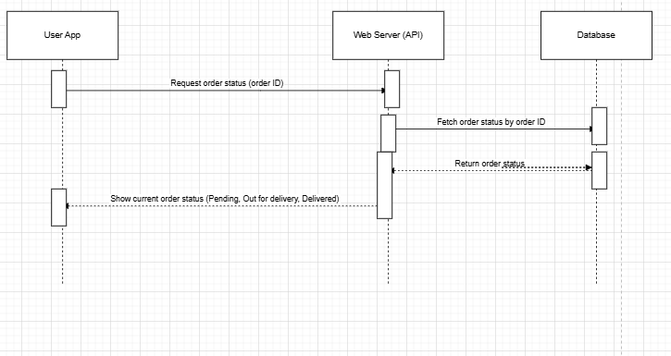
Sequential Diagram For Order status Fetching:

Slide 10
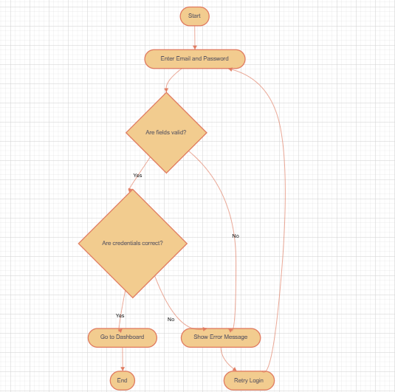
Activity Diagram For Login:

Slide 11
Client-Server Architecture:
Multiple clients (Web Browsers) interact with the Web Frontend.
Web Frontend communicates with a centralized Server.
Server processes requests, manages business logic, and interacts with Database.

Slide 12
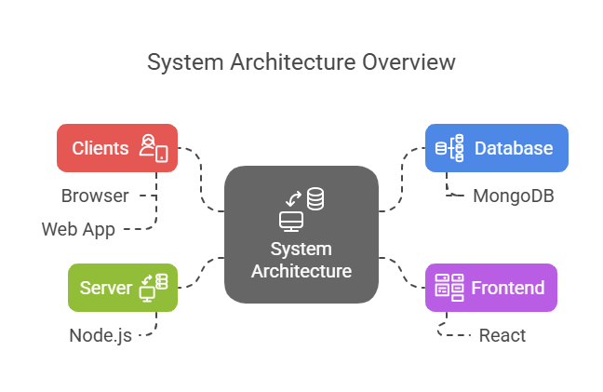

Slide 13
Work Division Between Group Members:
Member Name | Responsibility
Abdul Ahad | Frontend Development (UI/UX)
Khalid Umar | Backend Development (Routes + Controllers)
Huzaifa Amir | Database Design and Integration
Abdul Ahad | Testing, Bug Fixes, Documentation

Slide 14
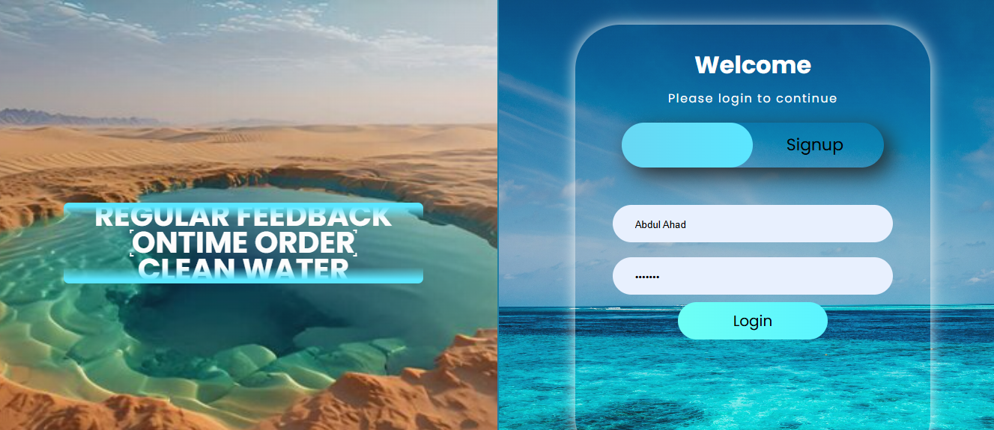
Actual Implementation Screenshots (1)

Slide 15
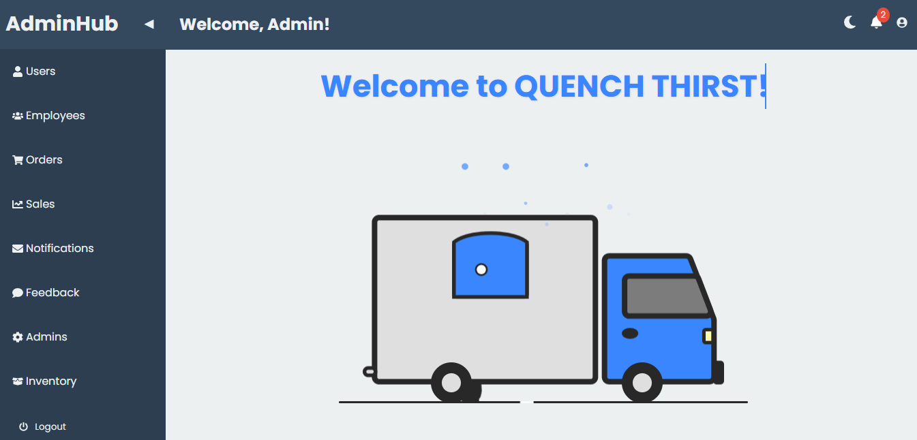
Actual Implementation Screenshots (2)

Slide 16
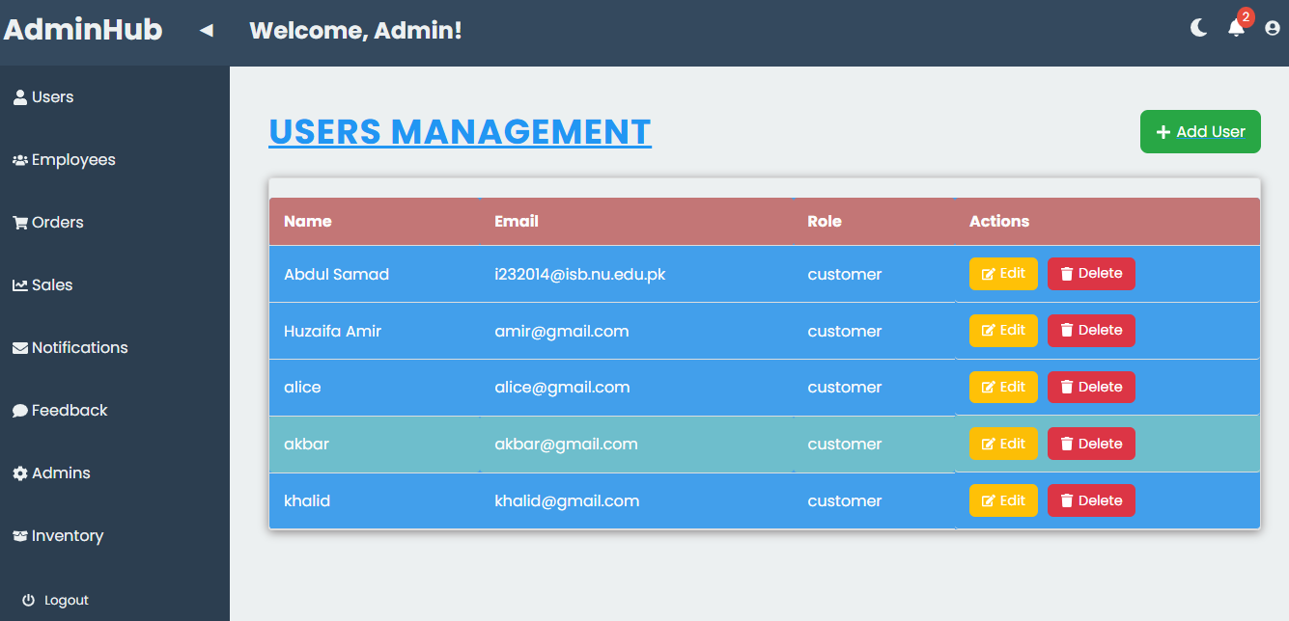
Actual Implementation Screenshots (3)

Slide 17
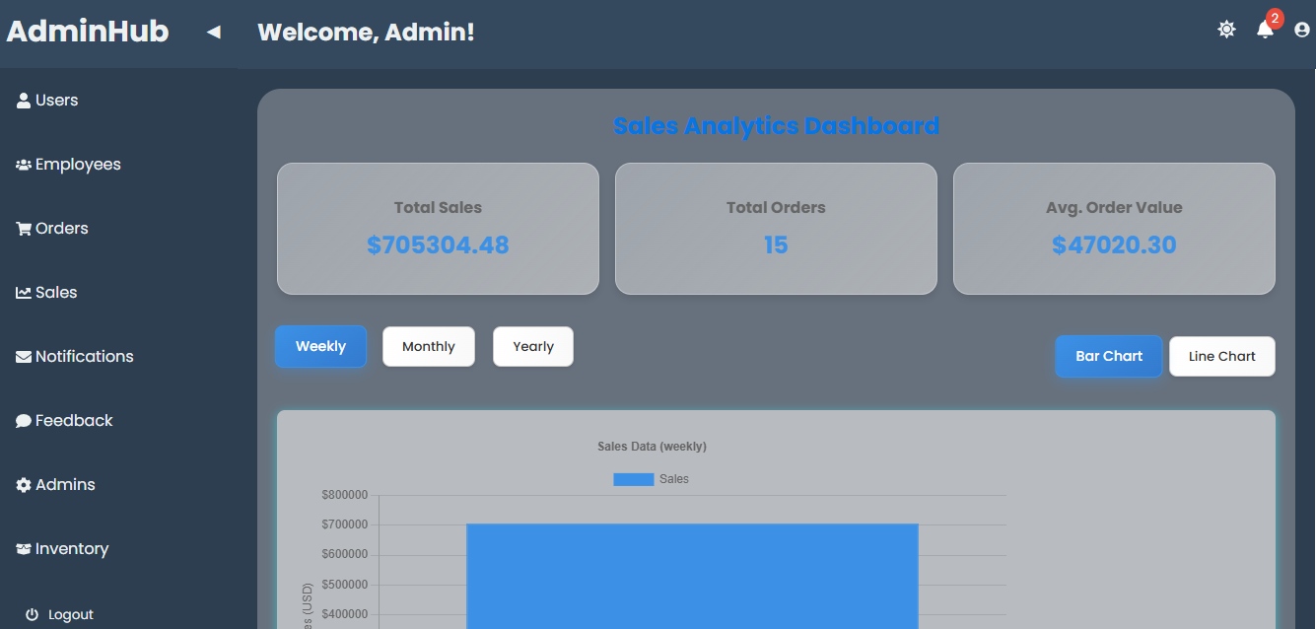
Actual Implementation Screenshots (4)

Slide 18
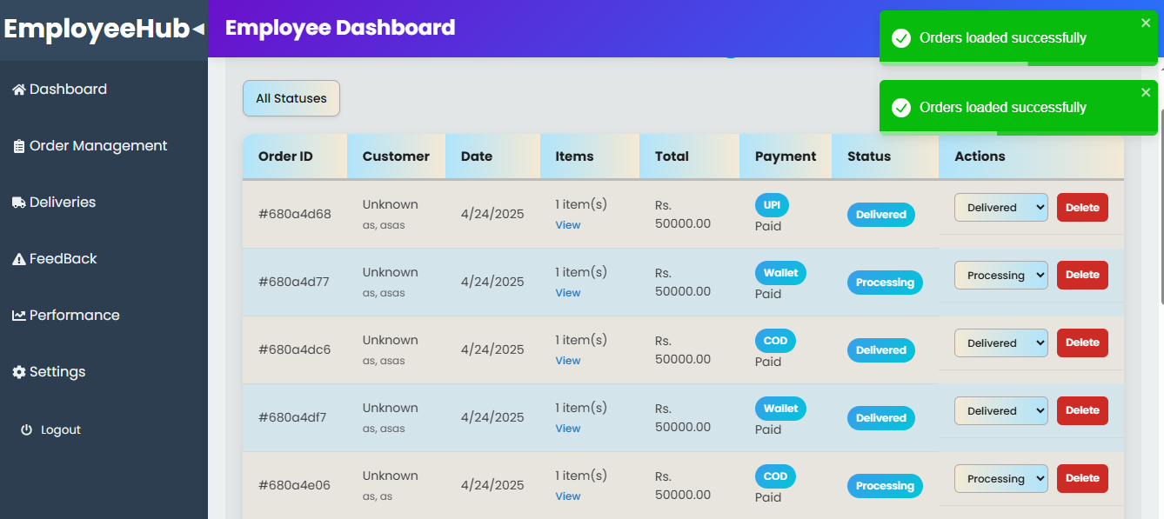
Actual Implementation Screenshots (1)

Slide 19
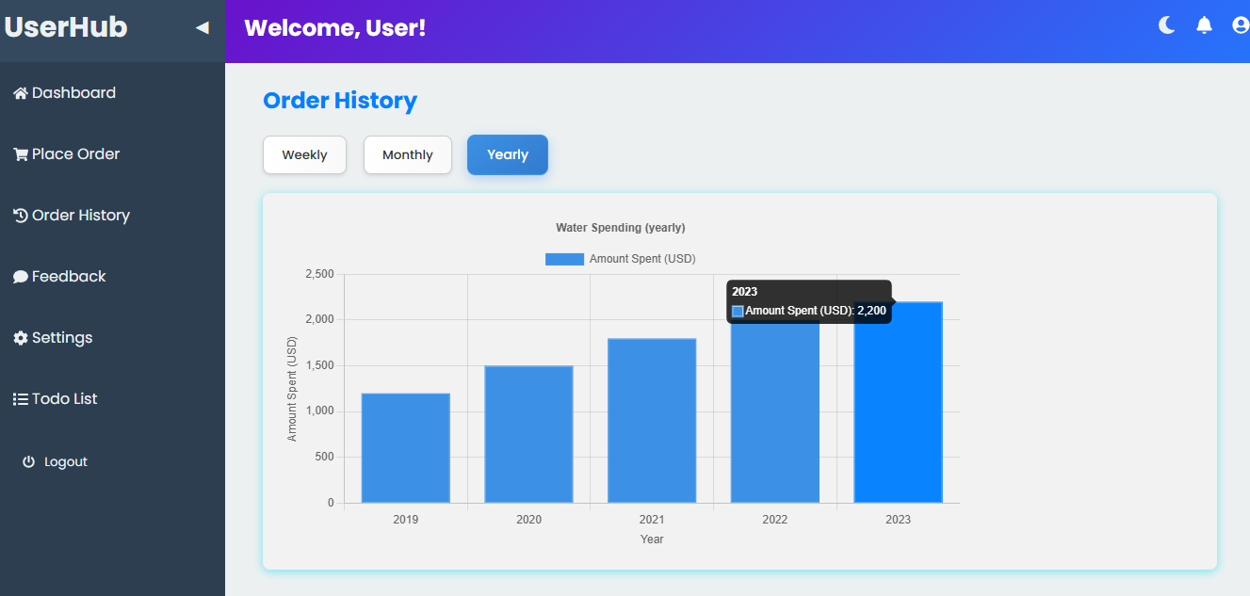
Actual Implementation Screenshots (1)

Slide 20
Lessons Learned:
Handling real-world issues like API failures, UI bugs, and database optimization.
Improved understanding of Client-Server Architecture.
Gained hands-on experience in full-stack web development.
Gained technical knowledge of how to identify NFRS.
How to nontechnically document the program.
Learned different diagrams that are part of software development.

