Slide 1
Qiskit Fall Fest 2026 | Healthcare
Kinship
One home visit. Four test kits. Which relatives do we test?
Planning thalassaemia cascade screening in Pakistan with a QAOA circuit that cannot break the kit limit
Syed Muhammad Saad Bukhari | Abdul Ahad | Faizan
kinship.sevenlabs.site | github.com/AbdulAHAD968/Qiskit-IBM
Notes:
Saad opens. A child is diagnosed with thalassaemia. A field officer has four test kits for the family. Our tool picks the relatives to test, using a QAOA circuit that can never break the kit limit, and checks every plan against the exact optimum.

Slide 2
Thalassaemia runs in families
Kits, lab capacity and home visits are limited, so every visit forces a choice
5%
5,250
31%
48
of people in Pakistan carry beta-thalassaemia
children born with thalassaemia major each year (estimate)
of tested relatives of a patient were carriers, against 0 of 397 controls
field officers cover all 36 districts of Punjab
A child is affected only when both parents are carriers. Screening starts from the relatives of a patient: cascade screening.
Notes:
About 5% of people in Pakistan carry beta-thalassaemia, and around 5,250 children are born with thalassaemia major each year. Screening teams start from a family with an affected child and test the relatives, but kits and visits are limited: 48 field officers cover all 36 districts of Punjab. Sources: Ahmed et al. NEJM 2002, EJHG 2022.

Slide 3
The value sits on couples, not individuals
An at-risk couple is confirmed only when both partners are tested
One kit: no couple can be confirmed
Two kits: an at-risk couple found
98%
2.6%
45%
of families where “test the likeliest carriers” misses the best plan
chance both grandparents are carriers, not the 26% a product of singles gives
of the best value reached by that simple rule, on average
Notes:
The key insight: an at-risk couple is only confirmed when both partners are tested. So the value of a plan sits on pairs of people. The obvious rule, test whoever is most likely to be a carrier, missed the best plan in 98% of our families. Pair risks are not products of single risks: each grandparent is a carrier with 51%, both together only 2.6%.

Slide 4
A pairwise problem with a hard budget
Exactly the shape QAOA encodes natively
maximise Σ c_{ij} w_{ij} x_{i} x_{j} + λ Σ r_{i} p_{i} x_{i} subject to Σ x_{i} = k
x_{ᵢ}
1 if relative i is tested on this visit
w_{ᵢⱼ}
chance i and j are both carriers, computed exactly from the family tree
c_{ᵢⱼ}
chance the couple is real: 1 if married or engaged, lower for a possible match
k
the kits for this visit; absent relatives are fixed to 0
Notes:
One yes-or-no decision per relative. Maximise the expected number of at-risk couples found, subject to exactly k tests. The weights come from an exact genetics engine on the family tree, cousin marriages included. That pairwise objective with a cardinality constraint is exactly the form QAOA encodes.

Slide 5
A circuit that can only output valid plans
One qubit per relative; the kit limit is built into the circuit, not a penalty
Dicke state
Cost layer
XY ring mixer
Measure
every plan with exactly k kits, built from gates
one ZZ rotation per couple, one Z per relative
swaps a tested and an untested relative
the best of 4,096 shots goes to the field officer
Cost and mixer repeat p = 1, 2, 3 times; COBYLA tunes the angles through the Qiskit Estimator
100%
61%
6 + 10
of shots use exactly k kits with our constrained circuit
for standard penalty QAOA at 16 qubits
ZZ and XY gates per layer, against 45 for the penalty circuit (10 qubits)
Notes:
Abdul Ahad. One qubit per relative. We start in a Dicke state, an equal superposition of every plan with exactly four kits, built from gates because Qiskit has none built in (Baertschi and Eidenbenz). The cost layer puts one ZZ rotation on each couple link. The XY mixer swaps a tested and an untested relative, so the number of kits never changes. COBYLA tunes the angles through the Estimator, and the Sampler reads out plans. Standard penalty QAOA has to learn the kit rule; only 61% of its shots are valid at 16 qubits.

Slide 6
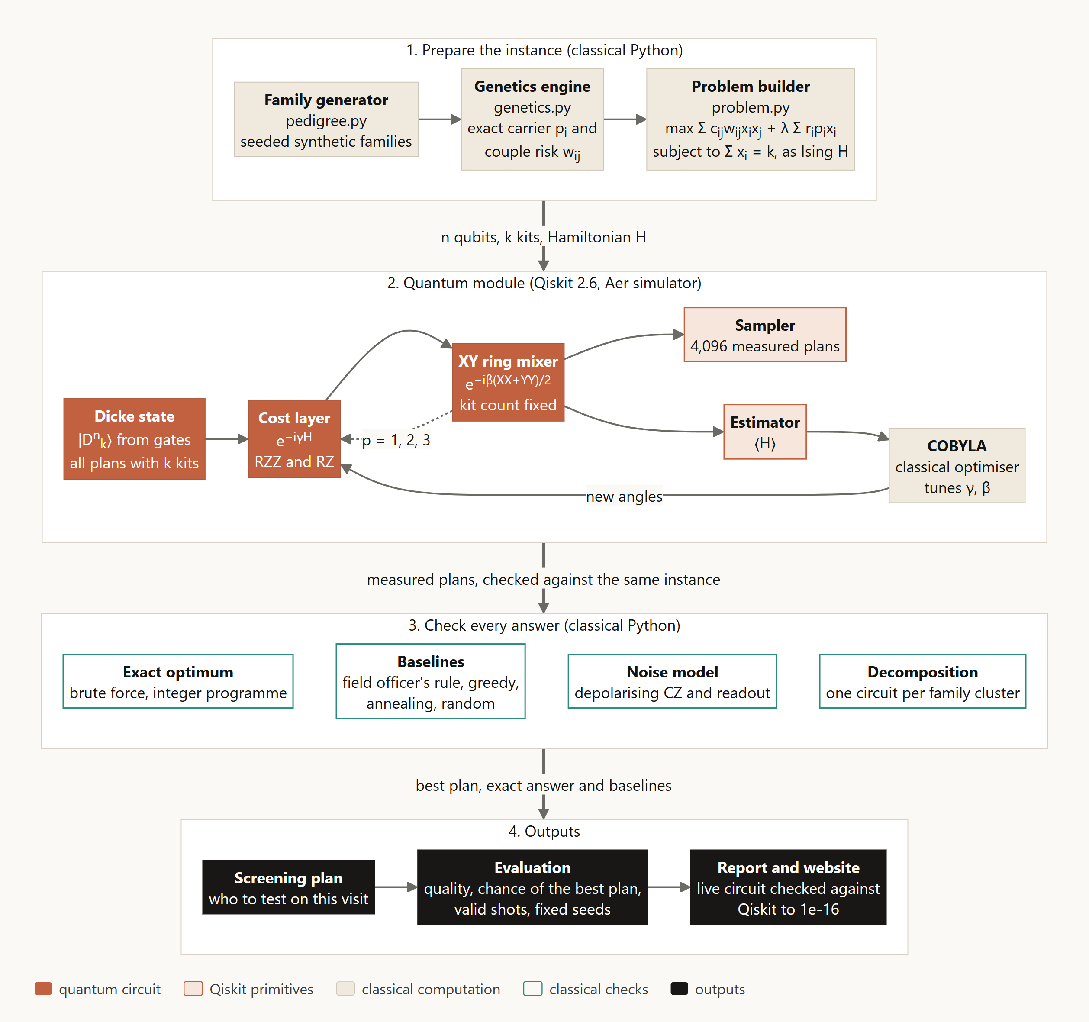
The circuit proposes, classical code checks
1
Prepare
family generator, exact genetics engine, problem builder
2
Quantum module
Dicke state, cost layer, XY mixer; Estimator, COBYLA and Sampler in Qiskit 2.6 on Aer
3
Check
brute force and integer programme for the exact optimum; field rule, greedy, annealing, random; noise model
4
Outputs
screening plan, evaluation, report, and a live website whose circuit matches Qiskit to 1e-16
Notes:
Four stages. Classical Python builds the instance and checks every answer against the exact optimum. The quantum module in Qiskit proposes the plans. 57 tests, pinned versions, fixed seeds, Docker image.

Slide 7
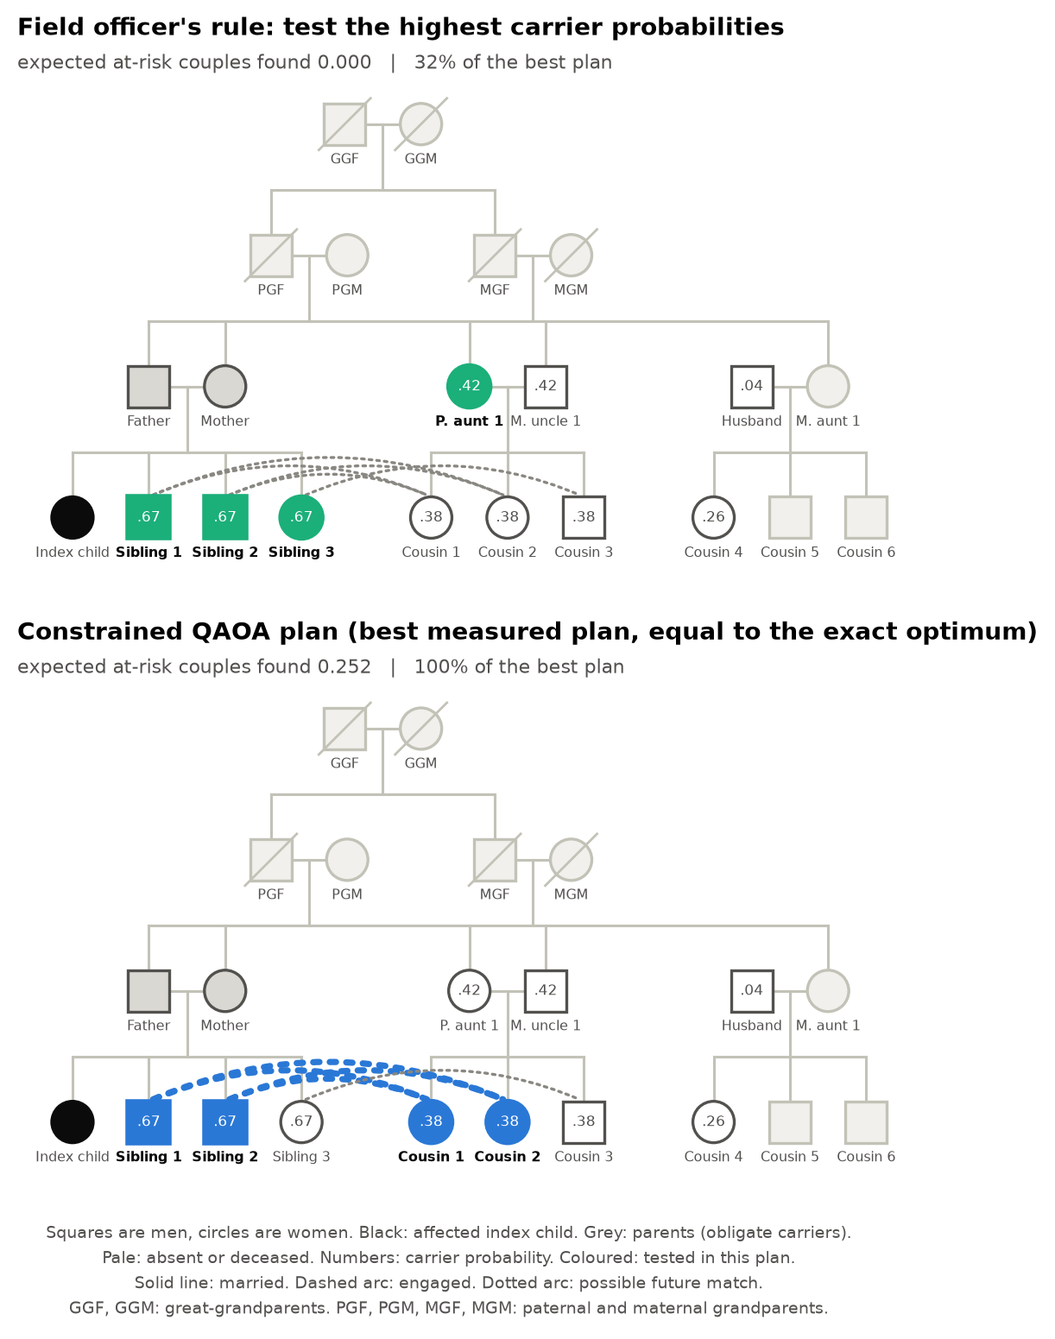
Live demo
kinship.sevenlabs.site
1
Watch the family being measured live: superposition, then one plan
2
Scroll: carrier probabilities, the field rule (0 couples), the QAOA plan (exact optimum)
3
Scroll the circuit: 210 equal plans become an 8.31% chance of the best one
4
Plan a visit: mark two cousins absent, the circuit re-plans in the browser
Notes:
Abdul Ahad runs the demo. 1. Overview: let the hero sit five seconds; each highlight is a real shot. 2. Scroll the hero: shading, field rule with zero couples, QAOA plan with two siblings and two cousins. 3. Circuit scroll: end on 8.31%. 4. Plan a visit: tap Cousin 1 and Cousin 2 absent; read the status line and the reason; press + for 5 kits. 5. Explore the circuit: penalty comparison. Backup: python -m kinship.demo.

Slide 8
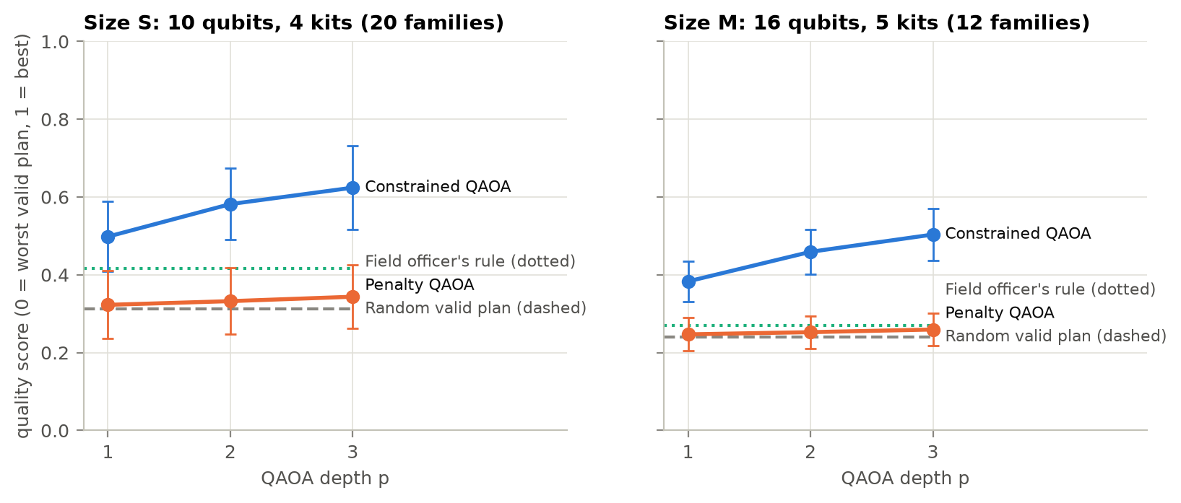
Measured against the exact answer, every time
Noise-free simulation, 20 families of 10 relatives and 12 of 16, depth 1 to 3
0.50
quality at 16 qubits, depth 3; random 0.24, field rule 0.27
32×
more often the best plan than a random pick (median 14×)
Linked families of 48 relatives and 12 kits were solved to the proven optimum, with circuits of at most 9 qubits.
Notes:
Faizan. Against the exact optimum: on 16 qubits constrained QAOA reaches quality 0.50, against 0.24 for random and 0.27 for the field rule, and one shot is the best plan 32 times more often than a random pick on average, median 14. Every shot is valid. Linked families of 48 people are solved to the proven optimum with circuits of at most 9 qubits.

Slide 9
What we do not claim
Said before anyone asks
No quantum speedup
Greedy beats QAOA
Brute force solves these sizes in milliseconds; annealing found the best plan in 92% of 16-qubit families
Greedy reaches 0.78 at 16 qubits; QAOA beats random and the field rule, not the stronger heuristics
Simulator only
Synthetic families
At 1% two-qubit noise only 37% of shots stay valid; the Dicke state alone costs 144 CZ gates
Calibrated to a 2002 study; one gene, a perfect test, one visit, and no patient data
Notes:
We do not claim a speedup. We show a problem QAOA represents directly, a circuit that cannot break the kit limit, and an honest comparison against exact answers. This is a method study on a new, real problem.

Slide 10
Where this goes next
1
Ask a thalassaemia centre
whether kits, lab slots or officer time is the real limit
2
Step-by-step testing
one result updates the next choice, beyond a single visit
3
Calibrate on programme data
real family structures from the Punjab project
4
Run on IBM hardware
the 10-qubit instance with angles trained on the simulator
Notes:
Next: confirm the binding constraint with a thalassaemia centre, model step-by-step testing, calibrate families against programme data, and run the smallest instance on a real IBM processor.

Slide 11
Four kits, two couples, the exact optimum
A real screening decision, written as a circuit that cannot break the rules, and checked against the exact answer every time.
Live site
kinship.sevenlabs.site
Code
github.com/AbdulAHAD968/Qiskit-IBM
Team
Syed Muhammad Saad Bukhari, Abdul Ahad, Faizan
Notes:
Thank you. Then questions: see DOCS/PITCH.md for the answers.

