Slide 1


Deep Fake Image Detection (DFID)
By
KARAR HANI HASHEM
Manar Falih

Slide 2
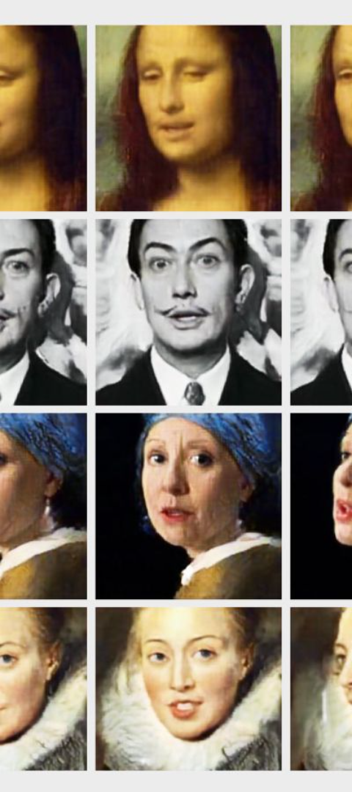
Introduction
1
Brief Overview
2
Rising Need for DFID
Deep fake technology: a looming challenge in the digital age.
Escalating demand due to the proliferation of deep fakes.
3
Previous Semester's Work
Initial studies and objectives laid the groundwork.

Slide 3
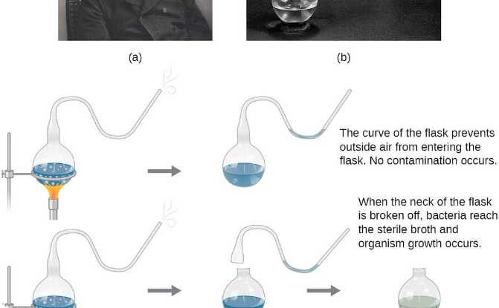

Previous Studies Recap
Key Findings Summary
Gap in Detection Methods
Overview of implications from our prior investigations.
Highlighting the inadequacy of existing detection mechanisms.

Slide 4

Objectives Defined
1
Develop a Robust DFID System
Creating a foolproof system to detect and counter deep fakes.
2
Evaluate Current Deep Learning Methods
Assessing the efficacy of existing methods in DFID.
3
Propose Improvements based on Gap Analysis
Enhancing detection through gaps identified in our prior studies.

Slide 5
Tools and Technologies Used
TensorFlow
JSON and NumPy
Matplotlib
A robust framework for building and training deep learning models.
For effective data handling, manipulation, and configuration management.
Empowering data visualization and results presentation.

Slide 6
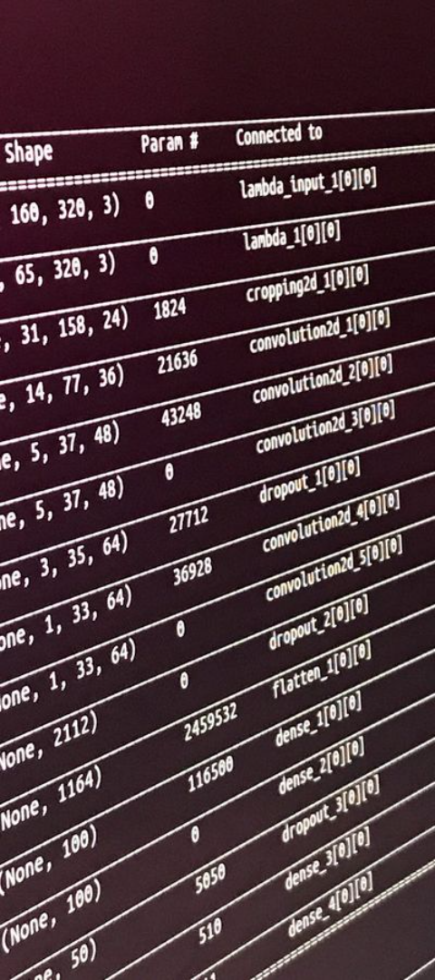
TensorFlow in DFID
1
Relevance to DFID
2
Model Creation
How TensorFlow's capabilities bolster deep fake detection.
Snippet to illustrate building a model using TensorFlow.
3
Architecture Choice
Discussing the selection of architecture for deep fake detection.

Slide 7



Data Handling and Visualization
JSON for Data Manipulation
NumPy for Manipulating Data
Matplotlib for Data Visualization
Demonstration of JSON's role in efficient data handling.
Exemplifying NumPy's role in numerical and matrix operations.
Highlighting the use of Matplotlib for presenting detection results.

Slide 8



Progress and Findings
Progress Summary
Preliminary Results
Insights from Tool Application
Highlights of the headway made in the second term.
Presenting initial outcomes applying the mentioned tools.
Realizations from deploying TensorFlow and related libraries in DFID.

