Slide 1
Hardware Design and Verification of Dilithium – Post Quantum Digital Signature Algorithm
M.Engg. Thesis defence by MUHAMMAD ABDUL AHAD (EL-25B5008) Supervised by
Assistant Prof Dr. Fahim ul haq
Co-supervised by
DR . SONIYA Shafi

Slide 2
Background
Classical schemes (RSA, ECC) rely on hard math problems.
With the increase of data, the need for data security is also increasing.
In order to protect our data, cryptographic algorithms are used.
Although these algorithms are too hard to solve for classical computers, quantum computers are able to solve them.
Since quantum computers are not yet standardized, this creates a threat called “Harvest Now, Decrypt Later.”
In order to combat this issue, post-quantum algorithms exist.

Slide 3
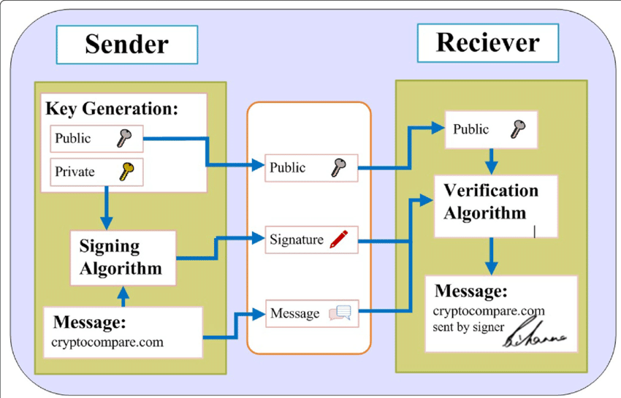
What is Dilithium?
Dilithium is a post-quantum digital signature algorithm.
A digital signature ensures three things:
Authentication – Verifies who sent the message.
Integrity – Ensures the message was not changed.
Non-repudiation – Sender cannot deny sending the message.

Slide 4
Literature Review
Classical schemes (RSA, ECC) rely on hard math problems.
Quantum Threats: Classical schemes (RSA, ECC) vulnerable to quantum attacks (Shor’s algorithm) → motivates PQC [1].
Lattice Cryptography: Bernstein et al.: lattice-based schemes secure & efficient; rely on hard problems like LWE [3].
Dilithium Design: Ducas et al.: strong unforgeability, practical key/signature sizes, uses polynomial arithmetic & NTT [2].
Software Challenges: Microcontroller/embedded implementations → high latency, memory use, energy consumption.
hardware outperforms general-purpose processors. Research Gap: Need modular, resource-efficient, verifiable hardware → addressed in this work.

Slide 5
PROBLEM STATEMENT
Software based implementations of CRYSTALS Dilithium suffer from high computational complexity, increased latency, and elevated power consumption
OBJECTIVE
Design and verify an efficient hardware architecture for Dilithium, implement key modules (polynomial arithmetic & NTT), and evaluate latency, area, and power.

Slide 6
Methodology
Classical schemes (RSA, ECC) rely on hard math problems.
Algorithm Analysis: Study reference C implementation to identify computational bottlenecks.
Architectural Decomposition: Break down key modules into dedicated hardware blocks
RTL Design & Integration: Implement modules in Verilog and integrate into full hardware design.
Functional Verification: Testbench-driven simulation to ensure correctness.
Performance Evaluation: Use FPGA synthesis tools to measure Latency , Resource utilization and Power consumption
Research Hypothesis: Hardware acceleration significantly improves Dilithium performance compared to software on embedded processors.

Slide 7
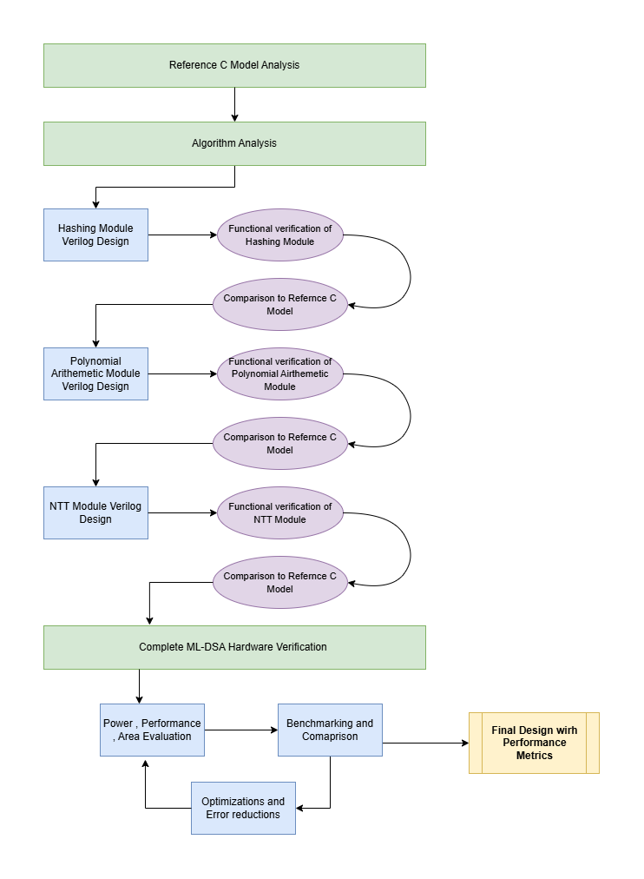
Methodology

Slide 8
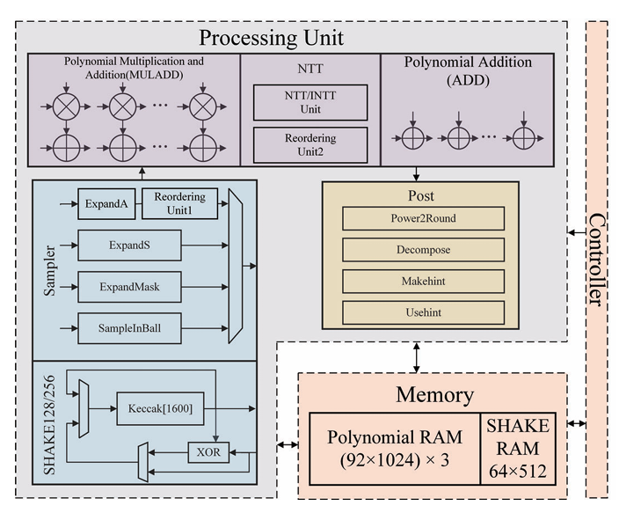
Dilithium High-Level Architecture
Fig. Dilithium High-Level Architecture. Reproduced from [4]

Slide 9






Dilithium Major Components
Classical schemes (RSA, ECC) rely on hard math problems.
Keccak engine (SHAKE-128/256)
Numeric Theoretic Transform (NTT) module (Poly Multiplication)
Memory
Sampler
Rounding/decomposition logic
Dilithium Main Controller

Slide 10
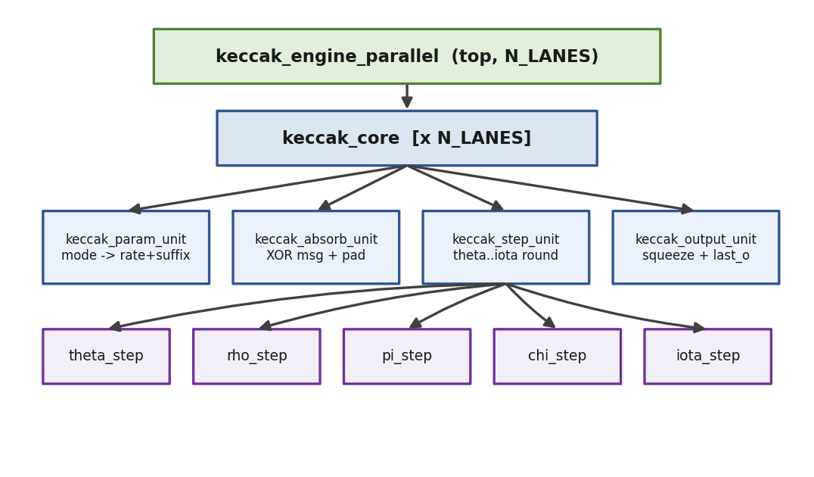
Keccak Engine - Design
Classical schemes (RSA, ECC) rely on hard math problems.
SHAKE128/SHAKE256 support
64-bit bus
one-round-per-cycle core
parameterized parallel lanes
4-lane speedup: 3.84x

Slide 11
Keccak Engine – Verification and Synthesis
Classical schemes (RSA, ECC) rely on hard math problems.
Cover group samples each completed SHAKE transaction
Cover points:
SHAKE mode: SHAKE128, SHAKE256
message length: empty, short, rate-boundary, multi-block
XOF length: continuous, small, medium, large
Cross coverage:
mode x message length
mode x XOF length
Results:
208/208 tests passed
100% functional coverage
Fmax: 84.31 MHz

Slide 12
Keccak Engine – Verification and Synthesis
Classical schemes (RSA, ECC) rely on hard math problems.

Slide 13
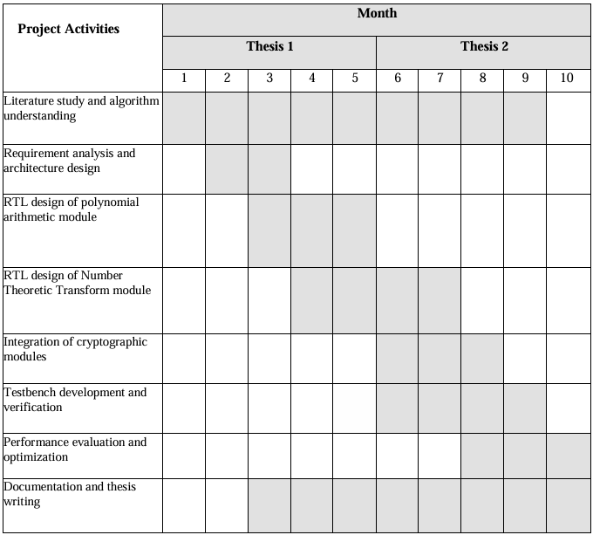
GANTT CHART

Slide 14
References
Classical schemes (RSA, ECC) rely on hard math problems.
National Institute of Standards and Technology, Post Quantum Cryptography Standardization Project, NIST, 2022.
Ducas, L., Kiltz, E., Lepoint, T., Lyubashevsky, V., Schwabe, P., Seiler, G., and Stehlé, D., CRYSTALS Dilithium: Algorithm Specifications and Supporting Documentation, NIST PQC Round 3, 2020.
Bernstein, D. J., Buchmann, J., and Dahmen, E., Post Quantum Cryptography, Springer, Berlin, 2009.
P. Sun, Q. Wang, and M. Ikeda, "PALS: A High-Speed ML-DSA Hardware Accelerator with Enhanced Pipeline on FPGA," in Proc. IEEE Int. Conf. Integrated Circuits, Technologies and Applications (ICTA), 2025, pp. 141–142, doi: 10.1109/ICTA68203.2025.11330133.

Slide 15
THANK YOU ! ☺

