Slide 1
Hardware Design and Verification of Dilithium – Post Quantum Digital Signature Algorithm
M.Engg IC Design Thesis by MUHAMMAD ABDUL AHAD (EL-25B5008) Supervised by
Assistant Prof Dr. Fahim ul haq
Co-supervised by
DR . SONIYA Shafi

Slide 2
Background
Data security demands are rapidly increasing.
Quantum computers threaten current cryptographic algorithms.
Sensitive data can be harvested today and decrypted later.
Post-quantum cryptography is designed to provide long-term security against quantum attacks.

Slide 3
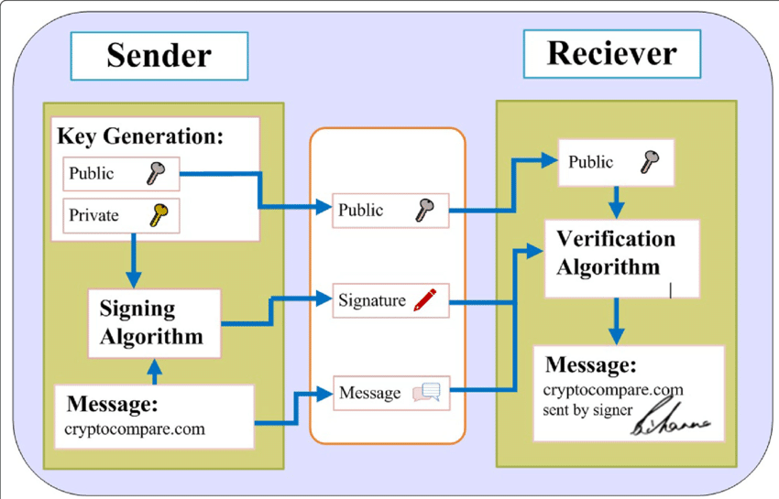
What is Dilithium?
Dilithium is a module lattice based post-quantum digital signature algorithm.
A digital signature ensures three things:
Authentication – Verifies who sent the message.
Integrity – Ensures the message was not changed.
Non-repudiation – Sender cannot deny sending the message.
Dilithium Operations
Key generation
Message signing
Verification

Slide 4
PROBLEM STATEMENT
Software based implementations of CRYSTALS Dilithium suffer from high computational complexity, increased latency, and elevated power consumption
OBJECTIVE
Design and verify an efficient hardware architecture for Dilithium, implement key modules (polynomial arithmetic & NTT), and evaluate latency, area, and power.

Slide 5
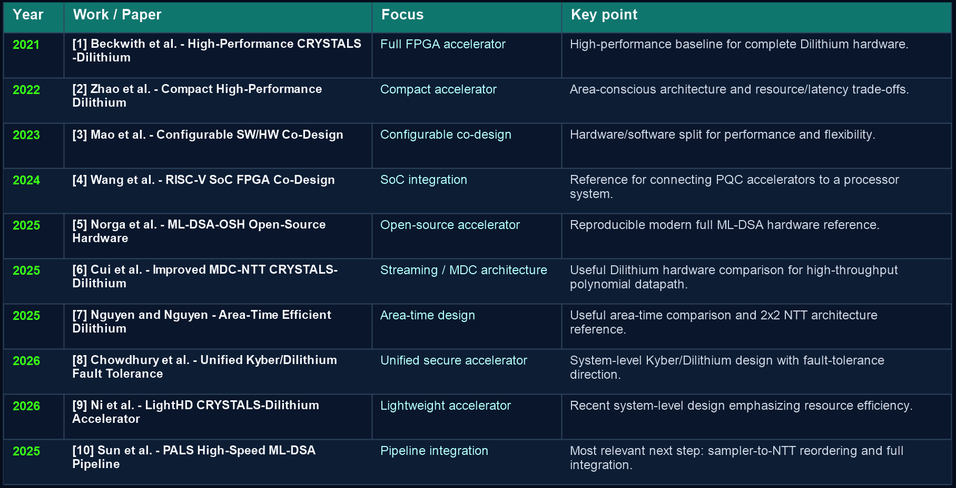
Hardware Literature Review

Slide 6
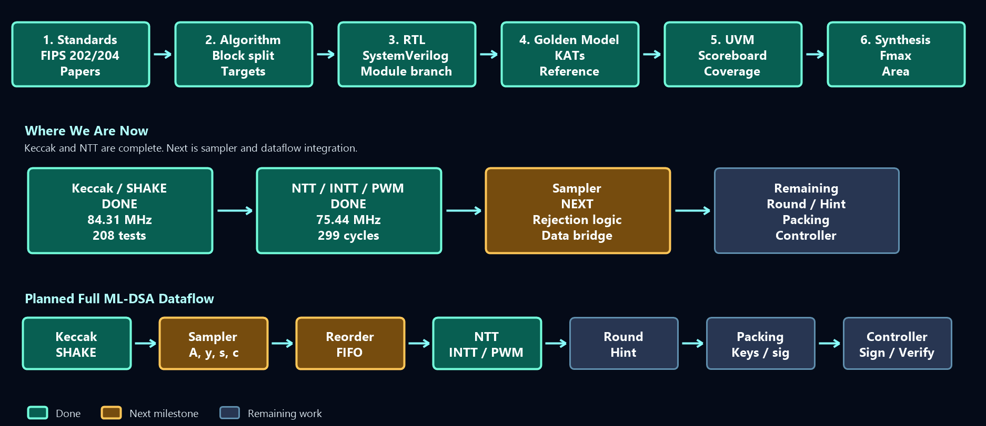
Methodology

Slide 7
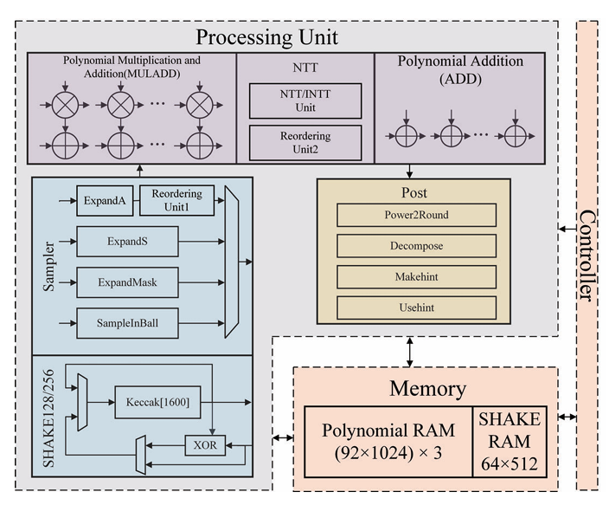
Dilithium High-Level Architecture
Fig. Dilithium High-Level Architecture. Courtesy- PALS 2025 [10]

Slide 8







Dilithium Major Components
Keccak engine (SHAKE-128/256) (Hashing)
Numeric Theoretic Transform (NTT) module (Poly Multiplication)
Memory
Sampler
Rounding/decomposition logic
Dilithium Main Controller

Slide 9
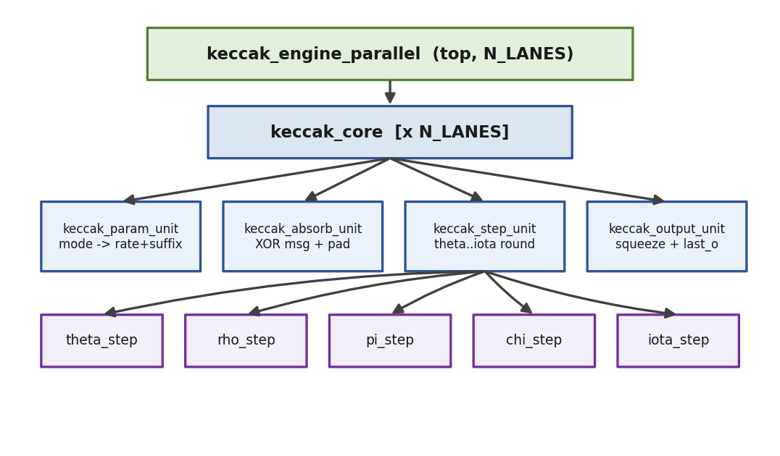
Keccak Engine – Design
Works on Sponge Construction
Absorb
Permute(θ -> ρ -> π -> χ -> ι)
Squeeze
24 permutation rounds (24 cyc/perm)
SHAKE128/SHAKE256 hashing support
64-bit bus
2-stage pipelined design (48 cyc/perm)
parameterized parallel lanes
4-lane speedup: 3.84x

Slide 10





Keccak Engine – Verification and Synthesis
Cover group samples each completed SHAKE transaction
Cover points:
SHAKE mode: SHAKE128, SHAKE256
message length: empty, short, rate-boundary, multi-block
XOF length: continuous, small, medium, large
Cross coverage:
mode x message length
mode x XOF length
Verified against System Verilog golden model
Results:
208/208 UVM tests passed
100% functional coverage
Fmax: 84.31 MHz (Cyclone V)
ALMS: 3,747 (4 Lanes)
Latency: 48 cyc/perm (2-stage pipeline)

Slide 11
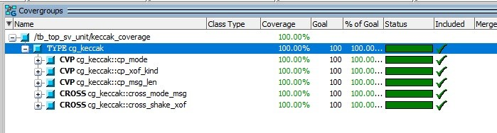

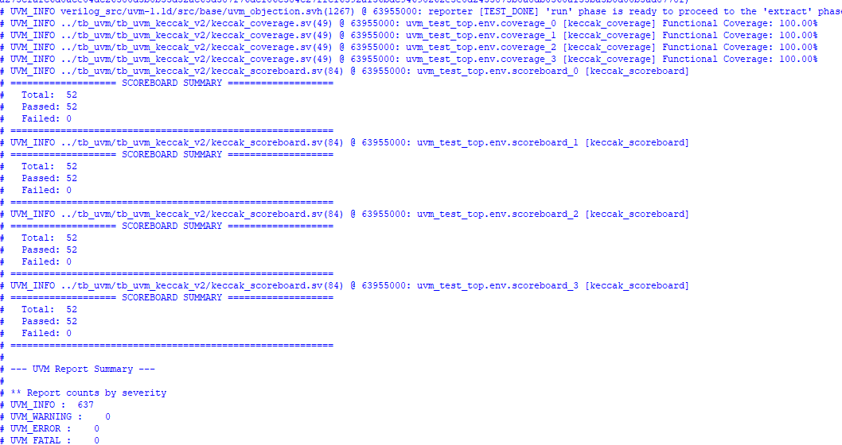
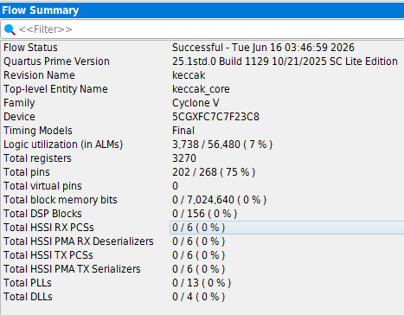
Keccak Engine – Verification and Synthesis Outputs

Slide 12
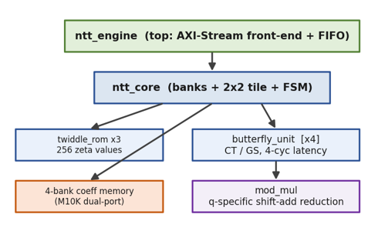



NTT – Design
FFT without Complex Numbers
Implements polynomial Multiplication over
Rq = Zq[x] / (x^256 + 1) , q = 8,380,417
Supports three operations:
forward NTT
inverse NTT with scaling
point-wise multiplication
Memory-based architecture with a 2x2 butterfly tile (4 Memory banks)
Uses Cooley-Tukey butterflies for forward NTT
Uses Gentleman-Sande butterflies for inverse NTT
q-specific shift-add modular reduction instead of Barrett reduction
299 cycles per NTT

Slide 13










NTT – Verification and Synthesis
Cover group samples each completed NTT transaction
Cover points:
Operation: forward NTT, inverse NTT, point-wise multiplication
Input pattern: zero, constant, random, boundary coefficients
Transform case: forward-only, inverse-only, round-trip
Output range: coefficients reduced modulo q
Cross coverage:
operation x input pattern
operation x coefficient range
transform case x edge case
Verified against System Verilog golden model
Results:
53/53 UVM tests passed
100% functional coverage
Fmax: 75.44 MHz (Cyclone V)
ALMS: 2,313 , DSPS: 6 , M10K: 18
Latency 299 cyc/ntt , 3.96 us

Slide 14
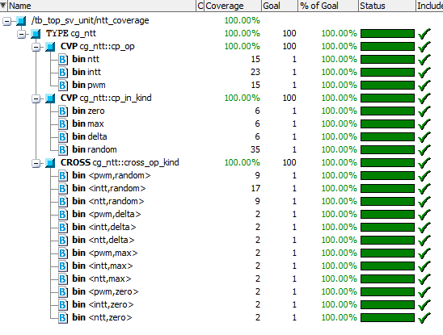

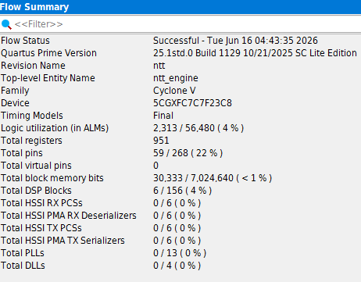
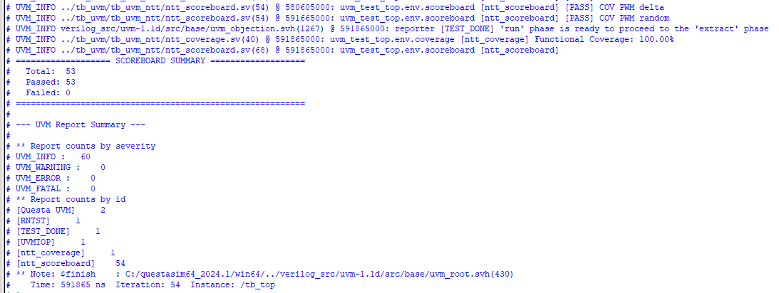
NTT – Verification and Synthesis Outputs

Slide 15
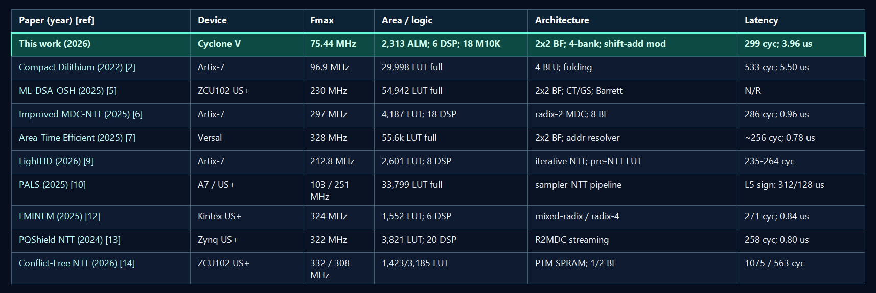
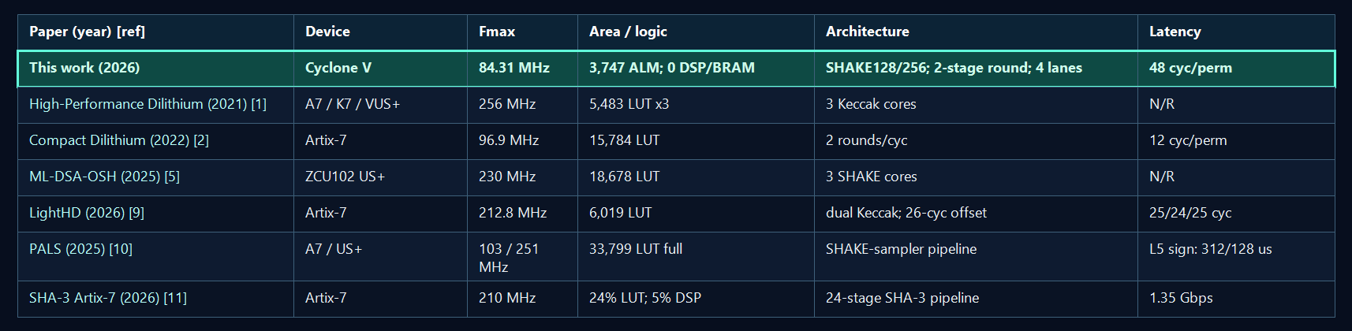
Comparison with published designs
NTT
KECCAK

Slide 16
Remaining Work
Sampler
Rounding/decomposition logic
Dilithium Main Controller and Module Integration
Complete Dilithium Verfication and Synthesis
end-to-end ML-DSA KAT verification

Slide 17
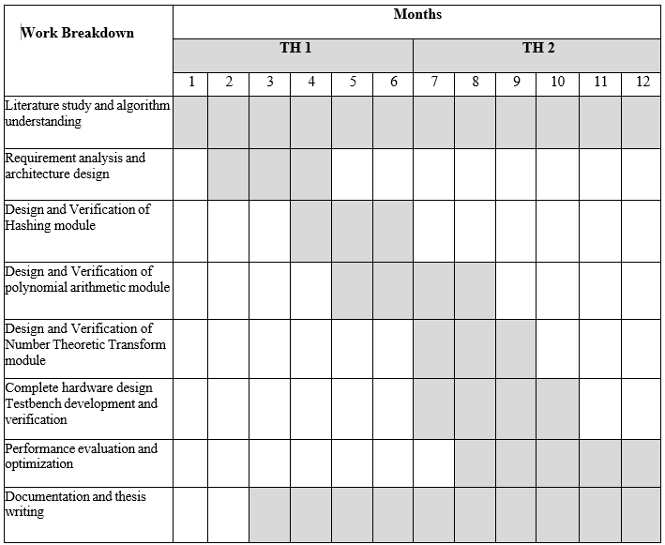













GANTT CHART

Slide 18
References
Classical schemes (RSA, ECC) rely on hard math problems.
[1] L. Beckwith, D. T. Nguyen, and K. Gaj, “High-Performance Hardware Implementation of CRYSTALS-Dilithium,” International Conference on Field-Programmable Technology, 2021.
[2] C. Zhao, N. Zhang, H. Wang, B. Yang, W. Zhu, Z. Li, M. Zhu, S. Yin, S. Wei, and L. Liu, “A Compact and High-Performance Hardware Architecture for CRYSTALS-Dilithium,” IACR Transactions on Cryptographic Hardware and Embedded Systems, vol. 2022, no. 1, pp. 270–295, 2022.
[3] G. Mao, D. Chen, G. Li, W. Dai, A. I. Sanka, C. K. Koc, and R. C. C. Cheung, “High-performance and Configurable SW/HW Co-design of Post-quantum Signature CRYSTALS-Dilithium,” ACM Transactions on Reconfigurable Technology and Systems, vol. 16, no. 3, Article 44, 2023.
[4] T. Wang, C. Zhang, X. Zhang, D. Gu, and P. Cao, “Optimized Hardware-Software Co-Design for Kyber and Dilithium on RISC-V SoC FPGA,” IACR Transactions on Cryptographic Hardware and Embedded Systems, vol. 2024, no. 3, pp. 99–135, 2024.
[5] Q. Norga, S. Kundu, and I. Verbauwhede, “ML-DSA-OSH: An Efficient, Open-Source Hardware Implementation of ML-DSA,” full version, 2025.
[6] Y. Cui, J. Zhong, B. Wang, T. Xu, C. Wang, and W. Liu, “High-Performance Hardware Implementation of CRYSTALS-Dilithium Based on Improved MDC-NTT,” IEEE Transactions on Computers, vol. 74, no. 9, pp. 2896–2908, September 2025.
[7] H. Nguyen and T. T. Nguyen, “Area-Time Efficient Hardware Design for CRYSTALS-Dilithium,” IEEE International Midwest Symposium on Circuits and Systems, 2025.
[8] S. Chowdhury, N. Mishra, S. Bhattacharya, and D. Mukhopadhyay, “Unified FPGA Design of Kyber and Dilithium with Provable Fault Tolerance,” IACR Cryptology ePrint Archive, Paper 2026/1008, 2026.
[9] Z. Ni, A. Khalid, Z. Zhang, Y. Cui, W. Liu, and M. O’Neill, “LightHD: A Lightweight and High-Performance Hardware Accelerator of CRYSTALS-Dilithium,” IEEE Transactions on Computers, vol. 75, no. 5, pp. 2007–2019, May 2026.
[10] P. Sun, Q. Wang, and M. Ikeda, “PALS: A High-Speed ML-DSA Hardware Accelerator with Enhanced Pipeline on FPGA,” IEEE International Conference on Integrated Circuits, Technologies and Applications, 2025.
[11] A. A. Abdulsamad and S. R. Repas, “Design of an Energy-Efficient SHA-3 Accelerator on Artix-7 FPGA for Secure Network Applications,” Computers, vol. 15, no. 1, article 3, 2026.
[12] Y. Tu and J. Xie, “EMINEM: Efficient FPGA Implementation of Mixed-RadIx NTT Hardware AccElerators for NIST Post-QuantuM Cryptography Falcon, Dilithium, and HAWK,” ACM Transactions on Reconfigurable Technology and Systems, vol. 18, no. 4, article 52, 2025.
[13] D. E. S. Kundi, J. M. Bermudo Mera, P.-Y. Strub, and M. Hutter, “High-Performance NTT Hardware Accelerator to Support ML-KEM and ML-DSA,” Workshop on Attacks and Solutions in Hardware Security, pp. 100–105, 2024.
[14] H. S. Ogawa, T. B. Paiva, M. A. Simplicio Jr., S. M. Hafiz, and B. Yildiz, “Efficient Conflict-Free NTT Hardware Architecture with Single-Port RAMs: Applications to ML-DSA,” IACR Cryptology ePrint Archive, Paper 2026/621, 2026.

Slide 19
THANK YOU ! ☺

