Slide 1

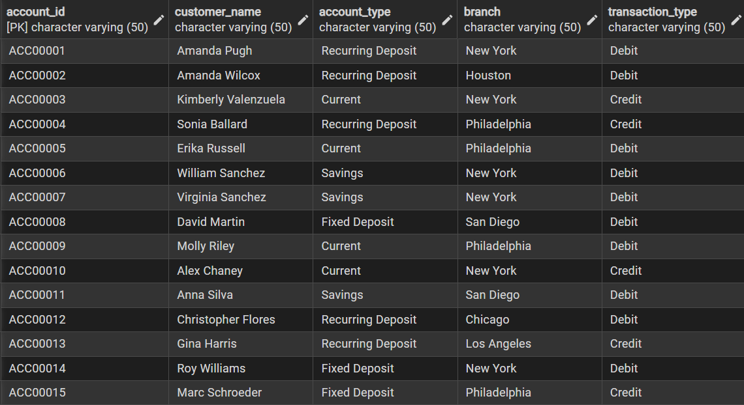
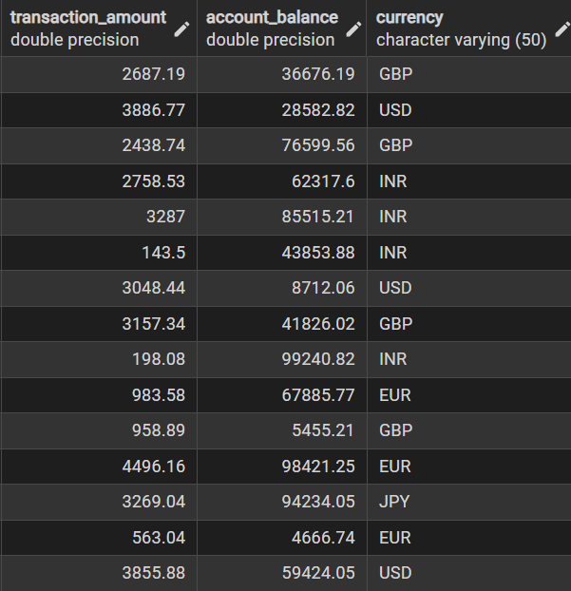
Raw Data Exploration (First-15 Rows)

Slide 2

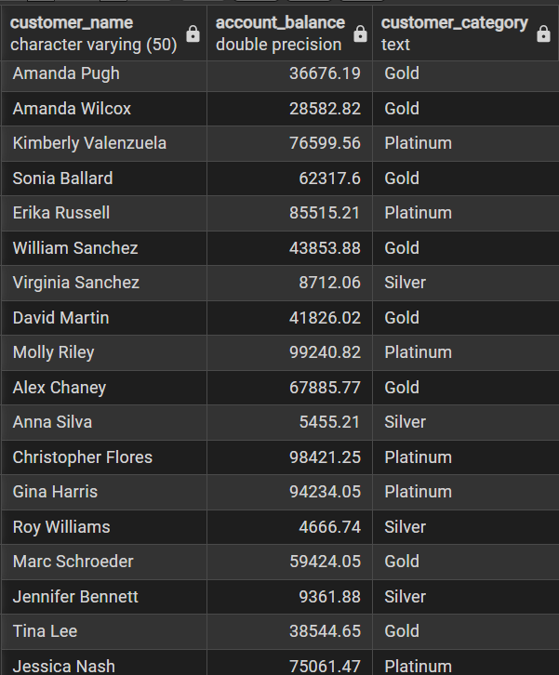

1. The Logical Query (Customer Categories)
2. The Financial Metric (Liquidity Ratio)

Slide 3

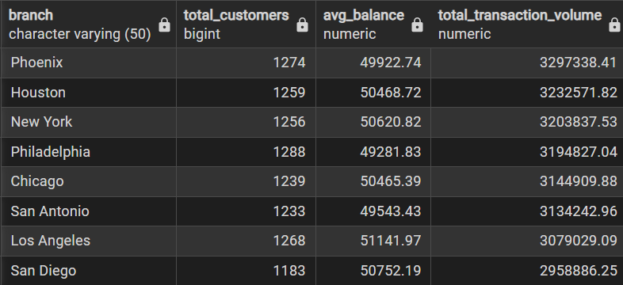

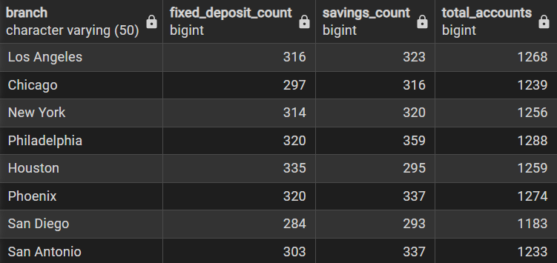
3. The Summary Master (Branch Performance)
4. The Deep Filter (Branch Account Breakdown)

Slide 4
