Slide 1
INDUSTRIAL ROBOT PERFORMANCE
Predictive Maintenance & Operational Risk Analytics
Power BI Capstone Project
From raw industrial data to executive decisions
250
Robots
2.9%
Defect Rate
214M
Maintenance Cost
20.59K hrs
Downtime
Prepared for academic / capstone presentation • September 2026

Slide 2
1. Project Overview
WHAT • WHY • PROBLEM
WHAT IS THIS PROJECT?
WHY THIS PROJECT?
• A Power BI analytics solution for monitoring industrial robot operations, health, maintenance and failure risk.
• Combines robot master data, sensor readings, production activity and maintenance history into one decision layer.
• Transforms operational records into KPIs, trends, risk categories and maintenance-priority insights.
• Unplanned downtime can disrupt production and increase maintenance cost.
• Sensor conditions such as temperature, vibration and motor current can indicate deteriorating robot health.
• Managers need a single view to prioritize risky robot types, manufacturers and failure modes.
PROBLEM STATEMENT
How can an organization use integrated operational and sensor data to identify unhealthy or high-risk robots,
understand the main causes of downtime and maintenance cost, and support proactive maintenance decisions?
PROJECT OBJECTIVES
• Monitor production & defect performance
• Measure robot health using sensor indicators
• Quantify downtime & maintenance cost
• Identify high-risk robot groups
• Turn analysis into actionable maintenance priorities
Industrial Robot Performance • Power BI Capstone
2

Slide 3
2. Dataset — Reference & Synthetic Data
KAGGLE → CUSTOM MODEL
KAGGLE REFERENCE
OUR SYNTHETIC DATASET
Industrial Machine Predictive Maintenance (syn)
• We did not use the Kaggle dataset as the final dashboard dataset.
• A custom synthetic industrial-robot dataset was created to fit the project requirements and Power BI model.
• The final model is robot-centric: 250 robots, multiple robot types and manufacturers, time-based sensor/production/maintenance records.
• The synthetic structure was designed to support realistic relationships, risk scoring and business scenarios.
Used as a reference for the predictive-maintenance feature design and industrial context. Its published features include vibration, motor temperature, current, RPM, ambient temperature, RUL, failure type and repair cost.
Kaggle reference: kaggle.com/datasets/tatheerabbas/industrial-machine-predictive-maintenance
Why synthetic? It allowed us to control the number of robots,
operational events, failure types and business metrics while keeping
the project reproducible and safe for a capstone.
DESIGN PRINCIPLE
• Reference real predictive-maintenance concepts → adapt to industrial robotics → generate consistent multi-table data → model in Power BI → build decision dashboards.
SCOPE
250
robots
2025–2026
analysis period
4
Excel fact/dimension files
3
dashboard pages
Industrial Robot Performance • Power BI Capstone
3

Slide 4
3. Dataset Architecture
FOUR EXCEL TABLES
Excel sheet | Role | Key fields / examples | What it contributes
Robot_Master.xlsx | Robot dimension | Robot_ID, Robot_Type, Manufacturer | One row per robot; core attributes used for grouping and filtering.
Sensor_Data.xlsx | Condition / sensor fact | Robot_ID, Date, Temperature, Vibration, Motor_Current, RPM, Torque, Energy_Consumption, Tool_Wear, Health_Score | Measures physical condition and robot health over time.
Production_Log.xlsx | Production fact | Robot_ID, Date, Units_Produced, Defects / production metrics | Measures throughput and quality performance.
Maintenance_Log.xlsx | Maintenance / failure fact | Robot_ID, Date, Maintenance_Type, Failure_Type, Cost, Downtime_Hours | Explains maintenance activity, failure causes, cost and downtime.
DATASET DESIGN
Robot dimension
Operational facts
Analytics-ready
Defines the population of 250 robots and their type/manufacturer context.
Sensor + production + maintenance tables capture different business processes.
Common Robot_ID and Date fields make the tables suitable for Power BI relationships.
Industrial Robot Performance • Power BI Capstone
4

Slide 5
4. Dataset Overview — What the Data Lets Us Analyze
DATA STORY
Robot_Master
Sensor_Data
WHO / WHERE Robot type • manufacturer • robot identity Enables slicers and comparisons by robot group.
HOW HEALTHY? Temperature • vibration • current • RPM • torque • energy • tool wear • health Supports condition monitoring and health relationships.
Production_Log
Maintenance_Log
HOW MUCH? Units produced • defects • date • robot Supports throughput and quality KPIs.
WHAT WENT WRONG? Maintenance type • failure type • cost • downtime • date • robot Links failures to financial and operational impact.
The four tables create a complete business chain: ROBOT → CONDITION → PRODUCTION → MAINTENANCE / FAILURE.
Industrial Robot Performance • Power BI Capstone
5

Slide 6
5. Power BI Data Model — Relationships
1:* RELATIONSHIPS
Robot_Master.xlsx
• Robot_ID (key)
• Robot_Type
• Manufacturer
Risk_Category is a helper/disconnected category table used to drive the High / Medium / Low risk distribution visual; it is not a transactional fact table.
1:*
1:*
1:*
Sensor_Data.xlsx
Production_Log.xlsx
Maintenance_Log.xlsx
• Robot_ID
• Date
• Sensor readings
• Health_Score
• Robot_ID
• Date
• Units / defects
• Robot_ID
• Date
• Failure / cost / downtime
1:*
1:*
1:*
Date Table
• Date • Month • Quarter • Year
• Time intelligence / trends
RELATIONSHIPS IMPLEMENTED
Industrial Robot Performance • Power BI Capstone
6

Slide 7
6. Measures & Risk Logic
ONLY THE DASHBOARD-CRITICAL METRICS
CORE OPERATIONAL MEASURES
RISK & MAINTENANCE MEASURES
• Total Robots
• Total Units Produced
• Defect Rate
• Average Health Score
• Average Temperature
• Average Vibration
• Average Motor Current
• Total Maintenance Cost
• Total Downtime Hours
• Average Risk Score
• High-Risk Robot Count
• Robots by Risk Category
• Average Risk Score by Robot Type
RISK MODEL
Robot Risk Score is a composite robot-level indicator built from the project's health / operational risk logic.
The score is translated into High, Medium and Low risk categories for management reporting.
The dashboard uses the resulting score and category measures rather than exposing every intermediate calculation.
Verified dashboard totals: 250 robots • 14M units produced • 2.9% defect rate • 47.35 average health • 214M maintenance cost • 20.59K downtime hours.
Industrial Robot Performance • Power BI Capstone
7

Slide 8
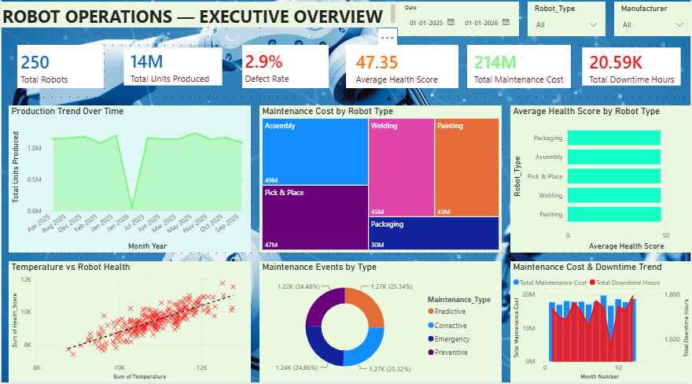
7. Dashboard Page 1 — Executive Overview
Executive decision layer
WHAT THIS PAGE SIGNIFIES
• Shows the overall operating picture: robot population, production, defect rate, average health, maintenance cost and downtime.
• Trend visuals show how production and maintenance cost move over time.
• Treemap / bar views expose where maintenance cost is concentrated across maintenance types and robot types.
• Business purpose: give management a fast answer to 'How are operations performing and where is cost concentrated?'
KEY BUSINESS INSIGHTS
• Assembly has the highest maintenance cost among robot types.
• Total maintenance cost is 214M while total downtime is 20.59K hours.
• The dashboard combines production, quality, health and maintenance in one executive view.
Executive takeaway: use this page to spot performance changes and cost concentration before drilling
into robot condition or risk.
Industrial Robot Performance • Power BI Capstone
8

Slide 9
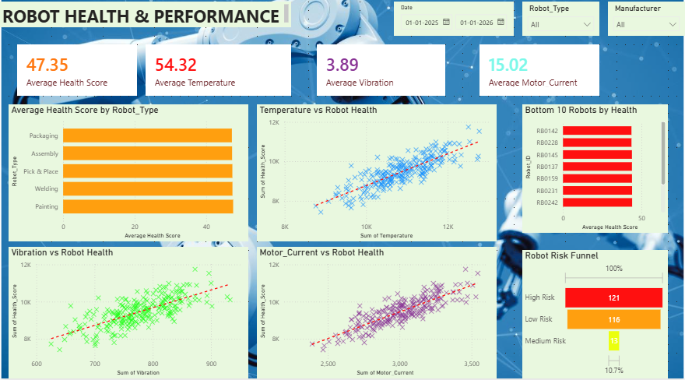
8. Dashboard Page 2 — Robot Health & Performance
Condition monitoring layer
WHAT THIS PAGE SIGNIFIES
• Focuses on robot health and the sensor signals that move with it.
• Health-by-robot-type compares condition across robot groups.
• Temperature, vibration and motor-current scatter plots show their relationship with robot health; trend lines make the direction of association easier to read.
• The bottom-10 health view highlights robots requiring closer inspection.
• The funnel summarizes the population by High / Medium / Low risk.
KEY BUSINESS INSIGHTS
• Average health score = 47.35.
• Robot 228 has the lowest average health score at 43.63.
• The risk funnel shows 121 High Risk, 116 Low Risk and 13 Medium Risk robots.
Health takeaway: sensor behavior and robot-level health identify where condition monitoring should become
more proactive.
Industrial Robot Performance • Power BI Capstone
9

Slide 10
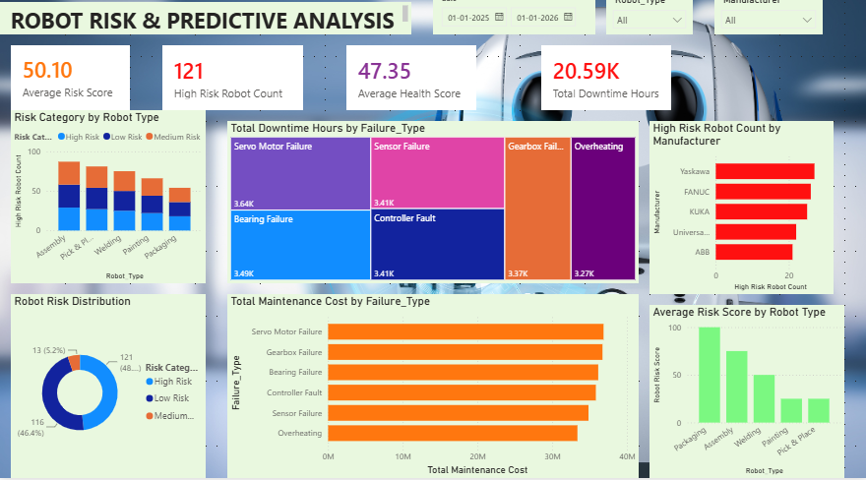
9. Dashboard Page 3 — Risk & Reliability
Risk-to-maintenance decision layer
WHAT THIS PAGE SIGNIFIES
• Combines risk concentration, failure impact, downtime and maintenance cost.
• Risk distribution shows the size of each risk category.
• Robot-type and manufacturer views identify where high-risk robots are concentrated.
• Failure-type treemaps and cost bars connect reliability problems to operational and financial impact.
• Average risk by robot type helps prioritize groups rather than only individual machines.
KEY BUSINESS INSIGHTS
• Packaging has the highest high-risk robot count: 100.
• Yaskawa has the highest absolute high-risk robot count: 27.
• Servo motor failure is the largest downtime driver: 218,542 hours, and also the largest maintenance-cost driver: 36,839,873.
• Robot 210 is #1 for downtime (8,842 hours) and maintenance cost (155,189).
Risk takeaway: prioritize maintenance where high risk, downtime and cost overlap — especially failure
modes and robot groups.
Industrial Robot Performance • Power BI Capstone
10

Slide 11
10. What Can Be Improved
NEXT ITERATION
Real-time data
Predictive ML
Connect the model to streaming / near-real-time sensor feeds so risk can be monitored continuously.
Train a failure / RUL model using historical sensor and maintenance data instead of relying only on a rule-based risk score.
Maintenance optimization
Alerting & automation
Add maintenance scheduling, spare-parts availability and technician capacity to move from diagnosis to optimized action.
Trigger alerts when risk crosses a threshold and integrate Power BI with operational workflows.
Data realism & governance
ROI tracking
Replace synthetic records with governed plant data; add validation rules, missing-data handling and lineage.
Add avoided downtime, avoided cost and maintenance ROI KPIs to quantify business value after interventions.
The current dashboard is a strong decision-support prototype. The next maturity step is to connect it to live data, predictive models and closed-loop
maintenance actions.
Industrial Robot Performance • Power BI Capstone
11

Slide 12
THANK YOU
Industrial Robot Performance
Predictive Maintenance & Operational Risk Analytics
Questions & Discussion

