Slide 1
Continuous Integration
I4SWT

Slide 2
Continuous Integration
A software development practice where members of a team integrate their work frequently, usually each person integrates at least daily – leading to multiple integrations per day. Each integration is verified by an automated build (including test) to detect integration errors as quickly as possible (…) Martin Fowler, 2006

Slide 3

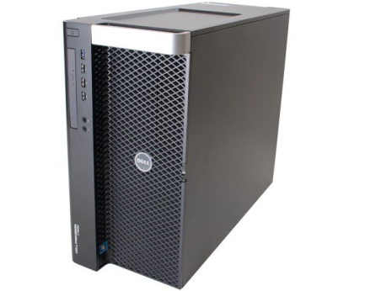
The principle
Workstation 1
Build server
Build application
+ ”Green Zone” tests
Code repository
Workstation 2
Fast integration:
Build application
+ ”Green Zone” tests
Nightly:
Build application
+ ”Green Zone” tests
+ Coverage
+ Integration tests
+ Code inspection
+ Reporting
+ …
Build application
+ ”Green Zone” tests
Notes:
At the workday’s start, each developer pulls the repo
Latest changes to working copy
Developers implement new features and tests for them.
When a feature is complete, the repo is pulled again and any changes integrated
Then, revised code and their tests are commited
Any broken builds on the CI server are top priority.

Slide 4
Benefits of CI
No ”integration hell” at the ”end” of a project
Never more than hours from working (deployable) build
Rapid feedback
Several graded builds (continuous, nightly, …)
Metrics for code and test quality never out of date
Certified and controlled runtime environment

Slide 5
Embedded benefits
Sharing of expensive or unique target hardware
http://www.slideshare.net/InfinITnetvaerk/swt14-mlapi-test-service
First steps toward continuous deployment/delivery
Even for embedded!

Slide 6
The setup at ASE
Student workstation
(on VPN)
Git server
https://github.com/user/repository
Jenkins server
http:// ci3.ase.au.dk:8080
Build application
+ ”Green Zone” tests
Student workstation
(on VPN)
Build application
+ ”Green Zone” tests

Slide 7
Trigger sequence

Slide 8
Steps on the way to Nirvana
End result: Build, tests, results
Git: Cloning, commiting, pushing and pulling – as last lecture with exercises
Jenkins: Configuring a new build project: demonstrated now

Slide 9
Important facts
Serveren hedder: ci3.ase.au.dk:8080
Opret jer med team181xx som brugernavn på Jenkins
Brug det aftalte password
Alle kan se/bygge/slette alle – lav evt. jeres eget view
Demoprojektet på Jenkins hedder
TemplateBuildTest
Brug genkendelige job navne – som I kan se i jeres view

