Slide 1
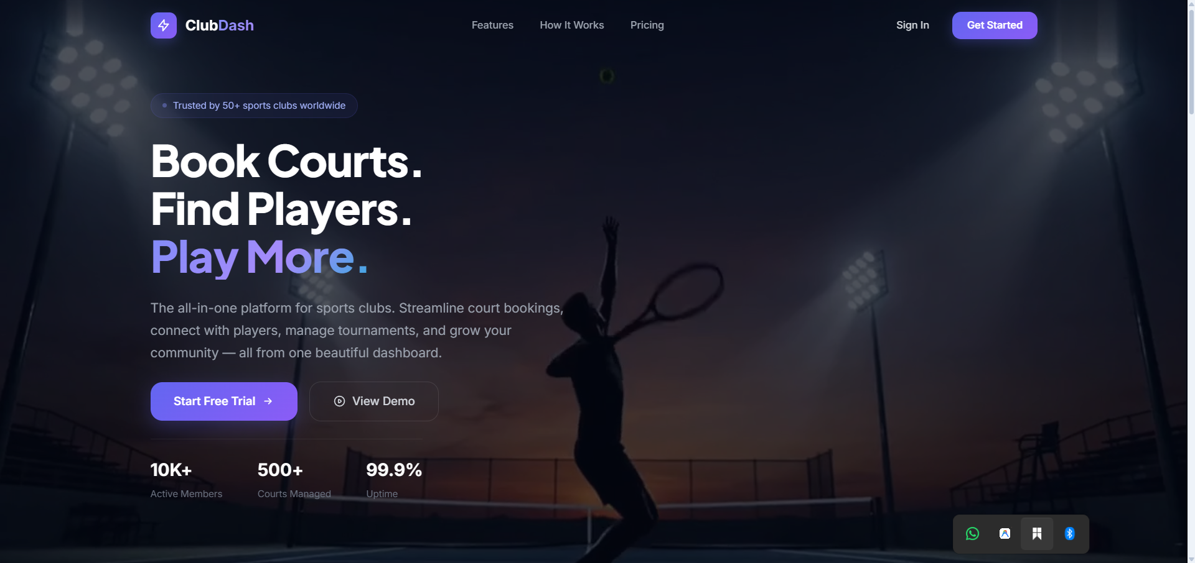
SOFTWARE ENGINEERING PROJECT
ClubDash
Sports Facility Booking
& Club Management
A unified platform for members, front-desk operations,
location-aware discovery and conversational assistance.
MEMBER
STAFF
AI
Vue 3 • Flask • Modular Monolith • Scrum / Agile
2026
SOFTWARE ENGINEERING PROJECT • 2026

Slide 2
CLUBDASH / PROBLEM → SOLUTION
02
From fragmented club operations to one connected workflow
Shared sports resources are limited; members, casual players and staff need different views of the same reservation state.
THE PROBLEM
THE SOLUTION
01
BOOKINGS
WhatsApp, spreadsheets or paper logs make conflicts harder to control.
✓
BOOK
Court, date, time and sport-aware availability.
02
AVAILABILITY
Members do not always see one clear source of truth for court status.
✓
MANAGE
Upcoming, past and active reservations.
03
OPERATIONS
Front desk needs a fast court × time view for the day.
✓
OPERATE
Front-desk availability, attendance and members.
04
DISCOVERY
Finding a nearby venue is often separate from the booking journey.
✓
DISCOVER
Bengaluru map, nearby venues and road routing.
CORE PRODUCT PRINCIPLE
One operational source of truth • multiple role-specific experiences
SOFTWARE ENGINEERING PROJECT • 2026

Slide 3
CLUBDASH / PRODUCT SCOPE
03
One platform. Four connected experiences.
Role-specific surfaces share the same application layer, reservation state and domain capabilities.
M
MEMBER
F
FRONT DESK
Discover, book, manage and engage.
Operate the club in real time.
Dashboard • Book a Court • Nearby Courts • My Bookings
Bookings • Availability • Attendance • Members
P
PUBLIC
AI
CLUBDASH AI
Explain the product before authentication.
Natural-language access to live club information.
Landing • Sign in • Create account
Member + Staff • role-aware • Phase 1 read-only
PUBLIC
→
MEMBER / STAFF WORKSPACES
→
AI ASSISTANCE
SOFTWARE ENGINEERING PROJECT • 2026

Slide 4
CLUBDASH / ARCHITECTURE
04
A modular monolith with explicit domain boundaries
Simple deployment model; explicit contracts between business capabilities. AI is an additional application layer, not a replacement for core services.
EXPERIENCE
Member portal • Front desk portal • Public site • AI widget
ARCHITECTURAL SEAM
↓
PUBLIC FACADE
APPLICATION
Flask API • authentication • role checks • assistant controller
Interfaces + DTOs
↓
↓
INTERNAL
DOMAIN
Users • Memberships • Bookings • Events • Payments • Attendance
Business logic + data access
Not imported directly by other modules.
↓
INFRASTRUCTURE
Database / ORM • OpenAI Responses API • OSRM • OpenStreetMap
This keeps responsibilities explicit
while avoiding unnecessary distributed-system complexity.
SOFTWARE ENGINEERING PROJECT • 2026

Slide 5
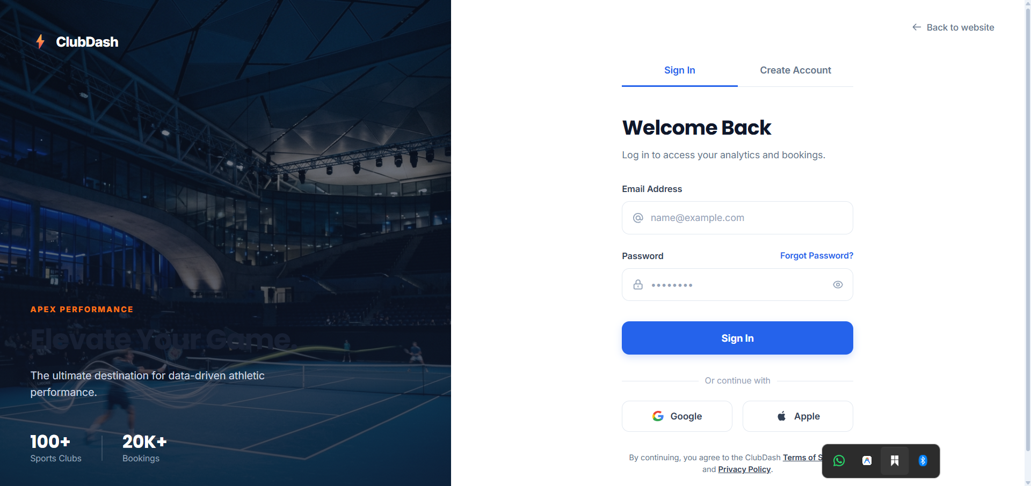
CLUBDASH / PUBLIC EXPERIENCE
05
A product-first entry point before authentication
The public surface establishes the promise; authentication then creates the role-aware workspace.
LANDING
Book courts. Find players. Play more.
AUTHENTICATION
Sign in / Create Account + Google / Apple
SOFTWARE ENGINEERING PROJECT • 2026

Slide 6
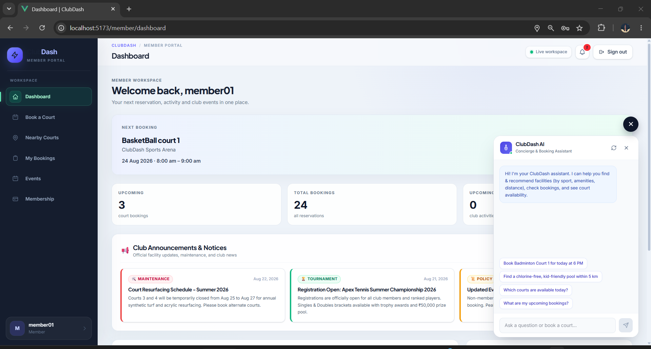
CLUBDASH / MEMBER WORKSPACE
06
The dashboard is the member's command center
Next reservation, booking metrics, club notices and the embedded AI concierge are available without leaving the authenticated workspace.
★ CLUBDASH AI
Floating concierge inside the
existing member workspace.
3
24
UPCOMING
TOTAL
AI
Persistent assistance
Ask about bookings, events, availability, membership and club information without switching pages.
SOFTWARE ENGINEERING PROJECT • 2026

Slide 7
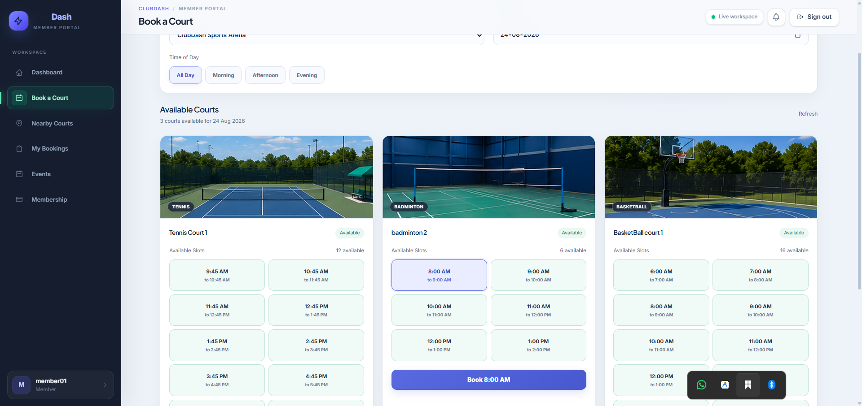
CLUBDASH / COURT BOOKING
07
Availability is surfaced exactly where the booking decision happens
Members choose club and date, compare sport-specific courts, then select an available time slot.
01
CONTEXT
Club + date + time-of-day
02
SPORT
Tennis / badminton / basketball
03
AVAILABILITY
Selectable time slots
04
ACTION
Book the selected slot
SOFTWARE ENGINEERING PROJECT • 2026

Slide 8
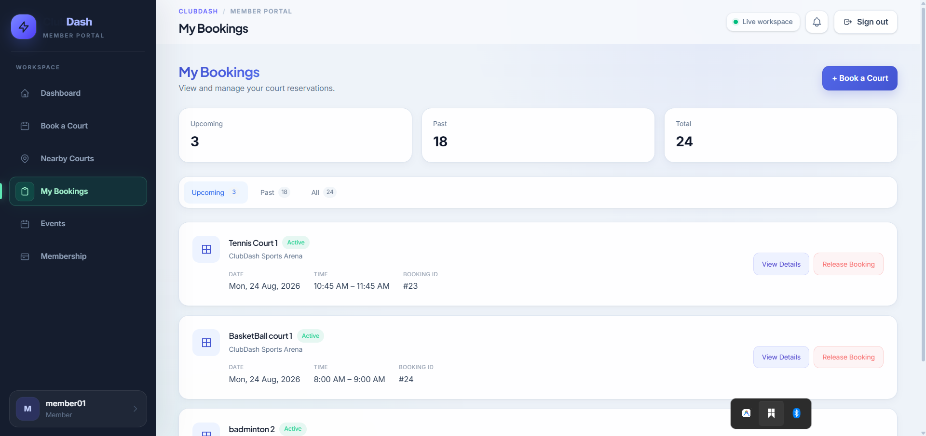
CLUBDASH / BOOKING LIFECYCLE
08
My Bookings turns reservations into a manageable record
Upcoming, past and total activity are visible at a glance, with traceable booking IDs and release controls.
3
18
24
1
Upcoming / Past / All
UPCOMING
PAST
TOTAL
Fast filtering by reservation state.
2
Booking ID
Each reservation has a traceable identifier.
3
View details
Inspect a reservation without leaving the workflow.
4
Release booking
Clear action for cancelling an active reservation.
SOFTWARE ENGINEERING PROJECT • 2026

Slide 9
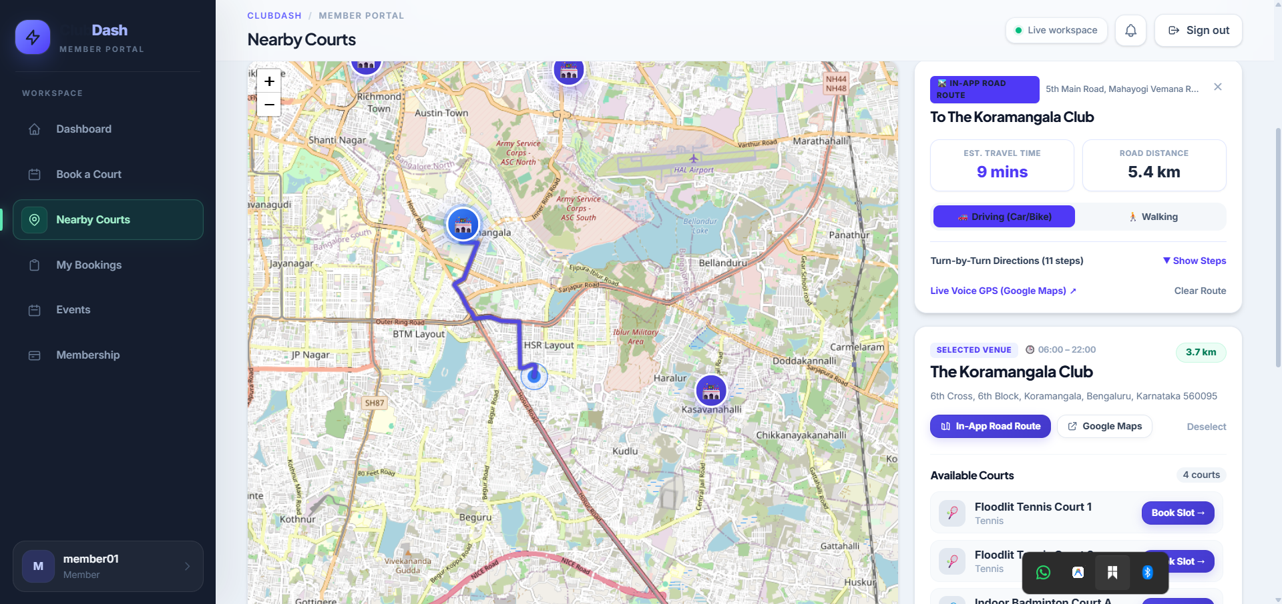
CLUBDASH / LOCATION DISCOVERY
09
Nearby Courts turns location into a booking decision
Map-based discovery combines venue selection, road-route context, ETA and court-level availability.
01
NEARBY VENUES
Map markers surface facilities around the member.
02
ROAD ROUTE
In-app route shows distance and estimated travel time.
03
COURT-AWARE
Selected venue exposes available courts and sport types.
04
EXTERNAL NAVIGATION
Google Maps handoff is available for live navigation.
SOFTWARE ENGINEERING PROJECT • 2026

Slide 10
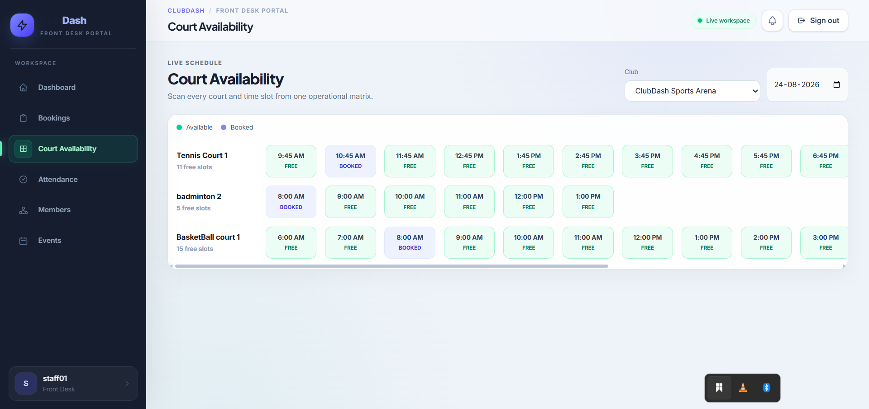
CLUBDASH / FRONT-DESK OPERATIONS
10
Staff get an operational view of every court and slot
The front-desk portal is optimized for scanning the day quickly and acting on availability.
FREE
Visible availability
BOOKED
Committed capacity
COURT × TIME
Each row maps a court to its schedule
FAST SCANNING
Dense information without losing status clarity
SOFTWARE ENGINEERING PROJECT • 2026

Slide 11
CLUBDASH / SHARED SOURCE OF TRUTH
11
One reservation state. Different jobs-to-be-done.
A member booking becomes an operational commitment visible to the front desk — without duplicating business logic.
M
MEMBER • “I booked this slot.”
F
FRONT DESK • “This slot is booked.”
My Bookings
Court Availability
Tennis Court 1
ACTIVE
SYNC
Tennis Court 1
10:45 AM
BOOKED
Mon, 24 Aug, 2026
→
10:45 AM – 11:45 AM
badminton 2
9:00 AM
FREE
Booking ID #23
BasketBall court 1
8:00 AM
BOOKED
Same state. Different job-to-be-done.
SOFTWARE ENGINEERING PROJECT • 2026

Slide 12
CLUBDASH / CLUBDASH AI
12
ClubDash AI: a controlled conversational layer over live club data
The assistant reduces navigation friction while preserving the existing REST/API, authorization and service boundaries.
USER INTENT
PHASE 1 / READ ONLY
“What are my upcoming bookings?”
1
MEMBER TOOLS
2
STAFF TOOLS
↓
get_my_bookings • get_events • get_availability
get_my_membership • get_club_information
get_staff_dashboard • get_staff_bookings
get_staff_attendance • get_court_status
POST /api/v1/assistant/chat
↓
ROLE-AWARE TOOL SELECTION
3
MODEL
4
CONTROL
↓
LIVE CLUB DATA
OpenAI Responses API
Server-side client • tool calling • multi-turn state
JWT authentication • backend authorization
OpenAI key never exposed to Vue
NO DIRECT DATABASE ACCESS • NO WRITE TOOLS IN PHASE 1
SOFTWARE ENGINEERING PROJECT • 2026

Slide 13
CLUBDASH / AI ARCHITECTURE & SECURITY
13
AI is an application layer — not a privileged shortcut
The model selects only approved server-side functions; the Flask backend executes them through existing ClubDash services.
VUE 3
→
FLASK
→
SERVICE
→
OPENAI
Assistant Widget
Assistant Controller
Assistant Service
Responses API
↓
↓
TOOLS
CLUBDASH
Restricted Registry
→
Services / DB
✓
SECURITY / CONTROL BOUNDARY
JWT user + role → approved tools only → existing services → live data. Browser cannot grant itself staff access; OpenAI API key remains server-side.
SOFTWARE ENGINEERING PROJECT • 2026

Slide 14
CLUBDASH / CAPABILITY MAP
14
Where each product capability lives
Role separation is explicit, and the current AI scope is deliberately read-only.
CAPABILITY
MEMBER
FRONT DESK
AI — PHASE 1
Court booking
✓
✓
—
Live availability
✓
✓
✓
Nearby clubs + route
✓
—
facility discovery
My bookings / release
✓
✓
✓
Events / registration
✓
✓
✓
Membership information
✓
✓
✓
Attendance
—
✓
✓
PHASE 1 AI BOUNDARY • No create booking, cancellation, reschedule, event registration, check-in/out or membership/club edits.
Court status
—
✓
✓
SOFTWARE ENGINEERING PROJECT • 2026

Slide 15
CLUBDASH / DEMO NARRATIVE
15
Present ClubDash as one continuous user journey
The strongest demonstration connects discovery, booking, operations and conversational assistance instead of showing isolated screens.
01
02
03
04
05
06
ENTER
→
ORIENT
→
BOOK
→
DISCOVER
→
MANAGE
→
ASSIST
Landing → Sign in
Dashboard → next booking + notices
Book a Court → select slot
Nearby Courts → venue + route + courts
My Bookings → details / release
AI Concierge → live information
LIVE DEMO ORDER
Book → verify in My Bookings → switch to Front Desk → show the slot as BOOKED → ask ClubDash AI for live information.
SOFTWARE ENGINEERING PROJECT • 2026

Slide 16
CLUBDASH / ENGINEERING & PRODUCT STRENGTHS
16
The value is in the integration between workflows
The strongest part of ClubDash is not one screen — it is the connection between booking state, operations, discovery and conversational access.
01
ROLE-AWARE UX
02
SHARED STATE
03
REAL LOCATION CONTEXT
Member and front-desk views solve different operational jobs.
Bookings and availability stay consistent across experiences.
Nearby Courts adds geolocation and road routing to discovery.
04
CONTROLLED AI
05
MODULAR BACKEND
06
DEMO-READY FLOW
Server-side tools and read-only Phase 1 preserve the security boundary.
Domain boundaries create a maintainable evolution path.
The product can be demonstrated end-to-end from login to AI.
PRODUCT STORY
BOOK → MANAGE → DISCOVER → ASSIST
SOFTWARE ENGINEERING PROJECT • 2026

Slide 17
CLUBDASH / CLOSING
17
CLUBDASH
Book courts.
Run the club.
Assist every member.
BOOK
OPERATE
One connected platform for member self-service,
front-desk visibility, location-aware discovery and ClubDash AI.
DISCOVER
BOOK
OPERATE
DISCOVER
ASSIST
Court reservations
Front-desk visibility
Nearby courts + routing
AI
Role-aware AI
SOFTWARE ENGINEERING PROJECT • 2026
ClubDash

