Slide 1
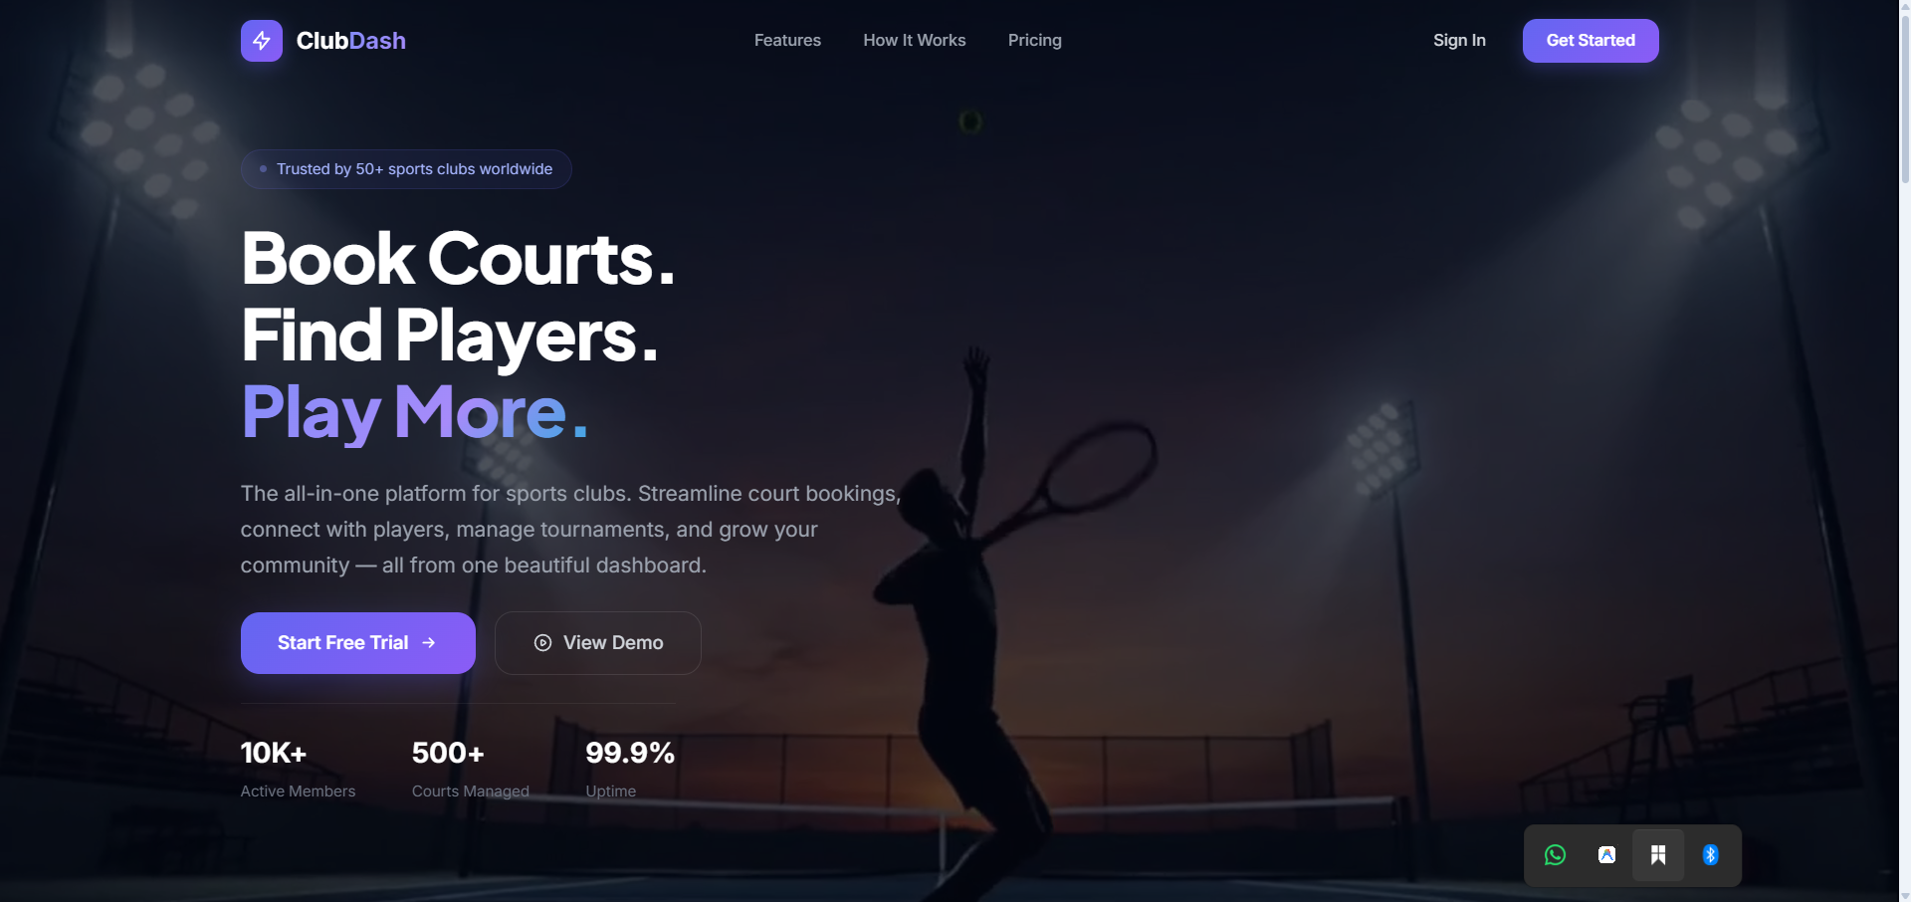
SOFTWARE ENGINEERING PROJECT
ClubDash
Sports Facility Booking
& Club Management System
From stakeholder research to one connected platform for members, staff and administrators.
SITUATION → TASK → ACTION → RESULT
TEAM 096
Member • Front Desk • Admin • ClubDash AI
Final Video Presentation

Slide 2
01 / STAR FRAMEWORK
02
The story behind ClubDash
Start with the problem, then show how research became the product.
S
SITUATION
T
TASK
A
ACTION
R
RESULT
Sports clubs often manage bookings, availability and communication through phone calls, WhatsApp and spreadsheets.
Create one centralized system that makes booking easier and gives staff and administrators a reliable operational view.
Interview stakeholders, derive user stories and build role-based workflows around shared club data.
Connect discovery, booking, reservations and club operations in one platform.
Problem
→
Research
→
Requirements
→
Implementation
→
Working product
CLUBDASH • TEAM 096 • 2026

Slide 3
02 / RESEARCH
03
We started with stakeholders, not screens
Six interviews helped us understand how the club was actually being used.
P
PRIMARY USERS
S
OPERATIONAL USERS
6
Permanent members and casual players use the system to discover, book and manage facilities.
Front-desk staff need booking, availability and attendance visibility.
stakeholder
interviews
A
MANAGEMENT
→
METHOD
5 Permanent Members
1 Front Desk Executive
Administrators need centralized management and operational visibility.
Semi-structured interviews focused on the existing process and pain points.
Key principle: features were derived from research rather than assumed from the UI.
CLUBDASH • TEAM 096 • 2026

Slide 4
03 / PAIN POINTS
04
Five recurring problems shaped the requirements
These are the reasons the product exists.
01
Fragmented booking
02
Manual scheduling
Phone calls and WhatsApp make reservations harder to control.
Staff spend time checking and updating schedules.
03
Peak-hour congestion
04
Missed announcements
Busy periods need clearer visibility of available capacity.
Important club information can be scattered across channels.
05
Manual records
Attendance and operational records require repeated manual work.
CLUBDASH • TEAM 096 • 2026

Slide 5
04 / TRACEABILITY
05
From interview finding to implemented feature
A direct chain connects research evidence to the final system.
RESEARCH FINDING
PAIN POINT
USER STORY / NEED
IMPLEMENTED RESPONSE
Phone / WhatsApp booking
Fragmented booking
Member wants to book online
Book a Court + availability + My Bookings
Manual booking updates
Booking conflicts
Front Desk wants reliable updates
Shared booking state + staff availability
Busy / peak hours
Peak congestion
Need clear slot visibility
Court/time availability view
Manual attendance
Manual records
Staff need attendance support
Attendance + check-in / check-out
Client booking-agent direction
Navigation friction
Users want easier access to club info
ClubDash AI + controlled tools
Interview → Finding → Pain Point → User Story → Requirement → Feature
CLUBDASH • TEAM 096 • 2026

Slide 6
05 / TASK → SOLUTION
06
One platform, different jobs-to-be-done
The roles are different, but they work on the same underlying club data.
MEMBER
FRONT DESK
ADMIN
Discover • Book • Manage
Operate the day
Manage the club
Dashboard
Book a Court
My Bookings
Memberships • Events
Nearby Courts
Bookings
Court availability
Members
Attendance
Operational status
Members
Bookings
Events
Announcements
Analytics
PUBLIC
→
MEMBER
→
STAFF
→
ADMIN
CLUBDASH • TEAM 096 • 2026

Slide 7
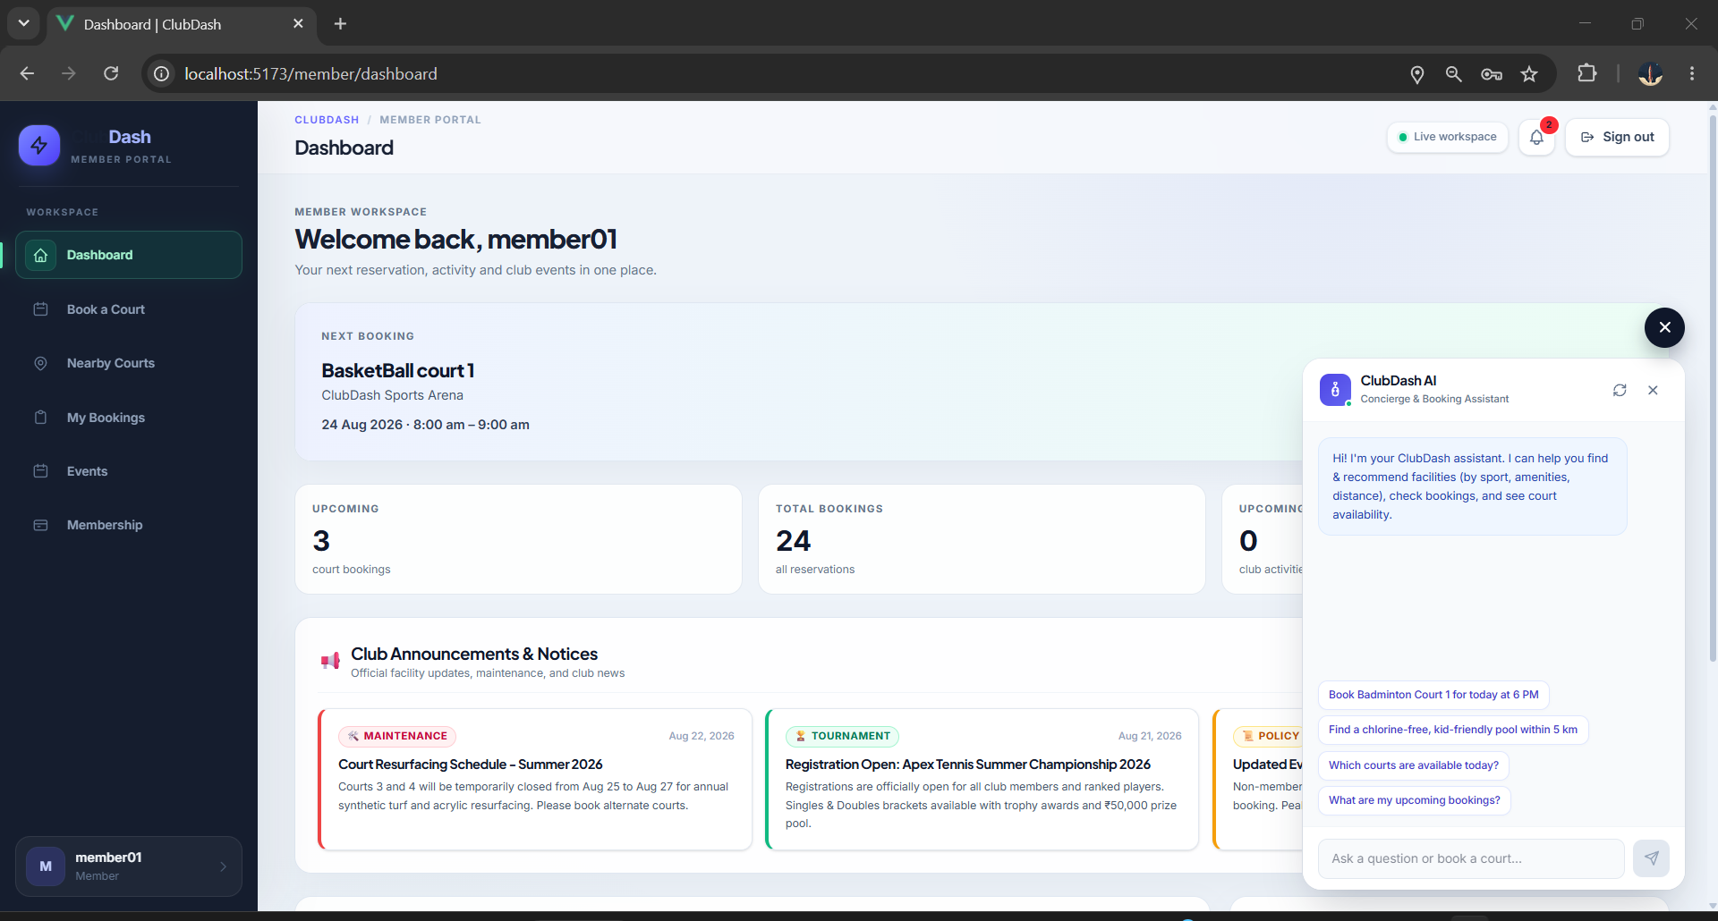
06 / ACTION — MEMBER
07
The member starts from one central dashboard
The dashboard brings the next booking, booking metrics, notices and AI assistance together.
MEMBER FLOW
Login → Dashboard
•
See upcoming reservation
•
View booking totals
•
Read club notices
•
Open ClubDash AI
CLUBDASH • TEAM 096 • 2026

Slide 8
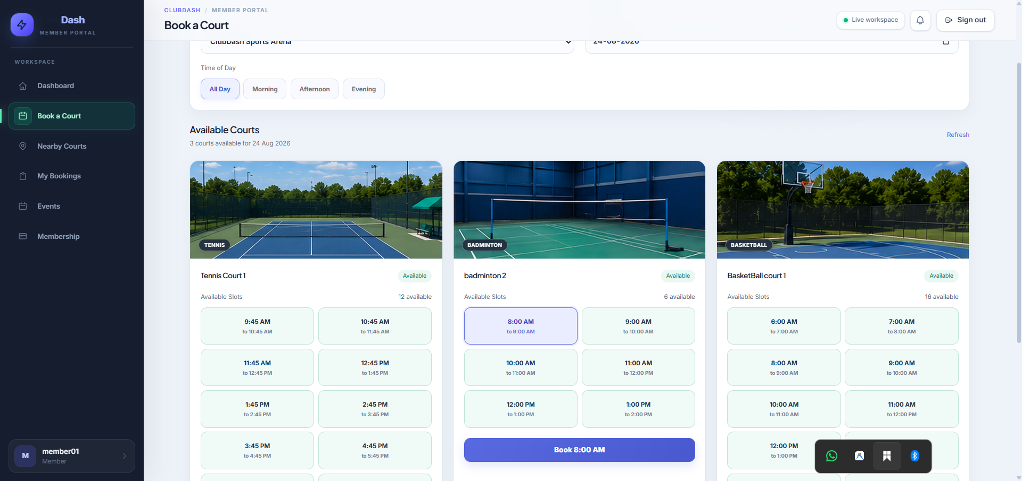
07 / ACTION — BOOKING
08
Availability is checked before the reservation is created
The booking flow directly addresses fragmented booking and conflict problems.
SMART BOOKING
•
Select club and date
•
Choose sport / court
•
See available slots
•
Past-time protection
•
Conflict validation
CLUBDASH • TEAM 096 • 2026

Slide 9
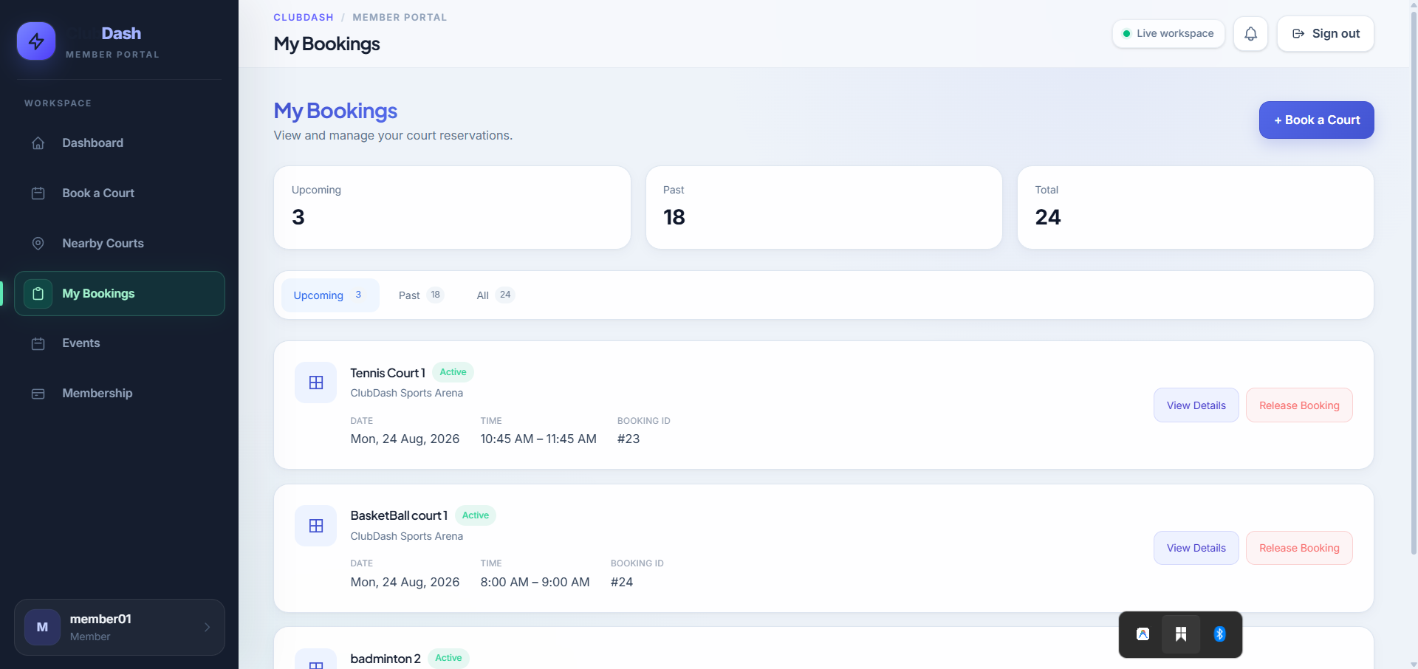
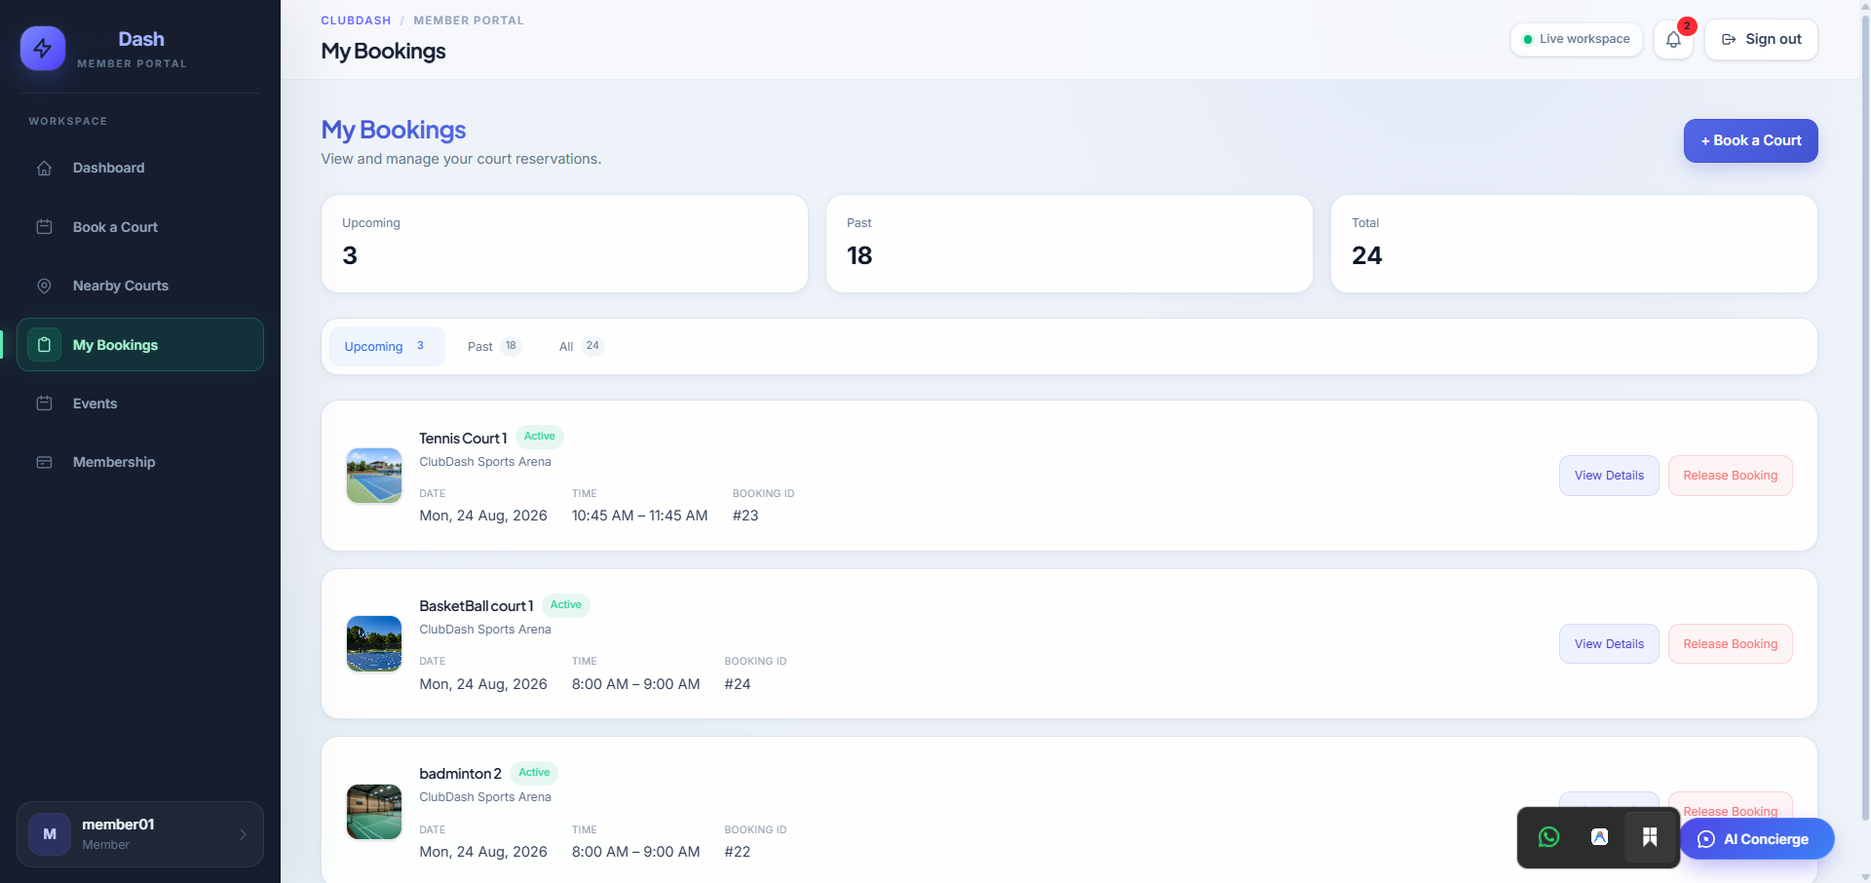
08 / ACTION — MANAGE
09
A reservation remains manageable after booking
My Bookings gives members a traceable record of their activity.
Upcoming / past reservations
Booking details + release controls
CLUBDASH • TEAM 096 • 2026

Slide 10
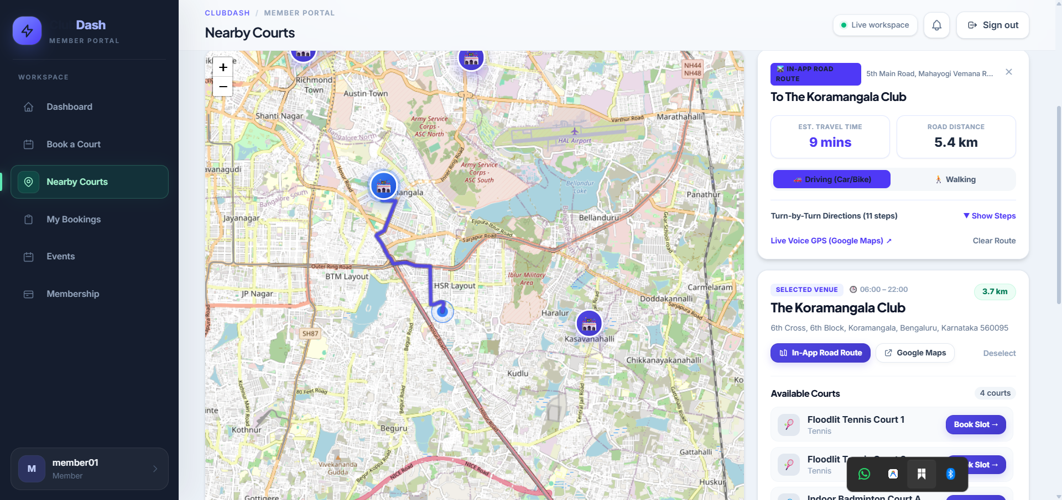
09 / ACTION — DISCOVER
10
Nearby Courts connects location to the booking decision
Users can discover a venue, view route context and inspect available courts.
DISCOVERY
•
Nearby venue markers
•
Distance and ETA
•
Road-route context
•
Sport / court context
•
Navigation handoff
CLUBDASH • TEAM 096 • 2026

Slide 11
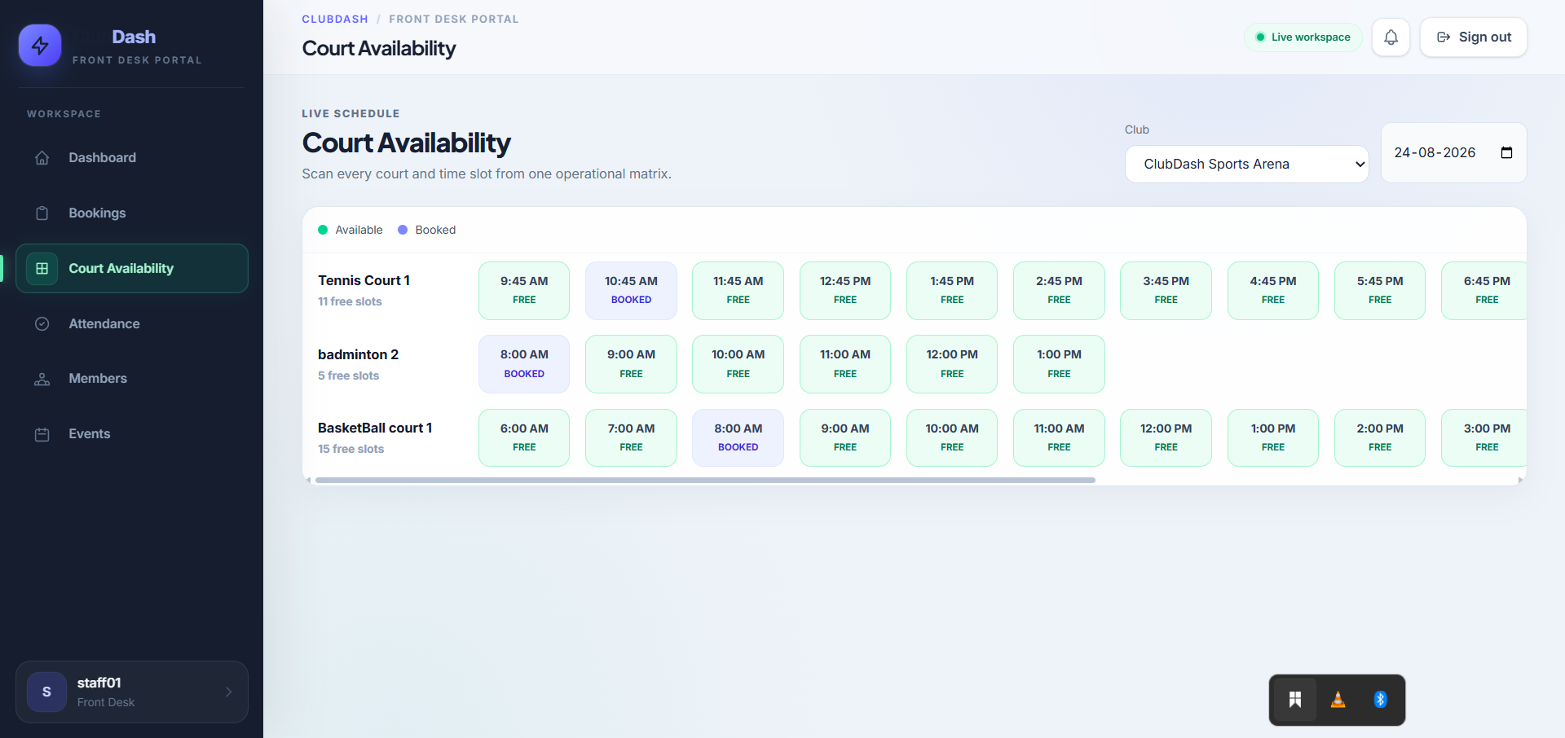
10 / ACTION — STAFF
11
The same booking becomes an operational commitment
Staff see the day's courts and slots through a dedicated front-desk workflow.
SHARED SOURCE OF TRUTH
Member
“I booked this slot.”
↓
Front Desk
“This slot is BOOKED.”
•
Live availability matrix
•
Bookings and members
•
Attendance workflow
CLUBDASH • TEAM 096 • 2026

Slide 12
11 / ACTION — AI
12
ClubDash AI adds conversational access without bypassing permissions
Phase 1 is read-only and uses approved server-side tools.
ROLE-AWARE AI FLOW
USER
Natural-language question
↓
VUE 3
Assistant widget
↓
FLASK
Auth + role checks
↓
TOOLS
Approved read-only functions
↓
DATA
Club services / DB
NO DIRECT DATABASE ACCESS
NO WRITE TOOLS IN PHASE 1
CLUBDASH • TEAM 096 • 2026

Slide 13
12 / COMPLETE FLOW
13
One connected journey across the roles
The demo should feel like one product, not a collection of isolated screens.
1
2
3
4
5
6
ENTER
→
ORIENT
→
BOOK
→
MANAGE
→
OPERATE
→
ASSIST
Landing → Sign in
Dashboard
Court + slot
My Bookings
Staff view
ClubDash AI
ADMIN / MANAGEMENT
Members • Bookings • Events • Announcements • Analytics
Core principle: shared reservation state + role-specific experiences.
CLUBDASH • TEAM 096 • 2026

Slide 14
13 / RESULT
14
What changed from the original problem?
The final product maps directly back to the research.
FRAGMENTED BOOKING
→
Centralized court booking + My Bookings
MANUAL SCHEDULING
→
Live court/time availability
PEAK-HOUR CONGESTION
→
Clear slot visibility and booking validation
MISSED UPDATES
→
Club announcements and notices
MANUAL RECORDS
→
Attendance and operational workflows
Result: one connected platform where members book and manage, staff operate, and administrators manage the club.
CLUBDASH • TEAM 096 • 2026

Slide 15
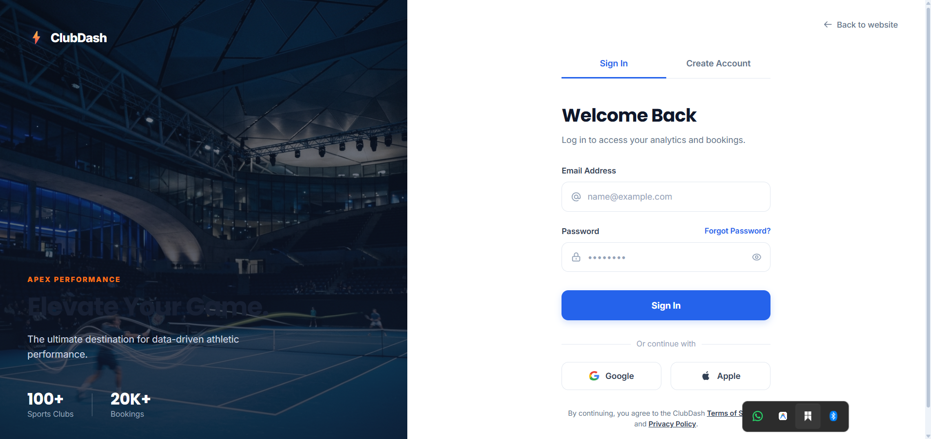
CLUBDASH
Book. Manage. Operate. Assist.
We identified the problem, researched it, translated it into user stories and requirements, and built the connected solution.
Thank you.
TEAM 096 • SPORTS FACILITY BOOKING & CLUB MANAGEMENT SYSTEM

