Slide 1

Lesson 3: Problem Identification and
Idea Generation
Dr. Leena Anum
Associate Professor
Department of Engineering Management
College of Electrical and Mechanical Engineering, NUST
leena.anum@ceme.nust.edu.pk

Slide 2
Agenda Style
01
Design Thinking
02
Business Plan
03
Viability : Cost and Revenue Models
04
Business Model Canvas

Slide 3
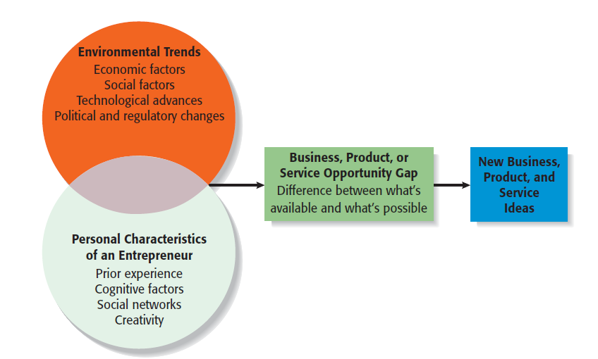
The Opportunity Recognition Process

Slide 4
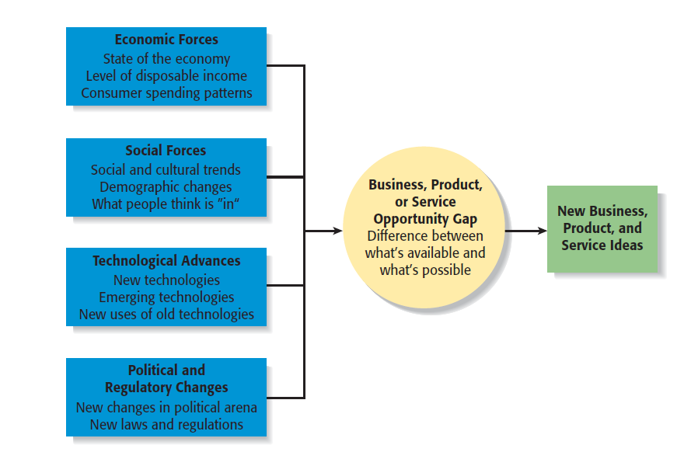
Environmental Trends Suggesting Business or Product Opportunity Gaps

Slide 5
Design Thinking
Design thinking is a non-linear, iterative process that teams use to understand
users, challenge assumptions, redefine problems and create innovative solutions to prototype and test. It is a human-centered problem-solving approach and typically follows five stages:
Empathize – Understand the user
Define – Frame the problem
Ideate – Generate ideas
Prototype – Build representations of solutions
Test – Validate with users
Design
Thinking

Slide 6
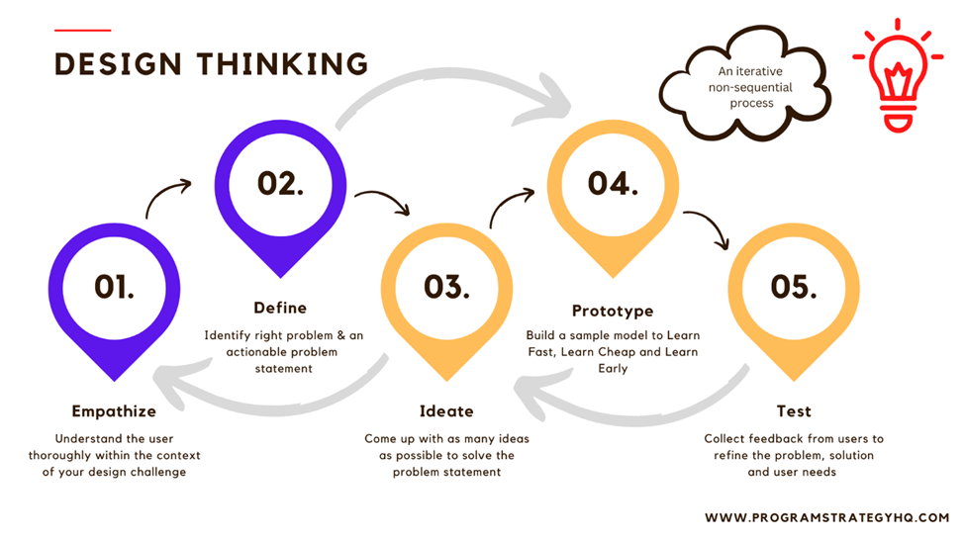

Slide 7
Three Lenses of DT
Desirability: Meet People’s Needs
Desirable
Feasible
Viability: Generate Profits
Viable
Feasibility: Be Technologically Possible

Slide 8
5 Whys
A technique to dig deep into a problem’s root cause by repeatedly asking “Why?”
(around five times)
Cause
Cause
1
2
3
4
5
Apparent Cause
Cause
Root Cause

Slide 9
Process Mapping
Flow Diagrams (CFD-DFD-ERD etc.)
Identify
Bottlenecks
Improve
Efficiency
Eliminate
Waste
Standardize
Operations
Process mapping is the creation of a visual diagram that breaks down a
complex workflow into a series of connected steps, showing the inputs,
activities, and outputs of a process from start to finish.

Slide 10
THE BUSINESS PLAN
A business plan is a structured document that describes a company’s goals, strategies, operations, and financial projections.
Think of it as both a roadmap for running the business and a pitch
document for investors, banks, or partners.

Slide 11
Elements of a Business Plan
Executive Summary
Industry Analysis
Company Description
Market Analysis
The Economics of the Business
Marketing Plan
Design and Development Plan
Operations Plan
Management Team and Company
Structure
Overall Schedule
Financial Projections

Slide 12
Market Analysis – Segmentation and Sizing
A market analysis is a key section of a business plan (or standalone research
report) that examines your industry, target customers, and competitors to
understand opportunities and risks. It helps you figure out where your business
fits and how to compete effectively
Market Segmentation / Customer Profiling
Demographics (Age – Gender – Qualification – Income)
Psychographics (beliefs – values)
Geographics (area – region)
Buying behavior (freq. of buying – basis)

Slide 13
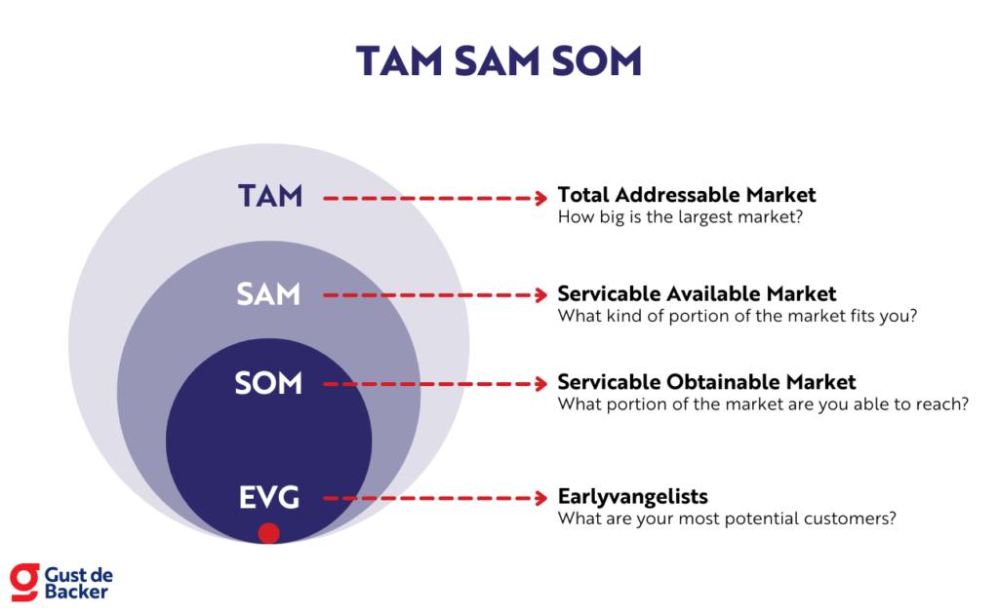
Market Sizing

Slide 14
Competitive Edge /
Competitive Advantage
A competitive edge is a unique advantage that allows a company to outperform its rivals by providing greater value to customers, resulting in more sales or superior market position.
This edge is what attracts customers to one business over another and is cultivated through unique, valuable, and difficult-to-replicate qualities like lower costs, superior product quality, innovative offerings, or exceptional customer service.

Slide 15
USP: Unique Selling Proposition
A distinct benefit or feature of a product or service that makes it superior to competitors, helping to attract and persuade customers by answering the question, "Why should I buy from you instead of them?"
USP

Slide 16
Value Proposition
A clear statement of the unique benefits provided by the innovation. Purposed at convincing stakeholders of the innovation’s value and feasibility. Demonstrates the potential and viability of an innovation.
Idea
Target Customer
Problem at Hand
Urban Commuters
Affordable/felx. Trpt.
Benefits
Solution
Convenience
On-demand service

Slide 17
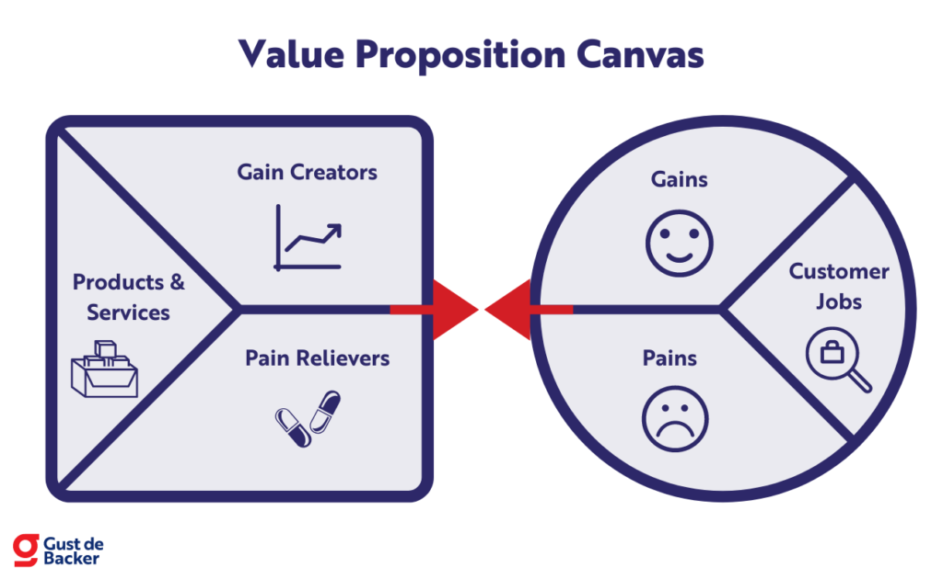

Slide 18
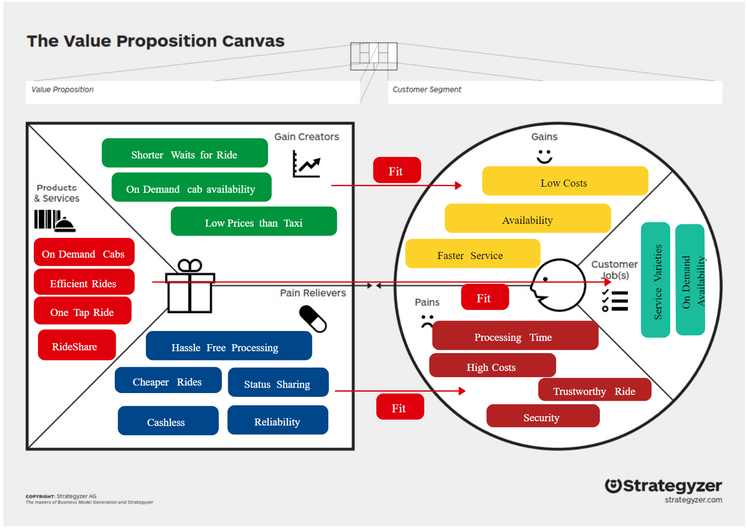

Slide 19
MVP: Minimum Viable Product
A minimum viable product, or MVP, is a product with enough features to attract early-adopter customers and validate a product idea early in the product development cycle

Slide 20
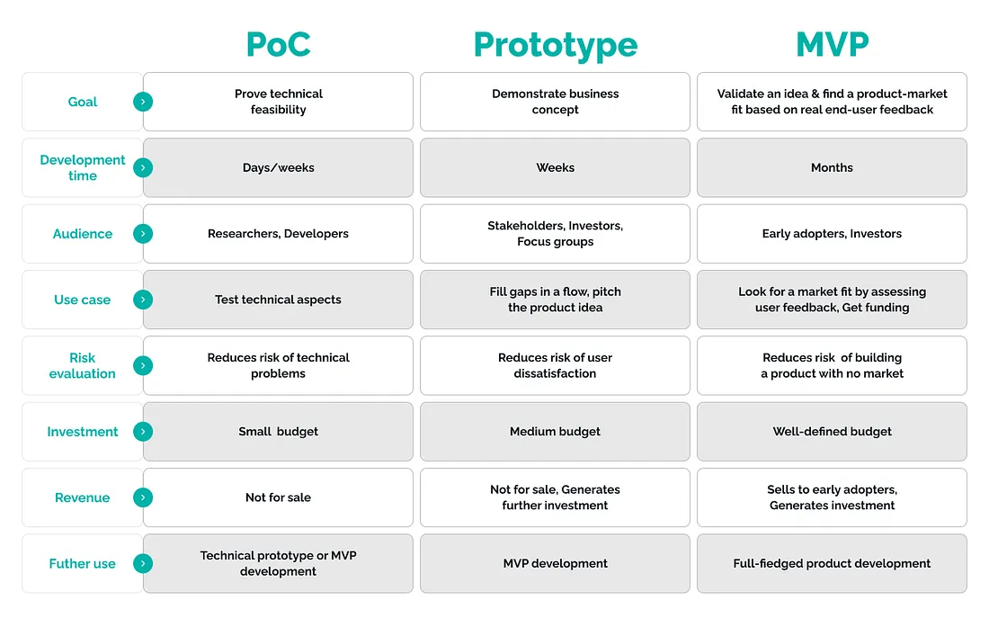

Slide 21
Thank You
Any Questions?

