Slide 1
Body Fat Prediction 7COM1075: Data Science and Analytics Masters Project Abdul Jaleel Mohammed 22090668 Maria Pssarou

Slide 2
Introduction
Obesity is a global health challenge that is growing at an alarming rate.
According to the World Health Organization (2022), around 2.5 billion adults are classified as overweight.

Slide 3
Research Question
1. Can machine learning models predict body fat percentage accurately using anthropometric measurements?
2. Does a hybrid model combining individual ML predictions achieve higher accuracy than standalone models?

Slide 4
Objectives
Data Preprocessing: Improve the quality of input data through cleaning, feature scaling, and feature selection techniques, including Spearman’s correlation analysis, mutual information gain, and variance inflation factor (VIF). This ensures that only the most relevant predictors are used to train the models.
Model Design: Implement and compare the performance of three non-linear ML models— Decision Tree Regressor (DT), Random Forest Regressor (RF), and Multilayer Perceptron (MLP). A hybrid model is also introduced to combine predictions from individual models, enhancing accuracy and robustness.

Slide 5
Objectives
Performance Evaluation: Assess model performance using standard regression metrics Such as MAE, RMSE, R², and MSE.
Web Application: Create a simple web application to predict body fat percentage.

Slide 6
Methodology
Data was collected and preprocessed from an open-source platform. It consists of 252 rows and 15 features.
Features included: Density, Age, Weight, Height, and Body circumferences.
Data was cleaned, in-order to find the missing values, and outliers detection.

Slide 7
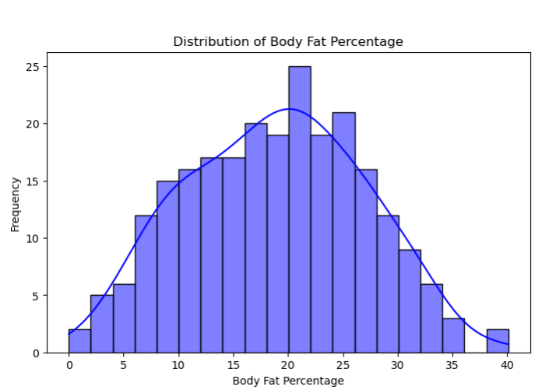
Figure 1: Graph showing normal distribution curve for body fat percentage.

Slide 8
Methodology
Features were selected utilizing Spearman’s rank correlation method.
A heatmap was created to identify the linear relationship between the features and the Target Variable.

Slide 9
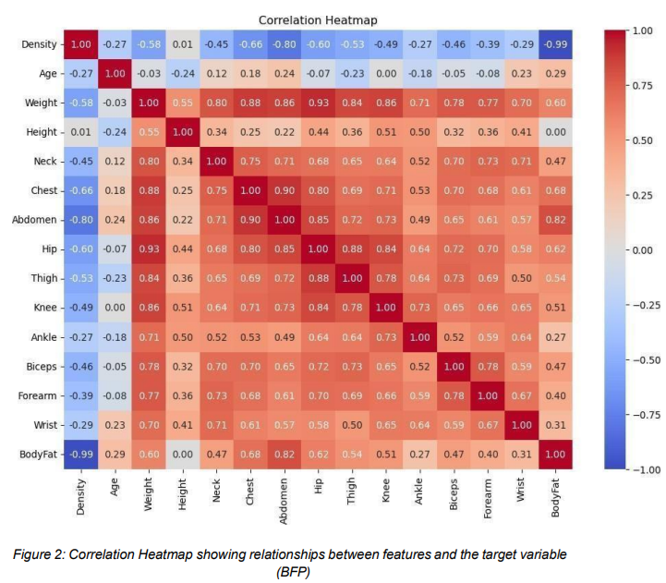

Slide 10
Methodology
Feature selection technique referred as Mutual Information Gain was applied to identify the features relevant to body fat percentage.
Top features included:
Density.
Abdomen circumference.
Weight.
Chest circumference.
Hip circumference.

Slide 11
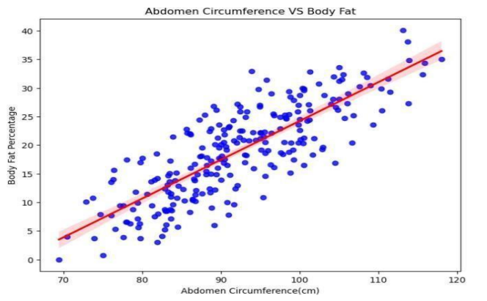
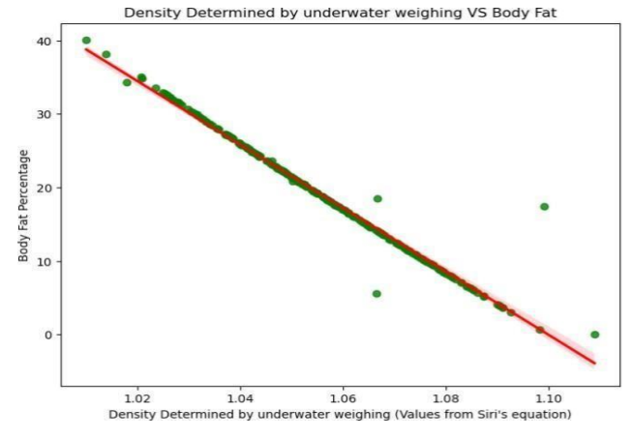
Scatter plots
Fig 1: Abdomen circumference VS Body Fat.
Fig 2: Density determined by underwater weighing VS Body Fat.

Slide 12
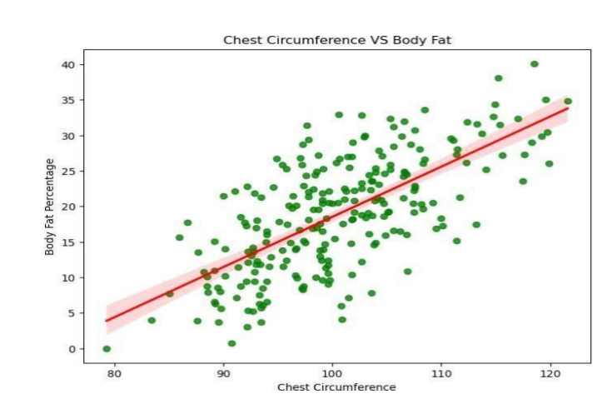
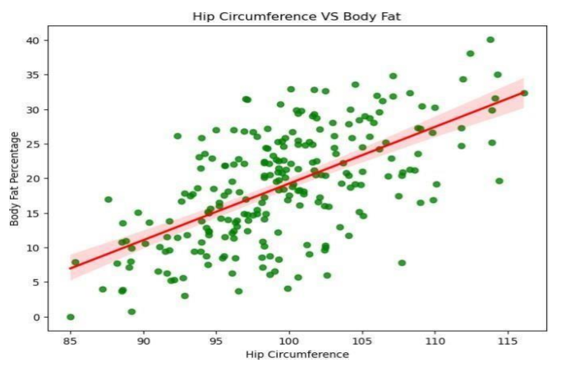
Scatter plots
Fig 4: Chest circumference VS Body Fat.
Fig 3: Hip circumference VS Body Fat.

Slide 13
Methodology
Three unique Machine Learning models were implemented such as, Decision Tree Regressor(DT), Random Forest Regressor(FR), and Multilayer Perceptron (MLP).
All the ML models were tunned utilizing the hyper-parameter tunning technique.
Eventually, a hybrid model was created by combining all three models.

Slide 14
Evaluation Metrics
Root Mean Square Error (RMSE)
RMSE measures the square root of the average Squared differences between predicted and actual values.
Mean Absolute Error (MAE)
MAE computes the average absolute differences between predicted and actual values. MAE is more robust to outliers compared to RMSE.
R-Squared ( R ^2)
R² quantifies the proportion of variance in the target variable explained by the model. Higher R² values (close to 1) reflect better model fit.
Mean Squared Error (MSE)
MSE measures the mean of squared differences between predicted and actual values. Provides a clear penalty for larger errors.

Slide 15
Comparative Analysis(Ours)
Model | RMSE | MAE | R² | MSE
Decision Tree | 1.3 | 0.62 | 0.97 | 1.7
Random Forest | 0.63 | 0.34 | 0.99 | 0.39
Multilayer Perceptron | 21.92 | 20.08 | -6.67 | 480.3
Hybrid Model | 0.62 | 0.34 | 0.99 | 0.39
Table 1: Comparison of the models.

Slide 16
Comparative analysis at Level-1
Metric | Our Results | Uçar et al. Results (Level 1)
RMSE | 1.3 | 4.608
R² | 0.97 | 0.595
MSE | 1.7 | 21.23

Slide 17
Strengths and Limitations of Hybrid Model:
Strengths:
The hybrid model achieved the lowest RMSE and MAE, demonstrating its ability to reduce prediction errors by aggregating outputs from complementary models.
Through robust cross-validation, the hybrid model showed consistent performance across different data splits, ensuring reliability and adaptability to unseen data.
By combining models, the hybrid approach captured both global patterns (e.g., MLP’s non-linear learning) and localized relationships (e.g., Decision Tree splits), achieving superior performance.

Slide 18
Strengths and Limitations of Hybrid Model:
Limitations:
Training multiple models and combining predictions increases computational costs and time, which may limit scalability for real-time applications.
The hybrid model’s performance depends heavily on high-quality, preprocessed data. Inconsistent or noisy data can reduce its predictive accuracy.
While simple averaging was effective, more sophisticated techniques like weighted averaging or stacked regression may yield further performance improvements.

Slide 19
Implications for Health Informatics
Clinical Integration.
Fitness Programs.
Preventative Care.

Slide 20
Challenges
Overfitting in Decision Tree Regressor:
Pruning and cross-validation techniques were applied to balance model complexity and performance.
MLP Regressor Hyperparameter Tuning:
The randomized search was implemented to identify the optimal parameters systematically.
Dataset Size:
The dataset contains 242 samples after preprocessing, limiting model generalizability.

Slide 21
Conclusion
This study successfully demonstrated the potential of machine learning techniques for predicting Body Fat Percentage (BFP) using anthropometric features.
The Hybrid model emerged as the superior, achieving the best performance with an RMSE of 0.62 and an R² of 0.99, outperforming other individual models and hybrid model.
Feature importance analysis revealed that density and abdomen circumference were the most significant predictors of BFP

Slide 22
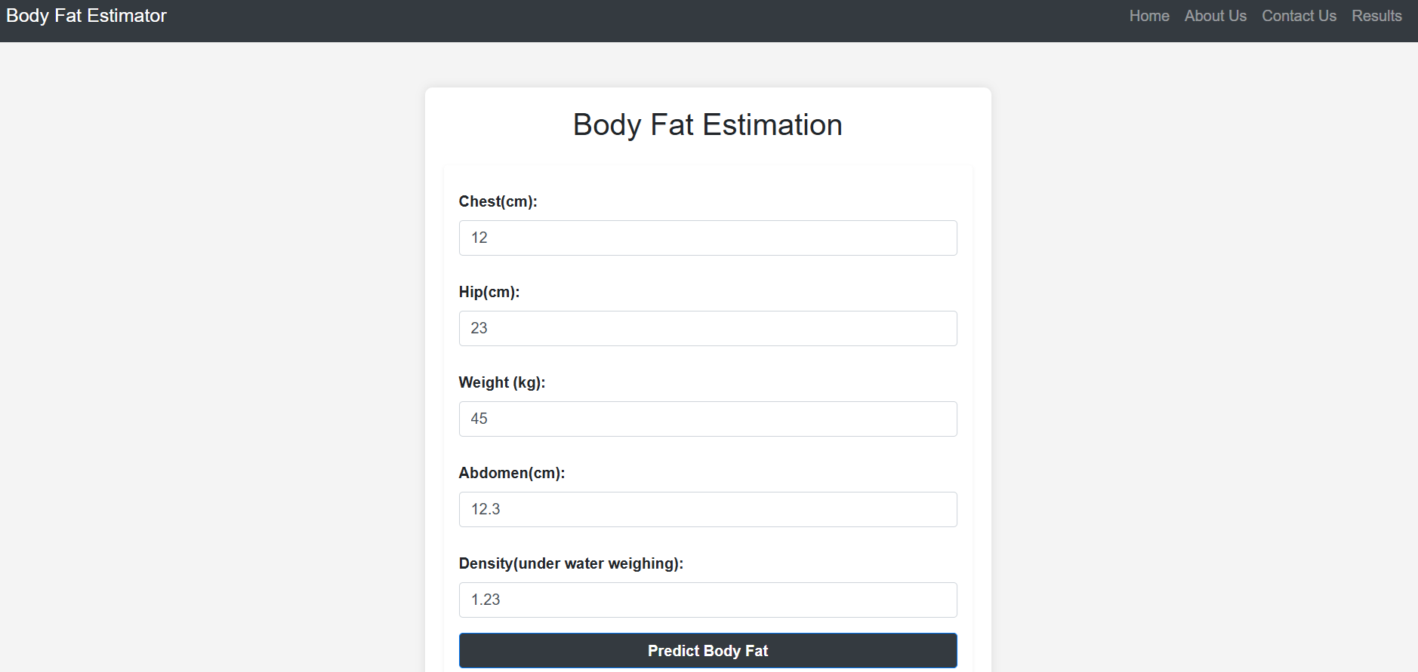
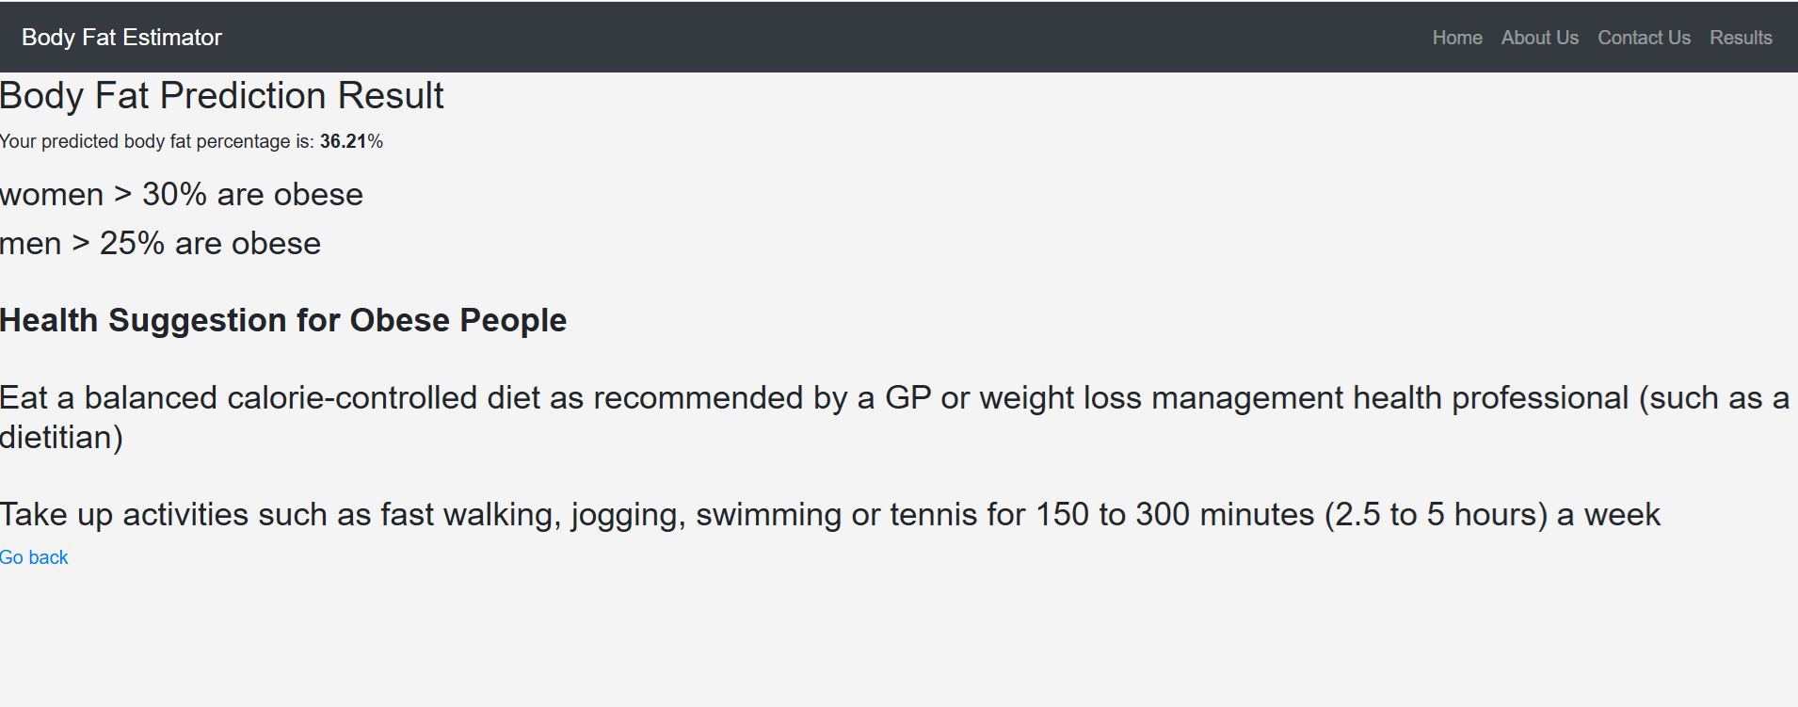
Simple Web Application
Fig(b): Results
Fig(a): Input Field

Slide 23
Thank You

