Slide 1
Body Fat Prediction 7COM1075: Data Science and Analytics Masters Project Abdul Jaleel Mohammed 22090668 Maria Pssarou

Slide 2
Introduction
Obesity is a global health challenge that is growing at an alarming rate.
According to the World Health Organization (2022), around 2.5 billion adults are classified as overweight.

Slide 3
Research Question
1. Can machine learning models predict body fat percentage accurately using anthropometric measurements?
2. Does a hybrid model combining individual ML predictions achieve higher accuracy than standalone models?

Slide 4
Methodology
Data was collected and preprocessed from an open-source platform. It consists of 252 rows and 15 features.
Features included: Density, Age, Weight, Height, and Body circumferences.
Data was cleaned, in-order to find the missing values, and outliers detection.

Slide 5
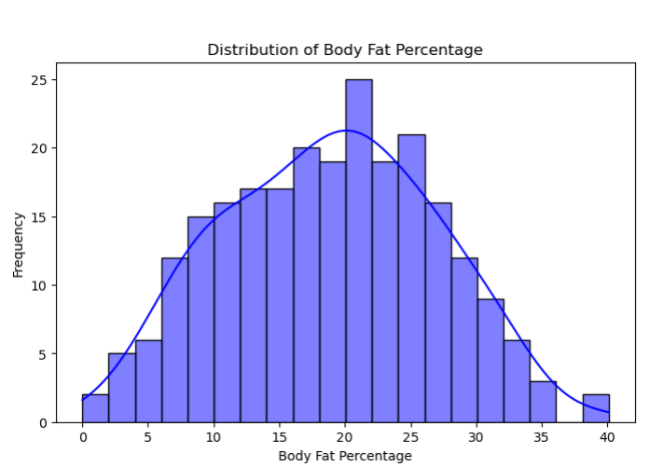
Figure 1: Graph showing normal distribution curve for body fat percentage.

Slide 6
Methodology
Features were selected utilizing Spearman’s rank correlation method.
A heatmap was created to identify the linear relationship between the features and the Target Variable.

Slide 7
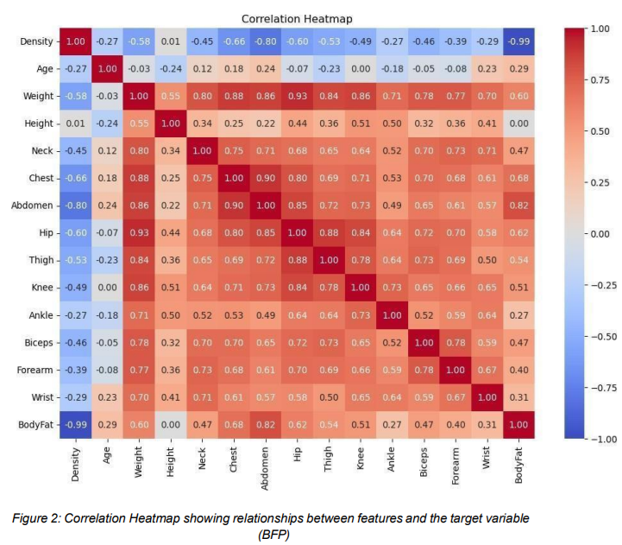

Slide 8
Methodology
Feature selection technique referred as Mutual Information Gain was applied to identify the features relevant to body fat percentage.
Top features included:
Density.
Abdomen circumference.
Weight.
Chest circumference.
Hip circumference.

Slide 9
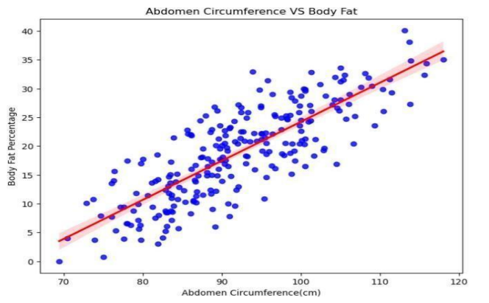
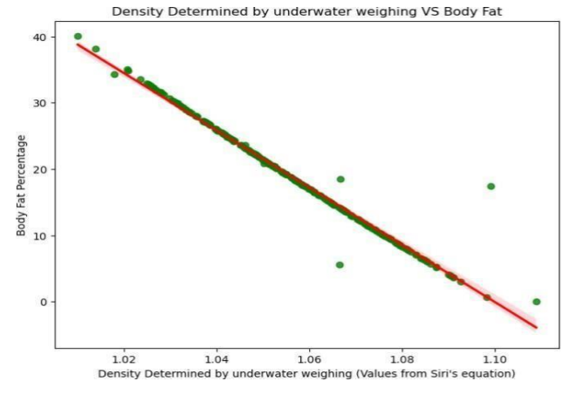
Scatter plots
Fig 1: Abdomen circumference VS Body Fat.
Fig 2: Density determined by underwater weighing VS Body Fat.

Slide 10
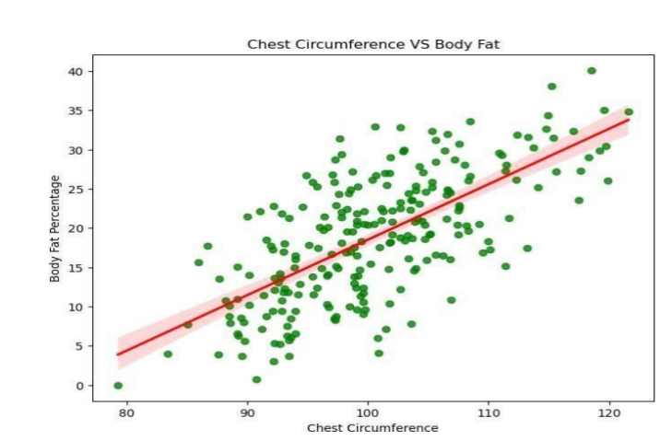
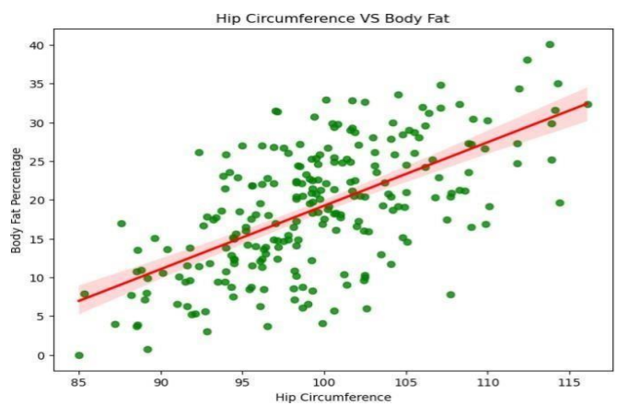
Scatter plots
Fig 4: Chest circumference VS Body Fat.
Fig 3: Hip circumference VS Body Fat.

Slide 11
Methodology
Three unique Machine Learning models were implemented such as, Decision Tree Regressor(DT), Random Forest Regressor(FR), and Multilayer Perceptron (MLP).
All the ML models were tunned utilizing the hyper-parameter tunning technique.
Eventually, a hybrid model was created by combining all three models.

Slide 12
Evaluation Metrics
Root Mean Square Error (RMSE)
Mean Absolute Error (MAE)
R-Squared ( R ^2)
Mean Squared Error (MSE)

Slide 13
Comparative Analysis(Ours)
Model | RMSE | MAE | R² | MSE
Decision Tree | 1.3 | 0.62 | 0.97 | 1.7
Random Forest | 0.63 | 0.34 | 0.99 | 0.39
Multilayer Perceptron | 21.92 | 20.08 | -6.67 | 480.3
Hybrid Model | 0.62 | 0.34 | 0.99 | 0.39
Table 1: Comparison of the models.

Slide 14
Comparative analysis at Level-1
Metric | Our Results | Uçar et al. Results (Level 1)
RMSE | 1.3 | 4.608
R² | 0.97 | 0.595
MSE | 1.7 | 21.23

Slide 15
Strengths and Limitations of Hybrid Model:
Strengths:
The hybrid model achieved the lowest RMSE and MAE, demonstrating its ability to reduce prediction errors by aggregating outputs from complementary models.
Through robust cross-validation, the hybrid model showed consistent performance across different data splits, ensuring reliability and adaptability to unseen data.
By combining models, the hybrid approach captured both global patterns (e.g., MLP’s non-linear learning) and localized relationships (e.g., Decision Tree splits), achieving superior performance.

Slide 16
Strengths and Limitations of Hybrid Model:
Limitations:
Training multiple models and combining predictions increases computational costs and time, which may limit scalability for real-time applications.
The hybrid model’s performance depends heavily on high-quality, preprocessed data. Inconsistent or noisy data can reduce its predictive accuracy.
While simple averaging was effective, more sophisticated techniques like weighted averaging or stacked regression may yield further performance improvements.

Slide 17
Implications for Health Informatics
Clinical Integration.
Fitness Programs.
Preventative Care.

Slide 18
Challenges
Overfitting in Decision Tree Regressor:
Pruning and cross-validation techniques were applied to balance model complexity and performance.
MLP Regressor Hyperparameter Tuning:
The randomized search was implemented to identify the optimal parameters systematically.
Dataset Size:
The dataset contains 242 samples after preprocessing, limiting model generalizability.

Slide 19
Conclusion
This study successfully demonstrated the potential of machine learning techniques for predicting Body Fat Percentage (BFP) using anthropometric features.
The Hybrid model emerged as the superior, achieving the best performance with an RMSE of 0.62 and an R² of 0.99, outperforming other individual models and hybrid model.
Feature importance analysis revealed that density and abdomen circumference were the most significant predictors of BFP

Slide 20
Thank You

