Slide 1
DESIGN AND ANALYSIS OF ALGORITHM LECTURE 3
OLUFEMI OLOLADE OLAEWE
SENIOR SOFTWARE DEVELOPER
[BSc. , M.PHIL]

Slide 2
MATHEMATICAL PROOF TECHNIQUES CONTD. Proof by Mathematical Induction
Class discussion

Slide 3
Determination of the run-time of an algorithm
An algorithm is an unambiguous computational procedure that takes some values or set of values as inputs and produces some values or set of values as output. Thus, an algorithm is a sequence of computational steps that transforms the input into the output. Half the battle comprehends what problem to solve. When initially approached, most problems have no simple, precise specification.

Slide 4
The Running Time of an Algorithm
When solving a problem, we are faced frequently with a choice among algorithms. On what basis should we choose? There are two often contradictory goals:
1. We would like an algorithm that is easy to understand, code, and debug. 2. We would like an algorithm that makes efficient use of the computer’s resources, especially one that runs as fast as possible.

Slide 5
Measuring the Running Time of a Program
The running time of a program depends on factors such as; 1. The input to the program.
2. The quality of codes generated by the compiler used to create the object program.
3. The nature and speed of the instructions on the machine used to execute the program.
4. The time complexity of the algorithm underlying the program.

Slide 6
Measuring the Running Time of a Program contd.
NB: The fact that running time depends on the input tell us that the running time of a program should be defined as a function of the input.
The natural size measure for input to a sorting program is the number of items to be sorted, or in other words, the length of the input list.
It is customary, then, to talk of T(n), the running time of a program on inputs of size n, for example, some program may have a running time T(n) = cn2 , where c is a constant. The unit of T(n) will be left unspecified, but we can think of T(n) as being the number of instructions executed on an idealized machine or computer.

Slide 7
Measuring the Running Time of a Program contd.
For many programs, the running time is really a function of the particular input, and not just of the input size. In that case, we define T(n) to be the worst - case running time, that is, the maximum, overall inputs of size n, of the running time on that input.

Slide 8
Measuring the Running Time of a Program contd.
We also consider Tavg(n), the average, overall inputs size n, of the running time on that input. While Tavg(n) appears a fair measure, it is often fallacious to assume that all inputs are equally likely. In practice, the average running time is often much harder to determine than the worst–case running time because the analysis becomes mathematically intractable and because the notion of “average” input frequently has no obvious meaning. Thus, we shall use worst – case running time as the principal measure of time complexity whenever we can do so meaningfully.

Slide 9
Measuring the Running Time of a Program contd.
we cannot express the running time T(n) in standard time units such as seconds. Rather, we can only make remarks like “the running time of such – and – such an algorithm is proportional to n. The constant of proportionality will remain unspecified since it depends so heavily on the compiler, the machine and other factors.

Slide 10
Growth of Functions
The order of growth of the running time of an algorithm gives a simple characterization of the algorithm’s efficiency and also allows us to compare the relative performance of the alternative algorithms

Slide 11
Big – Oh and Big – Omega Notation
Class discussion

Slide 12
Further Explanation on Growth Rate
We shall assume that programs can be evaluated by comparing their running time functions, with the constant of proportionality neglected. Under this assumption, a program with the running time O(n^2) is better than one with running time O(n^3).

Slide 13
Beside constant factors due to the nature of the program itself. It is possible for example, that with a particular compiler-machine combination, the first program takes 100n^2 milliseconds, whiles the second takes 5n^3 milliseconds. Wouldn’t the 5n^3 program be better than the 100n^2 program? The answer to the question depends on the types of inputs the programs are expected to process. For input of size n < 20, the program with running time 5n3 will be faster than the runtime 100n2. Therefore, if the program is to be run mainly on inputs small size, we would indeed prefer the program whose running time was 0(n3)

Slide 14
as n gets large, the ratio of the running times which is 5n3/100n2 = n/20 gets arbitrarily large
Thus, as the size of the inputs increases, the 0(n3) program will take significantly more time than the 0(n2) program.
Another reason for at least considering programs whose growth rate are as low as possible is that, the growth rate ultimately determines how big a problem we can solve on a computer. Put another way, as computers get faster, our desire to solve large problems then continue to increase. However, unless a problem has a low growth rate such as 0(n) or 0(nlogn), a modest increase in computer speed makes very little difference in the size of the largest problem we can solve in a fix amount of time.

Slide 15
Example 1
We see the running times of four programs with different time complexities, measured in seconds, for a particular compiler-machine combination in the diagram below. Suppose we can afford thousand seconds or about 20minutes to solve a given problem. How large a problem can we solve? In 10^3seconds, each of the four algorithms can solve roughly the same size of problem as shown below:

Slide 16
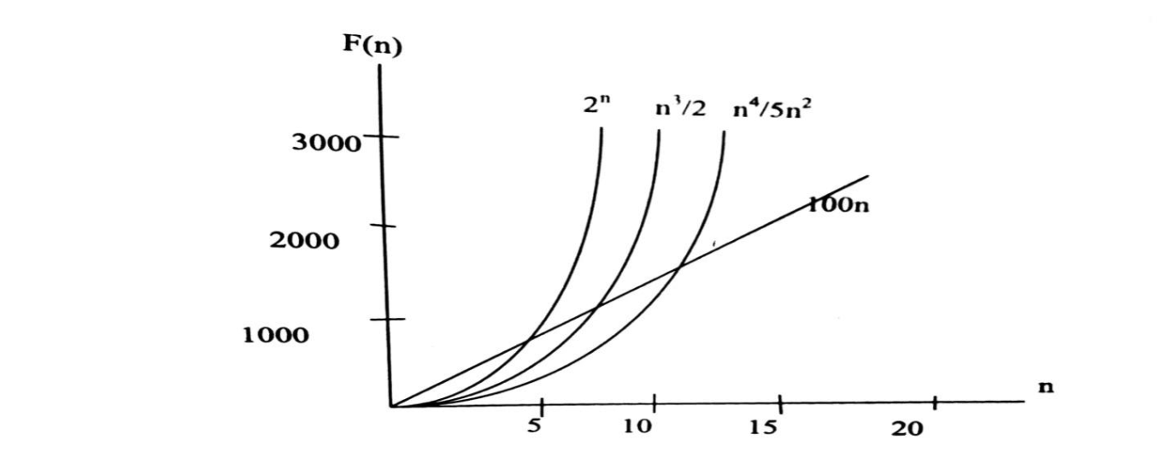

Slide 17
Suppose that, we now buy a machine that runs ten times faster at no additional cost. Then for the same cost, we can speed up 10^3 seconds on a problem where we spent 10^4 seconds.

Slide 18
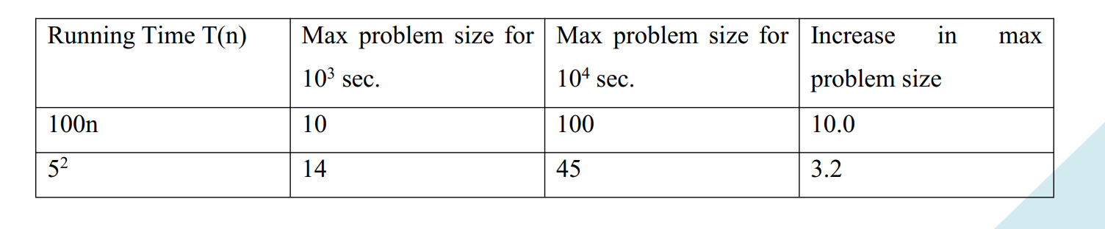
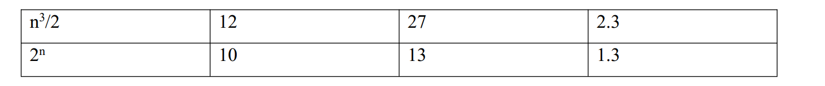
Running time table

Slide 19
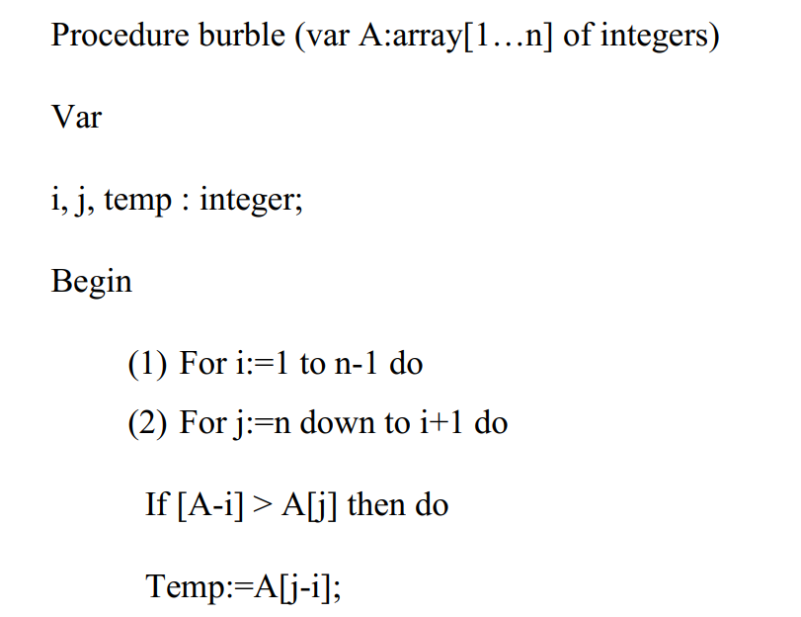
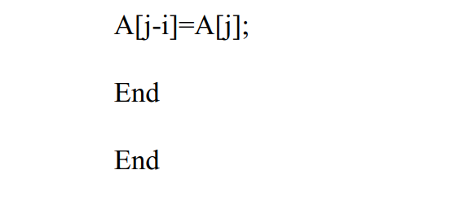

Slide 20
LECTURE 5: COMPLEXITY OF AN ALGORITHM
The complexity of an algorithm M is the function (f(n)) which gives the running time and storage space requirement of the algorithm in terms of the size n of the input data.

Slide 21
Rate of Growth
Suppose M is an algorithm, and suppose n is the size of the input data. Clearly, the complexity of M increases as n increases, it is usually the rate of increase of f(n) that needs to be examined. This is done by comparing f(n) with some standard functions.
The rate of growth for these standard functions are indicated in the table below, which gives their approximated values for certain values of n. The functions are listed in the order of their rates of growth, the logarithmic function grows slowly, the exponential function 2^n grows most rapidly, and the polynomial function n^c grows according to the exponent c.

Slide 22
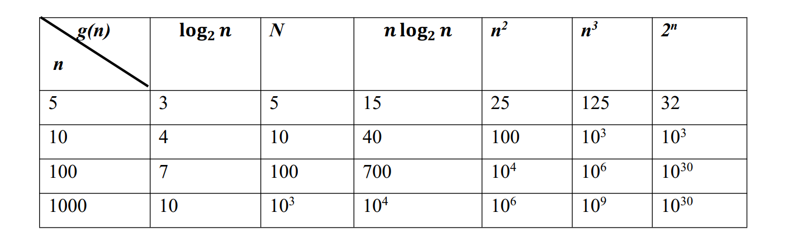
Rate of Growth contd

Slide 23
Time complexity contd.
The complexity of certain known searching and sorting algorithms are: a. Linear Search – O(n) b. Binary Search – O(lg n) c. Bubble Sort – O(n^2) d. Merge Sort – O(n lg n)

Slide 24
HOW TO CALCULATE TIME COMPLEXITY
Class discussion

Slide 25
QUIZ
Write an algorithm to sort a list of n integer numbers in an ascending order and hence compute the complexity of the algorithm.

Slide 26
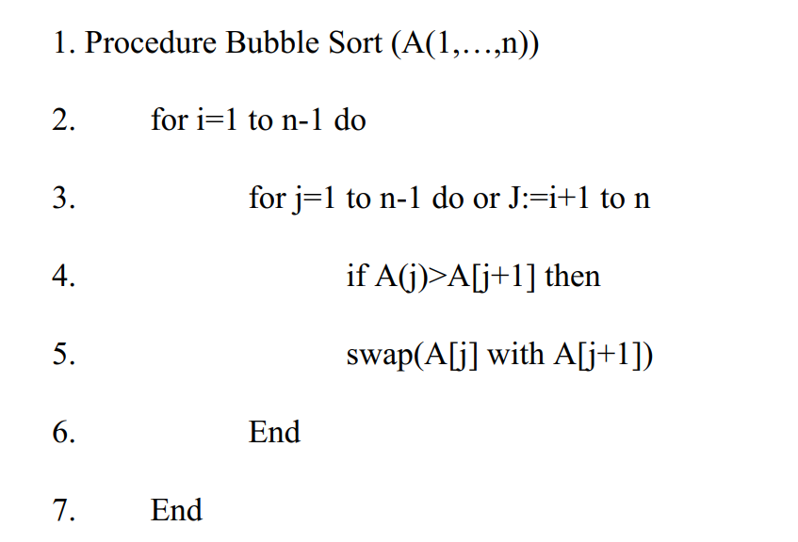
TIME COMPLEXITY ANALYSIS OF Bubble Sort Algorithm

Slide 27
TIME COMPLEXITY OF LINEAR SEARCH
The complexity of a linear search algorithm is measured by the number of functions of the comparison required to find ITEM in DATA, where DATA contains n elements . two important cases to consider are “the worst case” and “the average case”.
Clearly, the worst case occurs when one must search through the entire array , ie when ITEM does not appear in DATA. In this case, the algorithm requires n comparisons.

