Slide 1

Mawlana Bhashani Science & Technology University
Department of Computer Science and Engineering
Course Title : Software Development Project-II and Industrial tour
Course Code:CSE-3116
Project Title : Periodic Table
Developed By
Hasan Imam
ID:CE-14022
3rd Year 1st semester
Session: 2013-14
Supervised By
Lubna Yasmin Pinky
Lecturer
Department of CSE,
MBSTU.

Slide 2
Introduction
In our day to day life we need various common Apps for various purposes.
Periodic Table with Windows Form is such kind of desktop application that includes different
information Atoms.
The Atomic Table provides a convenient place to learn about the atoms.
It is designed for people to know the information about atoms .
Its will be helpful for the school ,college and university students who wants to learn about the atoms.
Atomic Table is an object oriented programming language based desktop application.
C# programming language is used to develop.
It is an arrangement of some important information about Atoms, it helps easy to learn to user.

Slide 3
Features Of The Project
Main Form of Periodic Table
Category of Atoms Button
Search Option Button
Atomic Symbol Button .
Category Form
Alkali Metal button
Alkaline Earth Metal
Transition Metal
Post Transition Metal
Metalloids
Other Nonmetals

Slide 4
Halogens
Noble Gases
Lanthanides
Actinides
Super Actinides
All items
Search Option Form
Search by Atomic Name
Show all information

Slide 5
Development Tools
1. Language: C#(C Sharp) .NET
2. Server: Microsoft SQL Server database
3. Compiler: Visual Studio 2015.
4. Editor: Visual Studio 2015/Notepad++.
Requirements
-> It must be installed in user PC.
-> Supported .NET framework must be installed.

Slide 6
Flow Chart
Start
Show Details about All the Atom
Main Form
Category Of Atom
Search Option
Show Details According to category
1.Search by name
2.Show all item

Slide 7
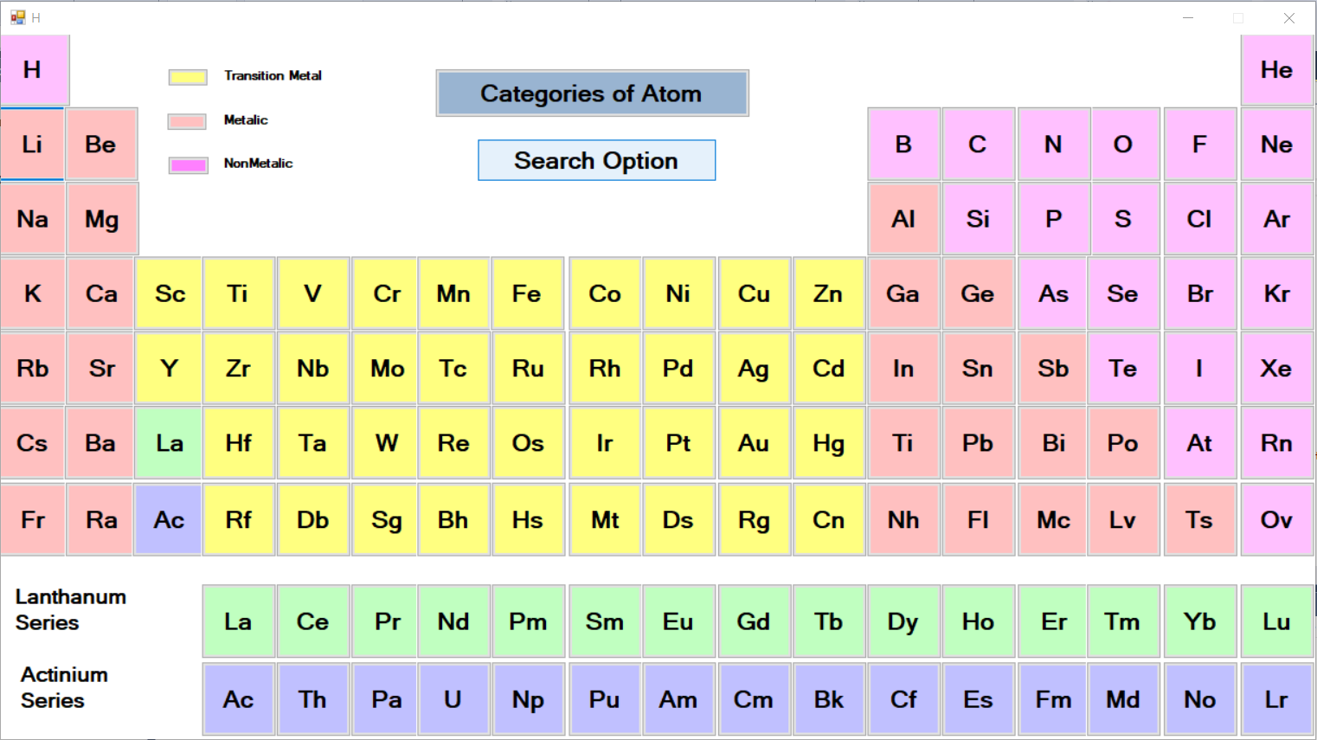
Periodic Table Main Form

Slide 8
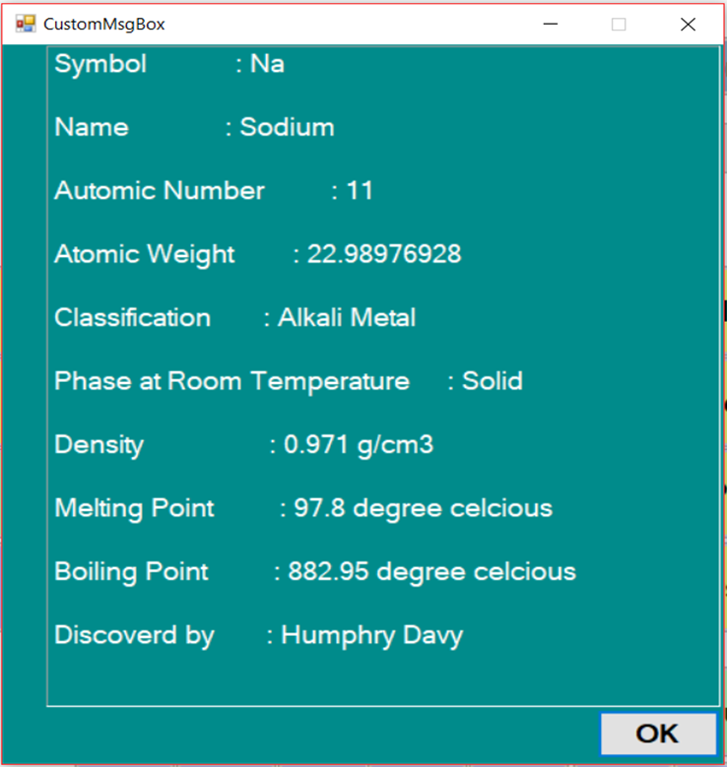
Showing details by clicking Atomic Symbol (Na) Button

Slide 9
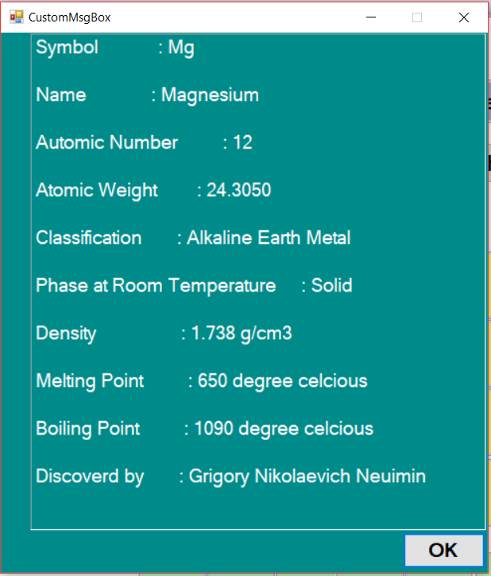
Showing details by clicking Atomic Symbol (Mg) Button

Slide 10

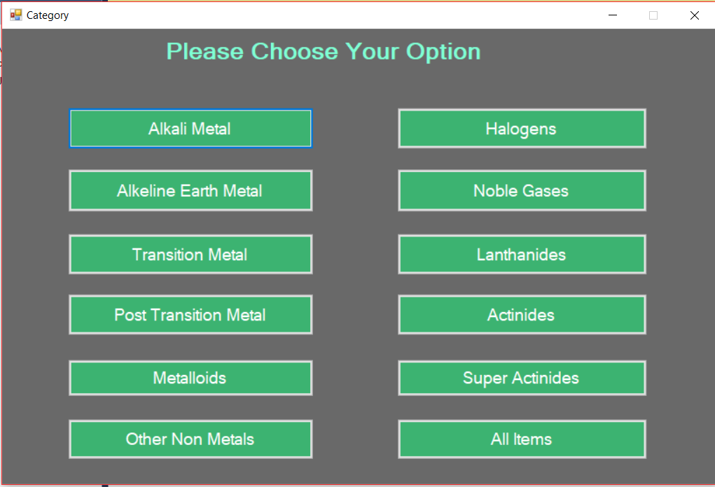
Category of Atom Form from main Form

Slide 11
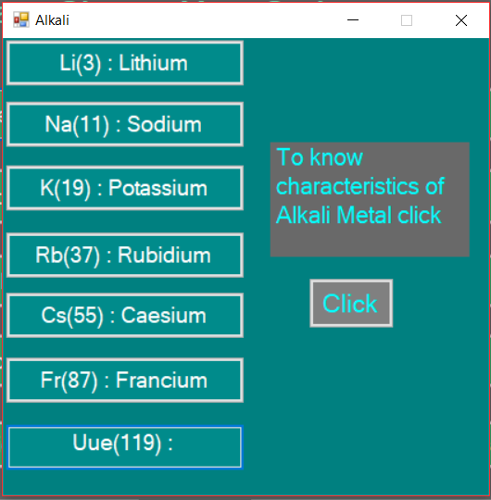
Category Form to Alkali Form

Slide 12
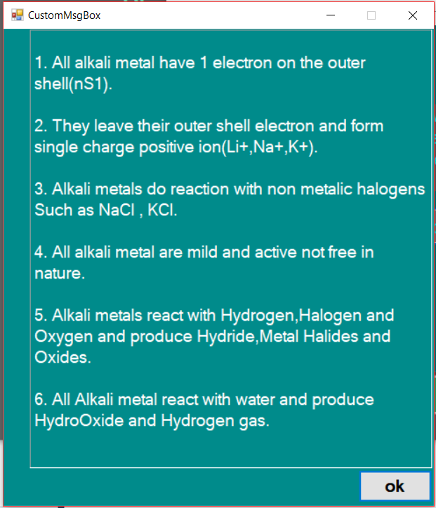
From Alkali Metals Form showing details about them

Slide 13
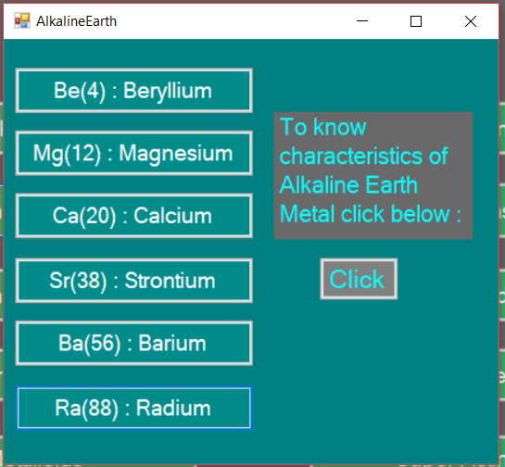
Category Form To Alkaline Earth Metal Form

Slide 14
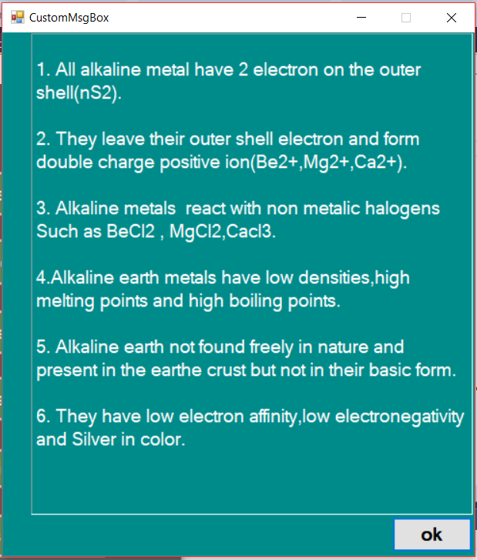
Alkaline Earth Metal Form to details about Alkaline Earth Metal

Slide 15
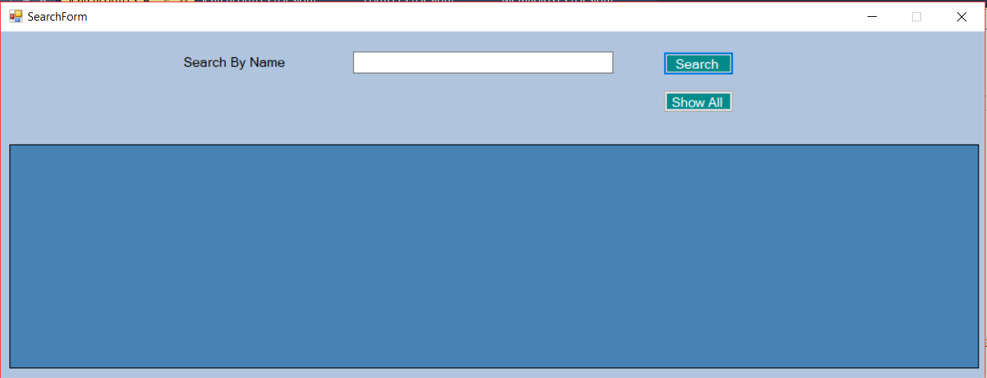
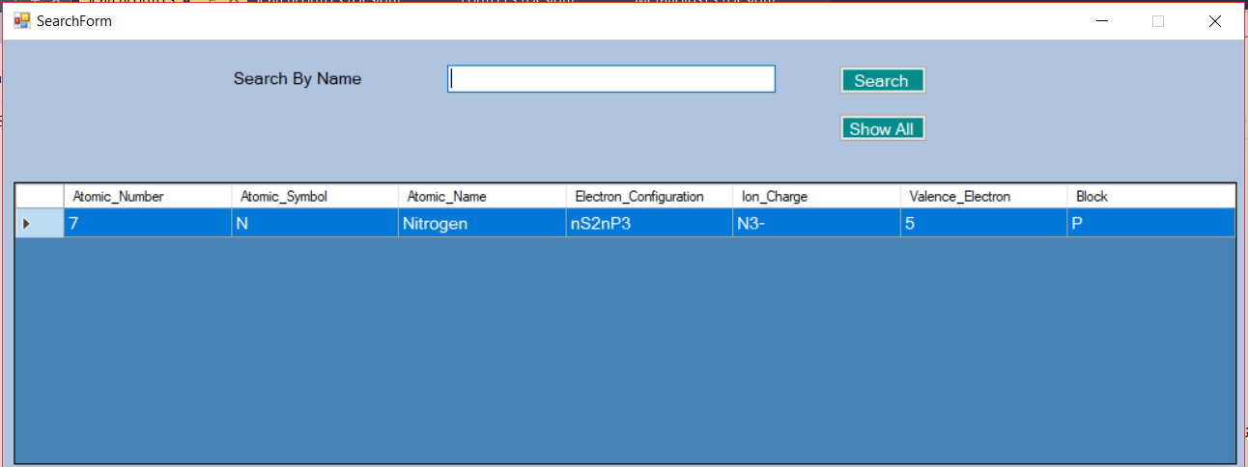
Search By Nitrogen

Slide 16

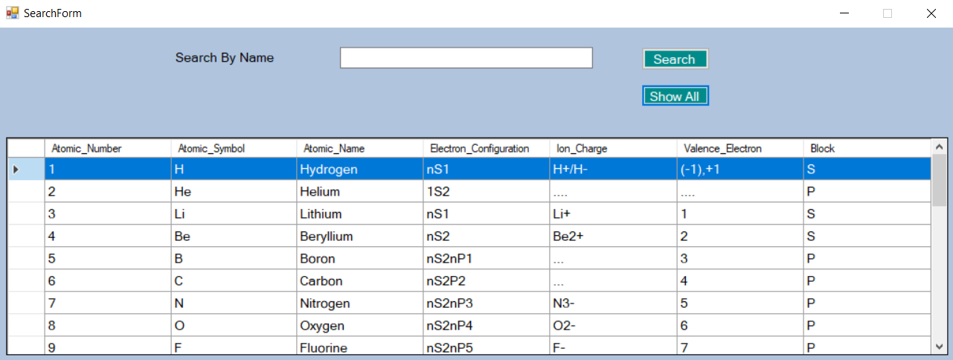
Showing All the information Stored in data base

Slide 17
Scope
This project will be helful for the school, college and university students.
Its helpful for learning chemistry.
Many extra features can be added which will be helpful for better learning.
Limitations
1.This project runs at offline only.
2.This must be install in user pc.

Slide 18
Conclusion
It was a great experience for me. I have faced a lot of problems in different stagesin my
project Hopefully, I have sloved these problem with the help of internet. I think project
is very essential for student. It gives me huge knowledge about any language In logical
sence.

Slide 19
Thank You

