Slide 1
Resume
Screening
Shaik Abdul Khadeer -20B81A05C1 Prathima -20B81A05F5 Siri Chandana -20B81A05H1
Guided by Mrs.Sampoornima
“We Analyse your Skills Smartly”

Slide 2
Introduction
Resume screening is a process in which recruiters find the right person for a job by narrowing down the list of eligible candidates based on the information in their resumes. Recruiters review candidates' resumes themselves or use software to complete the process.
Our aim is to create similar module for companies as well. With this application, companies can directly shortlist people using AI. We used Natural Language Processing for analyzing the resume

Slide 3
Why Resume Screening?
Manual screening involves recruiters reviewing each resume on their own, while software-based resume screening uses artificial intelligence tools that scan resumes for predetermined criteria.
Resume screening is a straightforward way to remove unqualified candidates from the application process and shortlist candidates to interview.

Slide 4
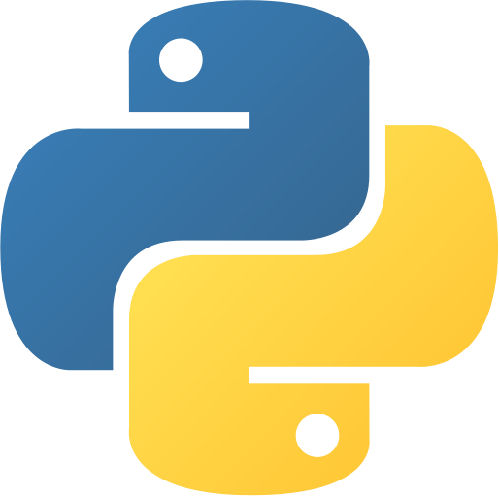
Tools & Technologies
Python Programming
NLTK & Pyparser for NLP
Streamlit
PDFMiner for extracting PDF
Base64 for PDF displaying
pandas
Github for management
Visual Studio Code
MySQL

Slide 5


Key-Features
Resume Store / Remove
PDF Extracting

Slide 6


Key-Features
Career Recommendation
Course Recommendation

Slide 7


Key-Features
Skills Recommendation
Easy User - Interface
(No Registration)

Slide 8
Existing system and disadvantages
Resume checkers and resume screening software exist. Resume checkers check if the resume is good according to general standards. It is not always the same general standards used by every company. Users wouldn’t know if their resume fits the organization’s standards or style. Similarly, resume screening software used by various organizations, analyze relevant data but fail to make recommendations or suggestions to the applying candidate.

Slide 9
Proposed system and advantages
Our Resume Analyzer can be used both by candidate and by the organization. The candidate applying for an organization can check if their resume fits organization’s standards and make necessary changes using the generated recommendations. Candidates can also check their scores to know where they stand. Skills and Courses are also recommended to the candidate based on the job role they are looking for. Similarly, the recruiters can extract relevant user data, and analyze best candidates from the graphs and stats generated.

Slide 10
UML DIAGRAMS

Slide 11
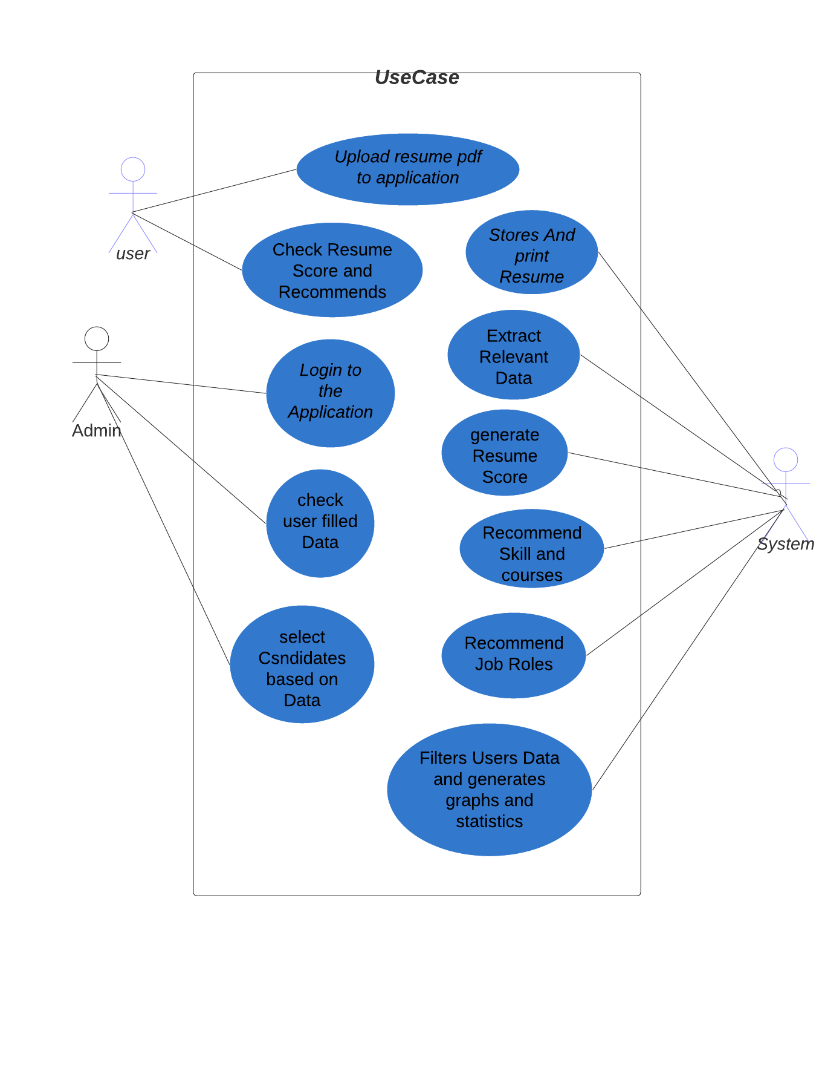
Use-Case Diagram

Slide 12
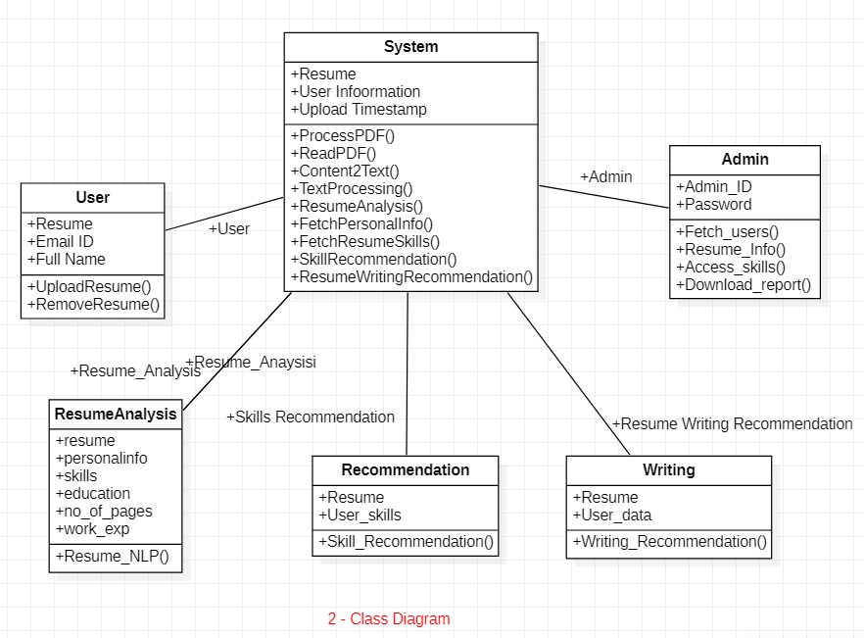
Class Diagram

Slide 13
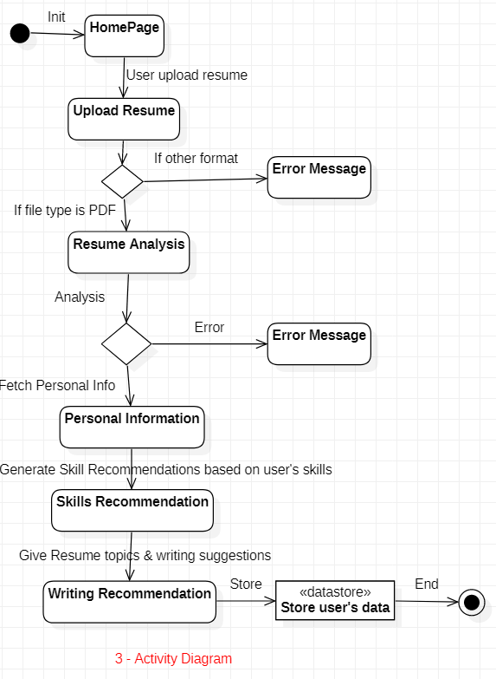
Activity Diagram

Slide 14
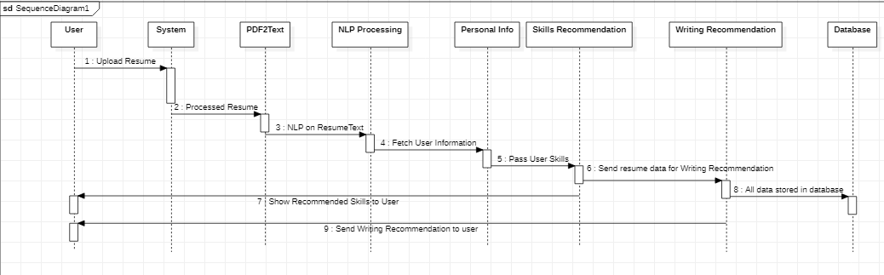
Sequence Diagram

Slide 15
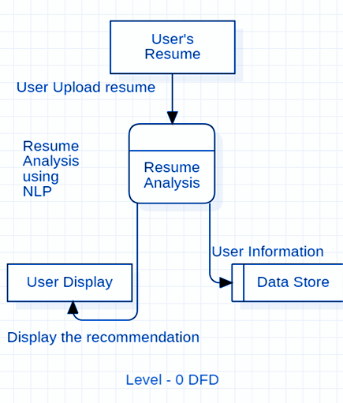
Level - 0 DFD

Slide 16
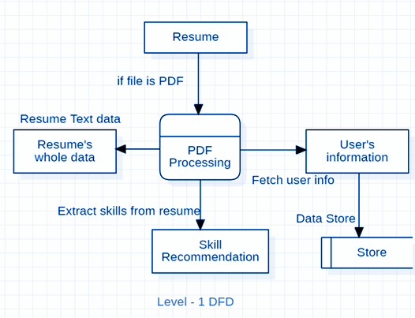
Level - 1 DFD

Slide 17
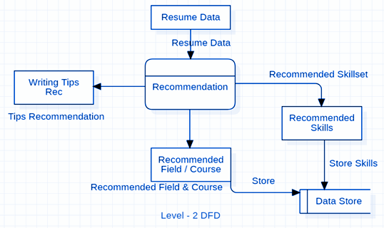
Level - 2 DFD

Slide 18
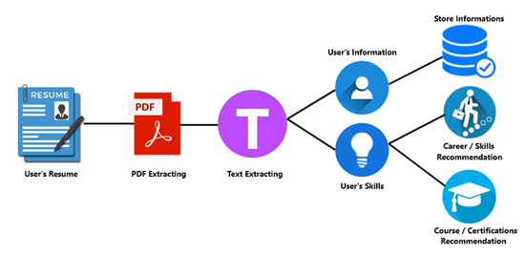
Workflow

Slide 19
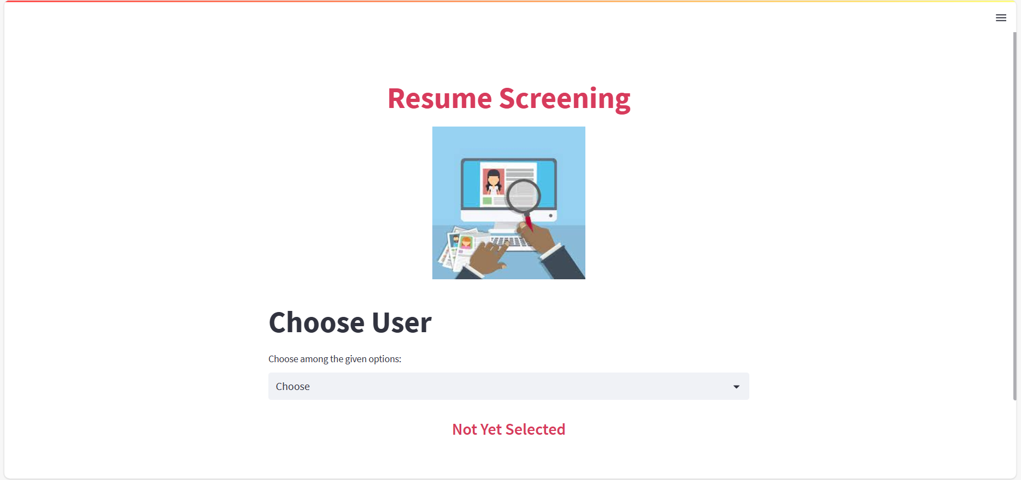
Homepage of Application

Slide 20
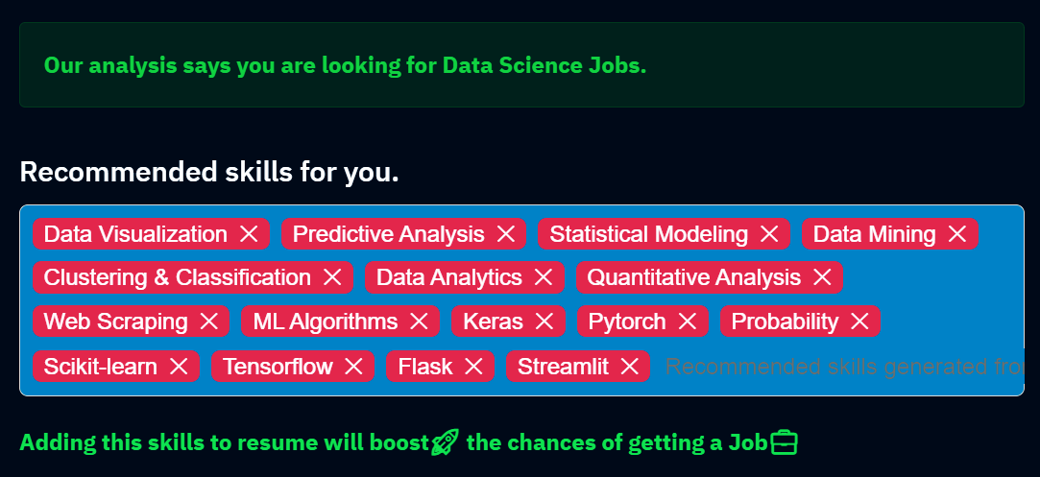
Career & Skills Recommendations

Slide 21
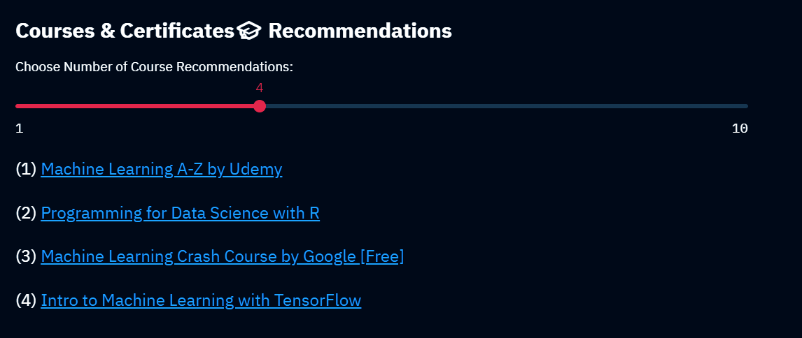
Courses Recommendations

Slide 22
Hardware & Software Requirements
 | Hardware | Software
Developers | 1. 4 GB RAM 2. 256 GB Storage 3. Intel i5 5th Gen + Processor | 1. Anaconda or Python 2. Visual Studio Code 3. Streamlit, PDFMiner 4. Pyparser, NLTK
Users | 1. Mobile 2. Tablet/PC 3. Laptop | 1. Any Browser 2. Working Internet

Slide 23
We can add more formats of resume, currently it is supporting only PDF format for uploading the resume.
This system is currently working with the limited types of fields and recommendations, we can say it is only working for IT professionals as of now. We can add more fields in future for all kinds of resume recommendations

Slide 24
Conclusion
The purpose of this project is to learn Natural Language Processing. Using NLP, here we tried to recommend skills, courses and job roles based on extracted data. We learnt to create web application using Streamlit python. We have gathered the knowledge of Plotly for the visualization and Data analytics which is used on the Admin side. In this project, we have learnt many Technical and Non-Technical skills including time management, documentations, NLP, Database handling, Visualization, Web development and much more.

Slide 25
References
Streamlit Documentation | Documentation from Streamlit Developer Community
OpenCV Documentation | Documentation from OpenCV Developer Community
NLTK Documentation || Official documentation from NLTK Developer Community
PyResParser Documentation || Official documentation from PyResParser Developer Community
PDFMiner Documentation || Official documentation from PDFMiner Developer Community

