Slide 1







<STACK OVERFLOW SURVEY >
<ABDUL MANNAN>
<20-Oct-2022>

Slide 2



OUTLINE
Executive Summary
Introduction
Methodology
Results
Visualization – Charts
Dashboard
Discussion
Findings & Implications
Conclusion
Appendix

Slide 3

EXECUTIVE SUMMARY
Skill required in the IT field keeps on changing and evolving
Different people try to learn other technologies or skills according to the market demand
It is very important to have knowledge of the market trends so that the one can prepare themselves
The purpose of this presentation is to have a brief overview of the current and future trends for different tech stacks

Slide 4

INTRODUCTION
This Presentation will help all the stakeholders of IT, so that they can make decisions accordingly
All stakeholders analyze the current trends and make decision according to the future trends

Slide 5

METHODOLOGY
Collected the Data using API and Exploring the Data
The data was wrangled/cleaned (removed duplicate, imputed missing values & normalized the data)
The data then Analyzed (Exploratory Data Analysis) to find the distribution of data, presence of outliers and determine the correlation between different columns in the dataset
Data is then visualize using different charts and graphs
Then two modified subset of Stack Overflow Dataset are downloaded and three dashboard are created on Cognos Dashboard Embeded

Slide 6
RESULTS

Slide 7
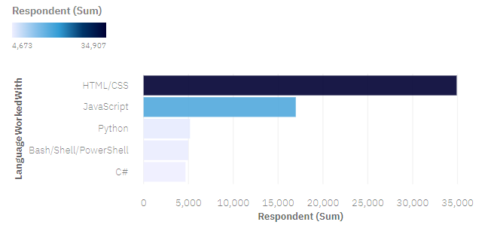
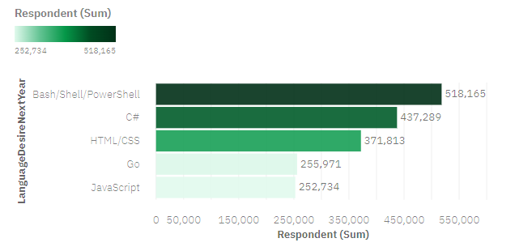
PROGRAMMING LANGUAGE TRENDS
Current Year
Next Year

Slide 8
PROGRAMMING LANGUAGE TRENDS - FINDINGS & IMPLICATIONS
Findings
HTML/CSS/JAVASCRIPT has decreased
Bash/Shell/PowerShell become top for next year
C# gained more interest for next year
Implications
Employ more people skilled in C# & Bash
Employ moderate people skilled in HTLM/CSS
Employ less people skilled in Python and JavaScript

Slide 9
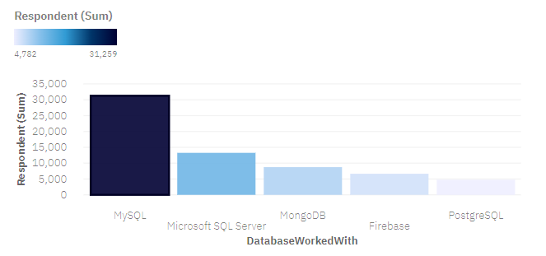
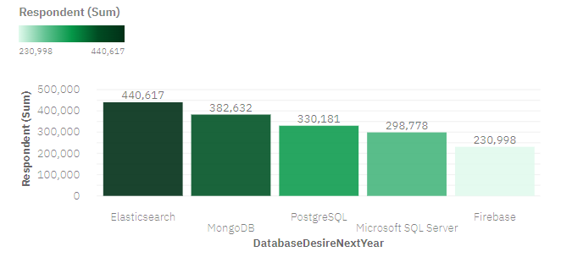
DATABASE TRENDS
Current Year
Next Year

Slide 10
DATABASE TRENDS - FINDINGS & IMPLICATIONS
Findings
MySQL failed to get position in top 5 for the next year and Elastic search hot first position
MySQL server loses interest and MongoDB & PostgreSQL gained interest for the next year
Firebase almost loses some interest for the next year
Implications
Stop Employing people with MySQL skill instead start employing Elasticsearch skilled people
Employ people skilled in MongoDB and PostrgeSQL

Slide 11

DASHBOARD
https://eu-de.dataplatform.cloud.ibm.com/dashboards/5b279465-4028-43c5-93d6-b6386cadbc73/view/4617d22017b129c254cec8e407cf2a5328312655b2bb805682827b4959697697f36f4192c827195bdc140565fbef4608cd

Slide 12
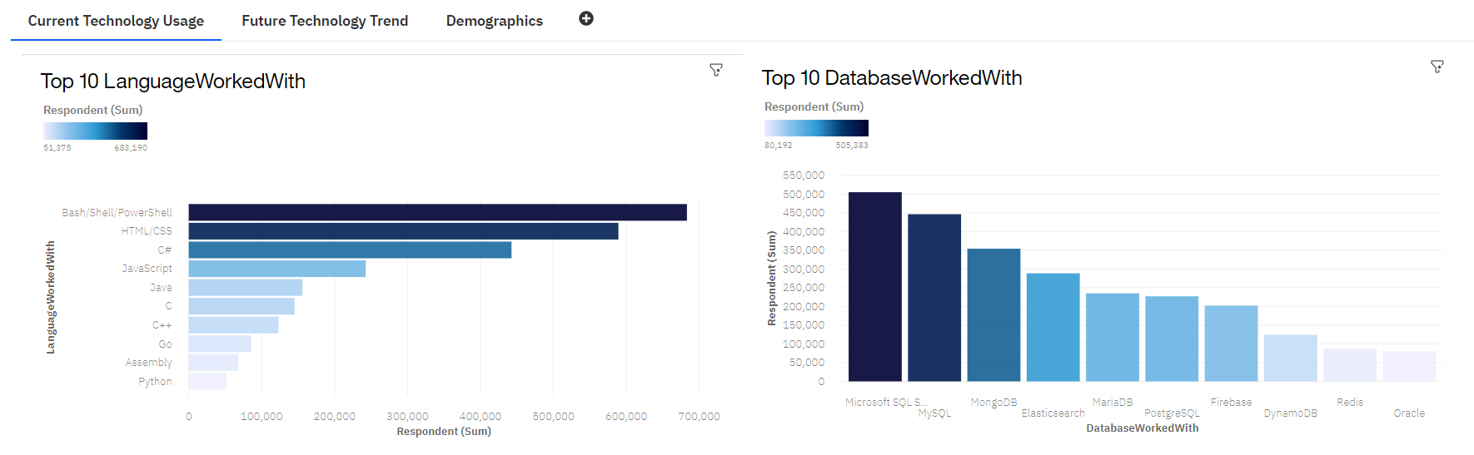
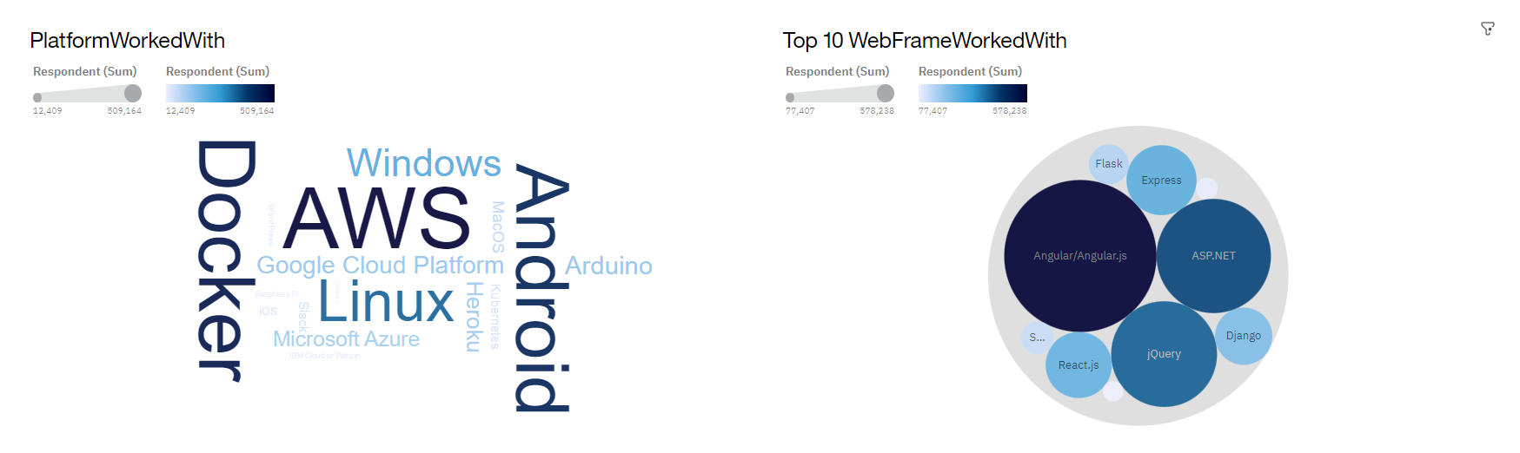
DASHBOARD TAB 1

Slide 13
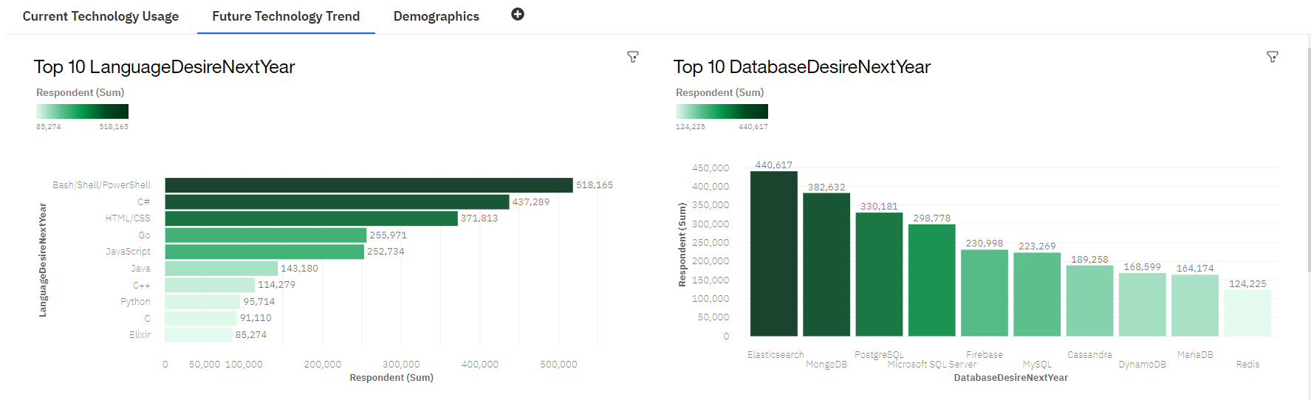
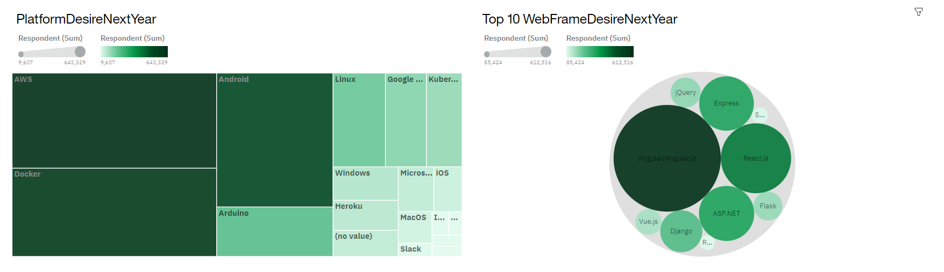
DASHBOARD TAB 2

Slide 14
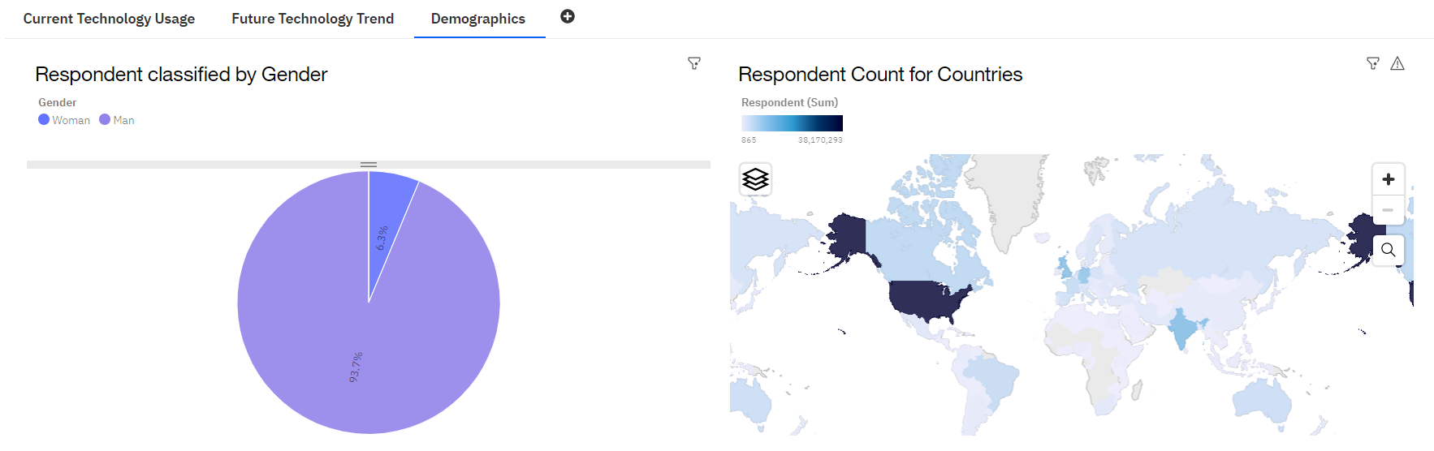
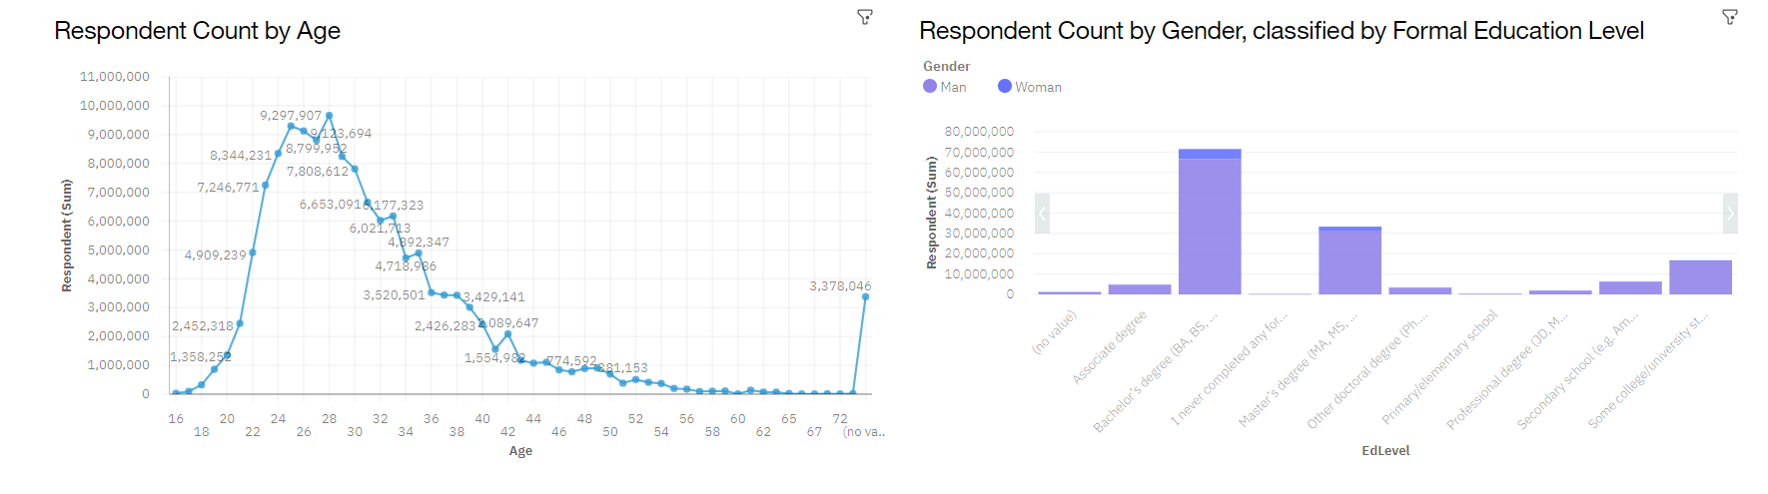
DASHBOARD TAB 3

Slide 15
DISCUSSION
Employ People Skilled according to Future Trends
Employees should learn the new tech stacks keeping in view the future trends so that they don’t have to lose job in Future

Slide 16
OVERALL FINDINGS & IMPLICATIONS
Findings
In Programming C# and Python gaining strength
In Database Elastic Search and Mongo DB is gaining strength
In Platforms AWS and Docker remain unchanged
In Web frames Angular.js remains unchanged whereas React.js is gaining strength
Implications
Employers should hire people skilled according to the future trends
Employees and Beginners should try to learn new technologies

Slide 17

CONCLUSION
Employers should make adjustments in staff for those skills no longer in demand
Making Adjustment means Companies should make arrangements for their existing employees to learn and adapt new tech stacks before hiring new employees

Slide 18
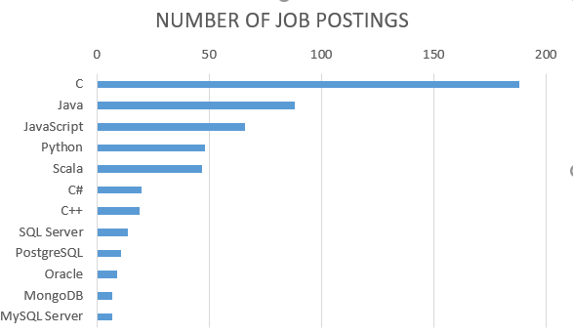
JOB POSTINGS

Slide 19
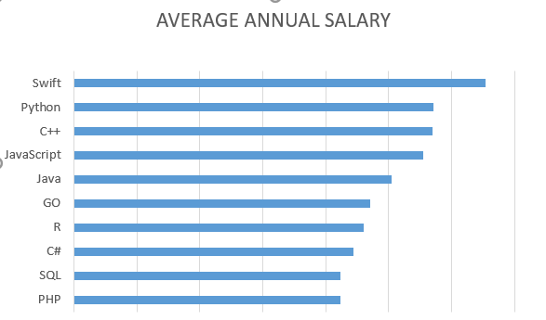
POPULAR LANGUAGES

