Slide 1
t
Farmers’ Representator
Abdul Mateen 2021-CS-190
Muhammad Ibrahim 2021-CS-169
Muhammad Danish 2021-CS-167
Muhammad Ahmad 2021-CS-211
t
t

Slide 2

t
Group G-39
Farmers
The Backbone of our Country
Abdul Mateen 2021-CS-190
Muhammad Ibrahim 2021-CS-169
Muhammad Danish 2021-CS-167
Muhammad Ahmad 2021-CS-211
t
t

Slide 3
t
t
Farmers
The Backbone of our Country
t
Abdul Mateen 2021-CS-190
Muhammad Ibrahim 2021-CS-169
Muhammad Danish 2021-CS-167
Muhammad Ahmad 2021-CS-211

Slide 4

t
Farmers
The Backbone of our Country
t
t

Slide 5
t
Farmers
The Backbone of our Country
18.5% of GDP
t
t

Slide 6
t
18.5% of GDP
Farmers
The Backbone of our Country
t
t

Slide 7
t
Description
Transportation Facility
Easy Market Access
Competitive Pricing
Secure Product Storage
Quality Check
Support for Farmer
t
t

Slide 8
t
Actors
CEO
Region Head
Organization Manager
Transport Manager
Farmer Manager
Driver
Farmer
t
t

Slide 9
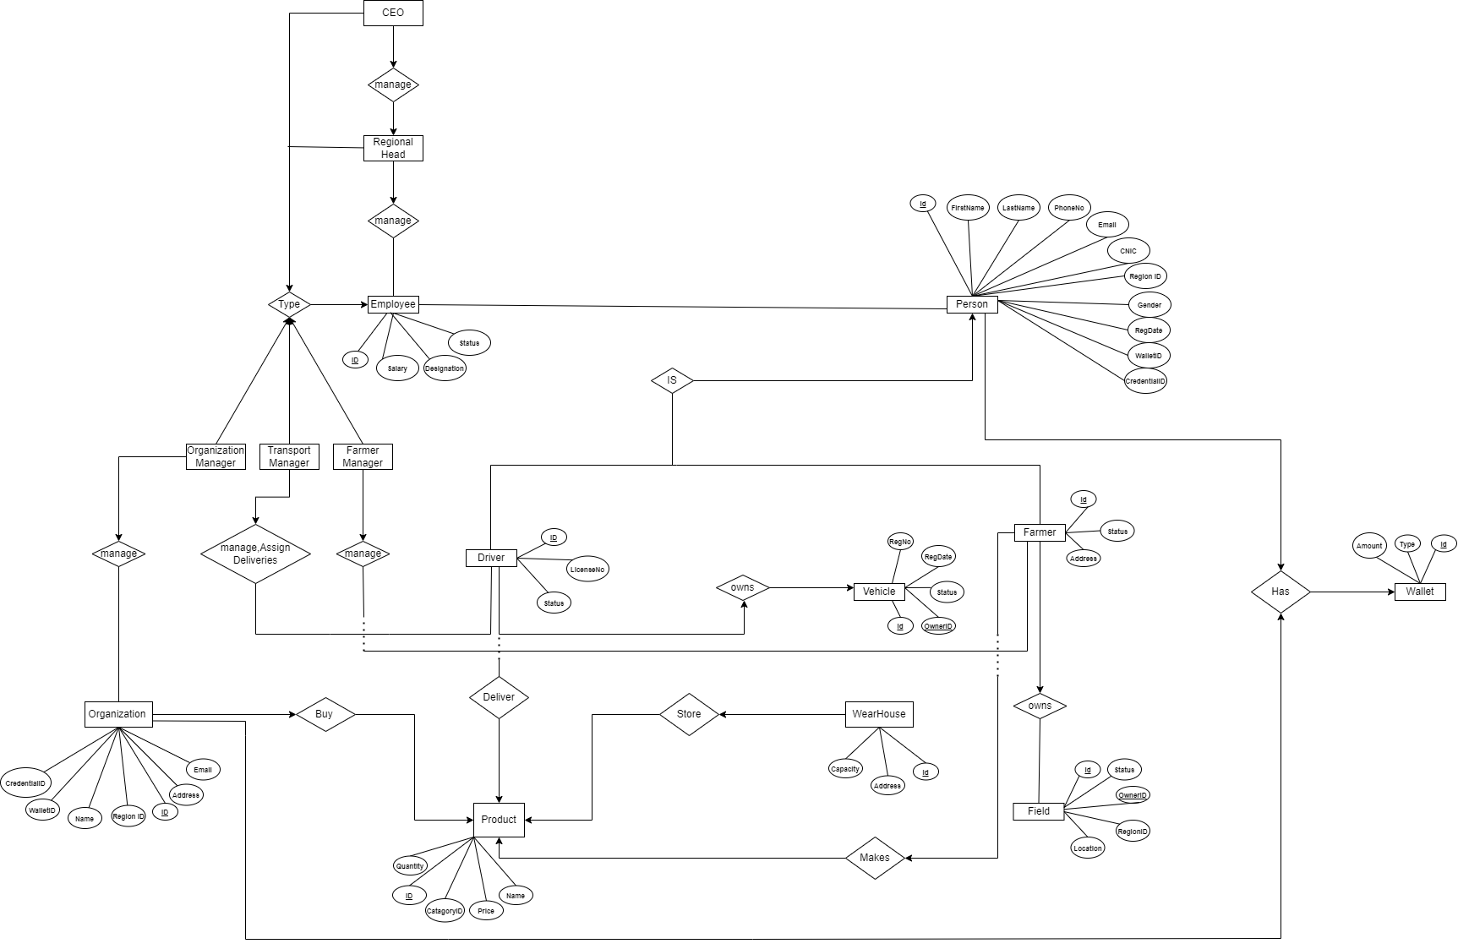
t
ER Diagram
Transportation Facility
Easy Market Access
Competitive Pricing
Secure Product Storage
Quality Check
Support for Farmer
t
t

Slide 10
t
ER Diagram
Transportation Facility
Easy Market Access
Competitive Pricing
Secure Product Storage
Quality Check
Support for Farmer
t
t

Slide 11
t
ER Diagram
Transportation Facility
Easy Market Access
Competitive Pricing
Secure Product Storage
Quality Check
Support for Farmer
t
t

Slide 12
t
ER Diagram
Transportation Facility
Easy Market Access
Competitive Pricing
Secure Product Storage
Quality Check
Support for Farmer
t
t

Slide 13
t
ER Diagram
Transportation Facility
Easy Market Access
Competitive Pricing
Secure Product Storage
Quality Check
Support for Farmer
t
t

Slide 14
t
ER Diagram
Transportation Facility
Easy Market Access
Competitive Pricing
Secure Product Storage
Quality Check
Support for Farmer
t
t

Slide 15
t
ER Diagram
Transportation Facility
Easy Market Access
Competitive Pricing
Secure Product Storage
Quality Check
Support for Farmer
t
t

Slide 16
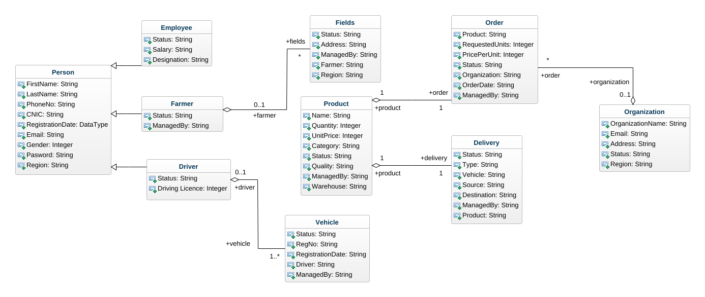
t
Class Diagram
t
t

Slide 17
t
Class Diagram
t
t

Slide 18
t
Class Diagram
t
t

Slide 19
t
Class Diagram
t
t

Slide 20
t
Class Diagram
t
t

Slide 21
t
Class Diagram
t
t

Slide 22
t
Class Diagram
t
t

Slide 23
t
Class Diagram
t
t

Slide 24
t
Class Diagram
t
t

Slide 25
t
Class Diagram
t
t

