Slide 1
FINAL YEAR PROJECT Management System
WPF Desktop Application

Slide 2

Description

Slide 3


Description

Slide 4

Description

Slide 5

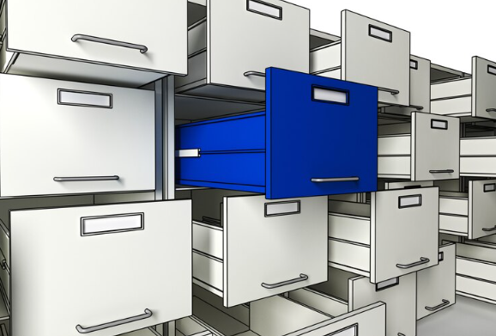
Data Storage in Universities

Slide 6

Problems in Register Storage System
Problems
Data Repetation
Copying Data
Updating Data
Generating Report
Unshareable Data

Slide 7
ABOUT DATA SCIENCE CONSULTING INFOGRAPHICS
What we want
No Repetation
Precise Calculations
Shareable Data
Easy to Manage

Slide 8
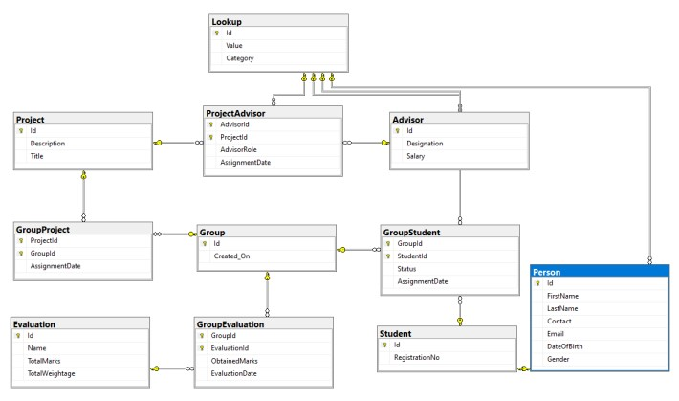
Data Base Design

Slide 9
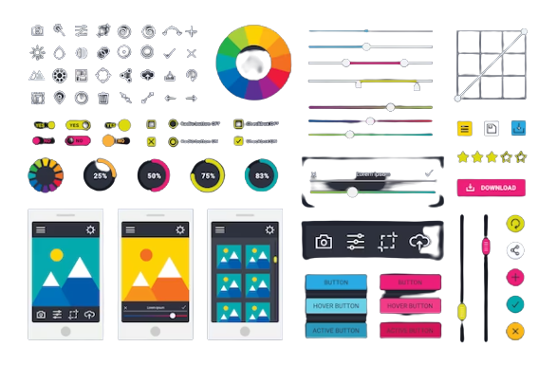
Graphic User Interface

Slide 10
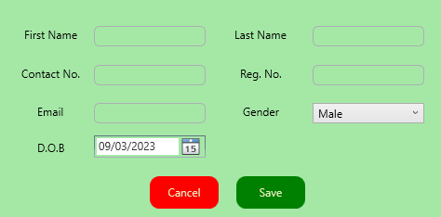
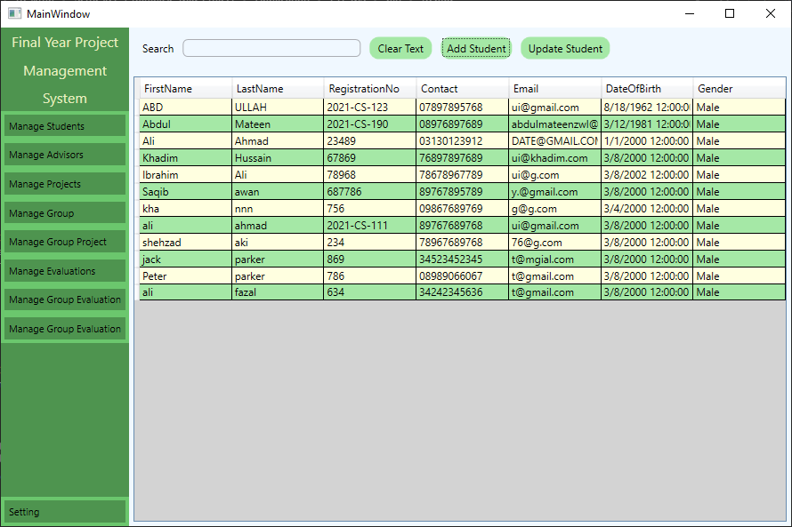
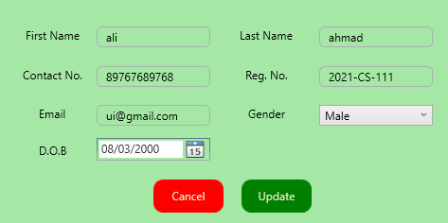
Student Section

Slide 11
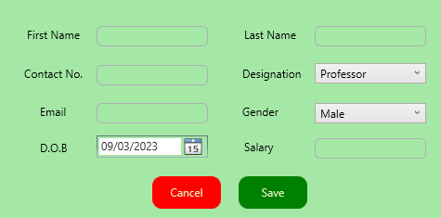
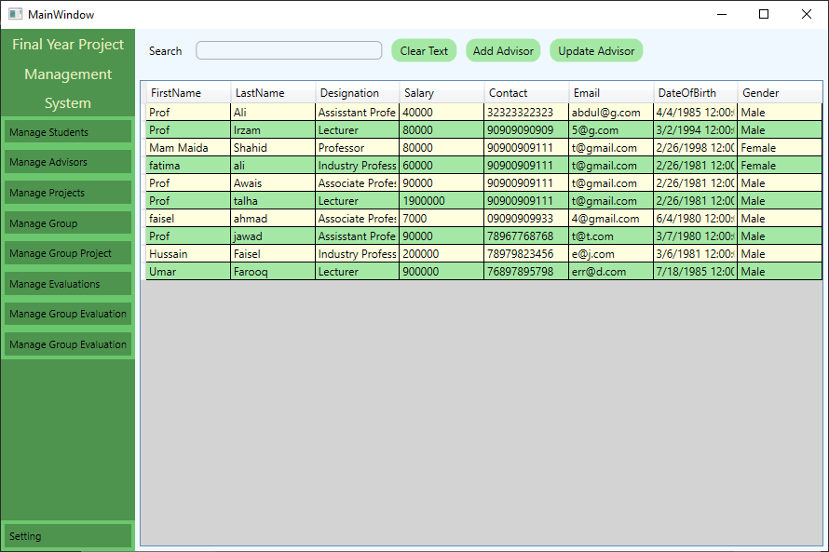
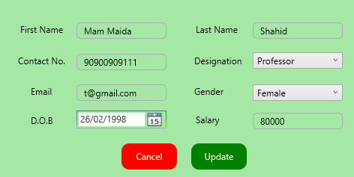
Advisor Section

Slide 12
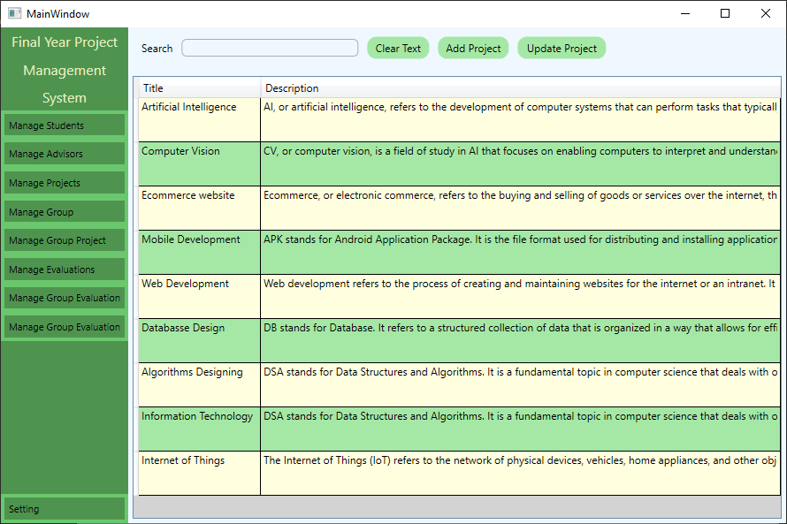
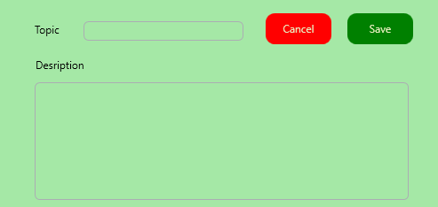
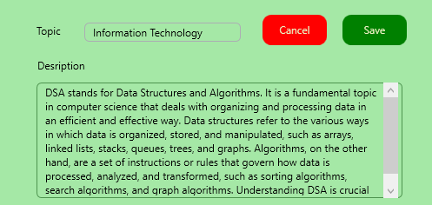
Project Section

Slide 13
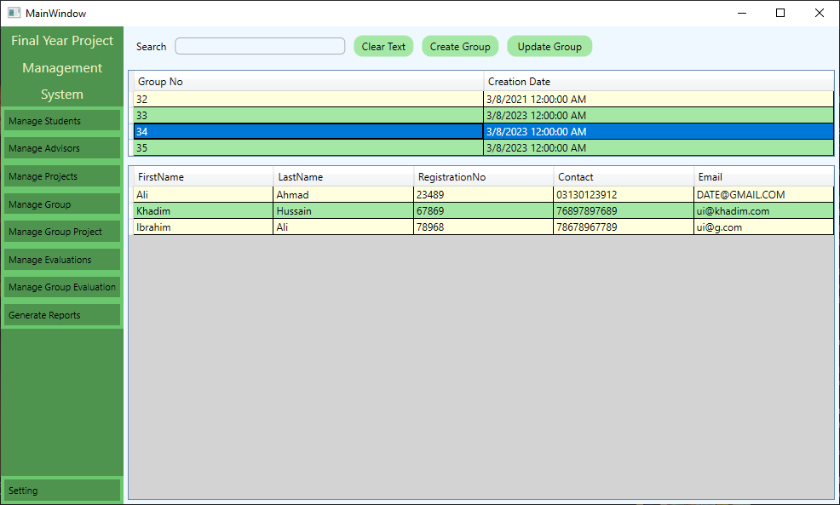
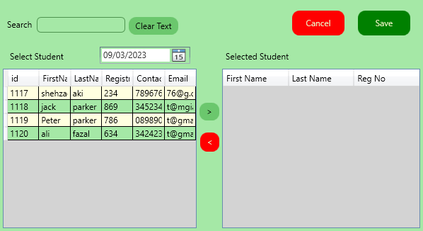
Group Section

Slide 14
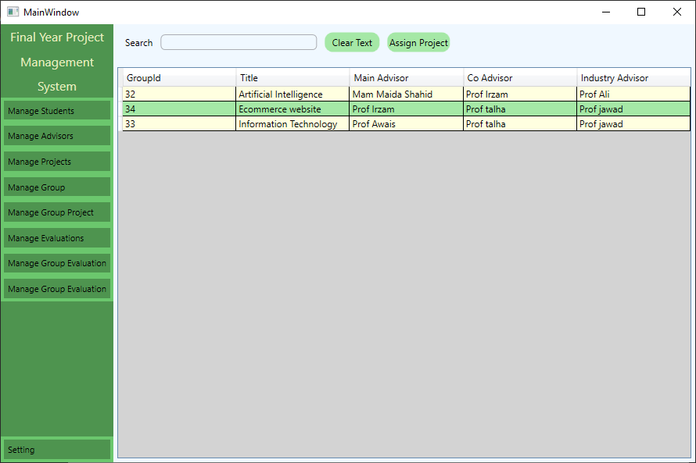
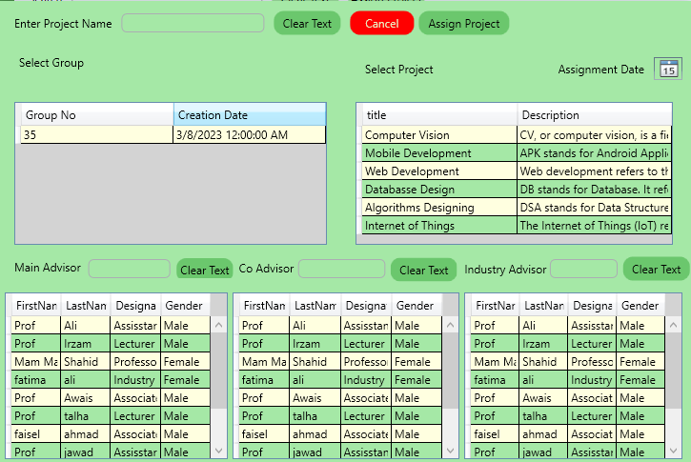
Group Project Section

Slide 15
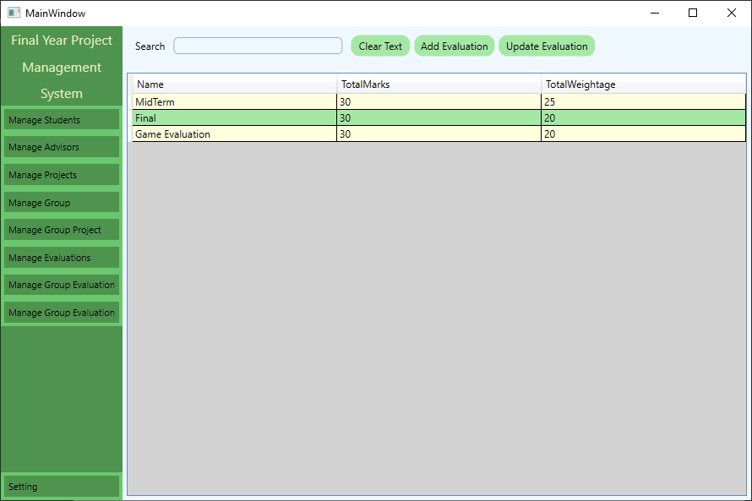
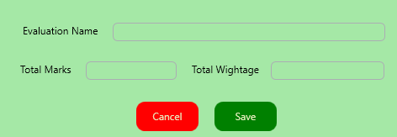
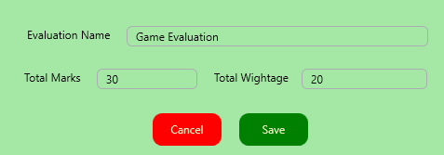
Evaluation Section

Slide 16
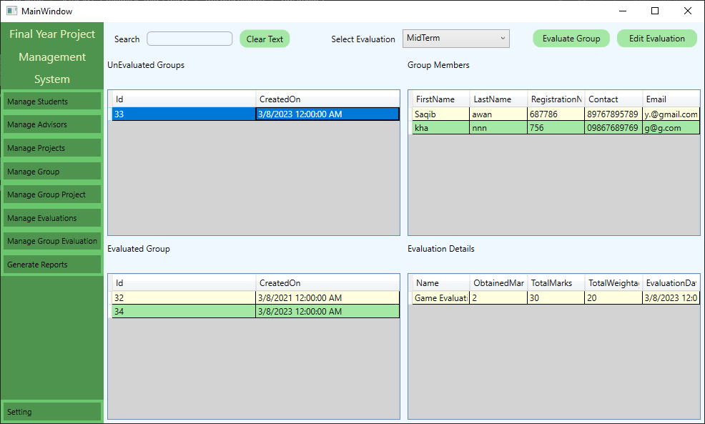
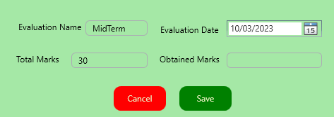
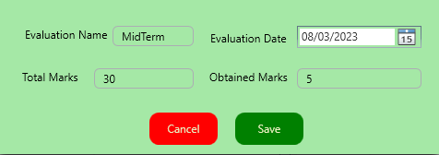
Group Evaluation Section

Slide 17
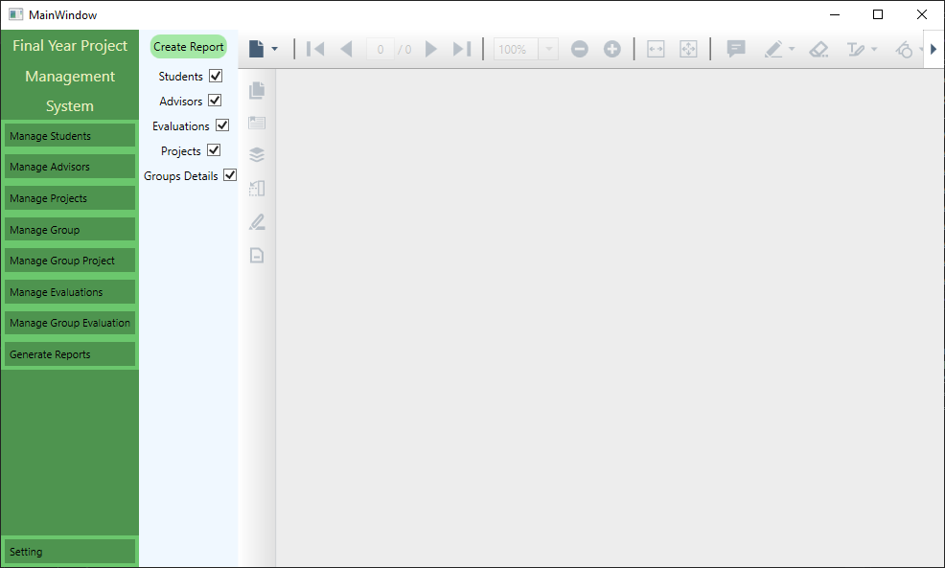
Generate Reports

Slide 18

Testing

Slide 19
Limitations
Single User Application
UnDeleteable Data
UnEditable Group
Unverified Information

Slide 20
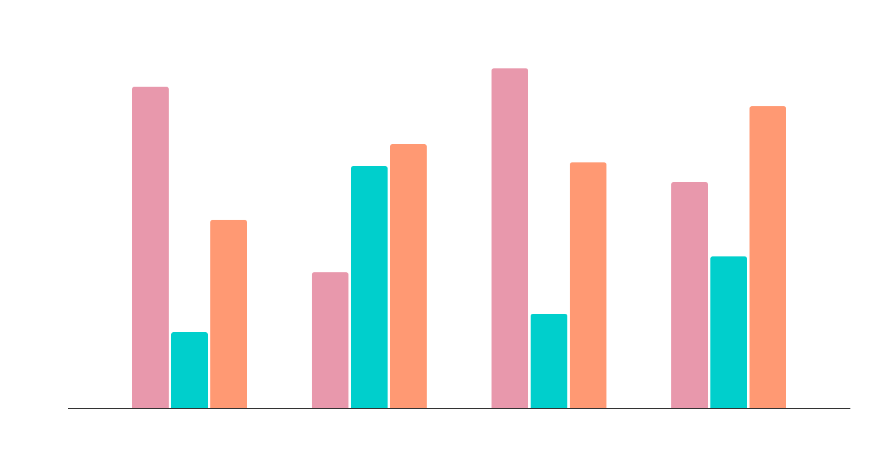
Reports
Students
Advisors
Groups
Evaluations

Slide 21

Thank You
Any Questions
https://facebook.com/AbdulMateenzwl
https://instagram.com/AbdulMateenzwl
https://linkedin.com/in/AbdulMateenzwl
https://twitter.com/AbdulMateenzwl
https://github.com/AbdulMateenzwl

