Slide 1
INTRODUCTION TO PSYCHOLOGY
Psychology

Slide 2
Learning Outcomes
Review of previous session
Psychology’s Key Issues
Nature Vs. Nurture
Conscious Vs. Unconscious causes of Behavior
Observable Behavior Vs. Internal Mental Processes
Free will Vs. Determinism
Individual Differences Vs. Universal Principles

Slide 3
Nature Vs. Nurture
Nature
How much of people’s behavior is due to their genetically determined nature (heredity)?
Nurture
How much of people’s behavior is due to the influences of the physical and social environment in which a child is raised?

Slide 4
Conscious Vs. Unconscious causes of Behavior
Conscious cause of behavior
How much of our behavior is produced by forces of which we are fully aware?
Unconscious cause of behavior
How much of our behavior is due to unconscious activity—mental processes that are not accessible to the conscious mind?
For example,
Psychologists adopting psychodynamic perspective argue that psychological disorders are brought about by unconscious factors, whereas psychologists employing the cognitive perspective suggest that psychological disorders largely are the result of faulty thinking processes.

Slide 5
Observable behavior Vs. Internal Mental Processes
Observable Behavior
Concentration solely on behavior that can be seen by outside observers, or
Internal mental processes
Focus on unseen thinking processes?
For example
Behavioral perspective, contend that the only authentic source of information for psychologists is behavior that can be observed directly.
Cognitive perspective, argue that what goes on inside a person’s mind is critical to understanding behavior, and so we must concern ourselves with mental processes.

Slide 6
Free will Vs. Determinism
Free will
The idea that behavior is caused primarily by choices that are made freely by the individual.
Determinism
The idea that people’s behavior is produced primarily by factors outside of their willful control.
For example
Biological perspective, psychodynamics perspective, behavioral perspective contends the idea of determinism while cognitive and humanistic perspective advocates the concept of free will.

Slide 7
Individual Differences Vs. Universal Principles
Individual differences
How much of our behavior is a consequence of our unique and special qualities?
Universal principles
How much our behavior reflects the culture and society in which we live?
For example
The neuroscience perspective tend to look for universal principles of behavior, such as how the nervous system operates or the way certain hormones works.
The humanistic perspective focus more on the uniqueness of every individual. They consider every person’s behavior a reflection of distinct and special individual qualities.

Slide 8
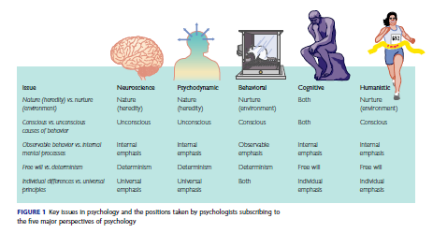

Slide 9
THANK YOU
HAPPY LEARNING STUDENTS!

