Slide 1
PERCEPTION
Psychology

Slide 2
Learning Outcomes
Definition of Perception
What is Perceptual Process?
Factors affecting Perceptual Process
Stages of Perceptual Process

Slide 3
Definition
“Perception is the organization, identification, and interpretation of sensory information in order to represent and understand the environment”.
“The process by which sensory input is interpreted.”
“Perception is the organization of sensory input into meaningful experience”
“The process of creating meaningful patterns from raw sensory information”.

Slide 4
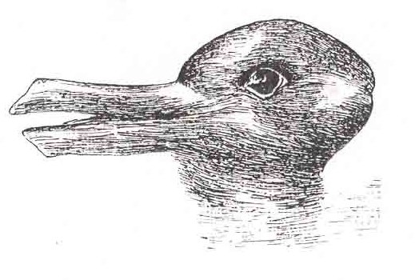

Slide 5
What is perceptual process?
The process by which people select, organize, interpret, retrieve, and respond to information”.
Perceptual information is gathered from:
Sight
Hearing
Touch
Taste
Smell

Slide 6


Slide 7
Factors Affecting the Perceptual Process
Characteristics of the perceiver
Motivation
Values and attitudes
Expectations
Cognitive Style
Past Experience and Culture
Personality
Characteristic of Setting
Physical context
Social context
Organizational context

Slide 8
Cont…
Characteristics of the perceived (Person, Object or event) such as:
Contrast
Intensity
Size
Motion
Repetition or Uniqueness

Slide 9
THANK YOU
HAPPY LEARNING STUDENTS!

