Slide 1
PERCEPTION
Psychology

Slide 2
Learning Outcomes
Perceptual Constancies
Common perceptual distortion

Slide 3
Perceptual Constancies
Perceptual constancy
A tendency to perceive objects as stable and unchanging despite changes in sensory stimulation. Memory and experience plays vital role.
e.g. white house will remain white, (Taj Mahal)
Size constancy
A perception of an object as the same size regardless of the distance from which it is viewed.
e.g. Train

Slide 4
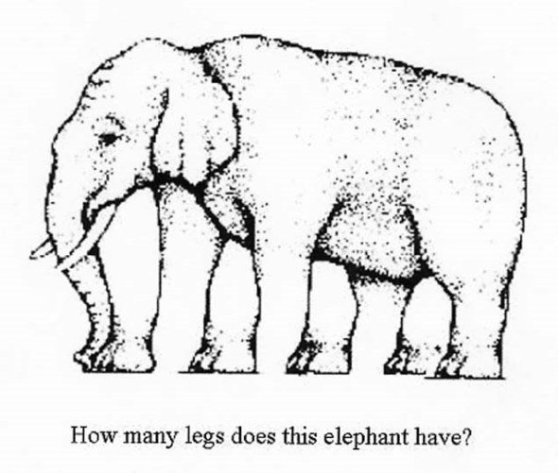

Slide 5
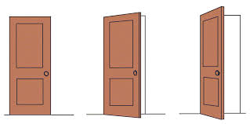
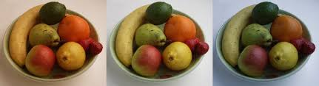
Cont…
Shape constancy
A tendency to see an object as the same shape no matter what angle it is viewed from.
Brightness constancy
A perception of brightness as the same, even though the amount of light reaching the retina changes.
Color constancy
An inclination to perceive familiar objects as retaining their color despite changes in sensory information.

Slide 6
Does spelling really matter?
I cdnuolt blveiee taht I aulaclty uesdnatnrd waht I was rdanieg The phaonmneal pweor of the hmuan mnid Aoccdrnig to a rscheearch at Cmabrigde Uinervtisy, it deosn’t mttaer in waht oredr the ltteers in a wrod are, the olny iprmoatnt tihng is taht the frist and lsat ltteer be in the rghit pclae. The rset can be a taotl mses and you can sitll raed it wouthit a porblem. Tihs is bcuseae the huamn mnid deos not raed ervey lteter by istlef, but the wrod as a wlohe. Amzanig huh? Yaeh and I awlyas thuohgt slpeling was ipmorantt.

Slide 7
Common Perceptual Distortions
All of the perceptual distortions occur at different stages of perceptual process.
Stereotypes
Halo Effects
Selective Perception
Projection
Contrast Effects
Self-fulfilling prophecy

Slide 8
Cont…
Stereotypes
Combines information based on the category or class to which a person, situation or object belongs.
e.g. women are poor drivers and cannot be a managers.
Old people cannot learn new skills.
Halo Effect
When one attribute (intelligence, sociability or appearance) of a person or situation is used to develop an overall impression of the individual or situation.
Punctuality

Slide 9
Cont…
Selective Perception
The tendency to single out those aspects of a situation, person, or object that are consistent with one’s needs, values or attitudes
A person only perceives what he desires to and ignores other viewpoints.
e.g. Teacher may have favorite student because they are biased by in-group favoritism. The teacher ignores the student's poor attainment and they might not notice the progress of their least favorite student
Consumers may engage in some ads and not others due to their pre-affiliation with the product or pre-existing beliefs about the brand

Slide 10
Cont…
Projection
The assignment of one’s personal attributes to other individual. It occurs at interpretation stage.
It can be controlled by high degree of understanding and self-awareness.
e.g. A person who is corrupt will see others as corrupt.
A teacher who is regular and punctual will expect his/her students to be regular and punctual.

Slide 11
Cont…
Contrast Effects
When an individual is compared to other people on the same characteristics on which the other rank higher or lower.
e.g. two siblings with different academic performance.
Self-fulfilling prophecy
The tendency to create or find in another situation or individual that which one expected to find.
e.g. predictions
if investors think the stock market will crash, they will buy fewer stocks.

Slide 12
THANK YOU
HAPPY LEARNING STUDENTS!

