Slide 1
Stress

Slide 2
Group Members:
Khadim Hussain 2021-CS-204
Muawz Naeem 2021-CS-189
Abdul Mateen 2021-CS-190
Muhammad Nasir Kamal 2021-CS-192
Saqib Shehzad 2021-CS-187
Muhammad Danish 2021-CS-167
Hamza Ali 2021-CS-194

Slide 3
Learning Outcomes:

Slide 4
Conent:
Stress
Stressors
Distress and Eustress

Slide 5
Reference Slide:
https://www.webmd.com/balance/guide/causes-of-stress
https://www.mind.org.uk/information-support/types-of-mental-health-problems/stress/signs-and-symptoms-of-stress/

Slide 6

Is there any need of stress in our lives?
YES or NO

Slide 7
Origin Of Stress:
Latin words “strictus” which means “tight” or “narrow” and “stringere” which means “to tighten”.

Slide 8
What is Stress?
Stress is a way in which human beings react both physically and mentally to changes, events, and situations in their lives.

Slide 9
Stressor:
Any chemical or biological agent, environmental condition, external stimulus or an event which causes stress to an organism.
In simple words,Anything that causes stress is stressor.

Slide 10
Stressor:
For Example:
The death of a beloved one.
Divorce.
Loss of a job.
Increase in financial obligations.
Moving to a new home.
And many more

Slide 11

Is All Stress Bad?

Slide 12
Catagories of Stress:
Hans Selye introduced the concept of stress having two categories:
Distress
Eustress

Slide 13
Distress vs Eustress:
Distress is stress that negatively affects you.
Eustress is stress that has a positive effect on you.
Eustress is what energizes us and motivates us to make a change.

Slide 14
Distress vs Eustress:
How Distress Impacts You
Lack of sleep
Headaches
Mood changes
Change in appetite
Shortness of breathe
Digestion issues
Vs.
How Eustress Impacts You
Increased energy
Increased focus
Creates excitment
Increased self-efficacy
Increased productivity
Increases resilence

Slide 15
Examples of Distress/Eustress Stressors:
Vs.
Eustress Stressors
Exercise
Socializing
Mindfulness/Meditation
Build relationship/friendship
Vacationing
Listening to happy music
Achieving a goal
Go to a spa
Distress Stressors
Deadlines
Financial crisis
Death of a loved one
Relationship problems
Abuse or feeling neglected
Illness or an injury
Work problems
Worrying about someone else

Slide 16
Stressor is Distress or Eustress???
Ask Yourself a couple of Questions:
How do you respond to certain stressors?
Do you let it overwhelm you or make use of the energy?
“It’s not stress that kills us, it is our reaction to it” -Hans Selye

Slide 17
Causes of Stress

Slide 18
For Most Of us it can be!
The death of a loved one
Facing big changes in life
Break up
Divorce
Loss of a job
Under a lot of pressure
Business loss
Parents Pressure
Carrier tension
Lack of Confidence
Insufficient resources to manage a family
Disaster like earthquake, Flood or War
Always having negative thought

Slide 19
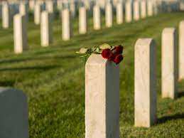
Death of a loved one:

Slide 20

Break Up/Divorce:

Slide 21

Loss of Job:

Slide 22

Business Loss:

Slide 23
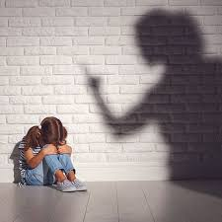
Parent pressure:

Slide 24

Carrier Tension:

Slide 25
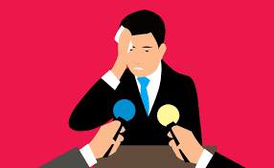
Lack of confidence:

Slide 26
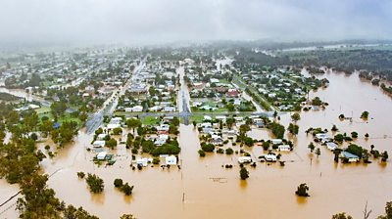
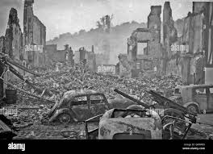
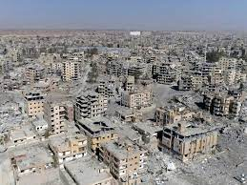
Disaster like flood/war:

Slide 27
Symptoms:
Emotional Symptoms
Physical Symptoms
Mental Symptoms

Slide 28
1) Emotional Symptoms:
Becoming easily frustrated, angry, and moody
Having a hard time relaxing and quieting your mind
Avoiding others
Being quiet and not talking to anyone about your problems
Trouble in sleeping or sleeping too much
Keep forgetting about anything

Slide 29
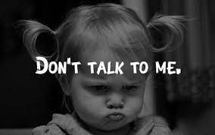
Moody/Frustrated:

Slide 30
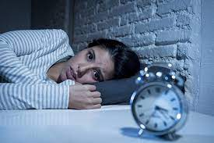
Can’t Relax:

Slide 31

Avoiding Others:

Slide 32
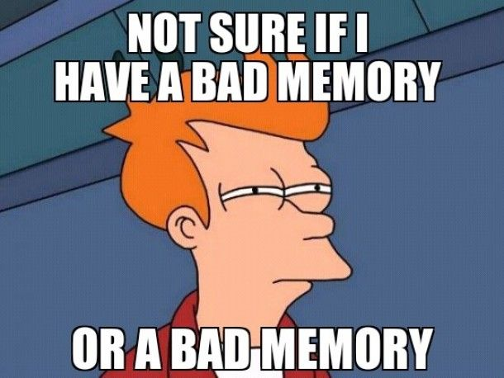
Keep Forgetting:

Slide 33
2) Physical Symptoms:
Difficulty in breathing.
Blurred eyesight or sore eyes.
Sleep problems.
Muscle aches and headaches.
Indigestion or heartburn.
Headache and Dizziness
High Blood pressure
Organs Malfunction

Slide 34

Blurred vision:

Slide 35
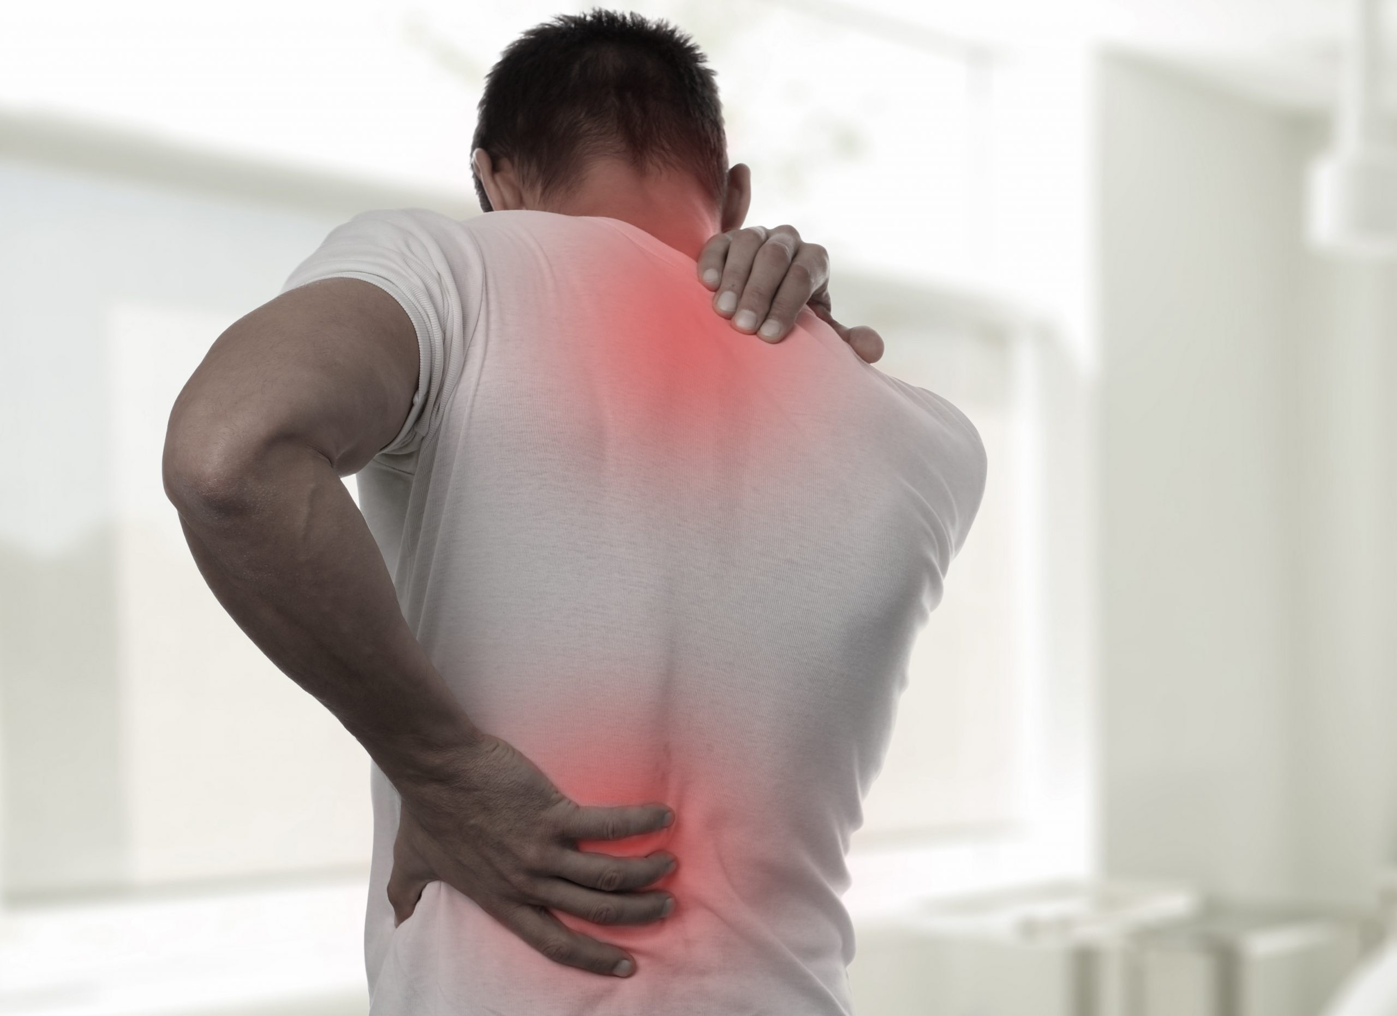
Muscle Pain:

Slide 36
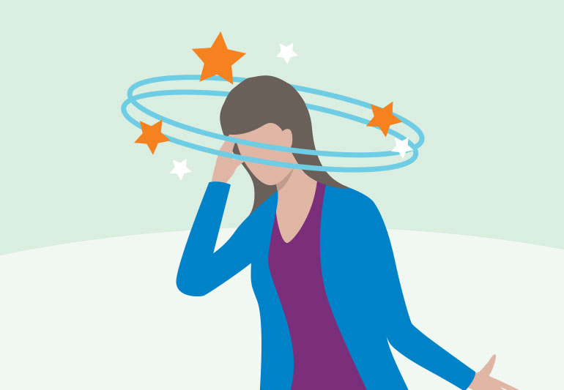
Headache and dizziness:

Slide 37
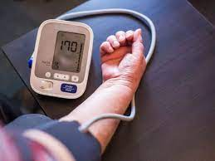
High Blood Pressure:

Slide 38
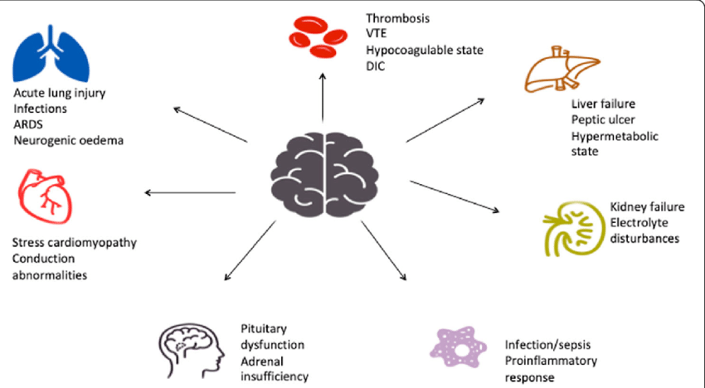
Organ Malfunction:

Slide 39
3) Mental Symptoms:
Depression or anxiety
Feeling unmotivated(Low self Esteem)
Making bad decisions
Panic attacks

Slide 40
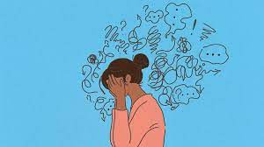
Depression:

Slide 41
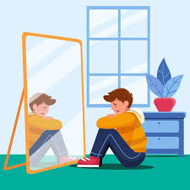
Low Self Esteem:

Slide 42
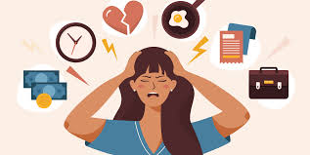
Panic Attacks:

Slide 43
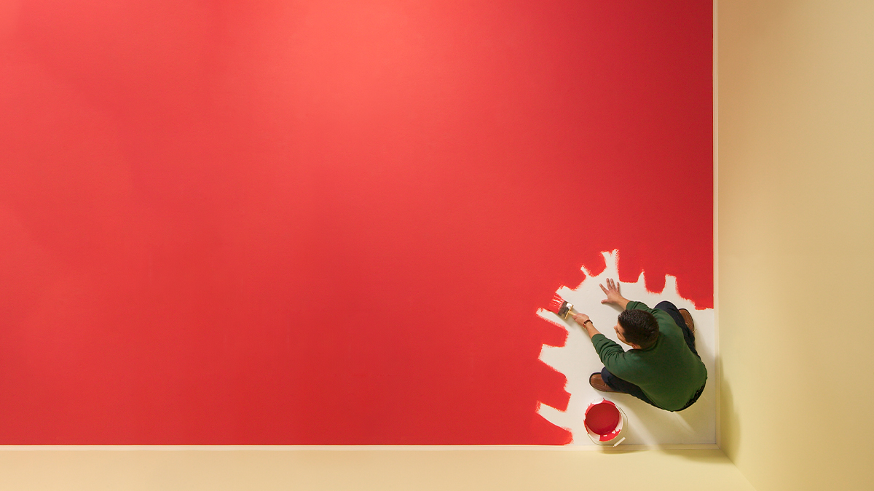
Making bad decisions:

Slide 44
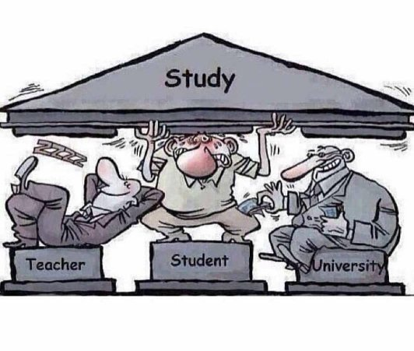
Education System In Pakistan

Slide 45


Slide 46

Education System In Pakistan

Slide 47
Stress?

Slide 48
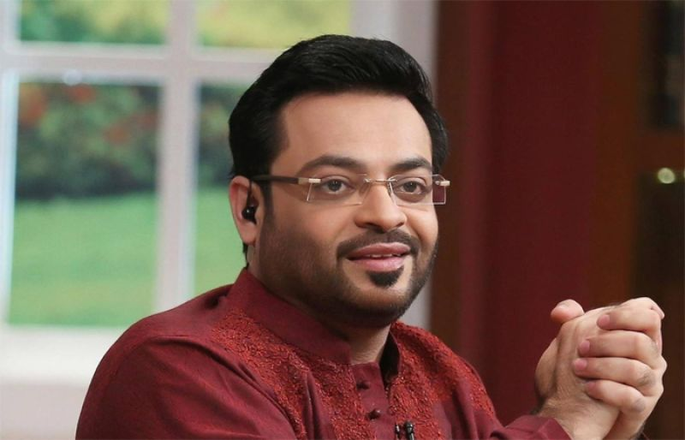
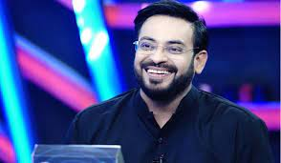
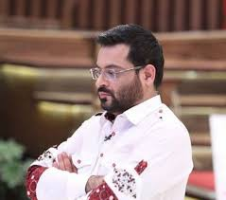
Stress?

Slide 49
Depression ?
Depression (major depressive disorder) is a common and serious medical illness that negatively affects how you feel, the way you think and how you act.

Slide 50
Difference Between Stress and Depression??
There are three major factors that can help you recognize the difference.
Intensity
Extent
Impact

Slide 51
Symptoms
Changes in Thinking
Changes in feeling
Changes in Behavior
Changes in Physical Well-being

Slide 52
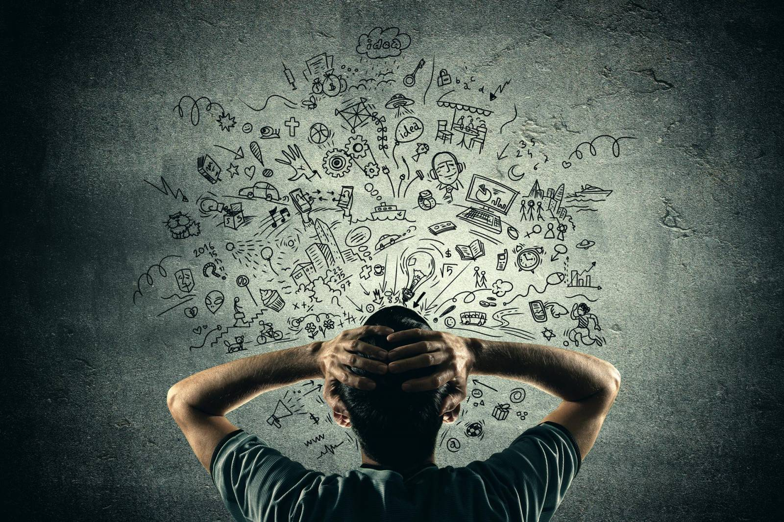
Change in Thinking??
1-you may experience problems with concentration
and decision making.
2-Some people report difficulty with short
term memory.
3-some may forget things all the time.

Slide 53
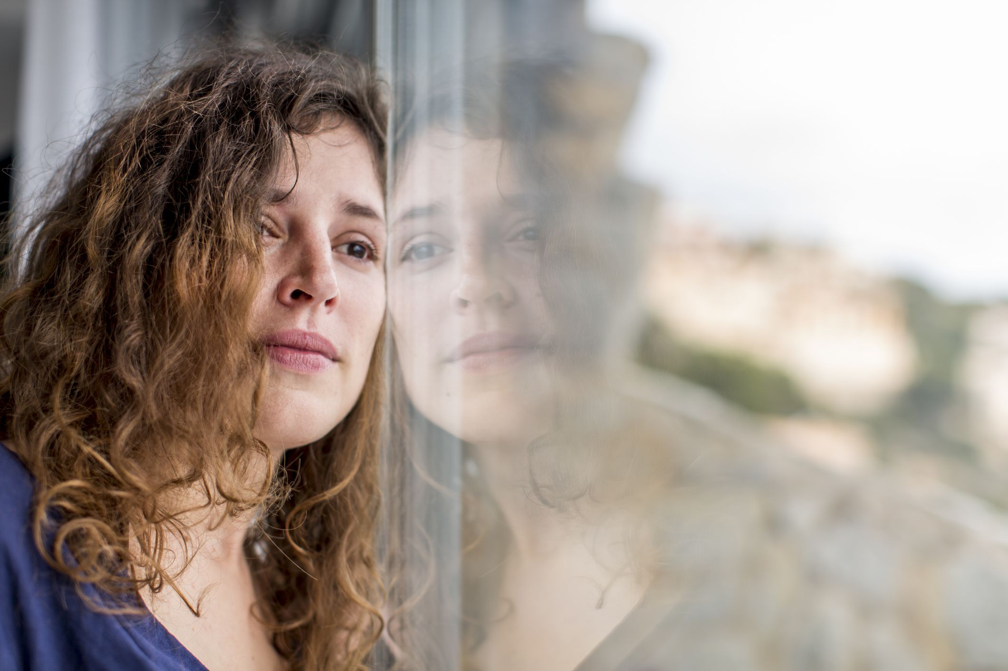
Change in Feelings??
1-You may feel sad for no reason at all.
2-No longer enjoy activities that were found
pleasurable.
3- May feel "slowed down" and tired all the time.
4-Sometimes irritability is a problem.
5- Difficulty in controlling your temper.

Slide 54
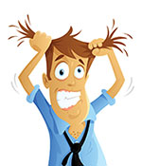
Change in Behavior??
1-Some people do not feel comfortable with others
2-Social withdrawal is common.
3- Some have experience of a dramatic change in
appetite, either eating more or less.
4- Sexual desire may disappear, resulting in lack of
sexual activity.

Slide 55
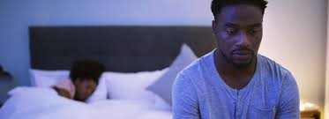
Change in Physical Well-Being??
1-Spending more time sleeping, is common.
2-Some people can't sleep, or don't sleep soundly.
3- Many people lose their appetite, feel slowed
down by depression, and complain of many aches
and pains.

