Slide 1
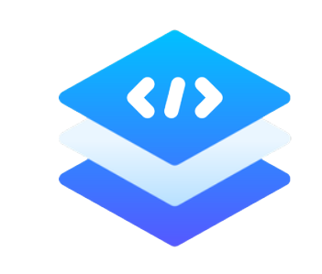
Welcome to TIERS Limited Summer Internship Program 2023

Slide 2
What is TIERS Limited?
TIERS Limited is a technology consulting firm that integrates strategy, design, and engineering services into a streamlined workflow designed to assist clients at every stage of the process.
We have designed and built a diverse range of high-quality products from scratch over the last four years. Our experts are knowledgeable in a wide range of fields, including real estate, e-learning, healthcare, e-commerce, advertising, augmented reality, finance, the sharing economy, and many others. We are more confident than ever in our core expertise after 4 years of experience and a team of 30+ people. Leading corporations rely on us. We have completed over 50 projects for over 100+ clients. The thing we are most proud of is gaining our clients' trust.

Slide 3

Our Services
Our Services includes
Web Development
Mobile Development
UI/UX
Digital Marketing
Artificial Intellegence/ Machine Learning
Devops

Slide 4

Founder & CEO Message
I am delighted to welcome each and every one of you to our esteemed company and extend my warmest greetings. As the Founder and CEO of Tiers Limited, it fills me with immense pride to see our internship program in full swing, even in a remote setting.
First and foremost, let me express my gratitude for choosing Tiers Limited as your platform to kickstart your professional journey. We firmly believe that internships provide an invaluable opportunity for young minds to gain practical experience, develop essential skills, and explore their passions. Our internship program is designed to offer you a nurturing environment where you can learn, grow, and make a real impact.
Shoaib Rafique

Slide 5
Founder & CEO Message (Cont.)
As an intern at Tiers Limited, you are an integral part of our family. We are committed to your personal and professional growth, and we will provide you with the necessary guidance, resources, and mentorship to make your experience enriching and rewarding. Take full advantage of this opportunity to expand your knowledge, build your network, and unlock your true potential
Shoaib Rafique

Slide 6
Instructions for internship
We will upload the manual to respected google classroom like web development, mobile development etc.
We will assign the Task based on the manual and You have to complete it in the given time span.
After Completion of one concept we will conduct an online test from where we can judge that how's the performance going on.
Internee will be removed from internship who will not submit their 2 tasks in the whole internship.
At the end we will also assign projects from where we can distinguish the top performers of the internship.

Slide 7

Benefits of Internship
Get Internship Certificate
Job Replacement Opportunities for top performers
Learn Professional Skills
Make yourself Competitive in IT Market
Hands on Practice through working on different projects
Mentorship & Guidance

Slide 8
What we will learn in this Internship?
For Front End Development we will learn
HTML
CSS
JavaScript
React
For Complete web Development we will learn backend technologies including MERN Stack
Node JS
Express JS (API)

Slide 9
What we will learn in this Internship?
For Databases We will learn two databases
MongoDB
SQL
We will also learn
Creating our own API (Application Programming Interface) and integrate it in our application.
Payment Gateway Integrations
Email Integrations

Slide 10
What we will learn in this Internship?
We Will also host our application after each project by using different platforms for free like
Netlify
000webhost
Glitch.com

Slide 11
Any Queries?
You can ask any query at any time in WhatsApp group or also by emailing us. Feel Free to contact us.
Email: info@tierslimited.com

