Slide 1
Touching On States: An In-depth Analysis
Al-Kandari, AbdulMuhsin
Blessing, James

Slide 2
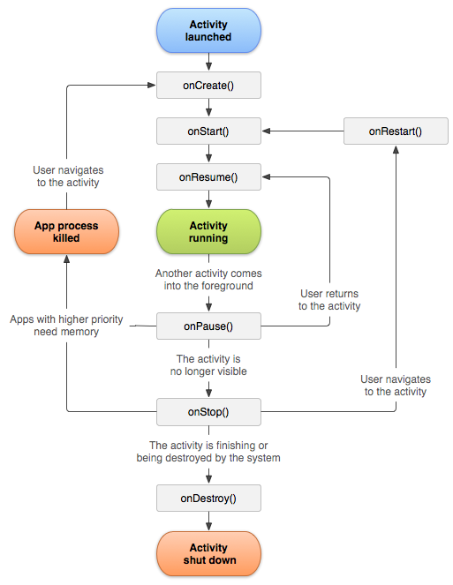
Quick Overview: What We Know?

Slide 3
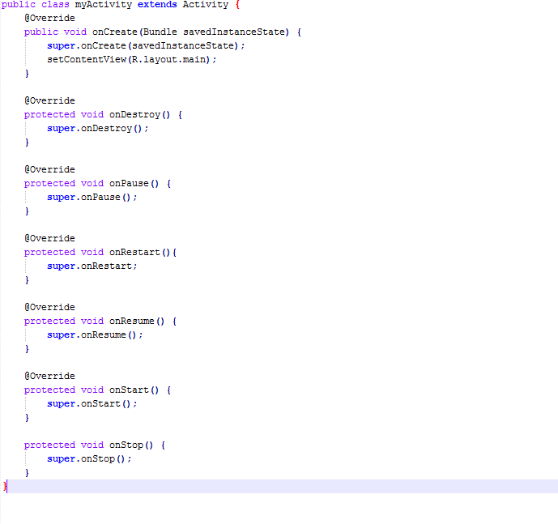
Placement: Where Do They Go?

Slide 4
Dynamic: How to Get Her There? onCreate(), onStart(), and onDestory()
onCreate(): Called when the activity is first created, it takes a Bundle object as its parameter which contains the activity’s previously frozen state if one exists. Where you should do all of your setup: create views, bind data to lists, etc. Always followed by onStart().
onStart(): Called when the activity is becoming visible to the user. Followed by onResume() if the activity comes to the foreground, or onStop() if it becomes hidden. ( onRestart() is a closely related method to onStart, it is called after your activity has been stopped, coding this method is optional.)
onDestroy(): The final call before an activity is destroyed. This happens either because the activity is finishing (finish() was called) or the android system is destroying the activity to save space. Distinguishing between these two scenarios is done with isFinishing().

Slide 5
Static: You’re Doing Your Job Right onResume()
Called when the activity will start interacting with the user.
When this fires the activity is top of the activity stack.
It signals the only state in which the user can input into the activity.
Always followed by onPause();
The best time to make sure that the needed resources are activated.

Slide 6
Static: Need A Break? onPause()
Called when the system is about to start resuming a previous activity or stopping the current activity
Typically used to commit unsaved changes, stop animations and stop other CPU consuming actions.
This method should be very quick, no CPU intensive actions, since the next activity will not Resume until the system returns from this method.
It is followed by onResume()if the activity returns back to the front, or by onStop() if it becomes invisible to the user.

Slide 7
Static: Satisfied onStop()
Called once the activity is no longer visible.
This may happen because a new activity is being started, an existing one is being brought in front of this one, or this one is being destroyed.
It is followed by either onRestart() if the activity is coming back to interact with the user, or onDestroy() if this activity is going away.
The app is destructible at this point.

