Slide 1
Android Development: We’re Getting There
Al-Kandari, AbdulMuhsin
Blessing, James

Slide 2
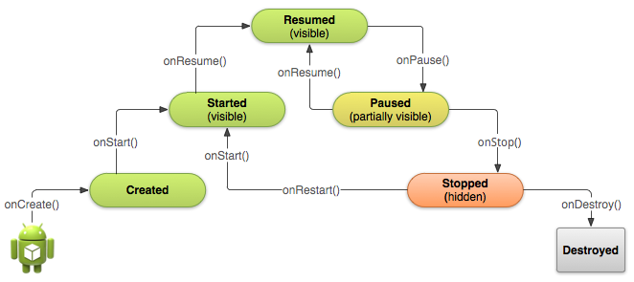
Activity Life Cycle Diagram

Slide 3
Walking Through an Activity’s Lifecycle
Any android activity can be in one of six states: Created, Started, Resumed, Paused, Stopped and Destroyed.
Walkthrough:
When an Activity is first “summoned” either by the start of the app or by an intent the onCreate() method fires, which quickly calls onStart(), which is followed closely by onResume().
The activity is now in the Resumed state, this is the state that the user interacts with and can be referred to as the running state.
From the Resumed state the activity can go to the Paused state which is called through the onPause() method, the paused state will only persist if the activity is partially obscured by another activity or fragment (an Example of this are dialogs or popups). Note: No input can be given to the activity in this state.
If the activity is completely hidden and not visible the Paused state will move into a Stopped state through onStop(). In this state the instance and the state information is retained. It is from this state that an activity can be Destroyed.

Slide 4
General Occurrences in Methods
onStart(): verify that the required system features are enabled
onResume(): initialize needed components (begin animations, or components that are only used while the activity has user focus like the camera)
onPause(): Stop animations, commit changes that a user would expect to be permanently saved (such as a draft email), and release system resources (broadcast recievers, gps, etc.)
Avoid CPU intensive work here because it can slow transition to the next activity
onStop(): release almost all resources (in extreme cases android might kill your app process without calling onDestroy() so it is important you don’t leave resources that leak memory), also perform larger more intensive shut-down operations (e.g. writing to a database)

Slide 5
Notes: What You Need to Know
Only 3 states are static: Resumed, Paused and Stopped.
For lower complexity applications, a need to implement ALL the lifecycle methods is highly unlikely. It is still important to understand each one even if you do not need to implement it.
Implementation of these lifecycle methods may be the only way to ensure your app behaves the way users expect.
Implementing these methods properly stops the following problems from occurring:
Crashes after phone calls or after switching to different apps.
Consumption of system resources while the user is not using them.
The user can no longer progress if they leave your app and return at a later time.
The program crashes or the user loses progress when the screen rotates between landscape and portrait.

Slide 6
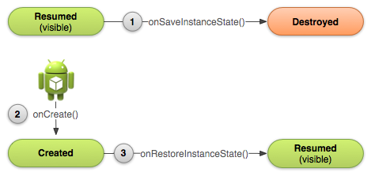
onCreate() & onDestroy(): We Didn’t Forget You, You’re Just Special
When destroying an activity, you often come across data that you would like to reload when the activity is recreated (especially when the screen rotates as switch from landscape to portrait or vice-versa causes the activity to be destroyed)
The data that you want to reload should not be stored permanently, Android solves this using Bundle objects and the onSaveInstanceState() and onRestoreInstanceState().

Slide 7
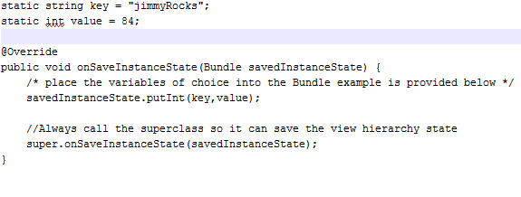
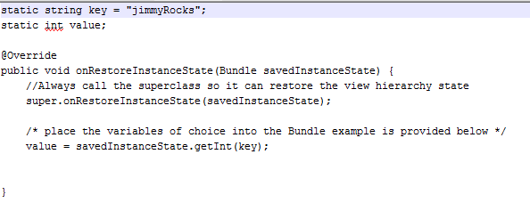
onCreate() & onDestroy(): Continued
The format of the onSaveInstanceState() method is as follows:
The format of the onRestoreInstanceState() method is as follows

Slide 8
Intents: Telling Your App Where to Go
When moving from an activity to another activity in android you have to declare your intent.
An intent is an abstract description of an operation to be performed.
The structure of an initializing an intent is as follows:
Intent myIntent = new Intent(this, nextActivity.class);
Intent: is the object type you are creating
myIntent: the name of your object
this: current activity
nextActivity.class: the name of your next activity, note that you are calling the java file not the xml file.

Slide 9
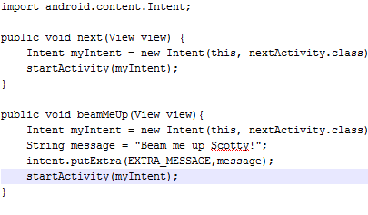
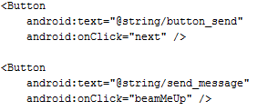
Intents: Moving on With A Click of a Button
An activity with two buttons in XML
The java methods for each button

Slide 10

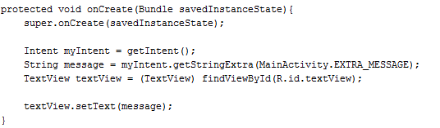
Intents: Receiving Info From An Intent
If the intent you used carries any extra information, that information needs to be received by the other activity.
This is done as follows:
The nextActivity’s TextView in the XML
The onCreate method for nextActivity

Slide 11
Exercise:
Build an app that illustrates the different activity states, is able to switch between activities, and illustrates saved instances. (remember that the saved instances are activity specific not application specific)

