Slide 1

Mastering Object-Oriented Programming (OOP) in Python
A Comprehensive Guide to Principles, Patterns, and Best Practices
Manus AI
November 2025

Slide 2

Presentation Roadmap
1
Introduction to OOP vs. Procedural Programming
2
Core Concepts: Classes, Objects, and Methods
3
The Four Pillars: Encapsulation, Abstraction, Inheritance, Polymorphism
4
Advanced Topics: super(), Dunder Methods, Composition
5
Best Practices and Real-World Application
6
Mini Project Demonstration

Slide 3
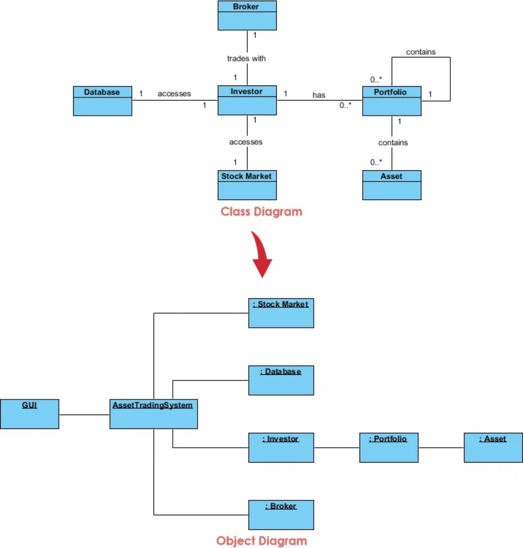
Defining Object-Oriented Programming (OOP)
OOP is a programming paradigm based on the concept of "objects," which can contain data (attributes) and code (methods). The primary goal of OOP is to model real-world entities and relationships, making complex systems easier to design, maintain, and scale.
•
Objects: Instances of a class, representing real-world entities.
•
Classes: Blueprints or templates for creating objects.
•
Four Pillars: Encapsulation, Abstraction, Inheritance, and Polymorphism.

Slide 4

Paradigm Shift: OOP vs. Procedural
Feature
Procedural Programming
Object-Oriented Programming
Focus
Functions and procedures
Objects and classes
Data & Code
Separated
Bundled together (Encapsulation)
Design
Top-down approach
Bottom-up approach
Reusability
Low
High (through Inheritance)
Complexity
Difficult to manage for large systems
Easier to manage and scale
Key Takeaway:
OOP offers a more intuitive and structured way to manage complexity by modeling real-world entities, leading to more maintainable and reusable code.

Slide 5
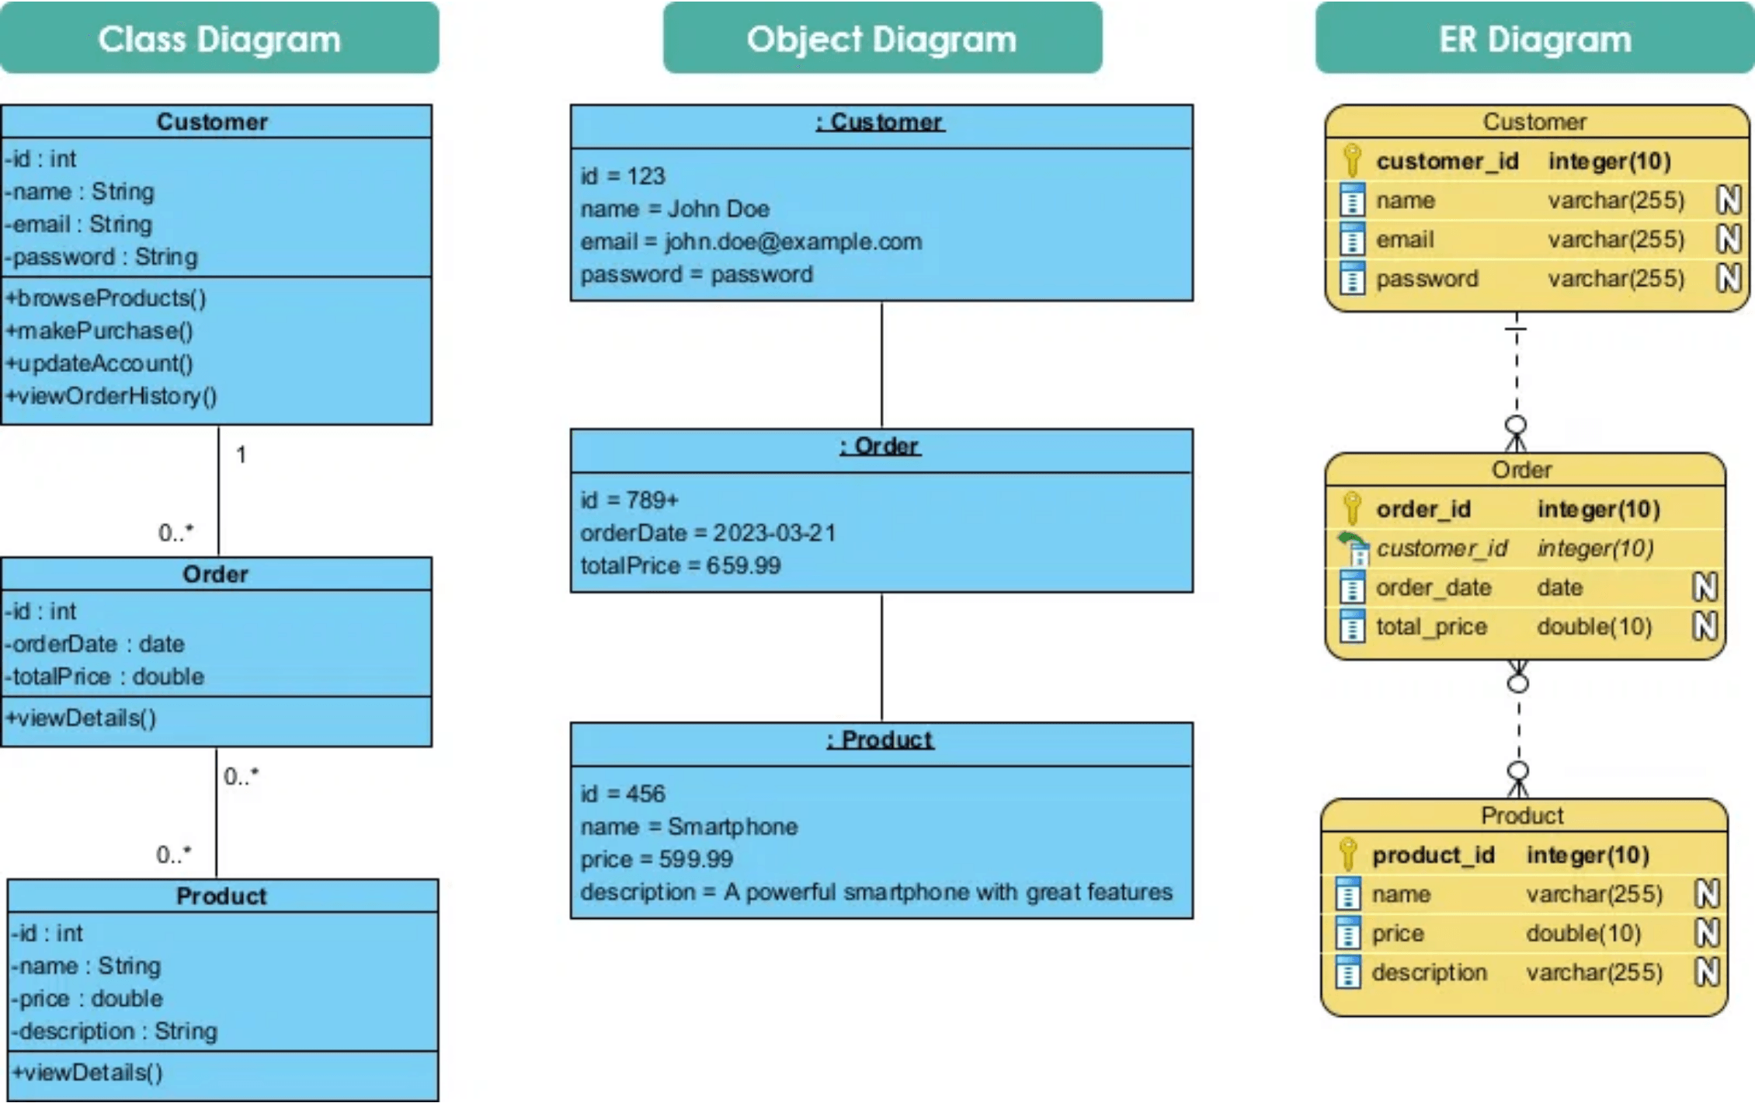
The Blueprint and the Instance
Class
Object
A user-defined blueprint or prototype from which objects are created. It defines a set of attributes and methods that the objects will possess.
An instance of a class. When a class is defined, no memory is allocated. Memory is allocated only when an object is instantiated.
Python Code Example
classDog:
# Class Attribute
species = "Canis familiaris"
# Method
defbark(self):
return"Woof!"
# Object Instantiation
dog1 = Dog()
dog2 = Dog()
# Accessing attributes and methods
print(dog1.species)
print(dog2.bark())

Slide 6
Initializing Objects with `__init__`
Definition:
The `__init__` method is a special method (a "dunder" method) that is automatically called when a new object is created from a class. It is used to initialize the object's attributes. The first parameter, `self`, refers to the instance being created.
Python Code Example:
1
classBook:
2
# The constructor method
3
def__init__(self, title, author, pages):
4
self.title = title # Instance Variable
5
self.author = author # Instance Variable
6
self.pages = pages # Instance Variable
7
8
defget_info(self):
9
returnf'"{self.title}" by {self.author}, {self.pages} pages.'
10
11
book1 = Book("The Great Gatsby", "F. Scott Fitzgerald", 180)
12
print(book1.get_info())
Output:
"The Great Gatsby" by F. Scott Fitzgerald, 180 pages.

Slide 7

Data Scope: Instance vs. Class Variables
classEmployee: # Class Variableraise_amount = 1.04def__init__(self, first, last, pay): # Instance Variablesself.first = first self.last = last self.pay = pay defapply_raise(self): self.pay = int(self.pay * self.raise_amount) emp1 = Employee("John", "Doe", 50000) emp2 = Employee("Jane", "Smith", 60000) # Instance variables are uniqueprint(emp1.pay) # 50000print(emp2.pay) # 60000# Class variable sharedprint(emp1.raise_amount) # 1.04print(emp2.raise_amount) # 1.04
Feature
Instance Variables
Class Variables
Scope
Unique to each object
Shared by all objects
Definition
Inside __init__ with self
Inside class, outside methods
Memory
Separate for each instance
Single copy in memory
Access
obj.variable_name
ClassName.variable_name
Modification
Affects only that instance
Affects all instances

Slide 8

Three Types of Methods
Method Type
Decorator
First Argument
Purpose
Instance
None
self
(the instance)
Operate on instance data. Most common type.
Operate on class data (class variables). Used as factory methods.
Class
@classmethod
cls
(the class)
None
Utility functions with logical connection to class but no access to instance or class data.
Static
@staticmethod
classCalculator:
@staticmethod
defadd(x, y):
return x + y
result = Calculator.add(10, 5)
print(f"Static Method Result: {result}")
Key Takeaway: Methods define the behavior of objects. Choosing the right method type (instance, class, or static) depends on whether you need to interact with instance data, class data, or neither.

Slide 9
Encapsulation: Bundling Data and Methods
Definition: Encapsulation is the mechanism of restricting direct access to an object's data (attributes) and methods, bundling them together within a class. It prevents accidental modification of data and hides the internal implementation details.
Single Underscore (_variable)
Double Underscore (__variable)
By convention, indicates a protected attribute. Should not be accessed directly from outside the class, but Python does not enforce this restriction.
Invokes name mangling, making the attribute harder to access from outside. Python mangles the name to _ClassName__variable.
Python Code Example (Using Getters and Setters):
classAccount:
def__init__(self, balance):
# Protected attribute by convention
self._balance = balance
# Getter method
defget_balance(self):
returnself._balance
# Setter method with validation
defdeposit(self, amount):
if amount > 0:
self._balance += amount
returnTrue
returnFalse
my_account = Account(1000)
my_account.deposit(500)
print(f"New Balance: {my_account.get_balance()}")

Slide 10
Abstraction: Hiding Complexity
Definition:
Python Code Example (Abstract Base Class):
Abstraction is the process of hiding the complex implementation details and showing only the essential features of the object to the user. It focuses on what the object does rather than how it does it.
1
from abc import ABC, abstractmethod
2
3
classVehicle(ABC):
4
@abstractmethod
5
defstart_engine(self):
Implementation in Python:
6
pass
•
Achieved using Abstract Base Classes (ABCs) from the abc module.
7
8
defstop_engine(self):
•
An abstract class cannot be instantiated directly.
9
print("Engine stopped.")
•
Subclasses must implement all abstract methods defined in the ABC.
10
11
classCar(Vehicle):
12
defstart_engine(self):
13
print("Car engine started with a key.")
14
15
car = Car()
16
car.start_engine()
17
car.stop_engine()

Slide 11
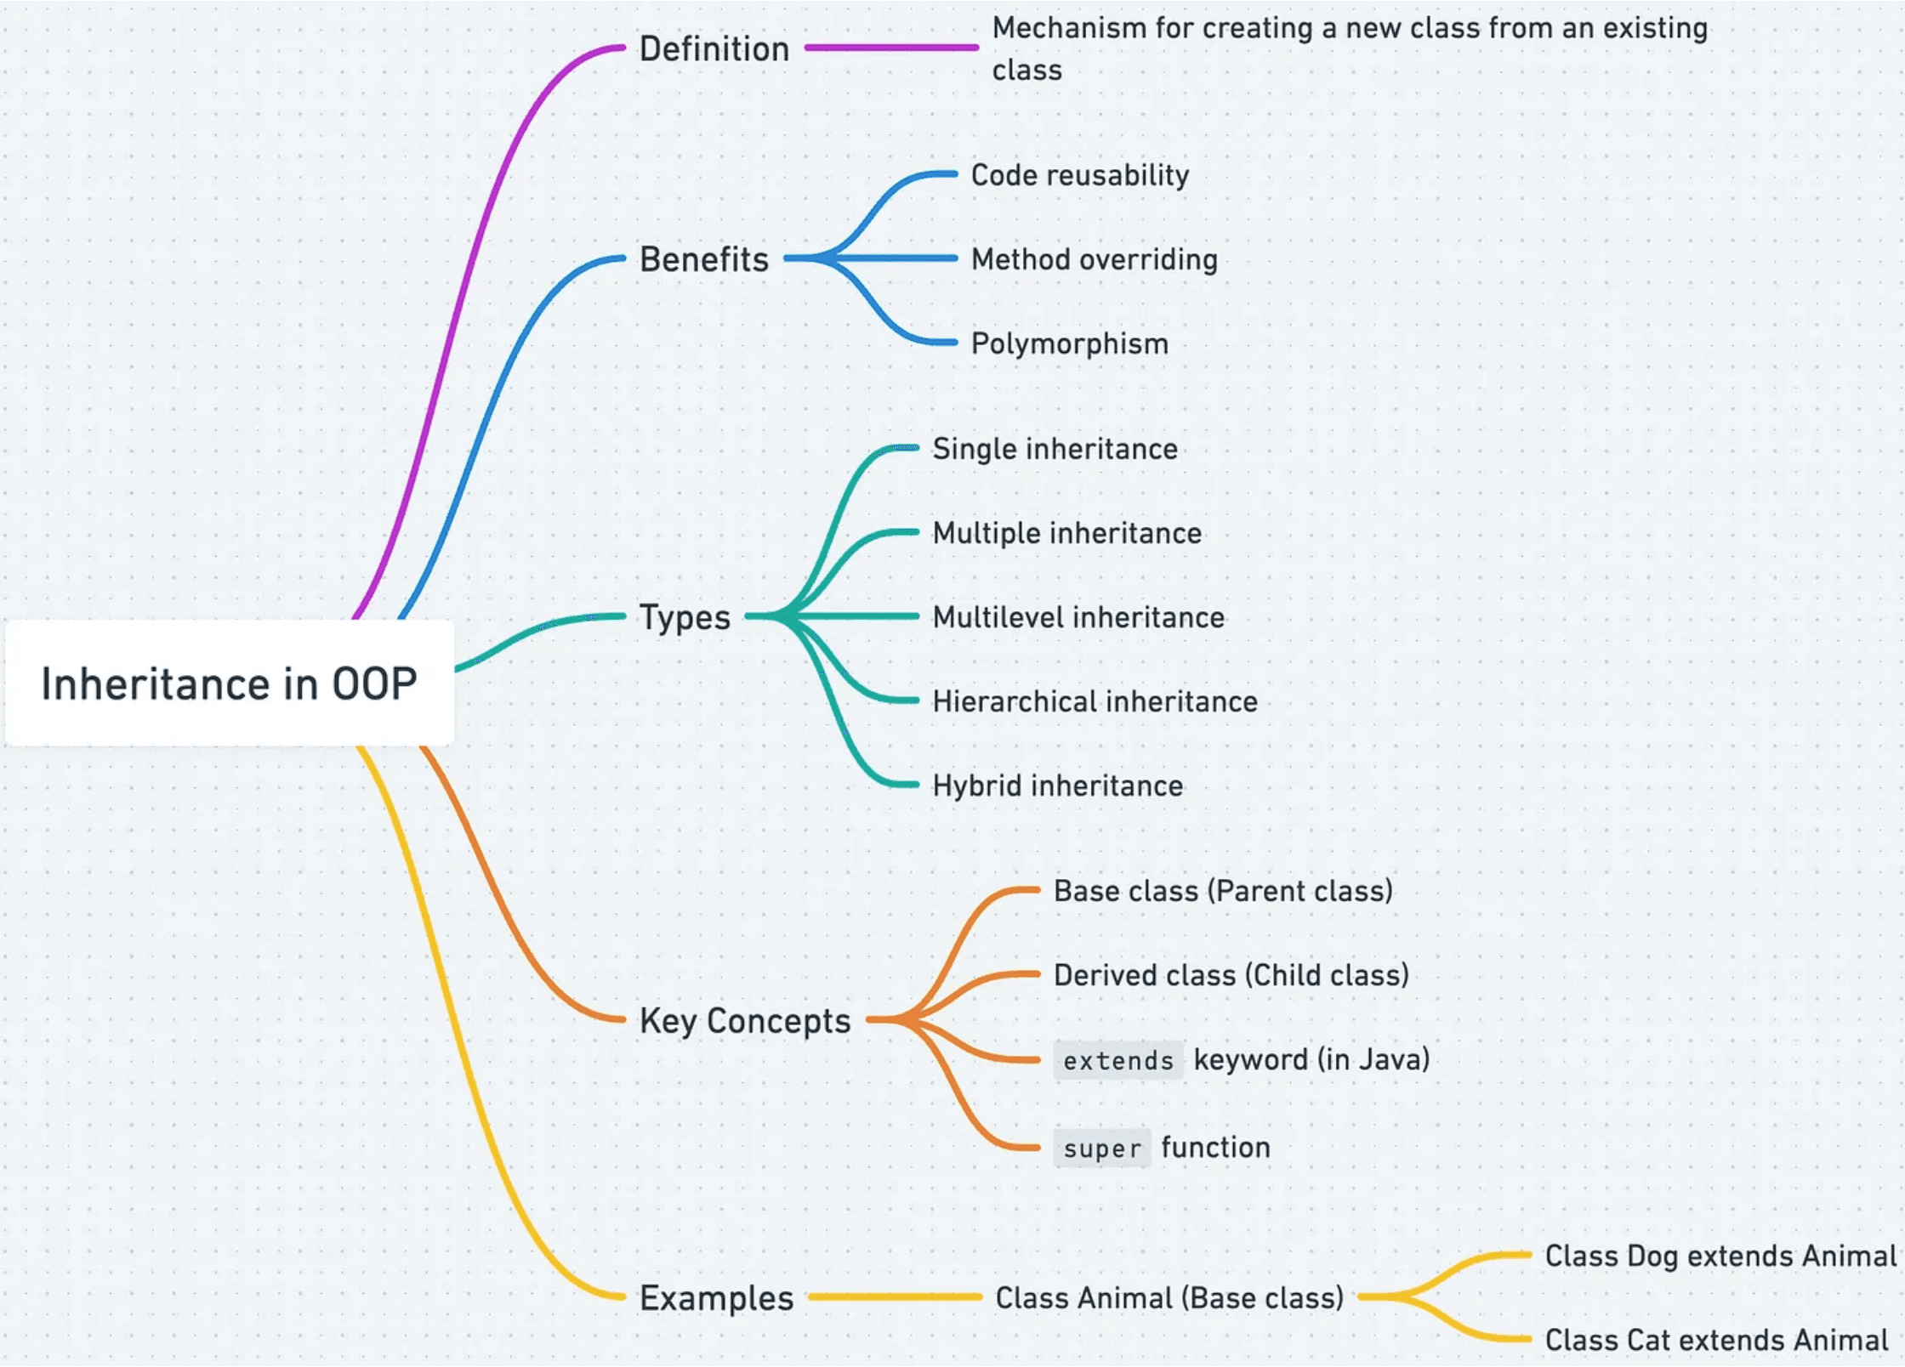
Inheritance: Code Reusability
Inheritance is a mechanism that allows a new class (subclass or derived class) to inherit attributes and methods from an existing class (superclass or base class). This promotes code reusability and establishes an "is-a" relationship.
•
Base Class: The parent class whose attributes and methods are inherited.
•
Derived Class: The child class that inherits from the base class and can extend or override functionality.
•
super(): Function to call parent class methods from the derived class.
1
classAnimal:
8
super().__init__(name)
2
def__init__(self, name):
9
self.breed = breed
3
self.name = name
10
defbark(self):
4
defeat(self):
11
print(f"{self.name} barks.")
5
print(f"{self.name} is eating.")
12
dog = Dog("Buddy", "Golden")
6
classDog(Animal):
13
dog.eat() # Inherited method
7
def__init__(self, name, breed):
14
dog.bark() # Dog-specific method

Slide 12
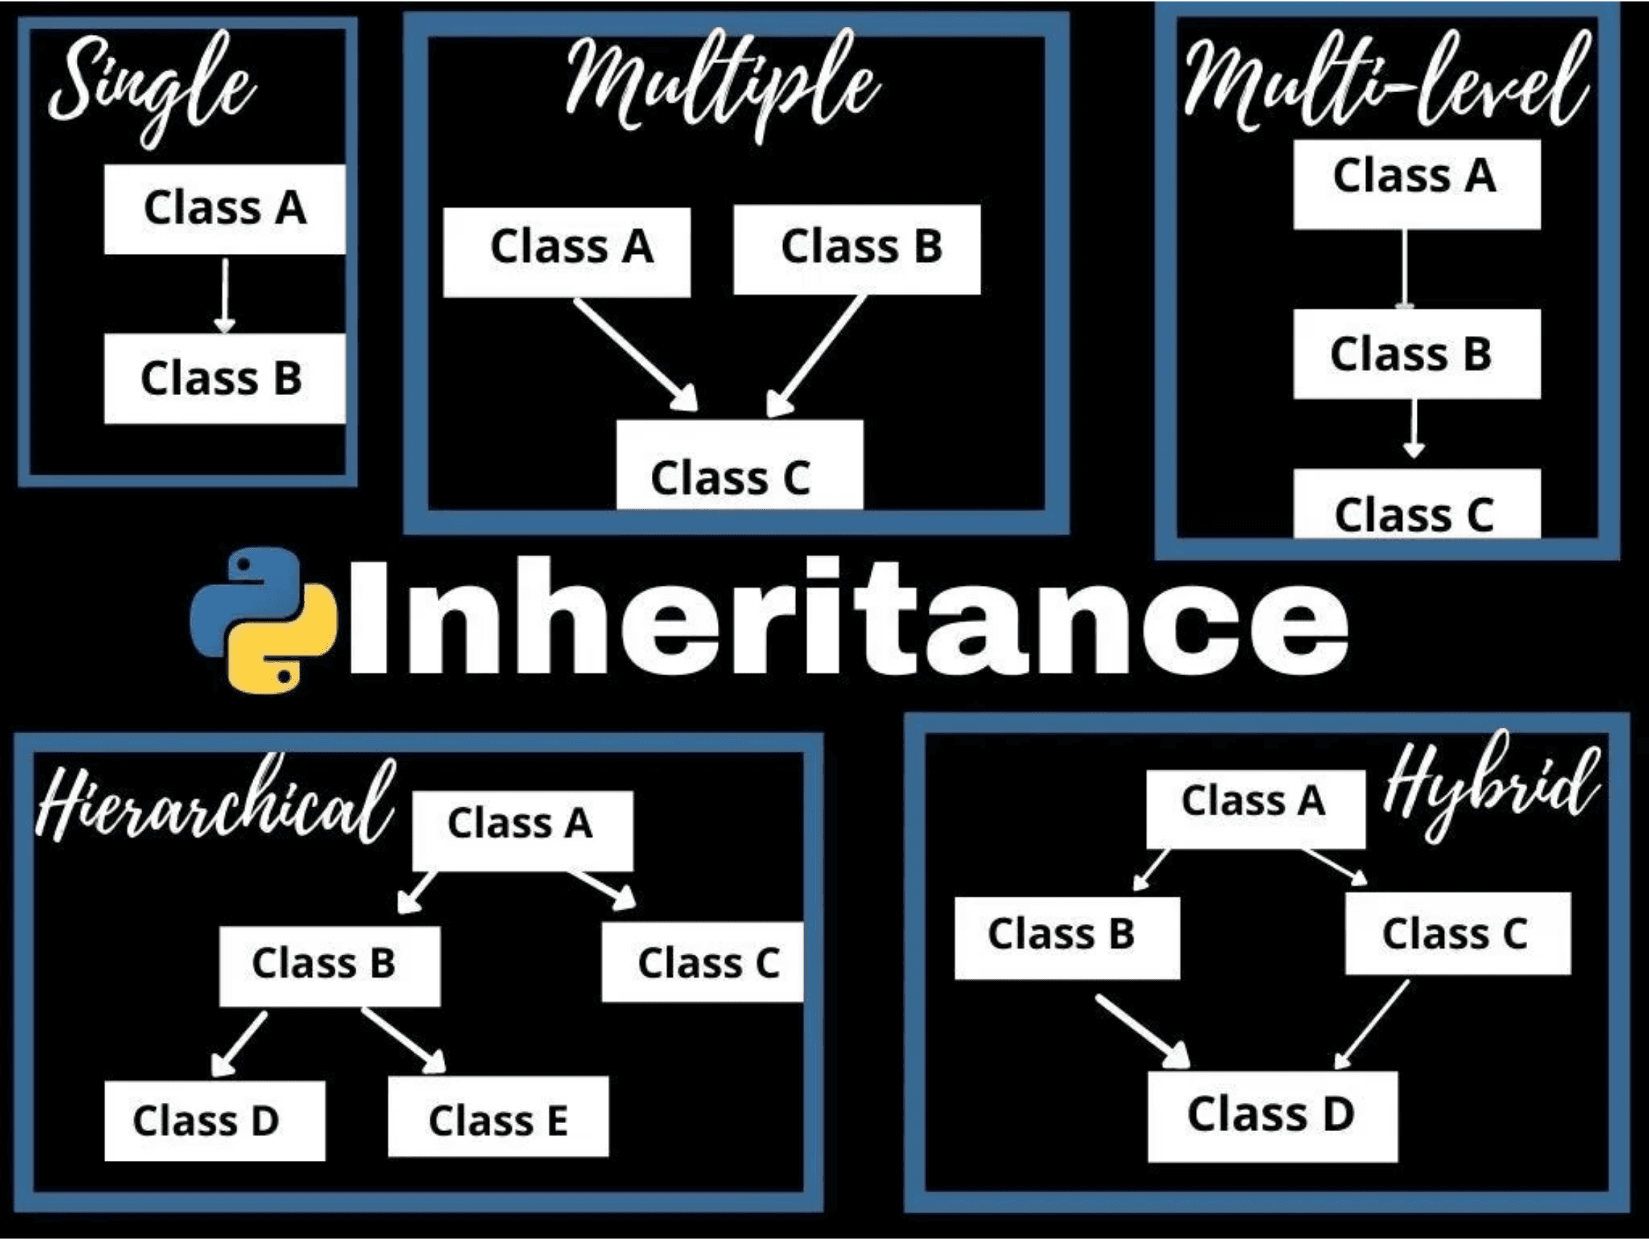
Inheritance Structures
1. Single Inheritance
A class inherits from one base class. The simplest form of inheritance.
Class B inherits from Class A
2. Multilevel Inheritance
A class inherits from a derived class, forming a chain of inheritance.
Class C inherits from Class B, which inherits from Class A
3. Multiple Inheritance
A class inherits from two or more base classes simultaneously.
Class C inherits from both Class A and Class B
4. Hierarchical Inheritance
Multiple classes inherit from a single base class.
5. Hybrid Inheritance
A combination of two or more types of inheritance in a single program.

Slide 13
Method Overriding: Customizing Behavior
Definition: Method Overriding occurs when a subclass provides a specific implementation for a method that is already defined in its superclass. This allows a subclass to change or extend the behavior of an inherited method.
Python Code Example:
1
classVehicle:
2
defmove(self):
3
print("The vehicle moves.")
4
classCar(Vehicle):
5
# Overriding the move method
6
defmove(self):
7
print("The car drives on four wheels.")
8
classBoat(Vehicle):
9
# Overriding the move method
10
defmove(self):
11
print("The boat sails on water.")
12
v = Vehicle(); c = Car(); b = Boat()
13
v.move(); c.move(); b.move()
Output:
The vehicle moves.
The car drives on four wheels.
The boat sails on water.

Slide 14
Polymorphism: Many Forms
Definition:
Polymorphism (meaning "many forms") allows objects of different classes to be treated as objects of a common type. In Python, this is often achieved through Duck Typing (if it walks like a duck and quacks like a duck, then it must be a duck) and Method Overriding.
Duck Typing: Python focuses on what an object can do (its methods) rather than what type it is. If an object has the required method, it can be used interchangeably with other objects that have the same method.
Python Code Example (Polymorphism with a Function):
1
classCat:
2
defspeak(self):
3
return"Meow"
4
classDog:
5
defspeak(self):
6
return"Woof"
7
defanimal_sound(animal):
8
# Function doesn't care about type,
9
# only that it has a 'speak' method.
10
print(animal.speak())
11
cat = Cat()
12
dog = Dog()
13
animal_sound(cat) # Output: Meow
14
animal_sound(dog) # Output: Woof

Slide 15
`super()`: Accessing the Parent
Definition: The `super()` function provides a way to access methods and attributes of the parent or sibling class. It is most commonly used in the `__init__` method of a subclass to call the parent's constructor, ensuring proper initialization of inherited attributes.
Python Code Example:
1
classParent:
2
def__init__(self, name):
3
self.name = name
4
print("Parent initialized.")
5
Common Use Cases:
6
defgreet(self):
•
Calling parent's `__init__()` to initialize inherited attributes.
7
returnf"Hello, {self.name}"
8
•
Calling overridden parent methods while extending functionality.
9
classChild(Parent):
•
Accessing parent class attributes and methods in multilevel inheritance.
10
def__init__(self, name, age):
11
# Calls Parent.__init__(self, name)
•
Resolving method resolution order (MRO) in multiple inheritance.
12
super().__init__(name)
13
self.age = age
14
print("Child initialized.")
Syntax:
15
super().__init__(parent_args)
super().method_name(args)
16
defgreet(self):
17
# Call parent's greet and extend it
18
parent_greeting = super().greet()
19
returnf"{parent_greeting}, age {self.age}"
20
21
c = Child("Alice", 10)
22
print(c.greet())

Slide 16

Magic (Dunder) Methods: Python's Protocol
Definition: Magic Methods (or Dunder Methods, short for Double Underscore) are special methods in Python that allow you to define how your objects interact with built-in operations and functions (e.g., `+`, `len()`, `print()`). They enable your objects to conform to Python's protocols.
Dunder Method
Purpose
__init__
Constructor method called when an object is created
__str__
String representation for users (used by print())
__repr__
String representation for developers (used by repr())
__len__
Defines behavior for the len() function
__add__
Defines behavior for the + operator
__eq__
Defines behavior for the == operator
Python Code Example (`__str__` and `__add__`):
1
classVector:
2
def__init__(self, x, y):
3
self.x = x
4
self.y = y
5
6
# Defines how the object is printed
7
def__str__(self):
8
returnf"Vector({self.x}, {self.y})"
9
10
# Defines the behavior of the '+' operator
11
def__add__(self, other):
12
returnVector(self.x + other.x, self.y + other.y)
13
14
v1 = Vector(2, 3)
15
v2 = Vector(5, 7)
16
v3 = v1 + v2 # Calls v1.__add__(v2)
17
print(v1) # Output: Vector(2, 3)
18
print(v3) # Output: Vector(7, 10)

Slide 17

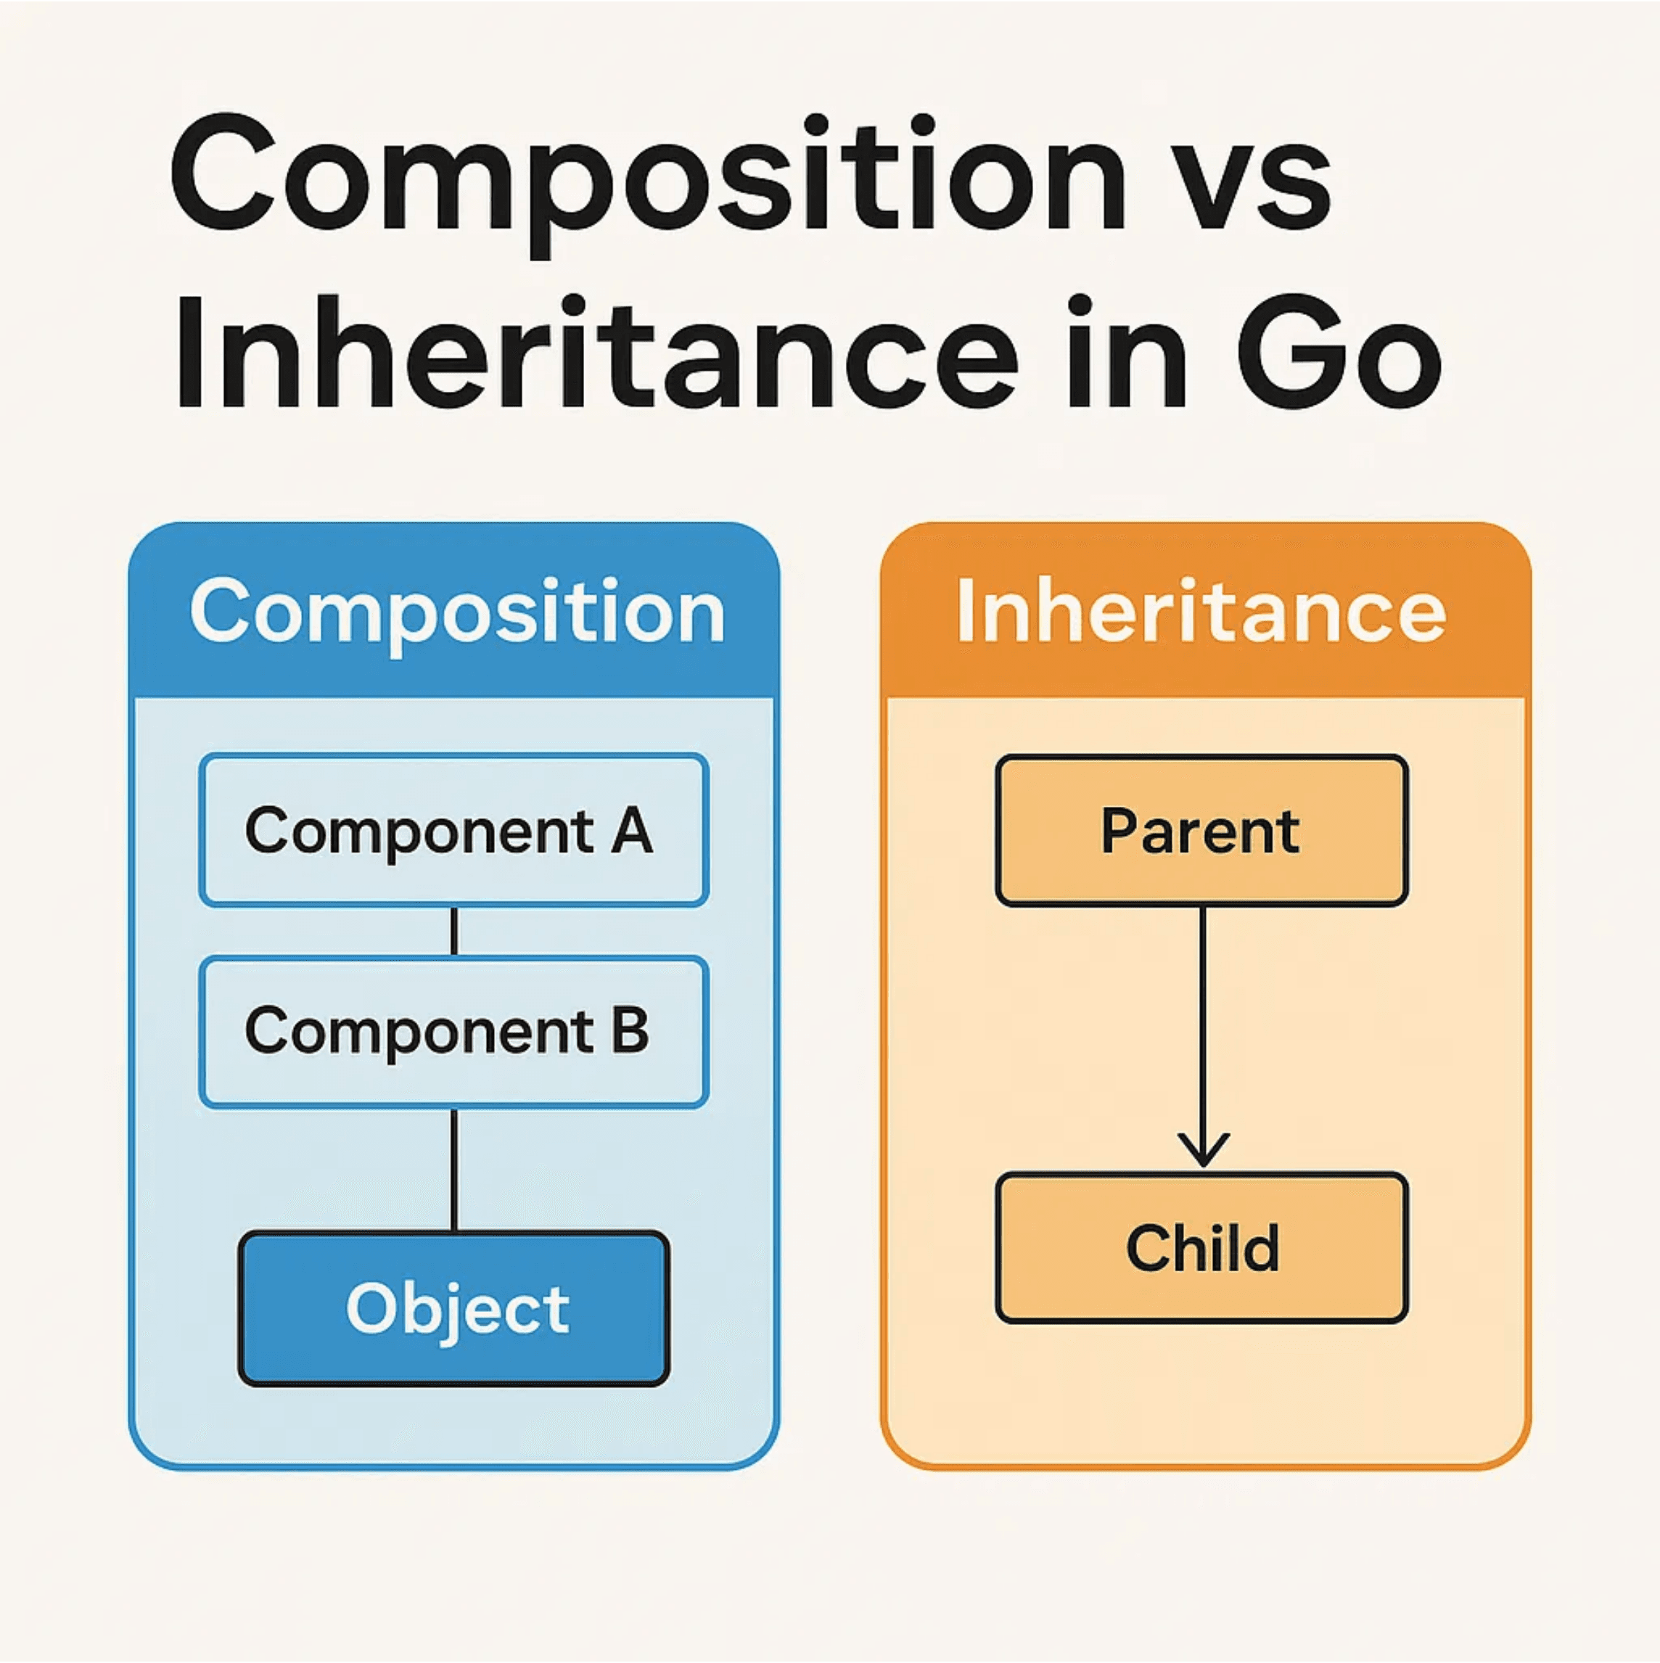
Design Patterns: Composition vs. Inheritance
Aspect
Composition (Has-A)
Inheritance (Is-A)
Object contains another object as a member
Class extends another class
Relationship
High - can change components at runtime
Low - hierarchy is fixed at design time
Flexibility
Components are independent and reusable
Code reuse through hierarchy
Reusability
Complexity
Simpler for complex scenarios
Can lead to deep hierarchies
Building complex objects from simpler parts
Clear "is-a" relationships
Best For
When to Prefer Composition:
•
Avoid deep inheritance hierarchies (more than 2-3 levels)
•
Need flexibility to change behavior at runtime
•
Multiple inheritance scenarios (use composition instead)
•
Building complex systems from independent components

Slide 18
Writing Clean and Effective OOP Code
1
2
Favor Composition over Inheritance
Use Properties for Encapsulation
Prefer composition to assemble objects from smaller parts. Use inheritance only for clear "is‑a" cases to stay flexible and avoid deep hierarchies.
Use @property for controlled access to attributes. Keep internals private while enabling validation when needed.
Car has‑a Engine (composition) vs. Car is‑a Vehicle (inheritance)
@property def age(self): return self._age
3
4
Follow PEP 8 Naming Conventions
Single Responsibility Principle
Use CamelCase for classes and snake_case for methods/attributes. Consistent naming improves readability and collaboration.
Give each class one responsibility and one reason to change. Focused classes are easier to test, maintain, and extend.
class MyClass: def my_method(self): pass
User class handles user data; UserRepository handles persistence
5
Document Everything with Docstrings
Write docstrings for classes, methods, and modules: purpose, params, returns, usage (PEP 257).
"""Add two numbers. Args: a, b. Returns: sum."""

Slide 19
Demonstration: A Simple Library System
Project Goal
Create a class-based system to manage books and a library collection. This mini-project demonstrates how to use OOP principles to build a practical, real-world application that manages books, tracks availability, and allows borrowing and returning operations.
Class Structure
Book Class
Library Class
Attributes:
Attributes:
•
title, author, isbn; is_available (status tracking)
•
books (list of Book objects); composition (has-a relationship)
Methods:
Methods:
•
__str__() (dunder method), borrow(), return_book()
•
add_book(), find_book(), list_available_books()
Key Principles Demonstrated
▸
Encapsulation: The Book class encapsulates book data (title, author, isbn) and provides methods to interact with it (borrow, return_book).
▸
Composition: The Library class demonstrates composition by containing a collection of Book objects, showing a "has-a" relationship.
▸
Dunder Methods: The Book class uses __str__() to provide a user-friendly string representation of book information.
▸
Real-World Application: This system demonstrates how OOP concepts translate into practical, maintainable code for managing data and operations.

Slide 20

Mini Project: The `Book` Class
The Book class represents a single book in the library system. It encapsulates book information (title, author, ISBN) and tracks availability status. It includes a dunder method for string representation and methods for borrowing and returning books.
Complete Book Class Implementation:
1
classBook:
2
def__init__(self, title, author, isbn):
3
self.title = title
4
self.author = author
5
self.isbn = isbn
6
self.is_available = True# Track availability
7
8
def__str__(self):
9
# Dunder method for string representation
10
status = "Available"ifself.is_available else"Borrowed"
11
returnf'"{self.title}" by {self.author} '
12
f'(ISBN: {self.isbn}) - {status}'
13
14
defborrow(self):
15
# Mark book as borrowed if available
16
ifself.is_available:
17
self.is_available = False
18
returnTrue
19
returnFalse
20
21
defreturn_book(self):
22
# Mark book as returned (available again)
23
self.is_available = True
24
returnTrue
25
26
# Example Usage:
27
book1 = Book("1984", "George Orwell", "978-0451524935")
28
print(book1) # Output: "1984" by George Orwell (ISBN: 978-0451524935) - Available
29
book1.borrow()
30
print(book1) # Output: "1984" by George Orwell (ISBN: 978-0451524935) - Borrowed
31
book1.return_book()
32
print(book1) # Output: "1984" by George Orwell (ISBN: 978-0451524935) - Available

Slide 21

Mini Project: The `Library` Class and Execution
The Library class demonstrates composition by containing a collection of Book objects. It provides methods to manage books, search for specific titles, and list available books. This shows how independent classes work together to build a complete system.
Library Class Implementation and Full Execution Example:
1
classLibrary:
2
def__init__(self, name):
3
self.name = name
4
self.books = [] # Composition: contains Book objects
5
defadd_book(self, book):
6
self.books.append(book)
7
deffind_book(self, title):
8
for book inself.books:
9
if book.title.lower() == title.lower():
10
return book
11
returnNone
12
deflist_available_books(self):
13
available = [b for b inself.books if b.is_available]
14
return available
16
# ===== EXECUTION EXAMPLE =====
17
lib = Library("City Library")
18
b1 = Book("1984", "George Orwell", "978-0451524935")
19
b2 = Book("To Kill a Mockingbird", "Harper Lee", "978-0061120084")
20
b3 = Book("Pride and Prejudice", "Jane Austen", "978-0141439518")
21
lib.add_book(b1)
22
lib.add_book(b2)
23
lib.add_book(b3)
24
print(f"Available books: {len(lib.list_available_books())}") # 3
25
b1.borrow()
26
print(f"Available books: {len(lib.list_available_books())}") # 2
27
found = lib.find_book("1984")
28
print(found) # "1984" by George Orwell (ISBN: 978-0451524935) - Borrowed
29
found.return_book()
30
print(f"Available books: {len(lib.list_available_books())}") # 3
31
for book in lib.list_available_books():
32
print(book)

Slide 22
Summary and Next Steps
The Four Pillars of OOP
Key Concepts Recap
Encapsulation
Abstraction
▸
Composition: Prefer "has-a" relationships over "is-a" for flexibility and simplicity.
Bundle data and methods; control access through visibility modifiers.
Hide complexity; expose only essential interfaces to users.
▸
Dunder Methods: Use __init__, __str__, __add__, etc. to define object behavior with built-in operations.
Inheritance
Polymorphism
▸
Method Overriding: Subclasses customize inherited methods to provide specific implementations.
Reuse code through parent-child relationships; use super() to access parents.
Objects of different types respond to the same method calls differently.
▸
super(): Access parent class methods and attributes in multilevel inheritance.
▸
Best Practices: Single Responsibility, PEP 8, properties, documentation, and clean code.
Next Steps for Continued Learning
1
Practice: Build small projects using OOP principles. Start with simple systems (e.g., todo app, student management) and gradually increase complexity.
2
Design Patterns: Study common design patterns (Singleton, Factory, Observer, Strategy) to solve recurring design problems elegantly.
3
Code Review: Read and analyze well-written open-source Python projects on GitHub to see OOP best practices in action.
4
Testing: Learn unit testing with unittest or pytest to ensure your OOP code is robust and maintainable.
5
Advanced Topics: Explore metaclasses, descriptors, context managers, and decorators to deepen your OOP mastery in Python.

Slide 23

Thank You
Thank you for your attention and engagement throughout this comprehensive journey into Object-Oriented Programming in Python. We hope this presentation has provided you with a solid foundation and practical insights into OOP principles and their real-world applications.
Remember: OOP is about organizing code into reusable, maintainable, and scalable components. Master the four pillars—Encapsulation, Abstraction, Inheritance, and Polymorphism—and you'll write better Python code.
Questions or Further Discussion?
Feel free to reach out for clarifications or to discuss advanced OOP concepts.
Keep practicing, keep learning, and continue building amazing applications with Python and OOP principles. Happy coding!

