Slide 1
Ethical hacking Internship
Task - 3

Slide 2
Steps Involved
Use burpsuite for this method
Make sure the proxy setting are as burpsuite proxy
Turn on intercept in burpsuite
Use Open browser option from burpsuite to open a browser or In Firefox open the link http://testasp.vulnweb.com
Forward in intercept in burpsuite
In burpsuit forward the response in intruder
In intruder section, post the XSS scripts and start attack
Check which XSS script that intruded, copy the response of it and paste it in browser to see how it works
Here <script>alert(1)</script> works and gives out an response of script injection

Slide 3
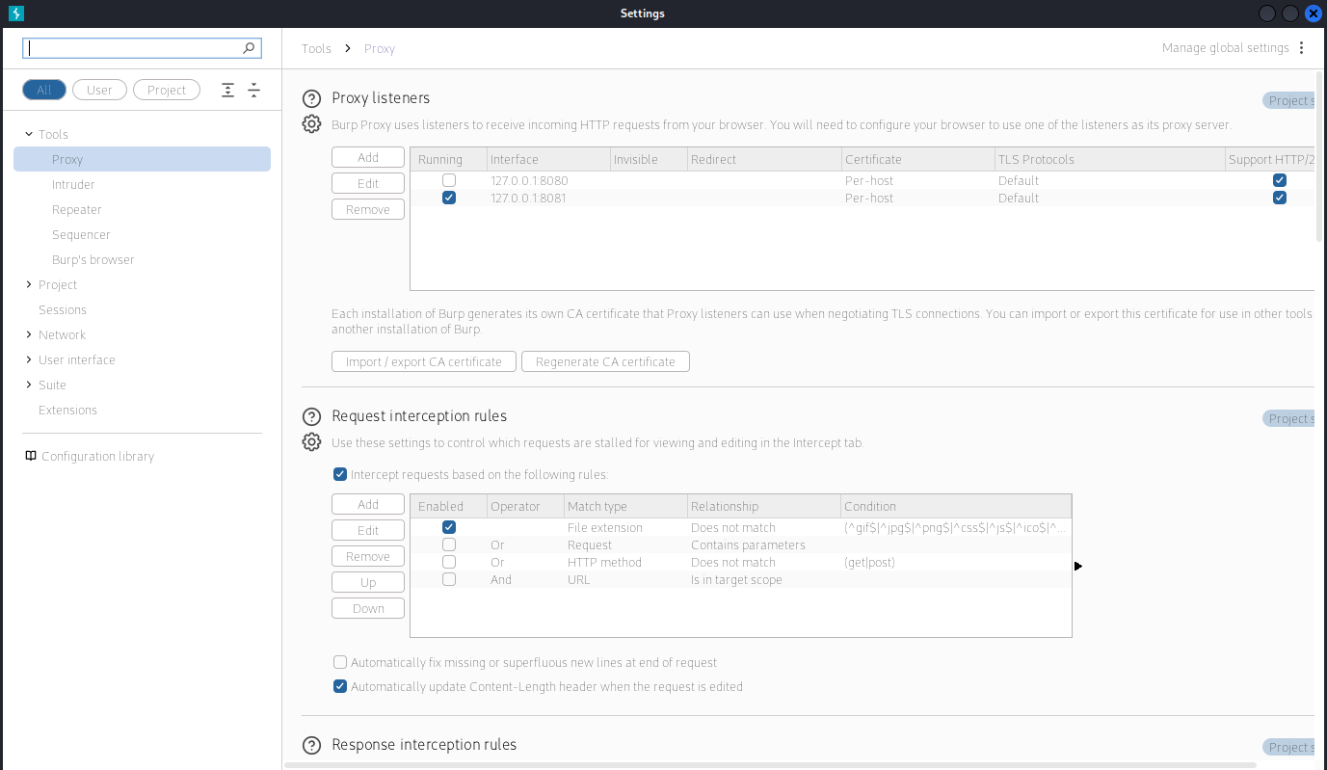

Slide 4
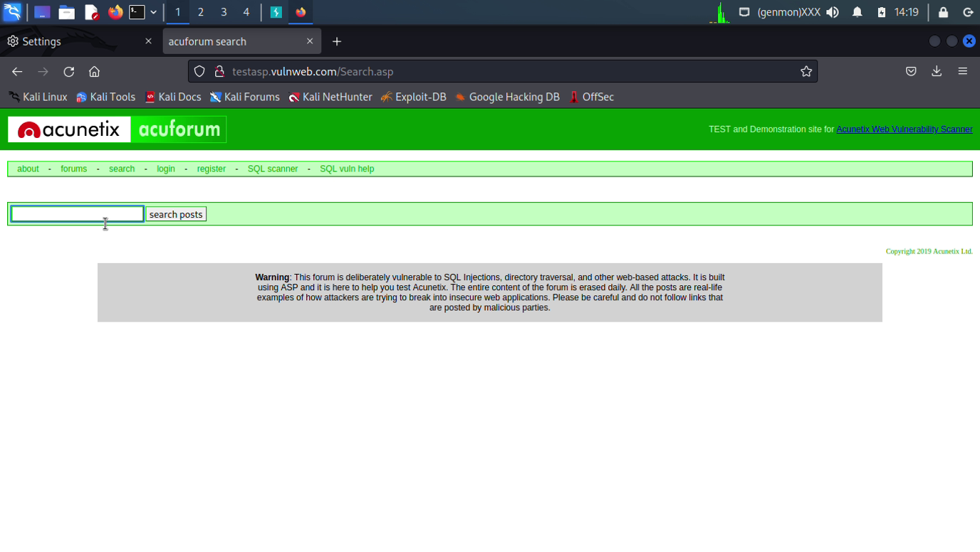

Slide 5
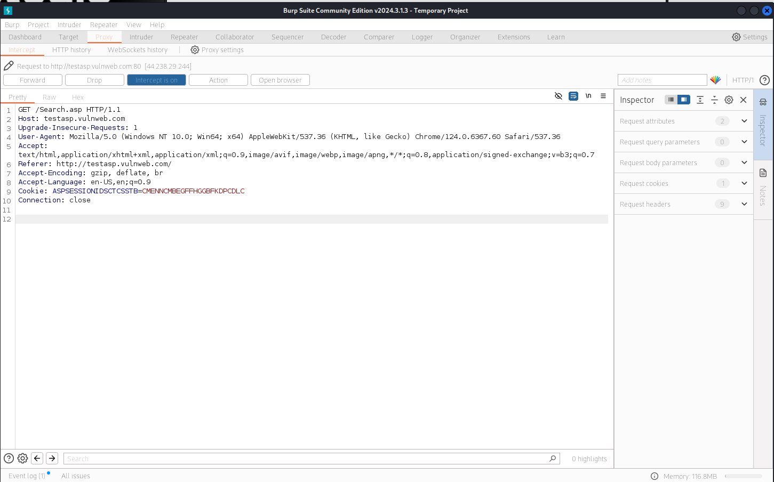

Slide 6
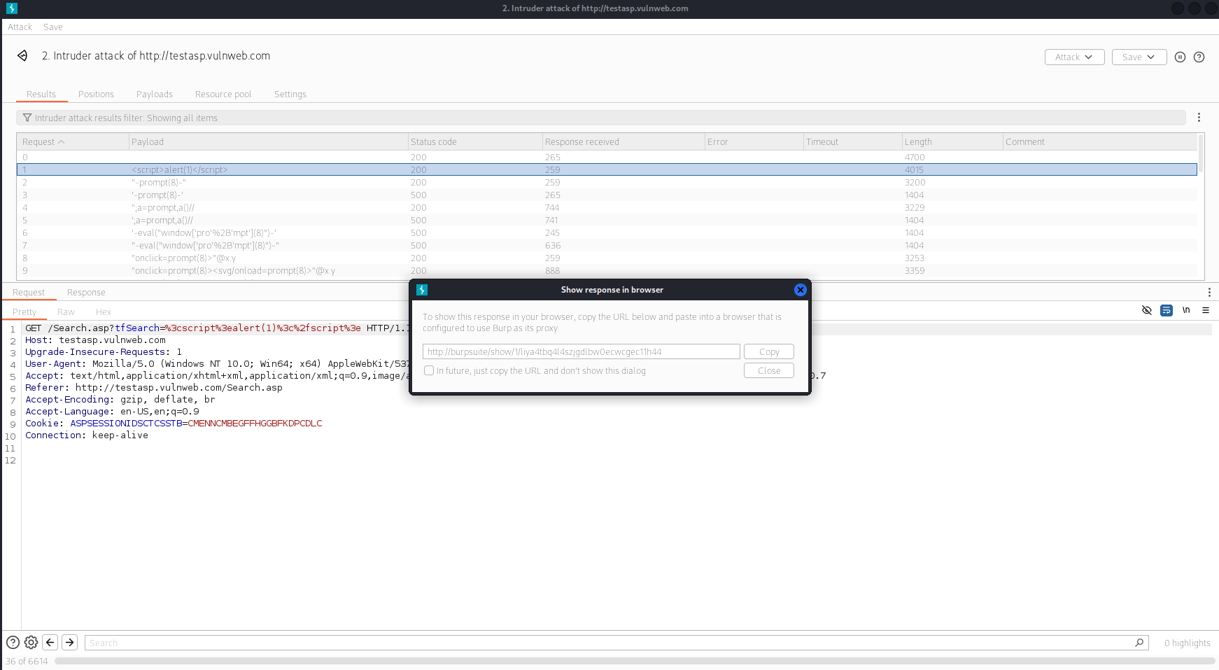

Slide 7
