Slide 1
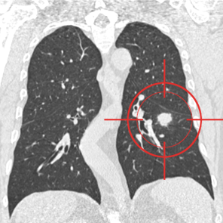
Pulmonary Nodule Analysis for Lung Cancer Detection in Low Dose CT Images
Under Supervision of: Dr. Hafeez Ur Rehman
A.Q. Ahmed Abbasi
Bachelors of Computer Science
National university of Computer & Emerging sciences
Ehmedabbasi@gmail.com
Wenesday March 15th, 2017

Slide 2
Outline
2
Background Overview
Objective
Flow Diagram
Reading Data
Resizing Data
3D CNN Model
References
Questions & Answers

Slide 3
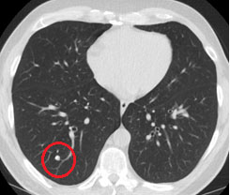
Background Overview
3
What are Lung Nodules? ^{[1]}
Round shaped growth in lungs
Types: malignant(cancerous) & benign
Method: Multi Detector Computed Tomography (MDCT)

Slide 4
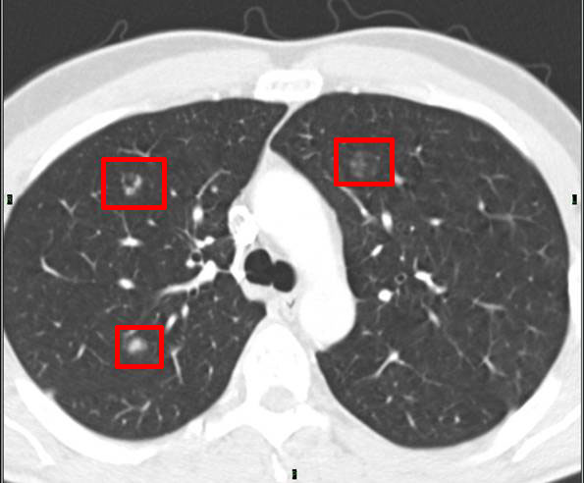
Objective
4
To give a system that detects & classifies lung nodules on the basis of some features in Low Dose MDCT Images.

Slide 5
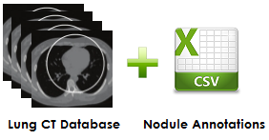
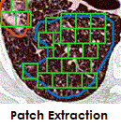
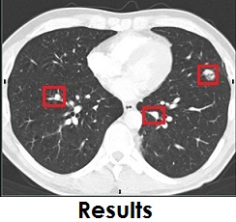
Flow Diagram
5
Preprocessing
FYP1 Activities
FYP2 Activities
Testing CNN
Training CNN

Slide 6
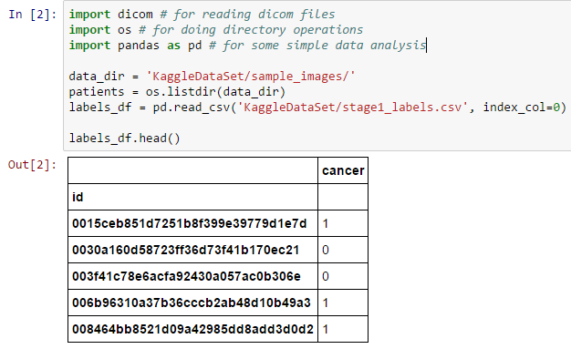
Reading Data(1/4)
6
Sample Data
Patients = 20
Classes = 2

Slide 7
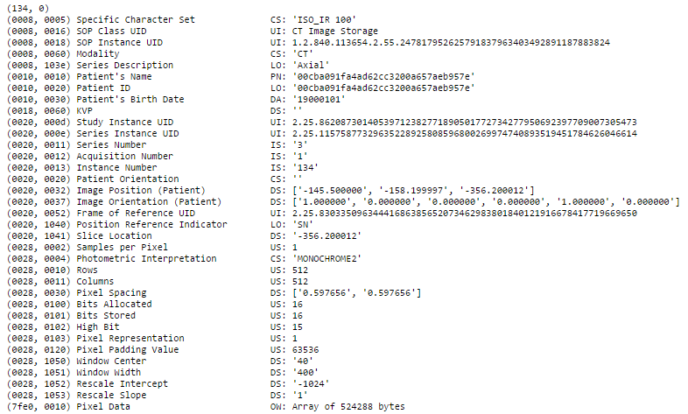
Continue(2/4)
7
DICOM Header

Slide 8
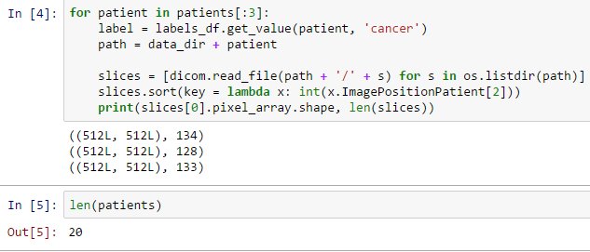
Continue(3/4)
8
X Dimension: 512
Y Dimension: 512
Z Dimension: Varies

Slide 9
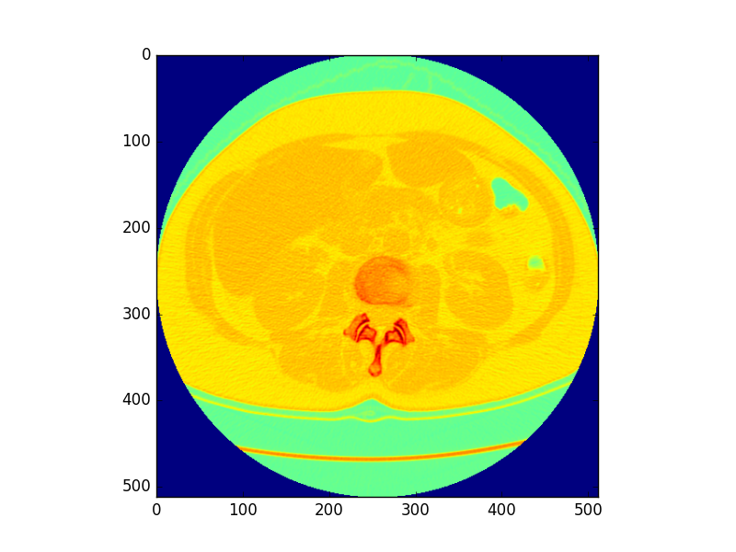
Continue(4/4)
9
2D Slice (512 * 512)

Slide 10
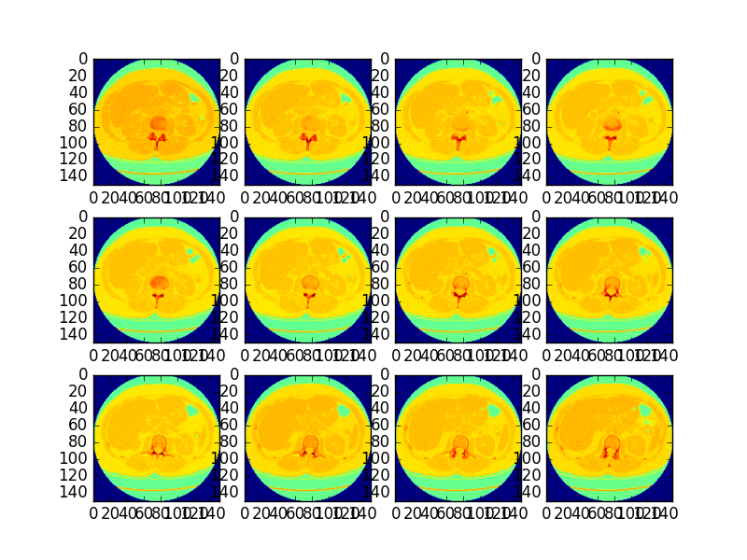
Resizing Data(1/2)
10
Huge X * Y Dimensions
12 2D Resized Slices (150 * 150)

Slide 11

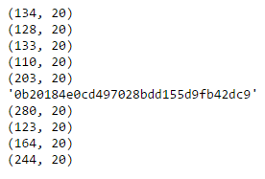
Continue(2/2)
11
Non uniform Z Dimension
Equal Chunks of Slices

Slide 12
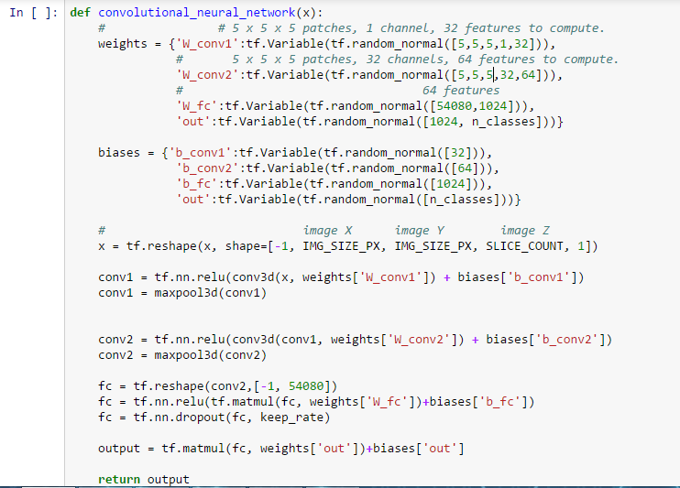
3D CNN Model
12
Patch Size = 5*5*5

Slide 13
References(1/2)
13
[1] National Center for Biotechnology Information.[Online]. Available: https://www.ncbi.nlm.nih.gov/
[2] S. Ramaswamay, K. Truong, “Pulmonary Nodule Classification with Convolutional Neural Networks,” Stanford University, 2016.
[3] I. Gori, M. E. Fantacci, A. Preite Martinez and A. Retico, “An automated system for lung nodule detection in low-dose computed tomography,” Medical Imaging: Computer-Aided Diagnosis, vol. 6514, 2007.
[4] W.J. Choi and T.S. Choi, “Automated Pulmonary Nodule Detection System in Computed Tomography Images: A Hierarchical Block Classification Approach,” Entropy, vol. 15, no. 2, pp.507-523, 2013.
[5] K. Murphy, B. van Ginneken, A. M. R. Schilham, B. J. de Hoop, H. A. Gietema, and M. Prokop, “A large scale evaluation of automatic pulmonary nodule detection in chest CT using local image features and k-nearest-neighbour classification,” Medical Image Analysis, vol. 13, pp. 757–770, 2009.

Slide 14
Continue… (2/2)
14
[6] C. Jacobs, E. M. van Rikxoort, T. Twellmann, E. T. Scholten, P. A. de Jong, J. M. Kuhnigk, M. Oudkerk, H. J. de Koning, M. Prokop, C. Schaefer-Prokop, and B. van Ginneken, “Automatic detection of subsolid pulmonary nodules in thoracic computed tomography images,” Medical Image Analysis, vol. 18, pp. 374–384, 2014.
[7] A. A. A. Setio, C. Jacobs, J. Gelderblom, and B. van Ginneken, “Automatic detection of large pulmonary solid nodules in thoracic CT images,” Medical Physics, vol. 42, no. 10, pp. 5642–5653, 2015.
[8] E. M. van Rikxoort, B. de Hoop, M. A. Viergever, M. Prokop, and B. van Ginneken, "Automatic lung segmentation from thoracic computed tomography scans using a hybrid approach with error detection", Medical Physics, vol. 4236 no. 10, pp. 2934-2947, 2009.
[9] GEOFF DOUGHERTY, “Medical Images obtained with Ionizing Radiations,” in Digital Image Processing for Medical Applications, Cambridge University press, 2009, pp. 73-74

Slide 15
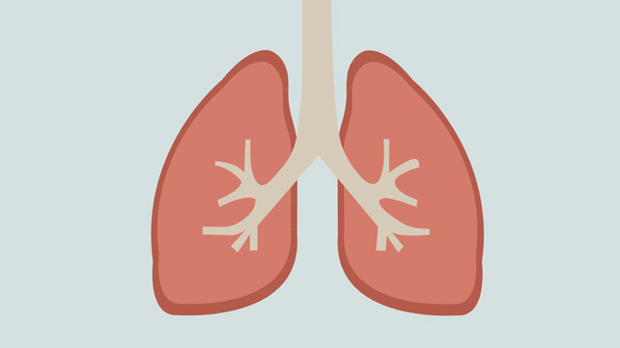
Question & Answers
15

