Slide 1
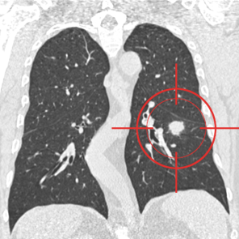
Pulmonary Nodule Analysis for Lung Cancer Detection in Low Dose CT Images
Under Supervision of: Dr. Hafeez Ur Rehman
A.Q. Ahmed Abbasi
Bachelors of Computer Science
National university of Computer & Emerging sciences
Ehmedabbasi@gmail.com
Tuesday February 14th, 2017

Slide 2
Outline
2
Background Overview
Objective
Flow Diagram
Achieved Milestones
Improvements
Detailed Project Plan
References
Questions & Answers

Slide 3
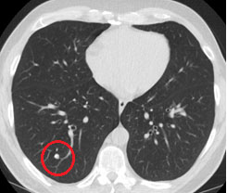
Background Overview
3
What are Lung Nodules? ^{[1]}
Round shaped growth in lungs
Types: malignant(cancerous) & benign
Method: Multi Detector Computed Tomography (MDCT)

Slide 4
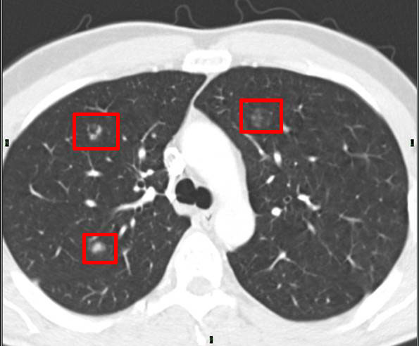
Objective
4
To give a system that detects & classifies lung nodules on the basis of some features in Low Dose MDCT Images.

Slide 5
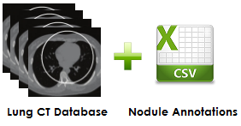
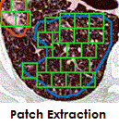
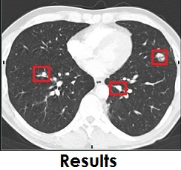
Flow Diagram
5
Preprocessing
FYP1 Activities
FYP2 Activities
Testing CNN
Training CNN

Slide 6
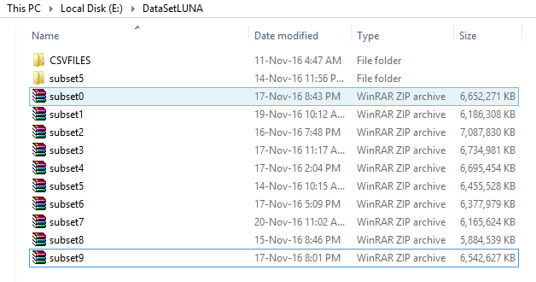


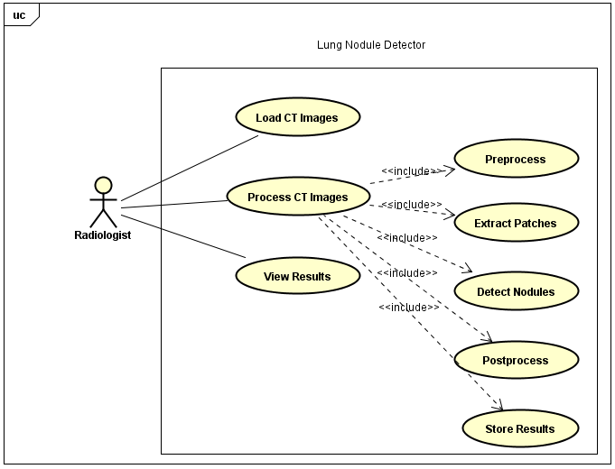
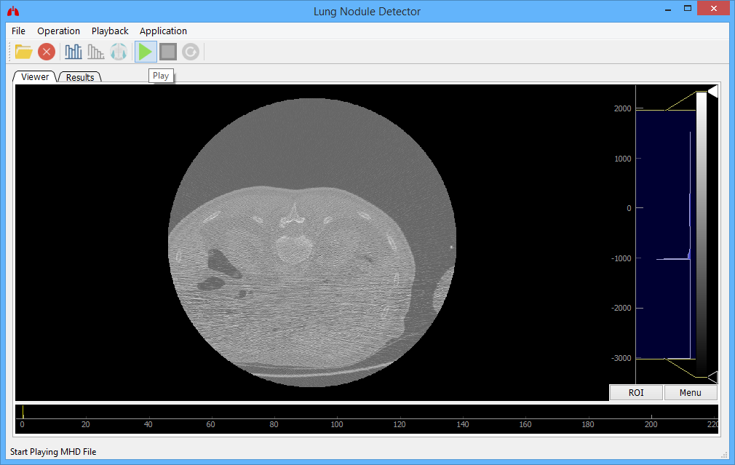
Achieved Milestones
6
Literature Review (8 research papers)
Dataset Collection (60 Gigabytes)
Environment Setup (Local Machine)
Design Diagrams
Project Implementation (Patch Extraction – 41 * 41 * 7)
Application Demo

Slide 7
Improvements(1/6)
7
Preprocessing (Scaling Intensity Values)
3D Convolutional Neural Network
(Following Tutorials: https://www.youtube.com/watch?v=ulq9DjCJPDU)

Slide 8
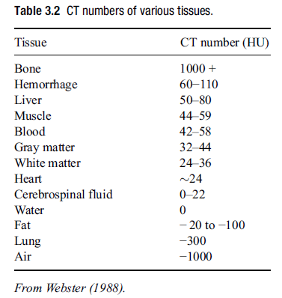
Continue(2/6) ^{[9]}
8
Intensity Values (-3000 to 2000)
Bits Required (2¹³ = 8192)

Slide 9
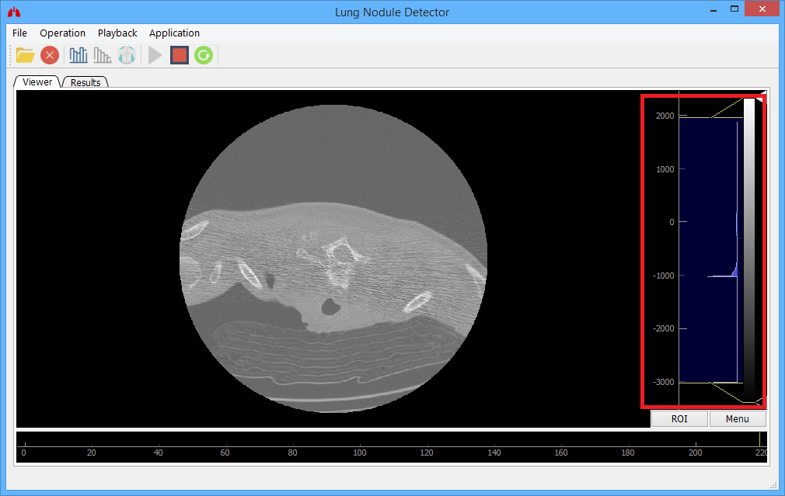
Continue(3/6)
9

Slide 10
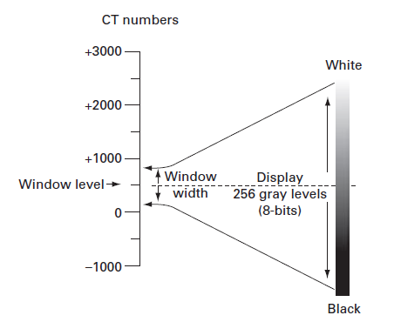
Continue(4/6) ^{[9]}
10

Slide 11
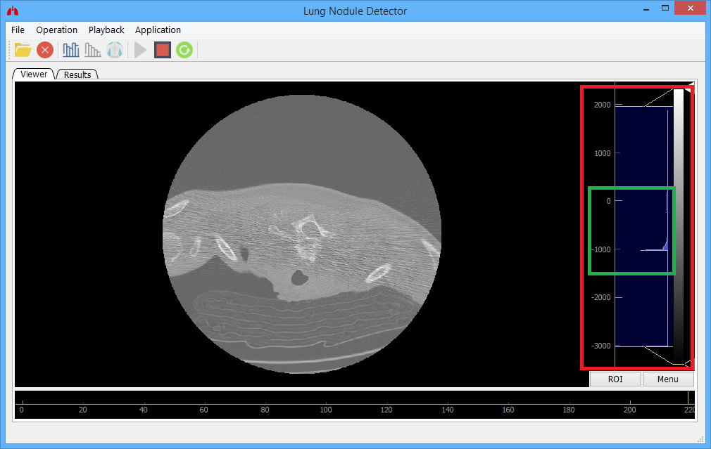
Continue(5/6)
11

Slide 12
Continue(6/6) ^{[9]}
8
Different Z Dimensions (512 * 512 * Anything)
Resizing Required
Patch size to Nodule Size Ratio (3 mm : How may Z axis Frames?)

Slide 13
Detailed Project Plan
12
Environment Setup (on Sir Hafeez’s Machine)
Training CNN
Testing CNN
Final Report Writing
Final Application Demonstration

Slide 14
References(1/2)
13
[1] National Center for Biotechnology Information.[Online]. Available: https://www.ncbi.nlm.nih.gov/
[2] S. Ramaswamay, K. Truong, “Pulmonary Nodule Classification with Convolutional Neural Networks,” Stanford University, 2016.
[3] I. Gori, M. E. Fantacci, A. Preite Martinez and A. Retico, “An automated system for lung nodule detection in low-dose computed tomography,” Medical Imaging: Computer-Aided Diagnosis, vol. 6514, 2007.
[4] W.J. Choi and T.S. Choi, “Automated Pulmonary Nodule Detection System in Computed Tomography Images: A Hierarchical Block Classification Approach,” Entropy, vol. 15, no. 2, pp.507-523, 2013.
[5] K. Murphy, B. van Ginneken, A. M. R. Schilham, B. J. de Hoop, H. A. Gietema, and M. Prokop, “A large scale evaluation of automatic pulmonary nodule detection in chest CT using local image features and k-nearest-neighbour classification,” Medical Image Analysis, vol. 13, pp. 757–770, 2009.

Slide 15
Continue… (2/2)
14
[6] C. Jacobs, E. M. van Rikxoort, T. Twellmann, E. T. Scholten, P. A. de Jong, J. M. Kuhnigk, M. Oudkerk, H. J. de Koning, M. Prokop, C. Schaefer-Prokop, and B. van Ginneken, “Automatic detection of subsolid pulmonary nodules in thoracic computed tomography images,” Medical Image Analysis, vol. 18, pp. 374–384, 2014.
[7] A. A. A. Setio, C. Jacobs, J. Gelderblom, and B. van Ginneken, “Automatic detection of large pulmonary solid nodules in thoracic CT images,” Medical Physics, vol. 42, no. 10, pp. 5642–5653, 2015.
[8] E. M. van Rikxoort, B. de Hoop, M. A. Viergever, M. Prokop, and B. van Ginneken, "Automatic lung segmentation from thoracic computed tomography scans using a hybrid approach with error detection", Medical Physics, vol. 4236 no. 10, pp. 2934-2947, 2009.
[9] GEOFF DOUGHERTY, “Medical Images obtained with Ionizing Radiations,” in Digital Image Processing for Medical Applications, Cambridge University press, 2009, pp. 73-74

Slide 16
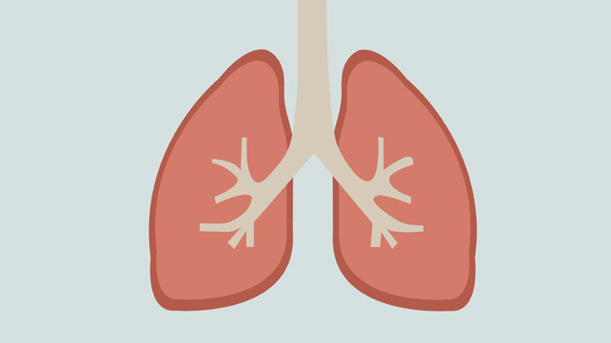
Question & Answers
15

