Slide 1
STOCK TREND PREDICTION

Slide 2
Hello!
I am Abdul Rabb Nawaz
21MCA3027

Slide 3
INTRODUCTION
One of the topics in financial market is stocks.
Correct prediction of stocks can lead to huge profits for the seller and the broker.
It is brought that prediction is chaotic rather than random,which means it can be predicted by carefully analyzing the history of respective stock market.

Slide 4
OBJECTIVE
To determine the values that particular stock will have in near future.
It display all the data in a graph.
In the graph, it will also show upgrade and downgrade prediction.

Slide 5
WHAT IS STOCK TREND PREDICTION?
Stock trend prediction is the process of analysing past data in order to predict the future trends.
It is a web app which is written in python language.
And using streamlit, Streamlit is an open source app framework in Python language.
Also LSTM model is used.
Graph will show all the data clearly.
User have to give a stock ticker.

Slide 6

SCREENSHOTS
(OUTPUT)

Slide 7
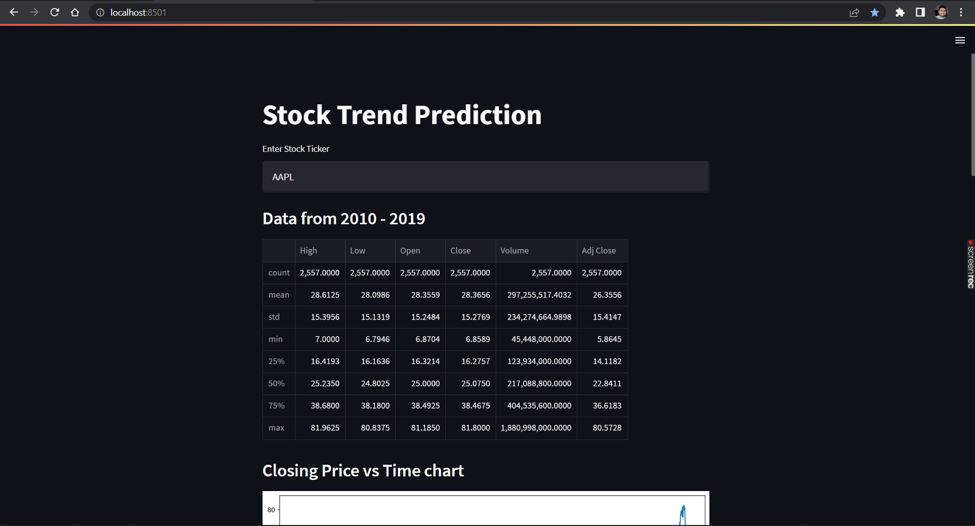

Slide 8
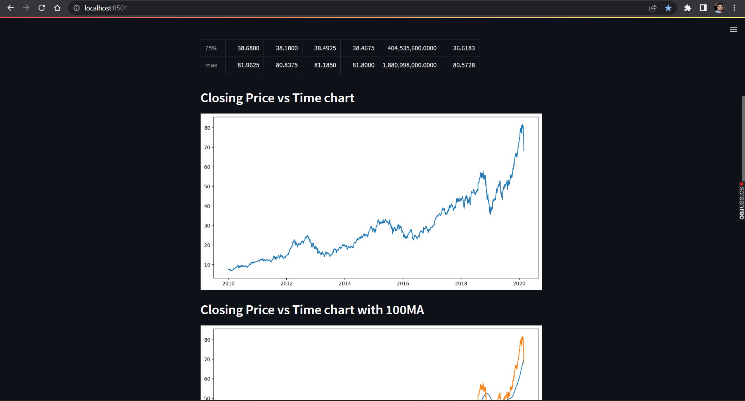

Slide 9
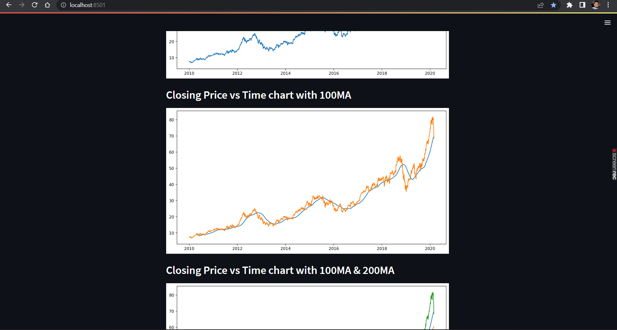

Slide 10
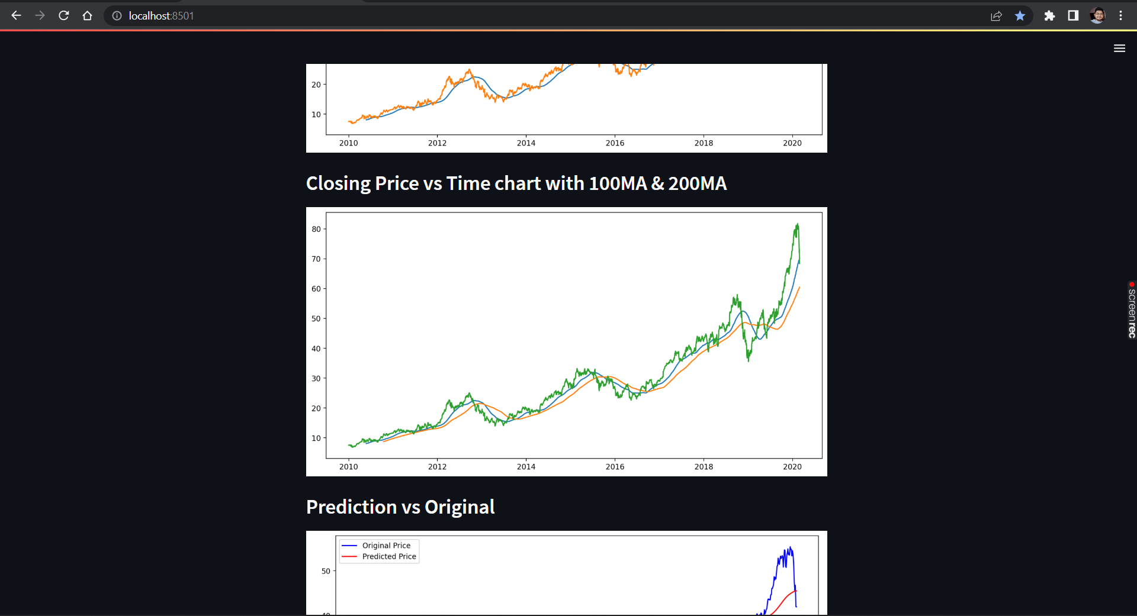

Slide 11
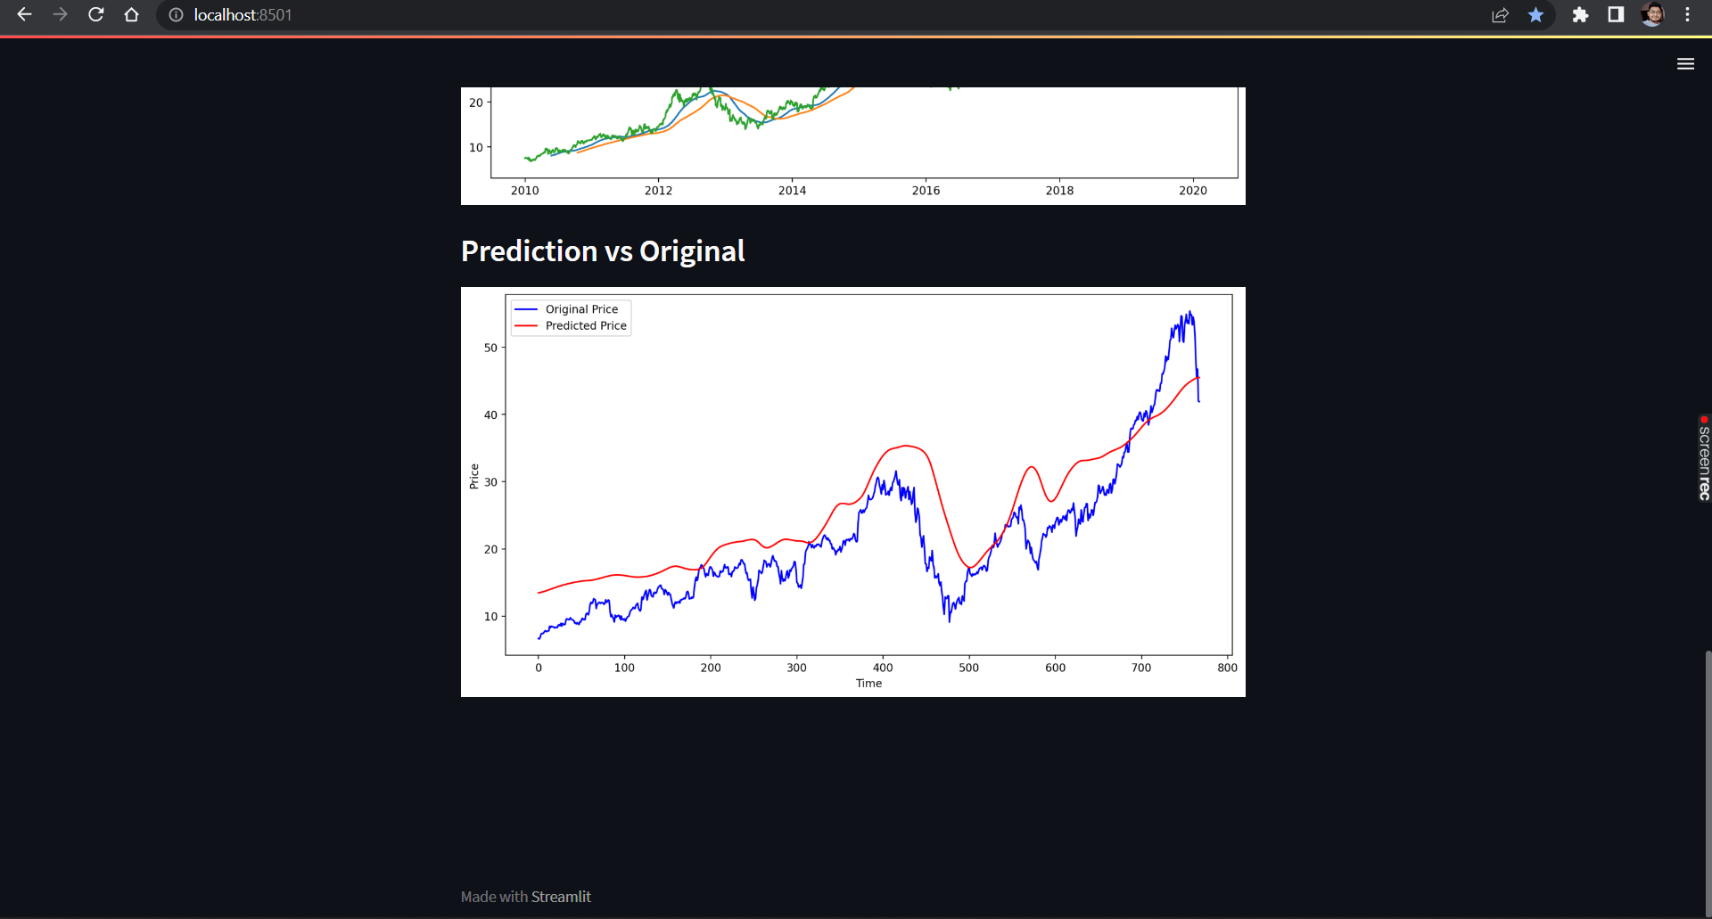

Slide 12
Github link - https://github.com/AbdulRabbNawaz/Stock-Trend-Prediction/upload
THANK YOU

