Slide 1
Spam Email Detection
BY: Shaikh Abdul Rafay

Slide 2
Motivation
ML-powered email detection can effectively filter out spam emails.
Reduced time spent manually sorting through emails, improved email organization.

Slide 3
Methodology Overview
Data Preprocessing
Exploratory Data Analysis (EDA)
Model Selection
Model Training
Evaluation

Slide 4
Data Preprocessing
Cleaned and organized the dataset to ensure consistency and accuracy.
Scaling
OverSampling
Embeddings

Slide 5
Exploratory Data Analysis (EDA)
Utilized visualizations to uncover patterns and trends in the data.
Used Nlp techniques to
Help models perform better.

Slide 6
Model Selection
Chose a diverse set of machine learning models for prediction.
Each model brings unique strengths to capture different aspects of the data.

Slide 7
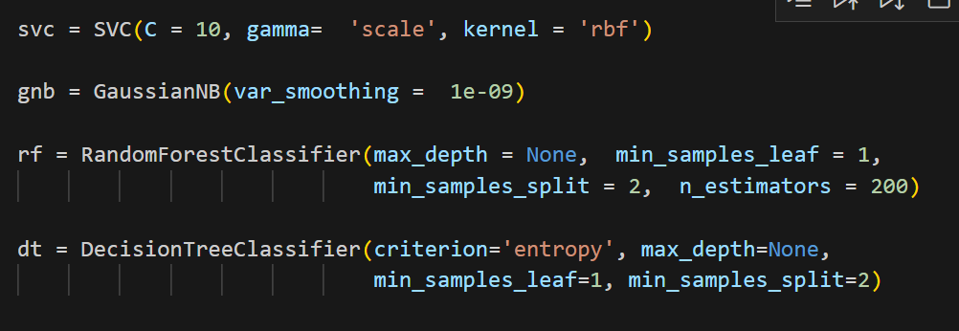
Model Training
Trained models on the dataset, optimizing their hyperparameters using GridSearchCV.
Fine-tuned models for improved predictive performance.

Slide 8
Evaluation
Assessed models' performance on a separate testing dataset.
Highlighted significant predictions and model accuracy.

Slide 9
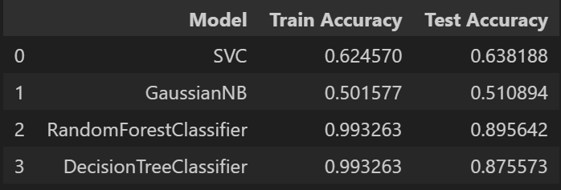
Results

Slide 10
Limitations
Senders information
Computational power

Slide 11

Thank You!

