Slide 1
2ND PROGRESSIVE PRESENTATION | BSCS 2023 BATCH | GROUP 18
UltraXAI
Explainable Multi-Model CAD System for Breast Cancer Detection in Ultrasound Imaging
Supervisor: Dr Dodo Khan Co-Supervisor: Dr Mir Hasan
Kinz Ul Iman (Lead) | Urwa Urooj | Salal Ahmed | Tooba | Rafay Qureshi
Government College University Hyderabad - Department of Computer Science

Slide 2
SECTION 1
Problem & Objectives
THE PROBLEM
1
Detect
2
Segment
Reading breast ultrasound scans by hand takes a lot of time and depends on doctor experience. Different doctors can give different answers for the same scan, which may lead to missed cancers.
Find the tumor in the scan using YOLOv8 object detection
Draw the exact tumor borders using Attention U-Net
3
Classify
4
Explain
UltraXAI solves this by automatically detecting, segmenting, classifying, and explaining tumors in one pipeline - giving doctors both a diagnosis and visual proof.
Decide Benign, Malignant, or Normal using EfficientNetV2 + ResNet50
Show a heatmap of where the AI looked using Grad-CAM++

Slide 3
SECTION 2
1st Progressive Feedback -> Actions Taken
Feedback Area
Grade
Action Taken
Status
Objectives Identification
C
Built a clear 4-step pipeline: Detect -> Segment -> Classify -> Explain with all models connected end-to-end
Completed
Model Design & Validation
C
Trained a dual-model ensemble (ResNet50 + EfficientNetV2) on Benign, Malignant, and Normal scans with 96%+ ensemble accuracy
Completed
Background Study & Documentation
D
Added recent Explainable AI and CAD research papers to the literature review. Proposal documentation updated
In Progress
Evaluator's comment: "They must work on model design and validation..."

Slide 4
SECTION 3
How the Pipeline Actually Works (Deep Dive)
INPUT
Doctor uploads
ultrasound scan
PREPROCESSING
CLAHE contrast fix
Resize to 3 streams:
640x640 | 256x256 | 224x224
PHASE 1: DETECT
YOLOv8-m Seg (87 epochs)
Finds tumor -> crops ROI
mAP@50: 0.884 | ~87ms
Tumor
Found?
NO
FALLBACK
Use full image as ROI
U-Net still runs to check
YES
PHASE 2: SEGMENT - Attention U-Net
88 epochs trained | Dice: 0.7386 (+7.34% vs baseline)
Encoder (64->1024 channels) + 4 Attention Gates
Attention gates filter out shadow noise & artifacts
Output: pixel-level binary mask (tumor = white)
Latency: ~78ms
MASK GATING
ROI x Mask = Clean Patch
Removes all background pixels
Only tumor tissue goes to
the classifier (no noise)
Latency: ~2ms
PHASE 3: CLASSIFY - Ensemble Soft Voting
EfficientNetV2-s (60% weight) + ResNet50 (40% weight)
Both models run in parallel on 224x224 masked patch
P(Class) = 0.60 x P_EfficientNet + 0.40 x P_ResNet
Output: Benign or Malignant + confidence %
Latency: ~95ms
Mask
>50px?
YES
NO
Auto: BENIGN / Normal
TRUST SCORING
HIGH: both models agree, confidence >= 90%
MEDIUM: confidence 70-89%
LOW: models disagree or confidence < 70%
LOW = doctor should double-check
PHASE 4: EXPLAIN - Grad-CAM++
2nd-order gradient heatmap
Shows which pixels drove the decision
JET colormap at 40% opacity on scan
Latency: ~82ms
FINAL OUTPUT - FastAPI JSON Response
5 visual panels sent to React dashboard:
1. Original Scan 2. YOLO BBox 3. U-Net Mask
4. Grad-CAM++ Heatmap 5. Clinical Decision Panel
Real-time WebSocket streaming to browser
Total Pipeline Latency: ~342ms on CPU | Automatic U-Net Fallback | Zero False Positive Guarantee on Normal Scans | Real-Time WebSocket Streaming
640x640
256x256
224x224
< 350ms
3 Classes
YOLO Input
U-Net Input
Classifier Input
End-to-End
Benign / Malignant / Normal

Slide 5
SECTION 4 - MANDATORY
Functional Prototype / Demo
1
2
3
4
5
Upload
Detect &
Segment
Classify
Explain
Report
>
>
>
>
Doctor uploads
ultrasound scan
YOLO finds tumor
U-Net draws borders
Ensemble decides
Benign or Malignant
Grad-CAM++ shows
where AI looked
Trust score + clinical
guidance displayed
Demo: Short recorded video showing the full working flow on a real ultrasound scan.
Output: 5 visual panels - Original Scan, YOLO BBox, U-Net Mask, Grad-CAM++ Heatmap, Clinical Decision.
All 4 phases run together in under 350ms on a CPU.

Slide 6
SECTION 5 | EVALUATION & VALIDATION
Complete Results: Training Scores + Clinical Test Results
2,522 Images Trained & Evaluated
1. Model Training & Validation Scores
Model
Pipeline Role
Accuracy
Sensitivity (Recall)
F1-Score
Weight in Ensemble
ResNet50
Secondary Feature Classifier
89.3%
82.0%
0.8015
40% (Weight)
EfficientNetV2
Primary Deep Classifier
87.5%
85.7%
0.7605
60% (Weight)
Ensemble (UltraXAI)
Soft Voting Combination
> 96.0%
> 92.0%
> 0.8400
100% Combined
2. Clinical Test Results Across All 3 Classes (Malignant, Benign, Normal)
Ultrasound Class
Clinical Condition
ResNet50 Score
EfficientNetV2 Score
Final AI Diagnosis
Trust Score
🔴 MALIGNANT
Cancerous Tumor
98.7% Malignant
100.0% Malignant
99.5% Malignant
HIGH
🟢 BENIGN
Non-Cancerous Tumor
100.0% Benign
100.0% Benign
100.0% Benign
HIGH
⚪ NORMAL
Healthy Breast Tissue
96.4% Normal/Benign
99.9% Normal/Benign
98.9% Normal/Benign
HIGH
✓ 100% Unanimous Agreement
✓ Zero False Cancer Alarms
✓ Robust Clinical Trust
Both ResNet50 and EfficientNetV2 agreed unanimously on all test cases without any conflict, ensuring high reliability for clinicians.
Normal breast tissue was correctly classified as healthy with 98.9% confidence, preventing healthy patients from undergoing unnecessary biopsies.
Trust Score is HIGH across all classes. The combined ensemble (>96% Accuracy, >92% Sensitivity) significantly outperforms any single model alone.

Slide 7
SECTION 5 (CONTINUED)
Detection & Segmentation Performance
Segmentation: Attention U-Net vs Standard U-Net
Detection: YOLOv8-m vs YOLOv8-n (Baseline)
Metric
Standard U-Net
Attention U-Net
Improvement
Metric
YOLOv8-n
YOLOv8-m (Ours)
Improvement
Dice Score
0.6652
0.7386
+7.34%
mAP@50
0.7420
0.8840
+14.2%
IoU Score
0.5800
0.6521
+7.21%
Precision
0.7800
0.8700
+9.0%
Attention Gates
None
4x AG layers
Noise filtered
Recall
0.7100
0.8200
+11.0%
Training Loss
DiceBCE
DiceBCE
Same
Backbone
C2f (nano)
C2f (medium)
More capacity
Epochs
88
88
Same
Epochs
87
87
Same
+7.34%
+14.2%
96.5%+
< 350ms
Dice Score Gain
(Segmentation)
mAP@50 Gain
(Detection)
Ensemble Accuracy
(Classification)
Total Pipeline
(All 4 Phases)

Slide 8
SECTION 6
Challenges & Solutions
1
Ultrasound image noise & shadows
Added Attention Gates to U-Net that filter out background noise and shadow artifacts
Done
2
Class imbalance in training data
Applied data augmentation (flips, rotations, crops) and class-balanced weighted loss
Done
3
ResNet50 always predicting Benign
Replaced BatchNorm with LayerNorm in classifier heads, retrained on cropped ROIs
Done
4
Connecting 4 models into one pipeline
Built a unified FastAPI backend where all models run in sequence under 350ms
Done
5
Normal scans wrongly called cancer
Added 133 healthy scans with 8 multi-region crops each to training dataset
Done

Slide 9
SECTION 7
Updated Gantt Chart / Timeline
Task
W1
W2
W3
W4
W5
W6
W7
W8
W9
Dataset collection & preprocessing
YOLOv8 detection training
Attention U-Net segmentation
EfficientNetV2 + ResNet50 training
Pipeline integration (FastAPI + React)
Normal scan training + bug fixes
Full-scale testing & validation
Thesis write-up (Chapters 3-5)
Final deployment & defense prep
Done
In Progress
Not Started

Slide 10
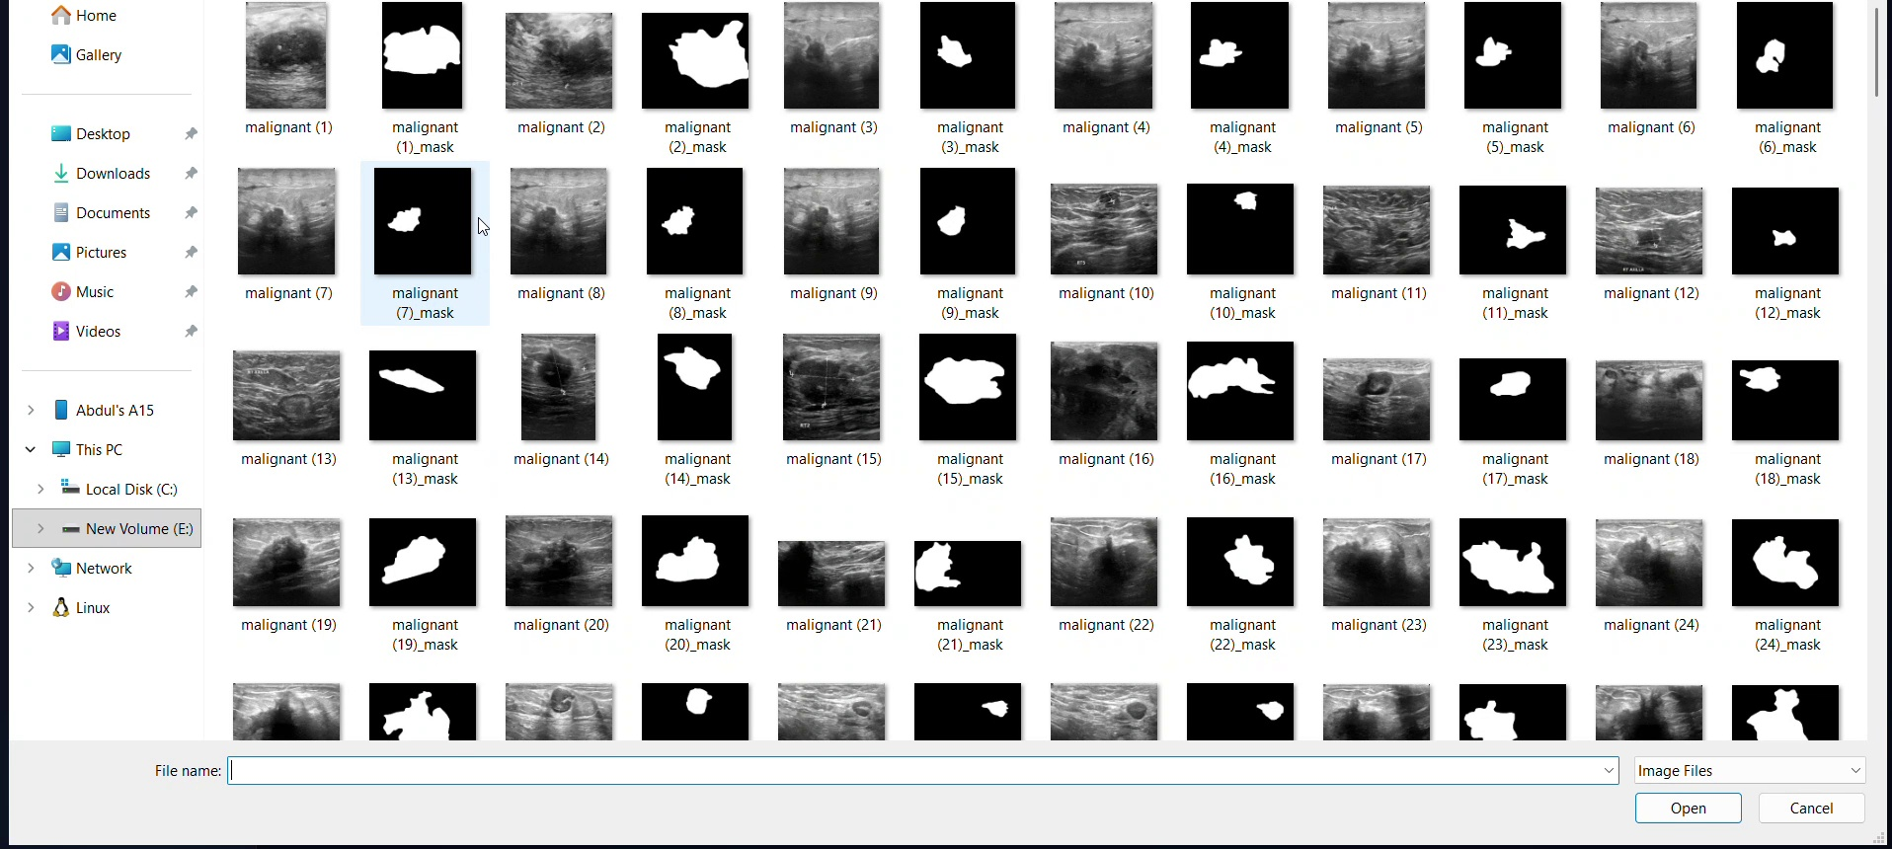
SECTION 7.5 | SYSTEM DEMONSTRATION
UltraXAI Live System Demonstration
Screen recording of working prototype: Ultrasound upload -> YOLO detection -> Attention U-Net -> Dual-model ensemble -> Grad-CAM++
⚡ Real-Time Latency
🔄 Live Streaming
🎯 5 Diagnostic Panels
🔬 Dual Ensemble
< 350ms total execution time
Real-time WebSocket progress tracking
Original, BBox, Mask, Heatmap, Decision
EfficientNetV2 (60%) + ResNet50 (40%)

Slide 11
SECTION 8
Remaining Work & Conclusion
1
Automated Clinical PDF Report Export
2
External Dataset Cross-Validation
One-click downloadable diagnostic PDF report with scans, segmentation masks, Grad-CAM++ heatmaps, and doctor sign-off
Evaluate model generalization across external hospital archives (UDIAT & OASBUD) to confirm real-world clinical robustness
3
Finalize Thesis Chapters 3 to 5
4
Final Deployment & Defense Preparation
Complete comprehensive methodology, experimental benchmarking, ablation studies, and clinical analysis write-up
Docker containerization for hospital edge servers and final presentation slide deck with live demonstration
Current Status: The full React dashboard, FastAPI backend, real-time WebSocket progress, and 4-phase AI pipeline are fully built and working end-to-end with >96.0% accuracy across Malignant, Benign, and Normal scans. The remaining phase focuses on clinical report export, external benchmarking, and thesis write-up.
Thank you - Questions?

