Slide 1
TrainHub – Responsive Fitness Equipment Website
Web & Mobile Technologies (B9IS124)
Group Members: Abdul Rafey (20042868) & Shaikh Saad (20051789)
Presentation Date: 25–27 June 2025

Slide 2
Project Overview
Responsive fitness website for a fictional business
Features product listings, detail pages, and reservation form
Built using HTML5, CSS3, JavaScript, and jQuery
Optimized for desktop, tablet, and mobile

Slide 3
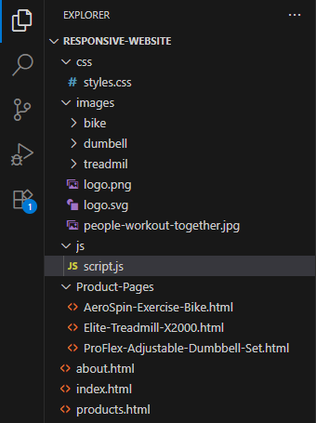
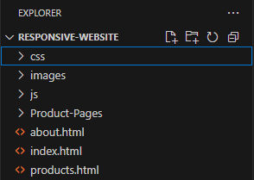
Site Map & Folder Structure
index.html, about.html, product.html
Product-Pages/ (3 individual product pages)
Folders: css/, js/, images/

Slide 4

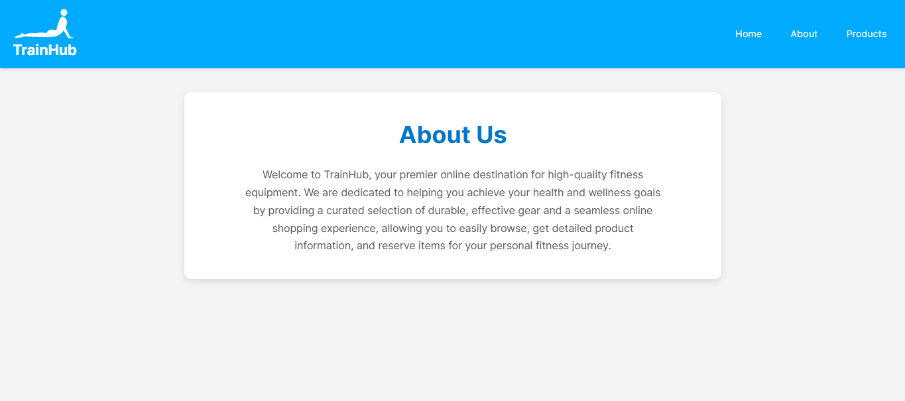
Home & About Page Design
Home: Hero section, short intro, CTA to Products
About: Single-column on both desktop and mobile
Consistent header and footer across pages

Slide 5
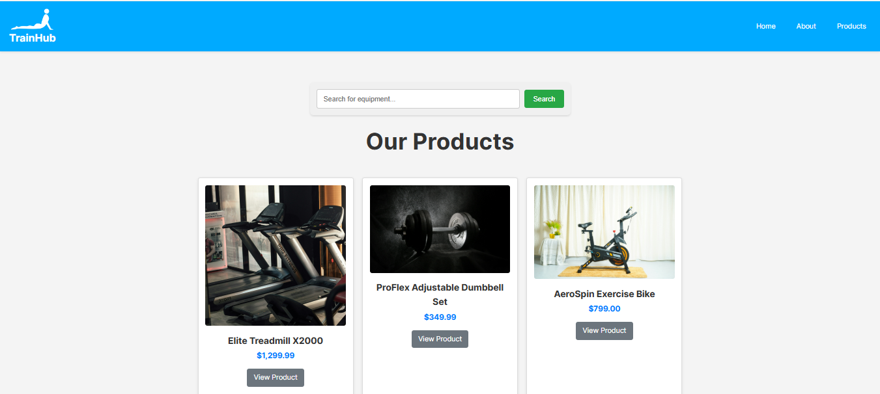
Products Page
Three product cards with image, title, and description
‘View Product’ button links to detail page
Search bar filters products using jQuery

Slide 6
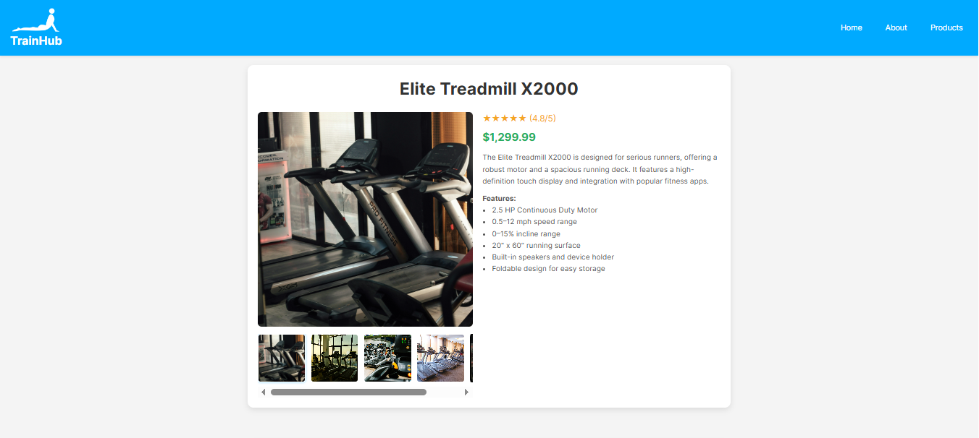
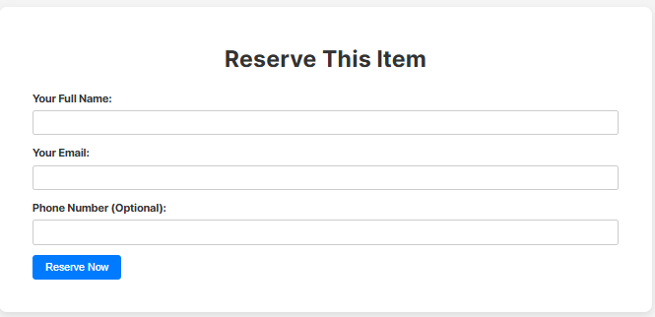
Product Detail Pages
Dedicated page for each product
Includes images, video, and detailed info
Reservation form at the bottom

Slide 7
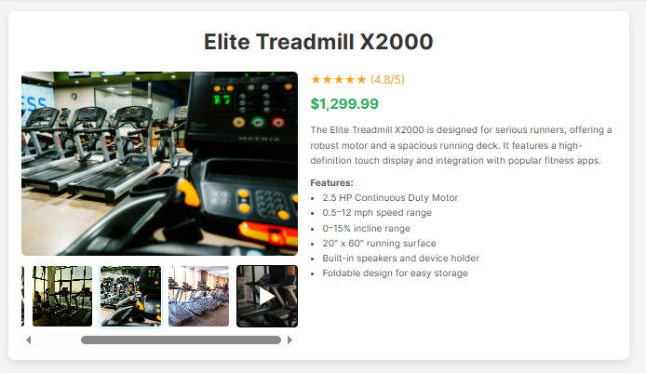
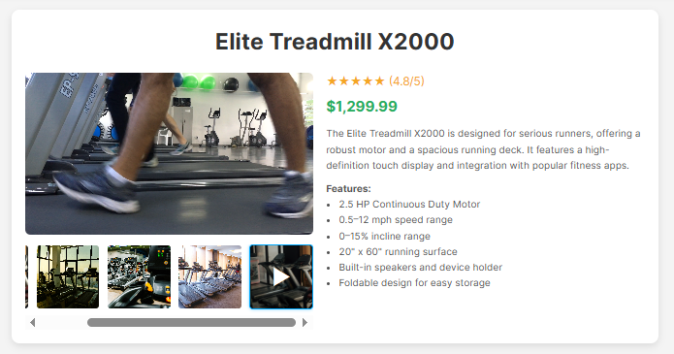
Media Gallery & Interactions
Image thumbnails update main product image
Video thumbnail switches to embedded video
jQuery handles transitions and active state

Slide 8
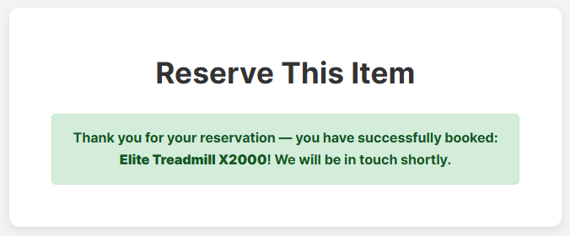
Reservation Form
Fields: Name, Email (required), Phone (optional)
JS validates and shows success message
No backend – all frontend logic

Slide 9
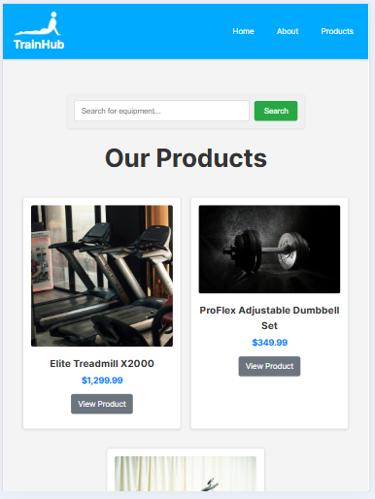
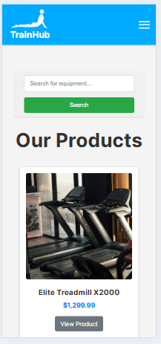

Mobile & Tablet Responsiveness
Mobile-first design strategy
Responsive navbar toggle via jQuery
Layout adapts to all screen sizes
Tested on multiple devices

