Slide 1
RADAR PROJECT
BY
AbdulRahman Mansour
Mohammed Yasser
UNDER THE SUPERVISION OF
Sherif AbdelMohsed

Slide 2
PRESENTATION CONTENT
COMPONENTS
PLOTTING RESULTS
PROBLEMS AND SOLUTIONS

Slide 3
What is a Radar ?
A radar is a system that detects the presence of an object in a certain range and lets us know that there is an object at that spot

Slide 4
01
COMPONETS

Slide 5
Servo Motors

Slide 6
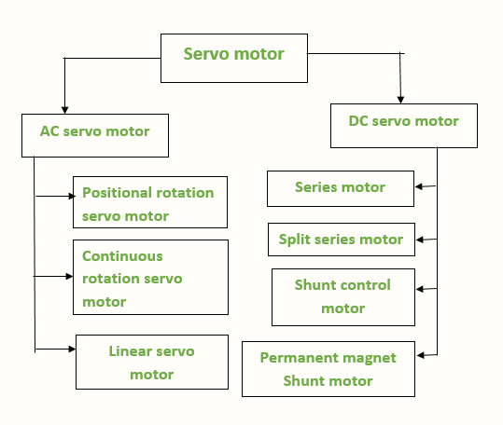
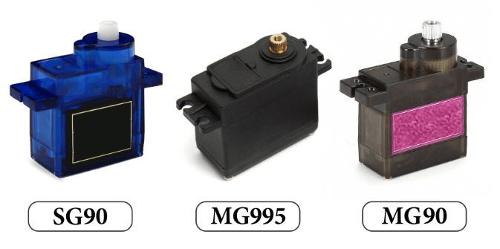
Servo Motor Types

Slide 7
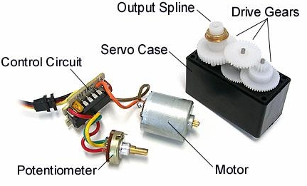
Servo Motor Components
Dc motor
Control “Control Circuit”
Sensor “Potentiometer”

Slide 8
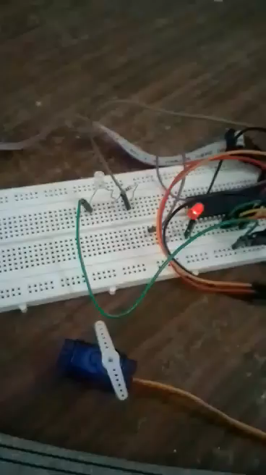
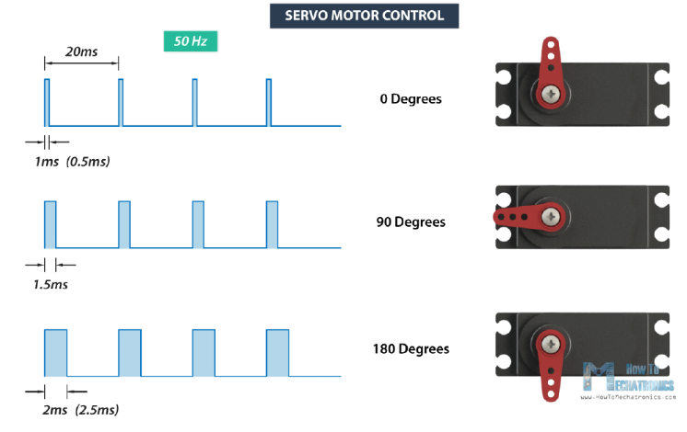
Servo Motor Control

Slide 9
ULTRASONIC SENSOR

Slide 10
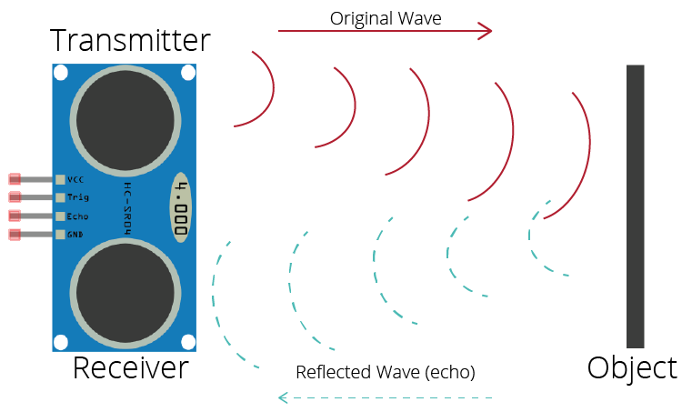
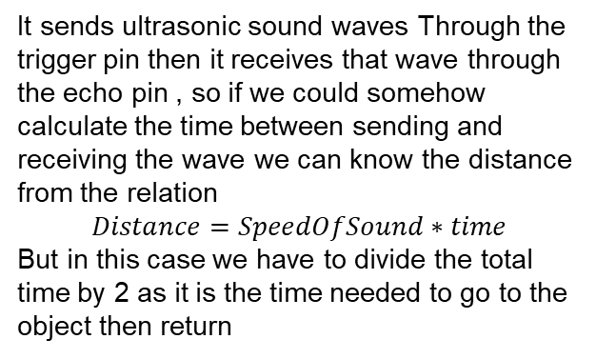
FUNCTIONALITY
It sends ultrasonic sound waves Through the trigger pin then it receives that wave through the echo pin , so if we could somehow calculate the time between sending and receiving the wave we can know the distance from the relation
$$Distance=SpeedOfSound∗time$$
But in this case we have to divide the total time by 2 as it is the time needed to go to the object then return

Slide 11
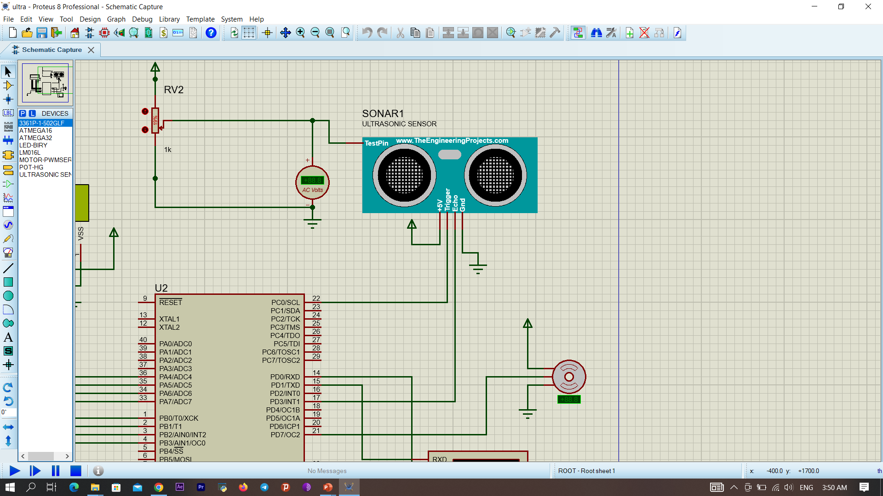
IMPLEMENTATION
First we have to initialize our timer (in this case it is TIMER0 to perform in normal mode and with a prescaler of 1 . Then we send our signal through the trigger pin .
But to receive this we have to connect the echo pin to an interrupt pin (in this case EXTI_LINE0) and setting it up to open the ISR when a rising edge happens .
We also need to initialize the timer 0 overflow interrupt to count the number of overflows .
When we enter the ISR that means we received he wave so to count the number of ticks we have to multiply the number of overflows by the 255 which is the maximum number of ticks that can be counted , then adding the number of current tick and by knowing the tick time which is 1us in this case we can calculate the distance .

Slide 12
02
PLOTTING RESULTS

Slide 13
DATA TRANSFER

Slide 14
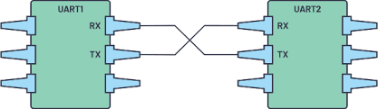
SENDING DATA
The data can be sent using the UART communication protocol which is one of the simplest communication protocols it can only send one character at a time and it can only be used for communication between 2 devices.
TX is the pin used for transmission .
RX is the pin used for receiving .

Slide 15
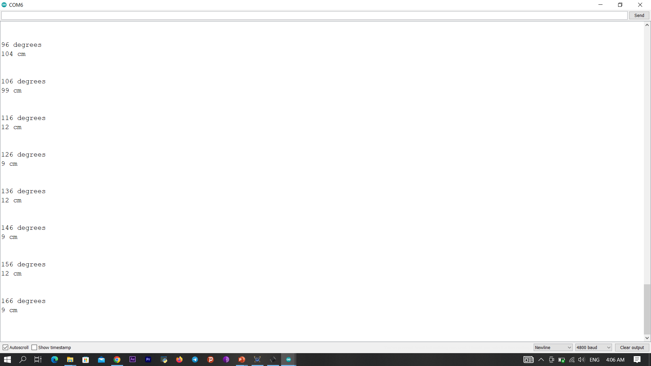
RECEIVING DATA
We Can receive the data on our laptop or computer by using a program that can read that port which is COMn
Where can change from 1 to 10 .
One of these programs is the Arduino IDE
In this case it’s COM6

Slide 16
DATA PLOTTING

Slide 17

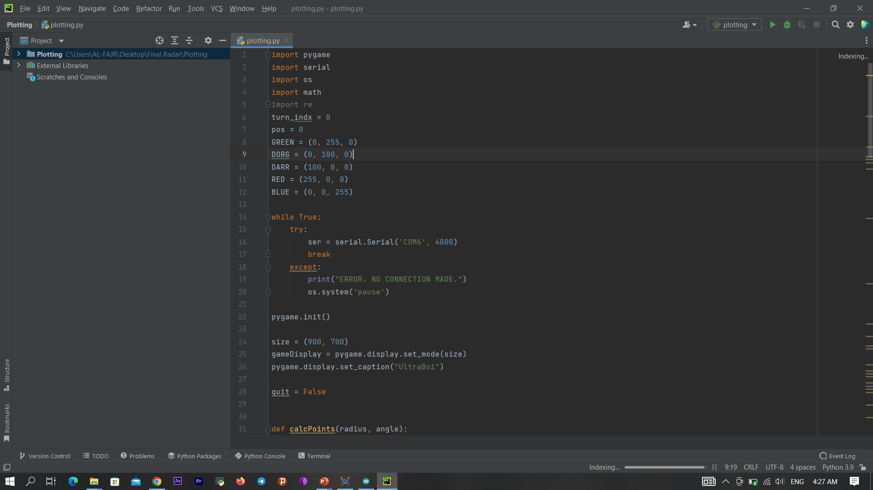
READING DATA
To read the data from the COM we used the pyserial library , Which needs to know the BuadRate of the data transfer and the COM we are using as shown in the following example
The try , except metho prevents the program from closing if we haven’t connected our USB cable yet and it will pause our code until we connect our cable

Slide 18
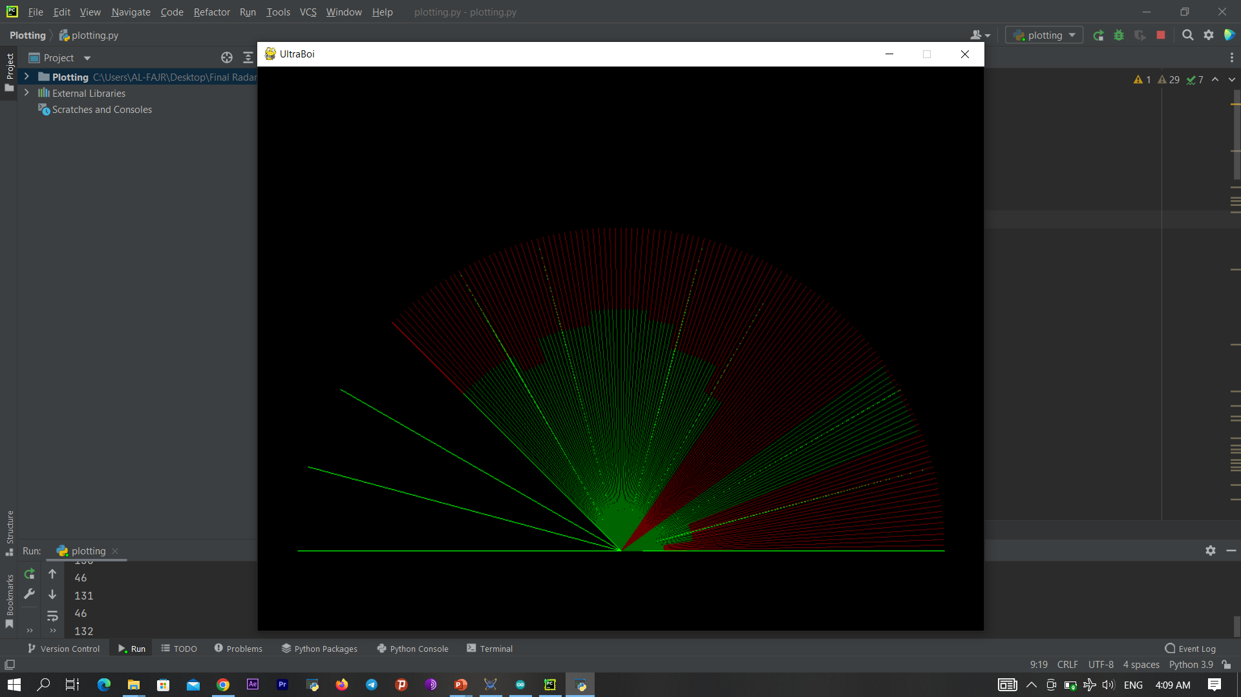

DATA VISUALIZATION
To draw the data we can use the pygame library . In our program the pygame code needs the angel and the distance to draw our data

Slide 19
03
PROBLEMS AND SOLUTIONS

Slide 20
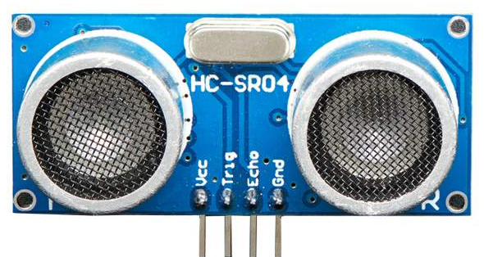
ULTRASONIC RESULTS
PROBLEM :
The ultrasonic sensor readings were completely wrong on the PROTEUS simulation although our calculation were correct which made us waste a lot of time looking for the problem .
SOLUTION:
It turned out that our calculations were correct and the external ultrasonic library that we used in PROTUES had some dysfunctionalities.

Slide 21
UART PROTOCOL
PROBLEM :
The UART PROTOCOL only operated with a system frequency of 8MHz and it didn’t sed data properly when we used 1MHz frequency
SOLUTION:
We used the UART PROTOCOL in normal mode instead of double speed mode and we used BaudRate of 4800.

Slide 22

FINAL PROJECT

Slide 23
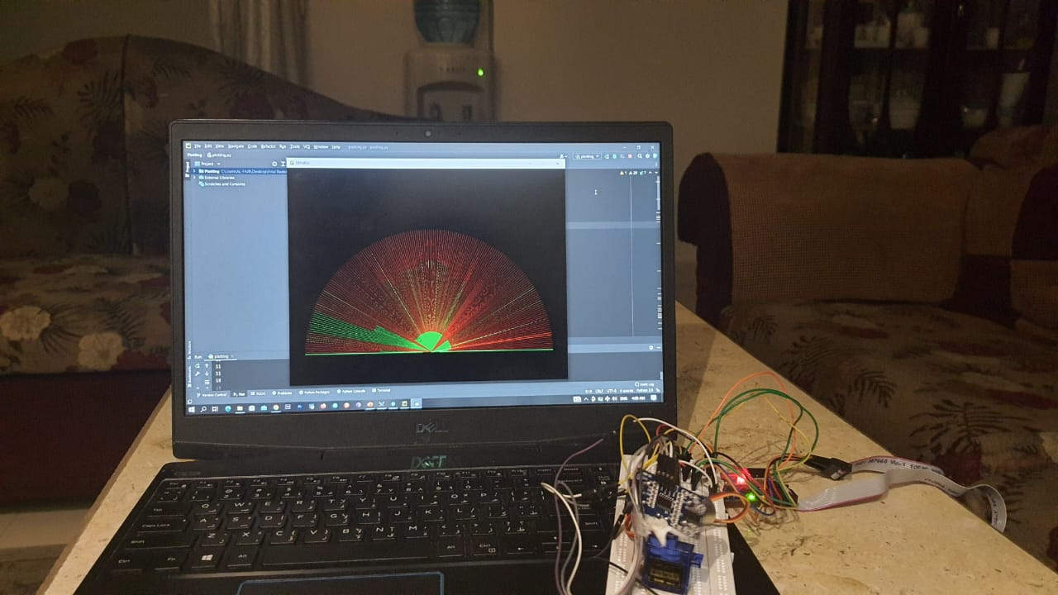
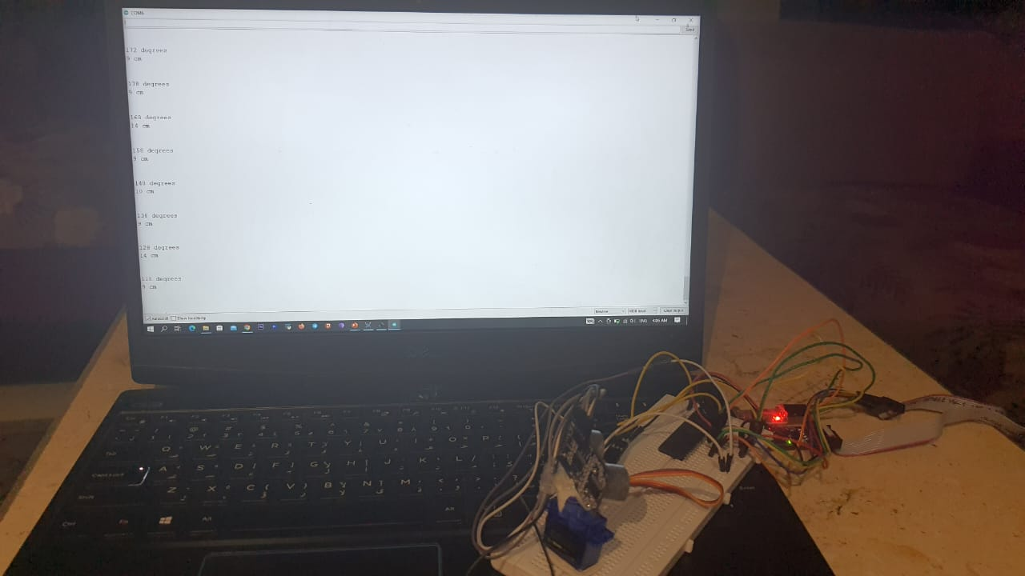
Results plotting
Results receiving

Slide 24

THANKS!
Do you have any questions?
abdulrahmanmansour98@gmail.com
mohmedyasser405@gmail.com
Abdulrahman : +20 114 391 4441
Mohammed : +20 120 700 5967
Please keep this slide for attribution

