Slide 1




Department of CSE(AI&ML)
An
Industry Oriented Mini Project Presentation On
Digital Paper Evaluation
Team Members:
Branch:
20C31A6628, Thakur Ram Singh
CSM
20C31A6627, Shaik Abdul Raqeeb
Name of the Supervisor:
20C31A6625, Sayyad Raheem
20C31A6632, Vaddepally Manoj
A.Praveen
Industry Oriented Mini Project Presentation
22 August 2023

Slide 2

Table Of Contents
Abstract
Introduction
Existing System
Proposed System
Proposed Modules
Requirements
Conclusion
Industry Oriented Mini Project Presentation
22 August 2023

Slide 3
Abstract
Exam papers or evaluated marks can be missed accidentally. To solve this, we automated the process of evaluation of exam papers and storing of marks using an online application. This stores softcopy of exam papers and also allotted marks in the database which can be accessed anytime and anywhere. It has separate access according to the role of user in the college/Institute. Evaluation of papers by evaluators from various places can be done online, which saves time, distance problems and evaluator availability, travel alliances, etc.
Industry Oriented Mini Project Presentation
22 August 2023

Slide 4
Introduction
Digital paper evaluation is the process of evaluating students’ examination papers online.
It involves grading and provide relevant feedback on student papers with improvised quality and in an accurate way.
This also involves storing of soft copies of written papers and marks of them for future purposes.
This is also referred to as an "onscreen marking solution," it is a technique for grading a candidate's response that was written on paper and handed to the examiner to grade on a digital platform.
Industry Oriented Mini Project Presentation
22 August 2023

Slide 5
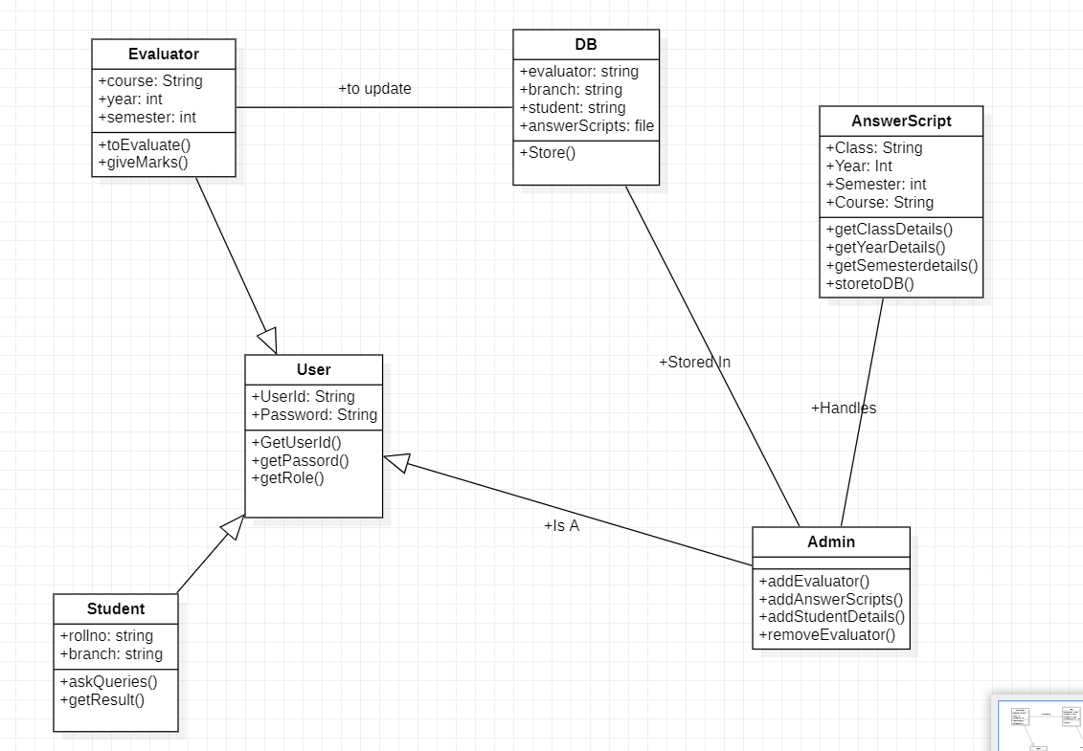
UML Diagram

Slide 6
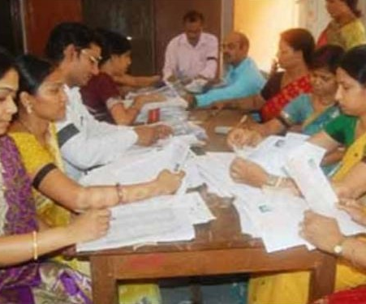
Existing System
Presently examination papers are gathered at a place and get corrected by respective subject evaluators.
The university level examination papers get corrected by calling evaluators from different institutions which may be located near or farther.
Travel alliance fund and the fee of evaluation will be provided to evaluators.
All the marks after evaluation will be uploaded online where students can check their performance.
Industry Oriented Mini Project Presentation
22 August 2023

Slide 7
Proposed System
Digital paper evaluation can be a valuable tool for evaluators. It can help to save time and ensure that student papers are properly evaluated.
We grade marks to respective questions online which will be stored in databases and also uploaded to share their performance with students.
It proportionally increases the number of evaluators by being remote and decreases costs by saving on travel alliances.
It will be a more efficient way to complete a huge number in lesser time comparatively.
It can also be implemented within an institution.
Industry Oriented Mini Project Presentation
22 August 2023

Slide 8
Proposed Modules
User Management Module:
This module will manage user roles and their access rights to the application. There will be two types of users faculty(evaluators) and administrators.
Evaluation Module:
This module will provide the ability to evaluate exam papers online. Evaluators are assigned with their respective subject papers only. They can grade marks specific to each question.
Marking Module:
This module will calculate total marks and store them into the database where it is separated according to student and subject.
Industry Oriented Mini Project Presentation
22 August 2023

Slide 9
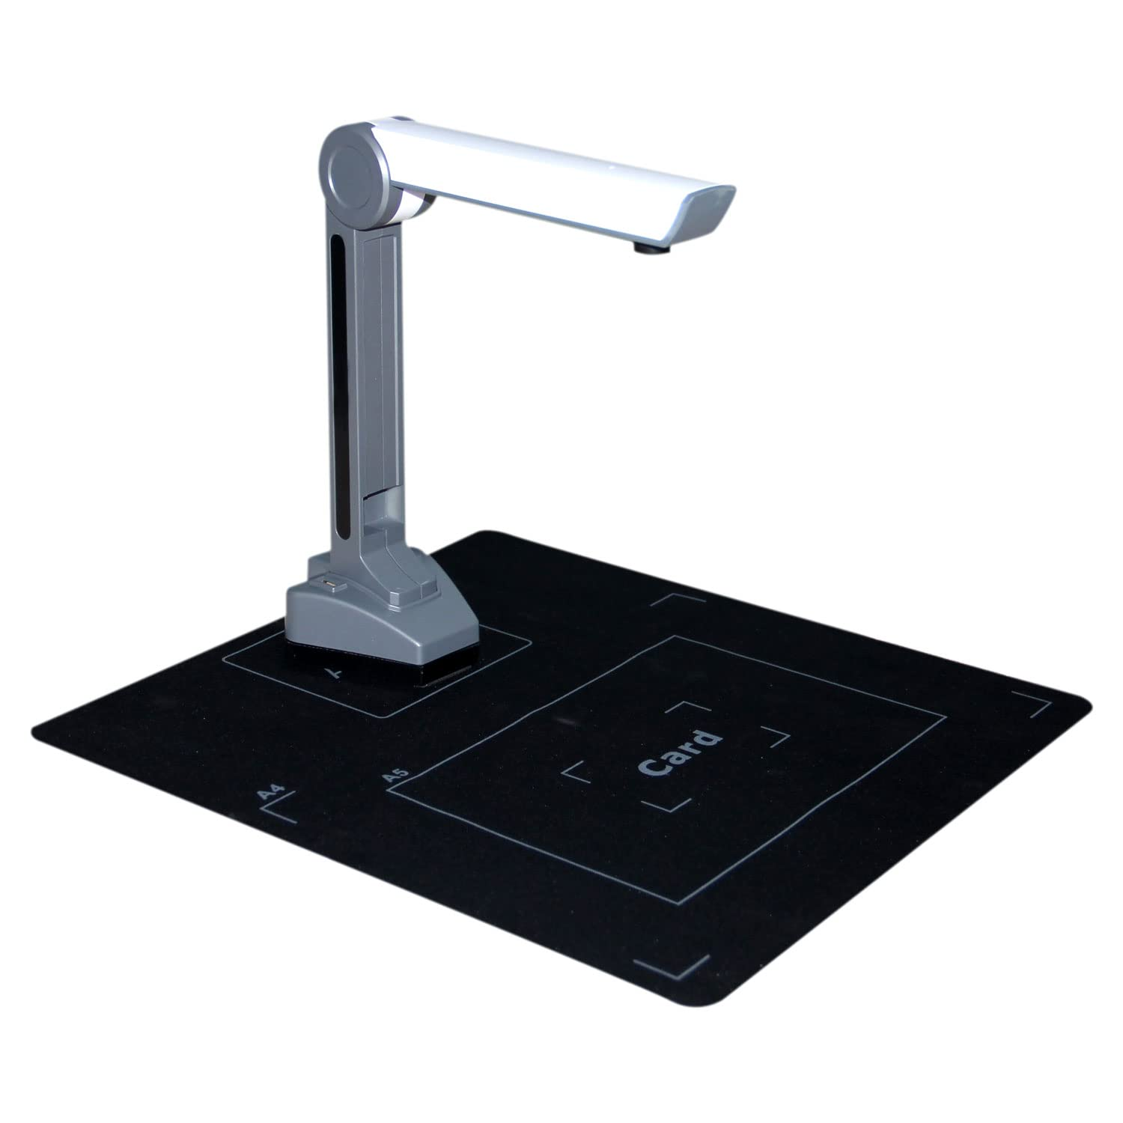



Requirments
Hardware Requirements:
Devices: Electronic Book Scanner, Computer/Mobile
Software Requirements:
Front-End: HTML, Bootstrap CSS, php
Back-End: mySQL
Web-servers: WampServer
Industry Oriented Mini Project Presentation
22 August 2023

Slide 10
Conclusion
Digital Paper evaluation is an aim of improving the quality of marks management using a digital platform to evaluate papers. It is helpful in decreasing time consumption and maintain accurate evaluation for every aspect of particular paper.
Industry Oriented Mini Project Presentation
22 August 2023

Slide 11


Thank You! Queries?!
Industry Oriented Mini Project Presentation
22 August 2023

