Slide 1
5th International Conference on Cognitive & Intelligent Computing (ICCIC-2025) Dates:- 12-13 November 2025 Venue:- Vasavi College of Engineering, Hyderabad, India
Title of Presentation:- MEGA-HEART: Construction of a Comprehensive Cardiovascular Dataset through Multi-Source Clinical Data
Paper ID:- 227
Presenter Name:- Shaik Abdul Razak
Track Name:- Artificial intelligence & Machine Learning

Slide 2
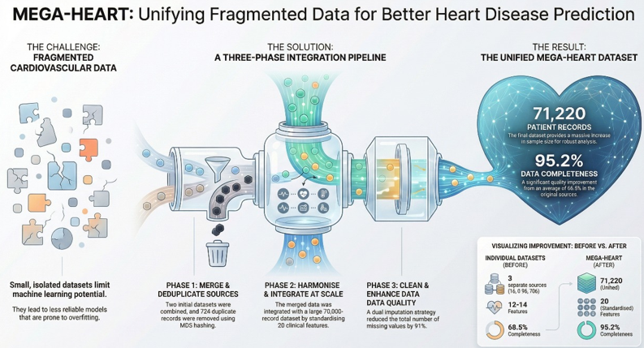
Introduction
Cardiovascular diseases are the leading cause of global mortality.
Machine Learning models need large, high-quality datasets for accurate
heart-disease prediction.
Existing public datasets are small,
fragmented, and inconsistent in schema
and units.
This fragmentation reduces model
performance and limits clinical applicability.
MEGA-HEART addresses this by integrating
multiple heterogeneous datasets into one
unified, high-quality resource.
12-12-2025

Slide 3
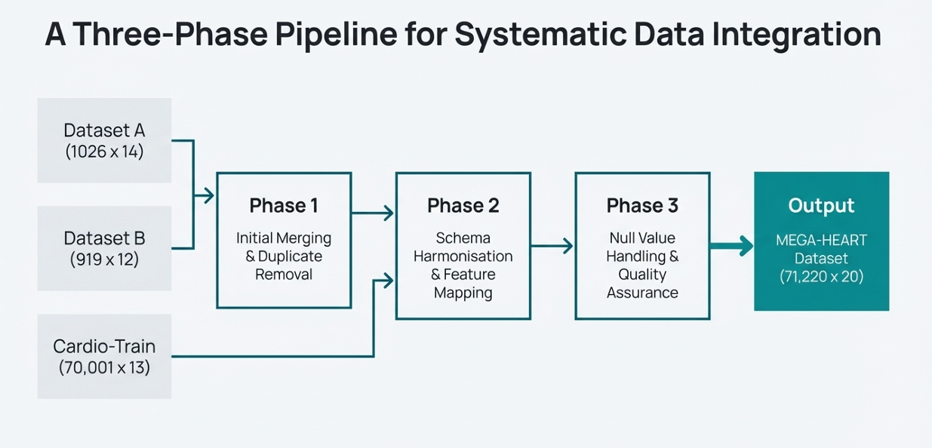
Methods
The main challenge was that existing heart-disease datasets were small, fragmented, and had different schemas.
To overcome this, a three-phase integration pipeline was used to create one unified, high-quality dataset.
Phase 1: Dataset Merging & Duplicate Removal
• Dataset A (1026×14) and Dataset B (919×12) were merged to address the problem of limited dataset size. • MD5 hashing was applied to detect and remove 724 duplicate records to ensure data purity. • Result: Clean intermediate dataset (1221×14).
Phase 2: Schema Harmonization
• Solved the problem of different column names,
units, and coding styles across datasets. • Standardized all features and created a unified
20-feature structure.
Phase 3: Missing Value Handling & Quality
Assurance
• Missing data was a major issue, so mean/median
(numerical), mode (categorical), and group-based
imputation were used.

Slide 4
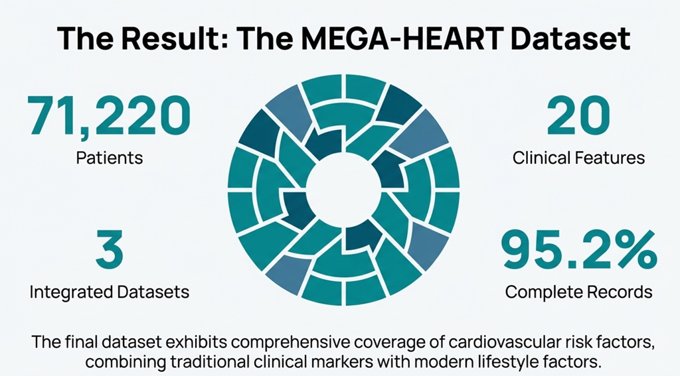
Results
Final MEGA-HEART dataset contains 71,220 records with 20 clinically meaningful features.
Duplicate elimination removed 724 overlapping records, improving data purity.
Missing values reduced from
12,450 to 1,120 — a 92.6% reduction
after imputation.
Data completeness improved from
68.5% to 95.2% after integration.
Data consistency increased from
72.3% to 94.8% after schema
standardization.
Feature coverage improved from
an average of 14.5 features to all
20 standardized features.

Slide 5
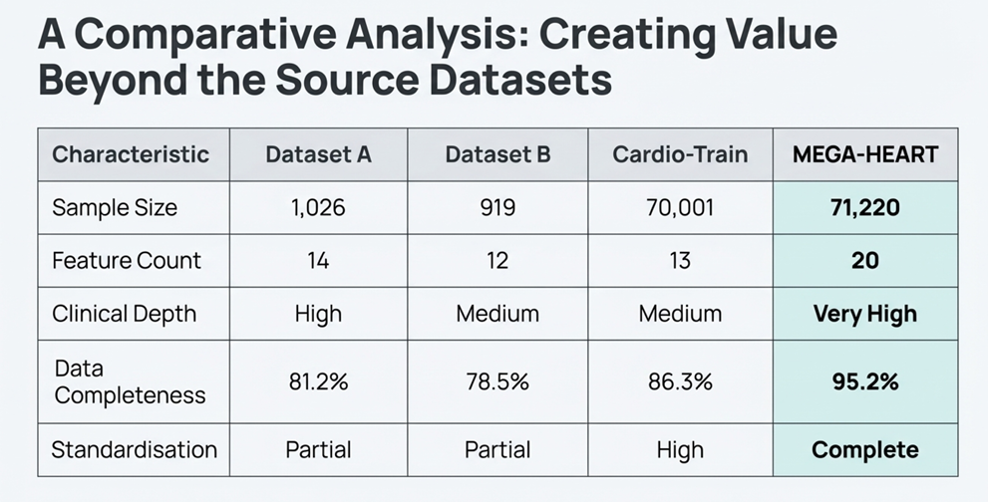
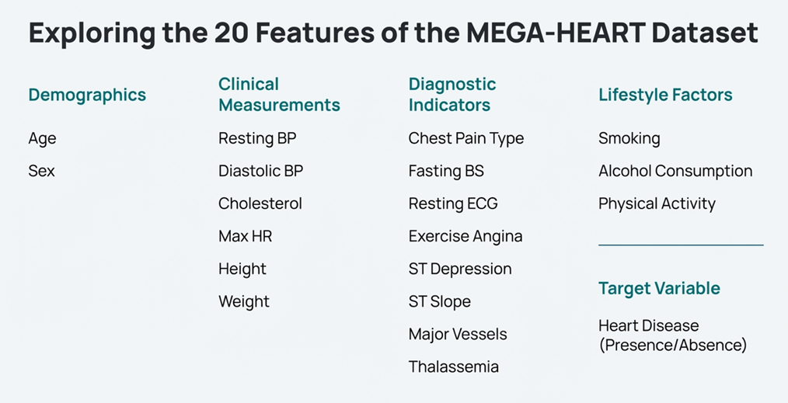
Discussion
The integration process successfully addressed the
fragmentation problem found in existing heart-disease
datasets.
MEGA-HEART provides a unified, large-scale dataset
that enables more reliable and generalizable
machine learning prediction models.
Standardization of schema and units improved data
consistency and reduced errors across clinical features.
The significant reduction in missing values increases
the robustness and trustworthiness of downstream
ML algorithms.
MEGA-HEART combines clinical, lifestyle, and diagnostic features,making it more comprehensive than any single source dataset.

Slide 6
Conclusion & Acknowledgement
MEGA-HEART successfully integrates three heterogeneous heart-disease datasets into one unified resource with 71,220 records and 20 features.
The framework resolves key issues such as data fragmentation, duplicate records, schema mismatch, and missing values.
The final dataset shows major quality improvements—higher completeness (95.2%), consistency (94.8%), and standardization (98.5%).
MEGA-HEART provides a strong foundation for building more accurate and generalizable machine learning models for heart-disease prediction.
⭐ ACKNOWLEDGEMENT
• I sincerely thank my guide, Dr. R. Praveen Kumar, for continuous support and guidance.
• I also thank Chaitanya Deemed to be University for providing research facilities.
• I express gratitude to ICCIC-2024 organizers for giving me the opportunity to present this work.

