Slide 1


HACKXTREME
Organized by GDG X GLEC
Team Details a. Team name: CIS (Tech Titans) b. Team leader name: SHAIK ABDUL RAZAK c.Team Member Names:K.Ramyasri, P.Rajesh, Suraj Bhan d. College Name: Chaitanya Deemed to be university

Slide 2
Problem Statement
Online examinations are increasing rapidly, but ensuring fairness in remote environments is difficult
Existing proctoring systems have major limitations:
Market Capital
$10B Global online education market is increasing rapidly
15-20 % students are flagged falsely
50M Students appear online exams every year with no fair
Binary cheating detection (Yes/No)
High false accusations
Privacy-invasive webcam monitoring
Cannot detect intelligent cheating behavior
No behavioral understanding
Note: There is a need for Ai- based intelligent system that predicts cheating risk instead of only detecting cheating.

Slide 3
Proposed Solution
We propose an AI-Based Online Exam Cheating Risk Predictor
A cognitive–behavioral probability-based proctoring framework that:
Tracks student behavior in real time
Analyzes gaze, posture, typing, mouse pointer and interaction
Uses AI to detect anomalies
Generates cheating probability (0–100%)
Reduces false accusations
After finalizing the result a mail will directly send with the quote to the student
Provides explainable and ethical monitoring

Slide 4
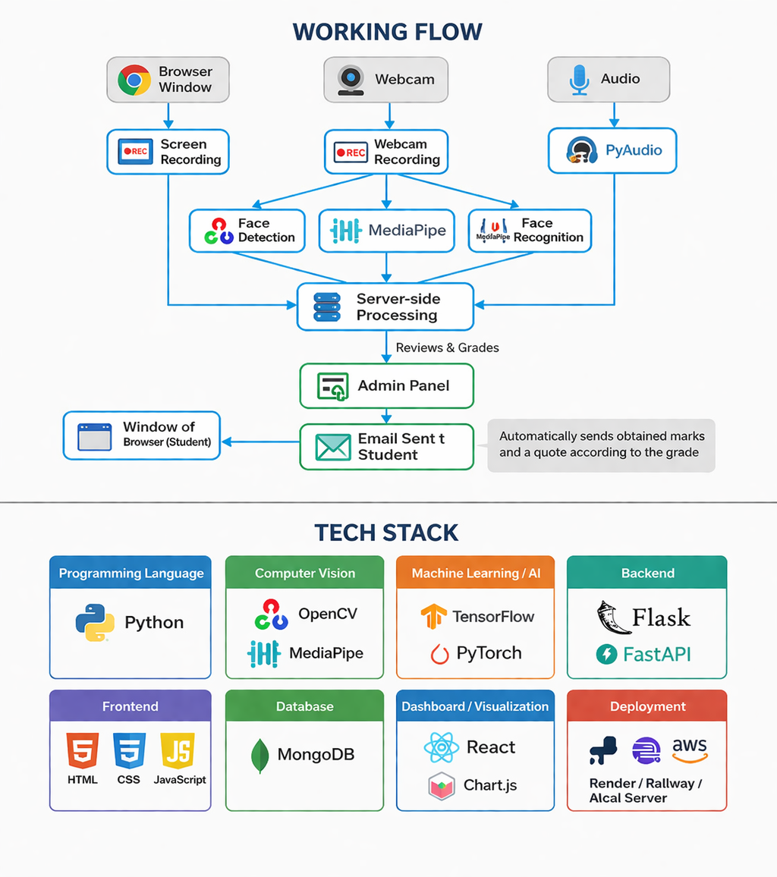
Working flow diagram

Slide 5
Market Opportunity
A Billion Dollar Problem. A Scalable Solution.
$1.6 Billion — Global online proctoring market in 2024
$6.5 Billion — Projected market size by 2030
26% CAGR
Our 3 Unfair Advantages:
Advantage 1 — Probability Over Binary
Advantage 2 — Ethical AI First
Advantage 3 — India First
Note:- Instead of having a reactive solution we have predictive solution

Slide 6
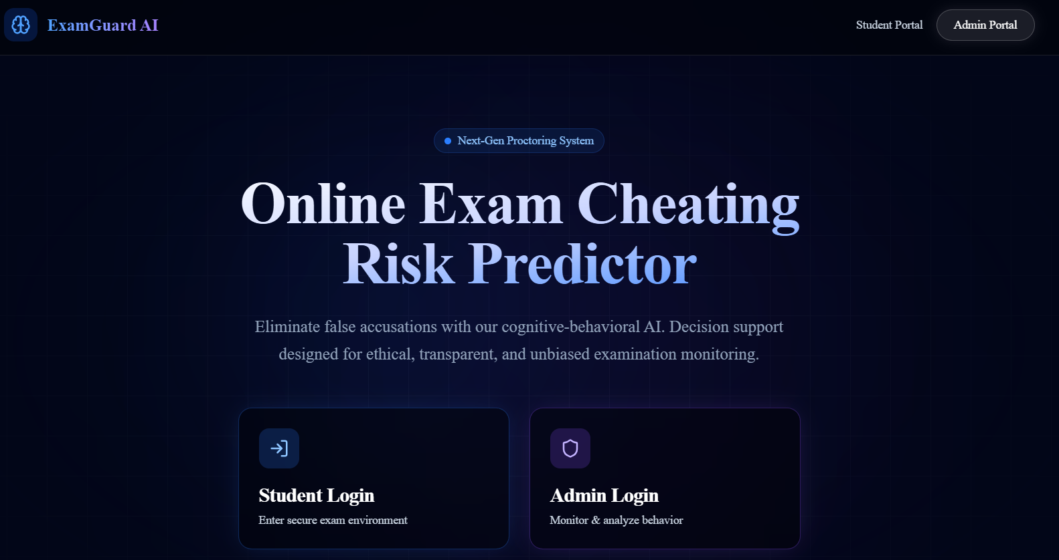
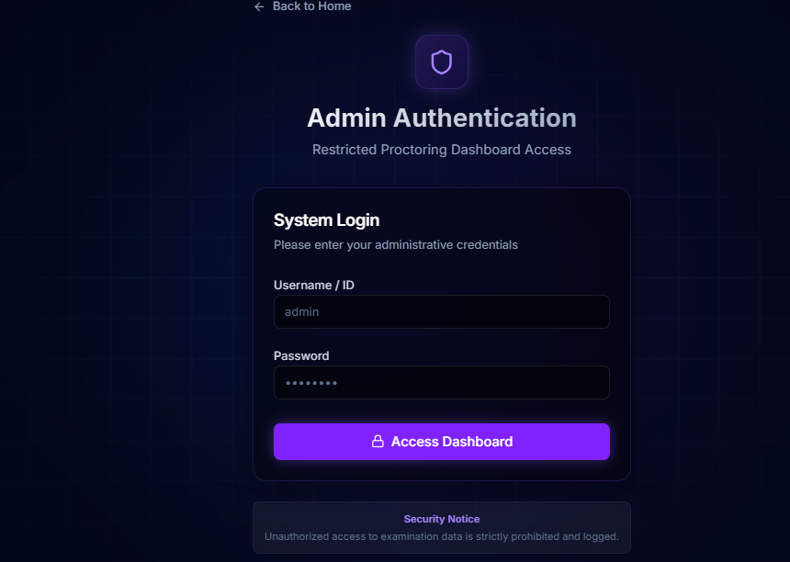
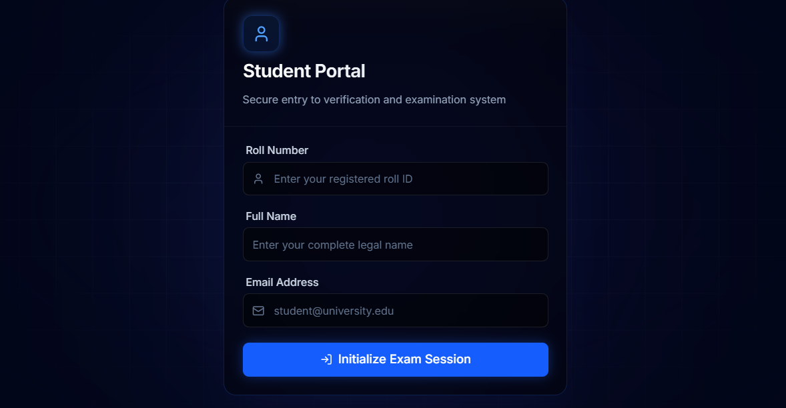
Technologies/Tools Used
Working product
Used Tech Stack

Slide 7
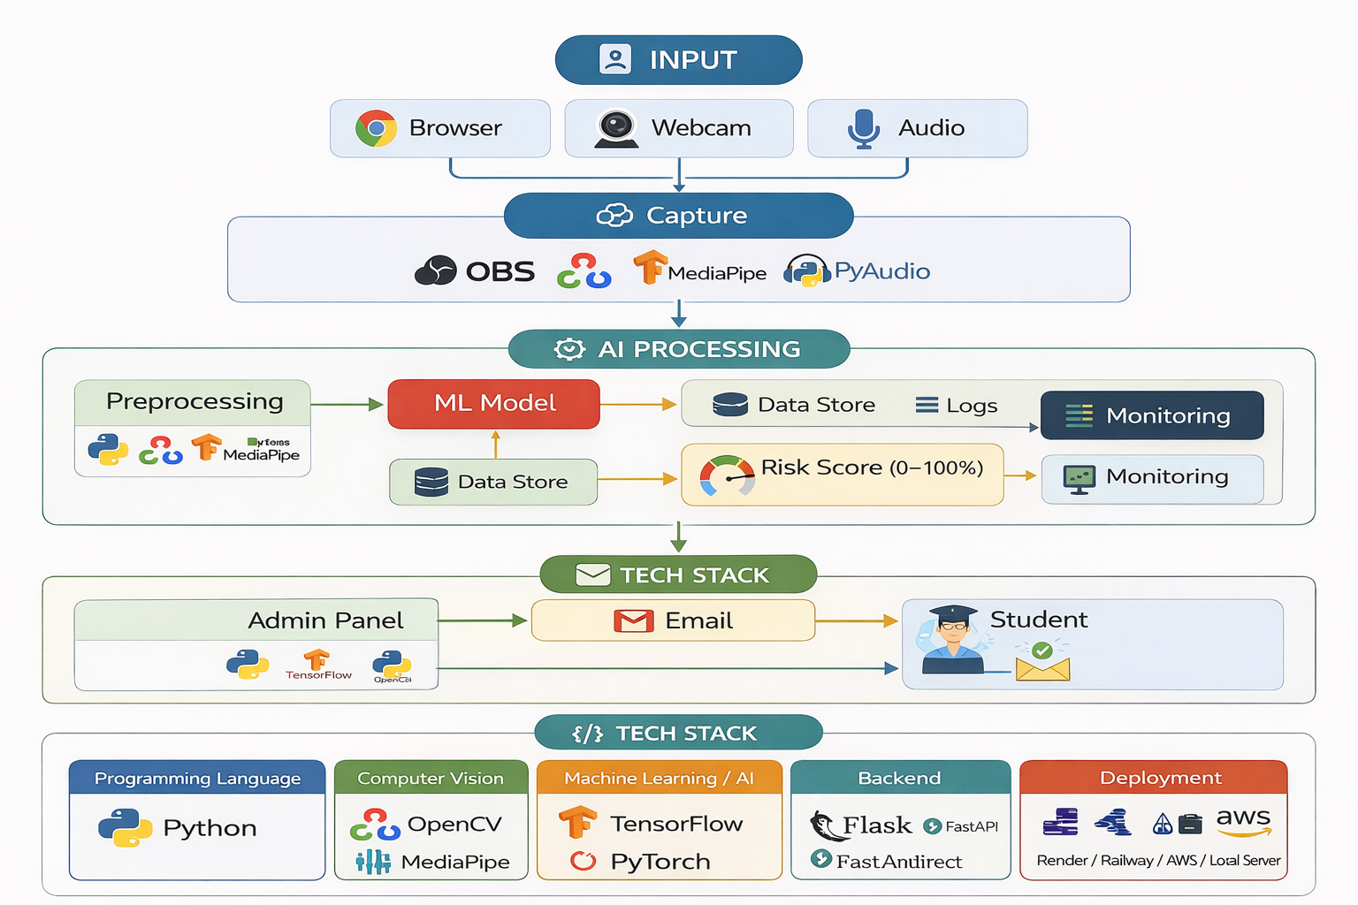
Architecture Diagram

Slide 8
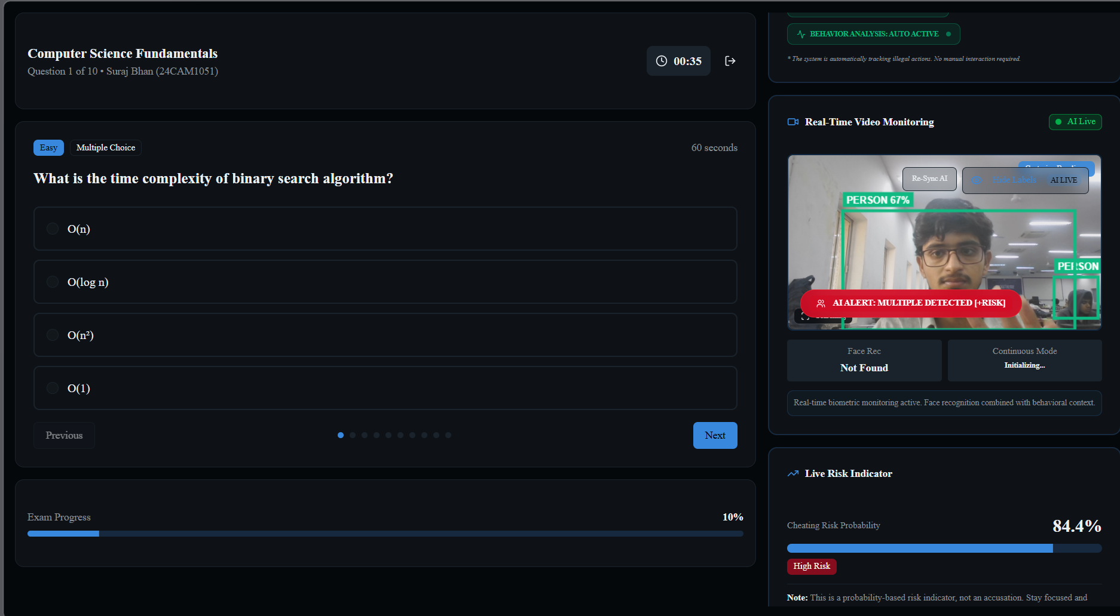
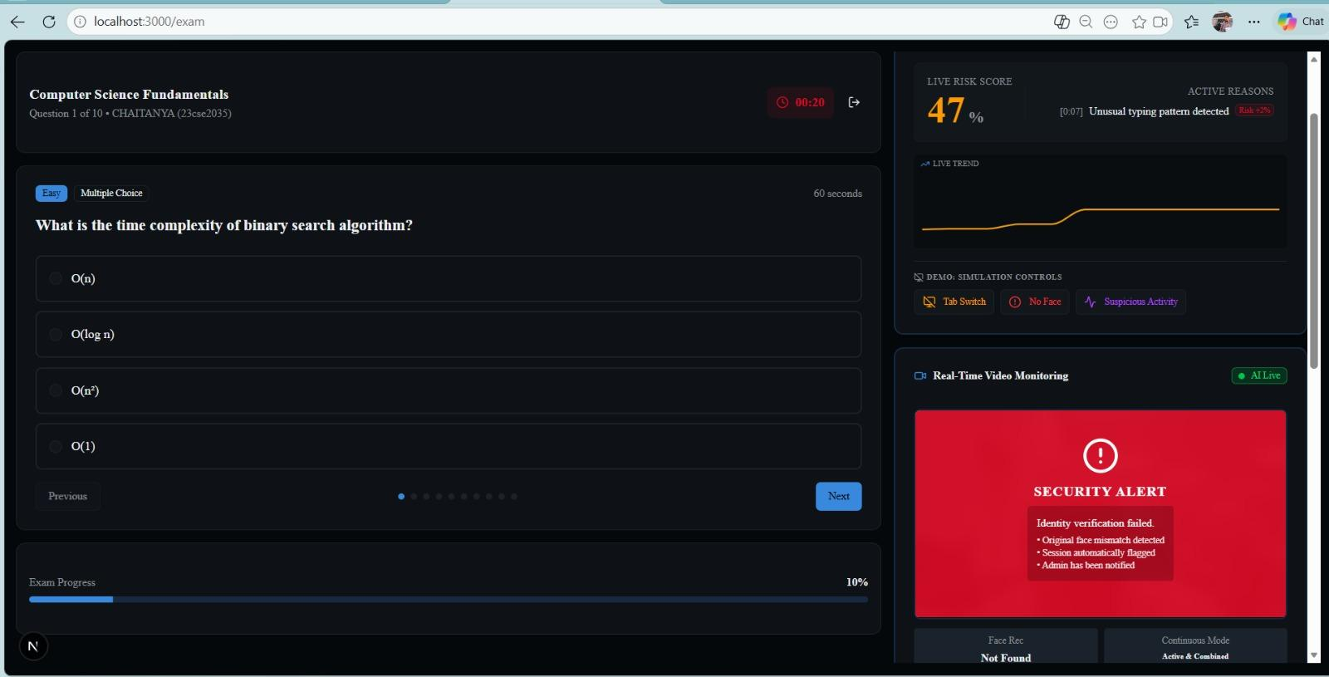
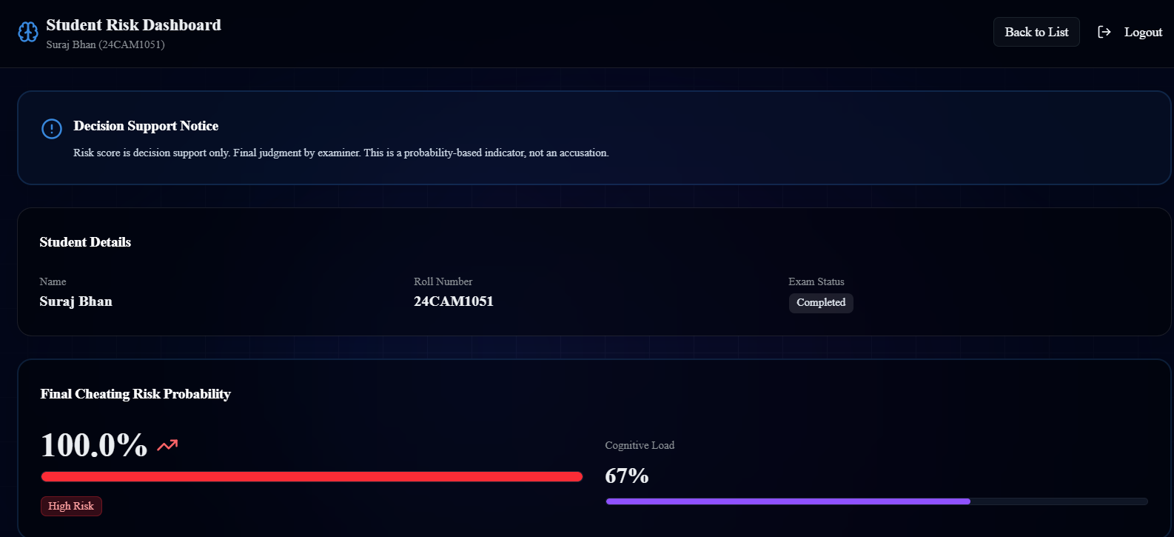
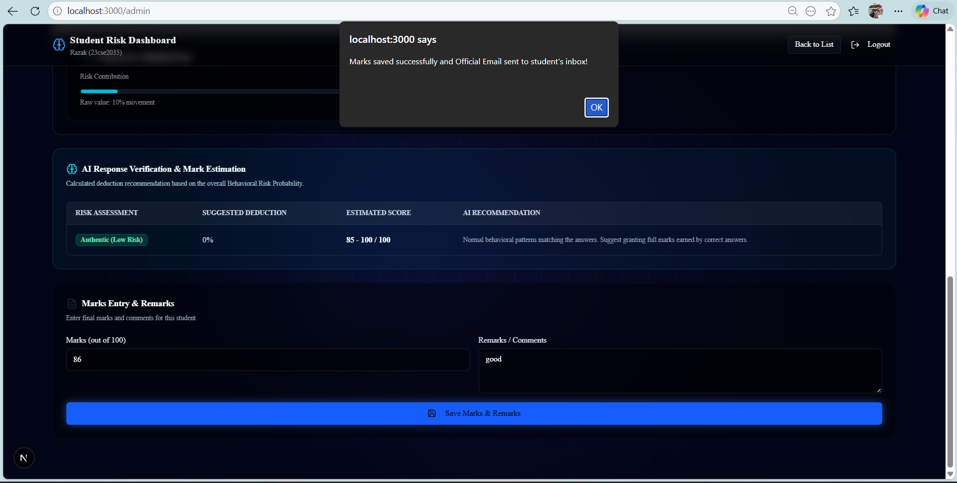
Working Product

Slide 9
Target Audience/Market
Market Need:
Growing Online exams
Need for fair evaluation
Demand for ethical AI monitoring
Scalable remote proctoring
Target Users:
Online learning platforms
Certification platforms
Government exams
EdTech companies
Colleges & University
This solution can be used in:
NPTEL
Coursera, edx
College LMS
Competitive exams
Company assessments
Allen, PW, Motion
Deployed Link: ExamGuard AI - Online Exam Cheating Risk Predictor
https://project-exam-guard-ai-batch2.vercel.app/

Slide 10
Thank You
Team – Tech Titans

